Slide 1
Text Mining Yelp Reviews using LDA and LSA
Yelp Challenge Dataset
Data Science Specialization
Johns Hopkins University (via Coursera)
Capstone Project
November 2015

Slide 2
Using Review and Business data of Yelp Challenge Dataset to answer following questions
Would it is possible to qualitatively determine the review score using text analytics? In other words are there particular terms indicative of the score?
The application of the analysis may be used to help Yelpers to retrieve better results from searching reviews.
Focus:
The analysis focuses on reviews for medical doctor, physician, dentist or health centers services in the state of Arizona

Slide 3
Process is layout below. Latent Dirichlet Association (LDA) and Latent Semantic Analysis (LSA) are method used for text mining.
Getting, cleaning, and preparing data
Text mining basics
Topic Modeling using Latent Dirichlet Allocation (LDA)
Reading JSON files into R objects.
Persist R Objects to files for later loading
Persist business R Objects to database (optional)
Merging business and review for selected business and states
Query business and review text for only healthcare related business in Arizona state
Persist the merged result to a table in an RDBMS for use and query later
Create corpus, remove punctuations, number, stop words
Stemming all documents
Using R tm package to create Document term matrix (DTM) and term document matrix (TDM)
Remove sparsity
Latent Semantic Analysis (LSA)
Group and label the review text with a topic
Finding similarities among the review documents
Cross reference the topic and review stars also topic, review star, and business star
Uncover the terms that are indicative of positive, negative reviews

Slide 4
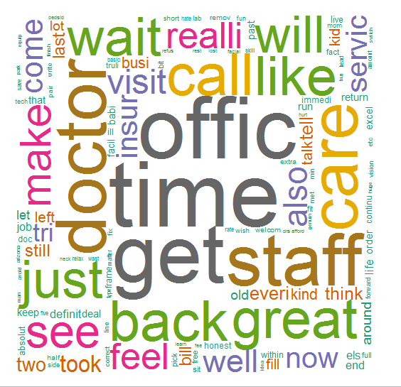
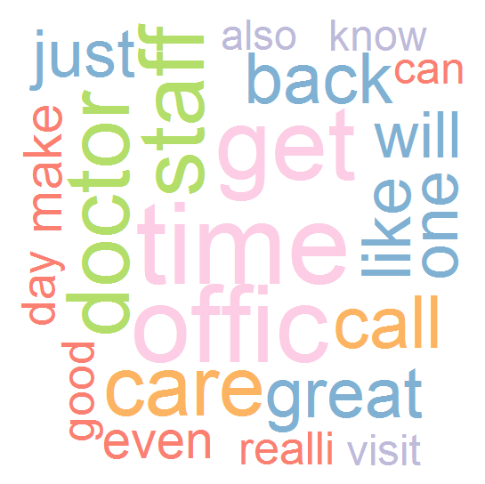
Word cloud is an effective tool to get a quick and informative view of the data. Data on the left cloud is 100% sparse, and 78% sparse on the right. Both clouds immediate ‘tells’ the dataset is about ‘doctor’, ‘office’, and ‘time’.
>> Non-/sparse entries: 533952/209531502
Sparsity : 100% Maximal term length: 80
Weighting : term frequency (tf)
AZ.dtm <<DocumentTermMatrix (documents: 10827, terms: 19402)
AZ.dtm.sp <<DocumentTermMatrix (documents: 10827, terms: 47)
>> Non-/sparse entries: 112366/396503
Sparsity : 78%
Maximal term length: 9
Weighting : term frequency (tf)

Slide 5
Findings
LDA indicates the following terms are strongly associated to the good reviews: best,friend, recommend, good, great, help
LDA fails on label appropriate topics when the text contain negation. For example:
“[he] called back promptly” vs “[office] does not call back for days” vs “do not hear anything from the office”
The text that contains these phrases are labelled under the same topic
Where LDA fails, LSA can be used to find similarity or dissimilarity.
LSA finds that the two review text in the example above are quite ‘far’ apart.
LDA and LSA can be used in complement each other for different tasks-topic modeling and clustering documents and/or queries
The number of reviews for poor ranking businesses are much lower than good business. It seems that when service is poor, users may not bother spending time to write reviews.
Next step:
LDA can be used to intelligently categorize Yelp business categories
Couple LDA and LSA in providing a Latent Semantic Index (LSI) to allow for a search of reviews using natural language like.

