Slide 2
Co-R
On
Off
R
A
Co-R
On
Off
R
A

Slide 3
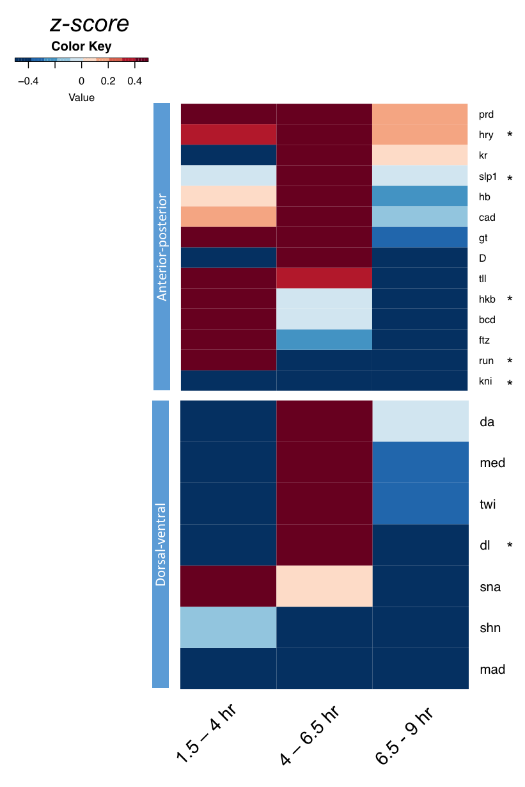
Gro colocalizes with multiple developmental factors

Slide 4
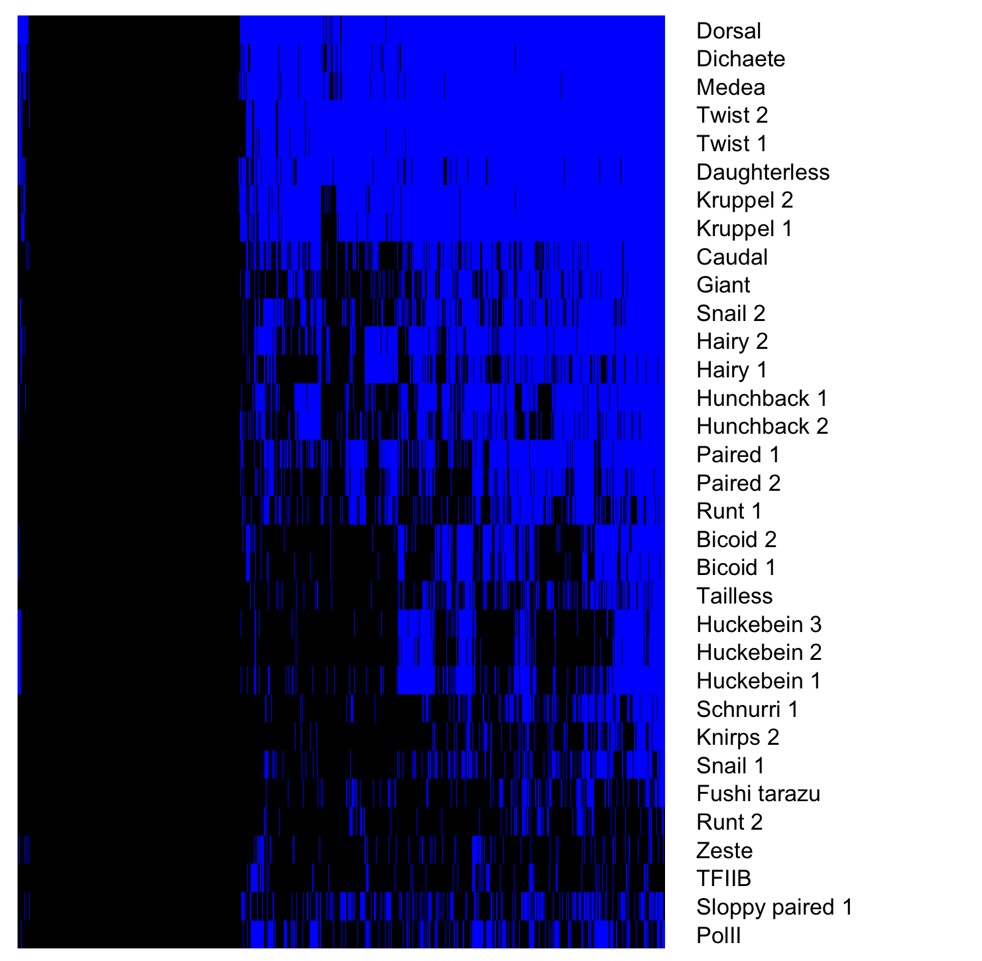
Gro binding sites overlap many additional TFs
Gro binding sites, 1.5 – 4 hr embryos
Factor occupancy

Slide 5
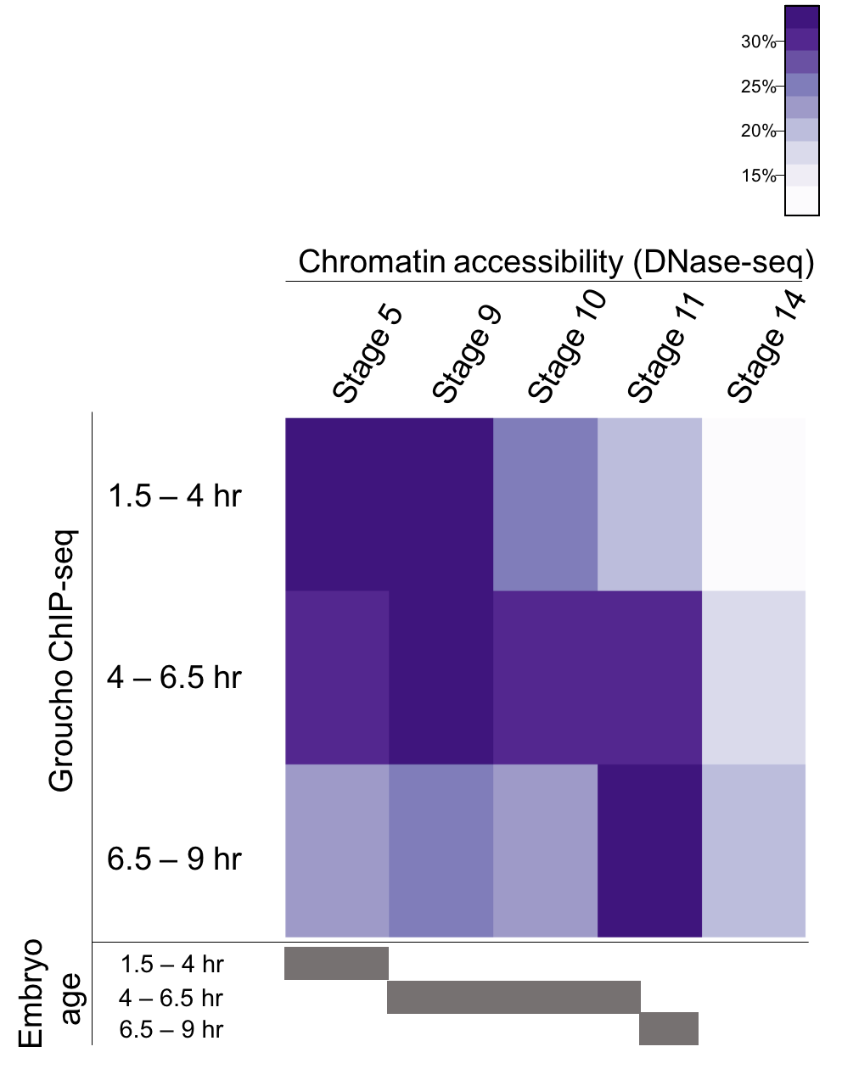
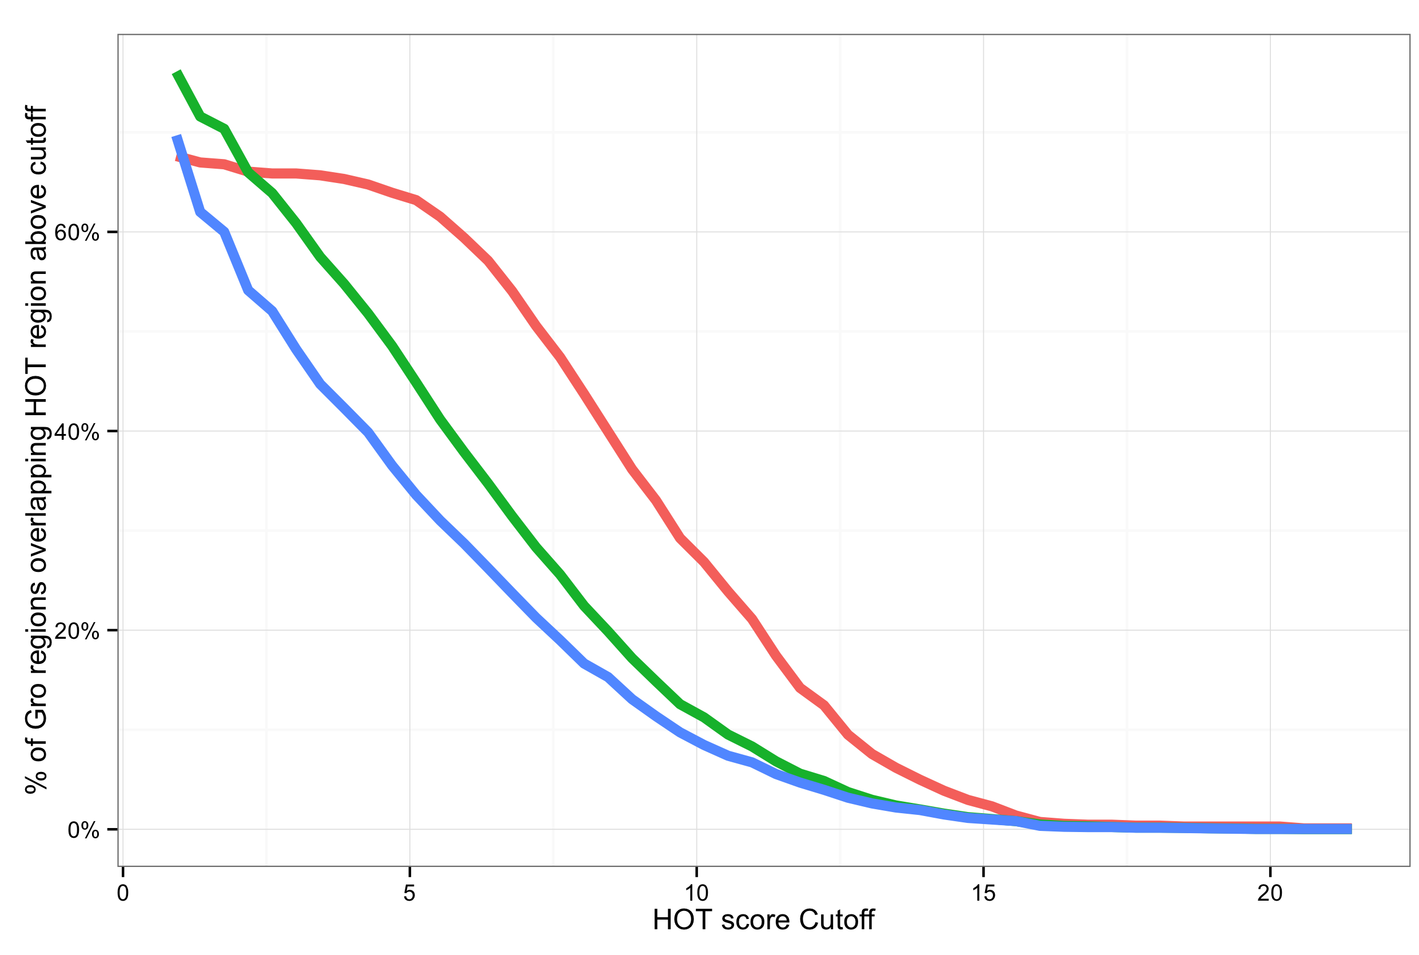
Gro is frequently recruited to areas of high TF density
Notes:
Legend
High accessibility
HOT region explanation

Slide 6
4 – 6.5 hr
3056
1.5 – 4 hr
6.5 – 9 hr
64
1409
782
717
2311

Slide 7
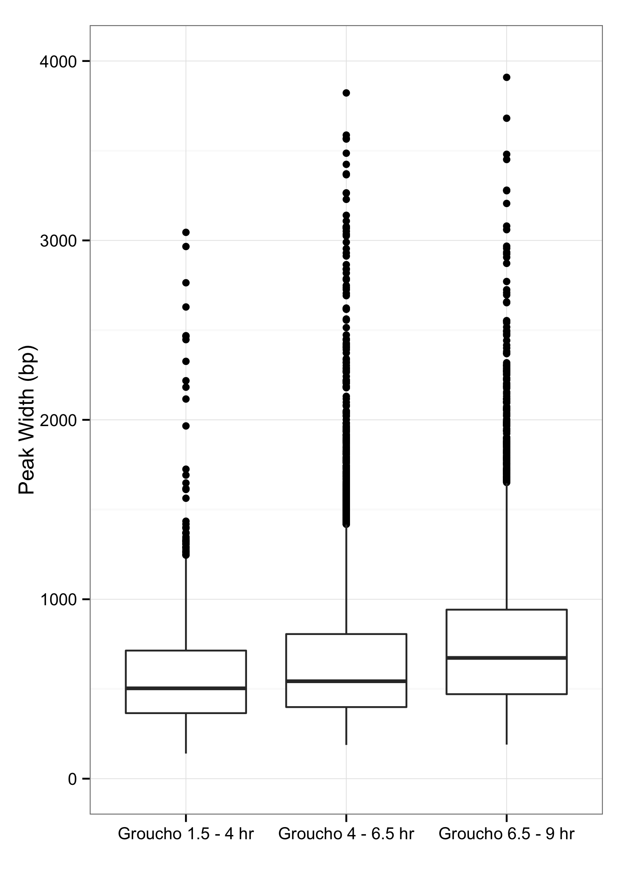
Gro binding is not indicative of spreading
Notes:
y-axis
Zaret lab data

