Slide 1
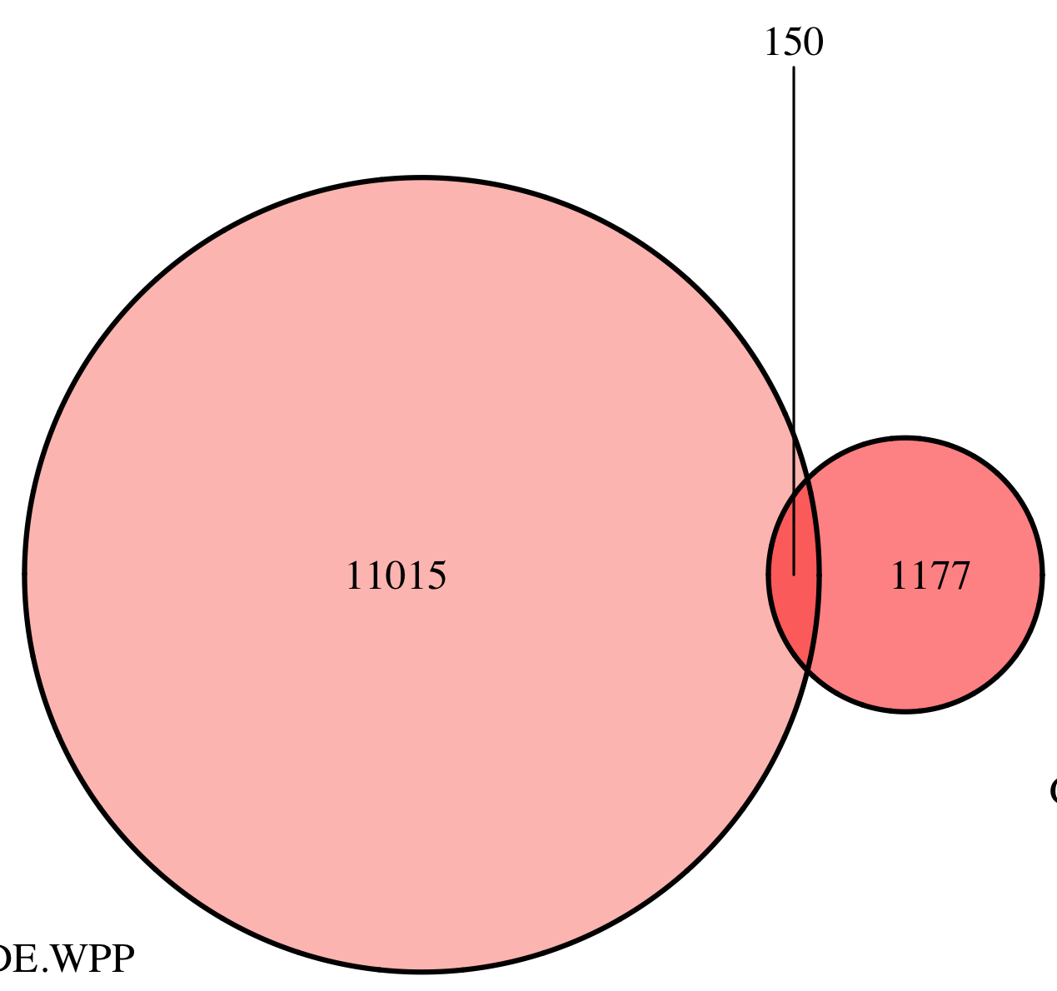
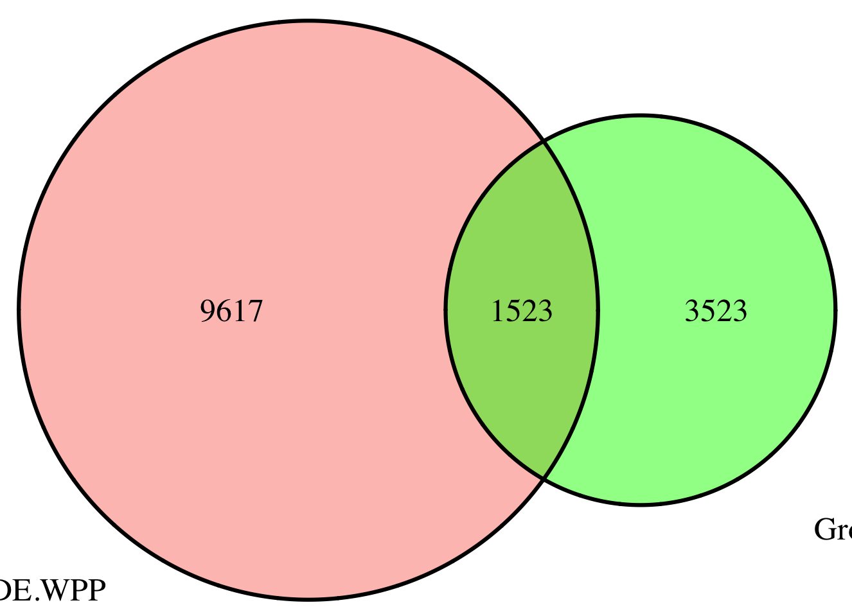
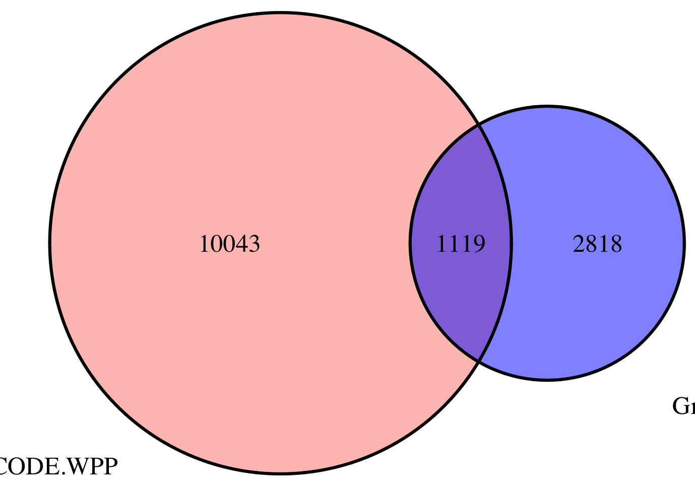
Fig. 2-3
Embryo
1.5 – 4 hr
modENCODE
White Pre-Pupae
Embryo
4 – 6.5 hr
Embryo
6.5 – 9 hr

Slide 2
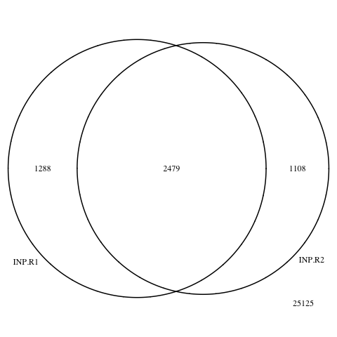
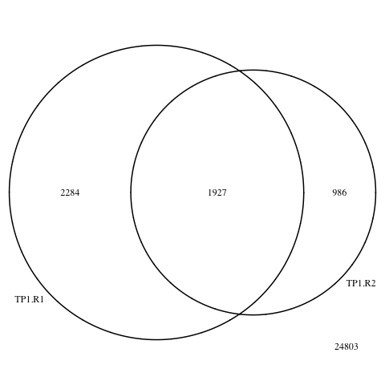
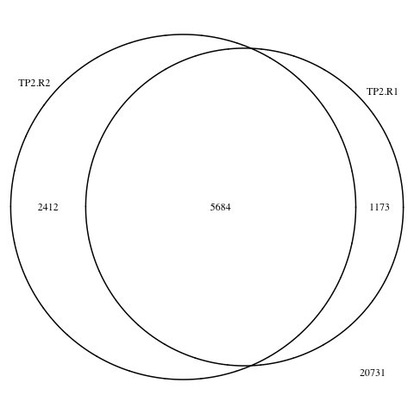
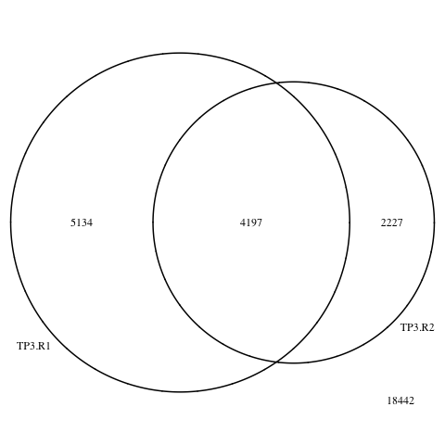
Fig. 2-4
Input
1.5 – 4 hr
4 – 6.5 hr
6.5 – 9 hr

Slide 3
z-score
1.5 – 4 hr
4 – 6.5 hr
6.5 - 9 hr

Slide 4
Fig. 2-12

