Slide 2
Co-R
On
Off
R
A
Co-R
On
Off
R
A

Slide 3
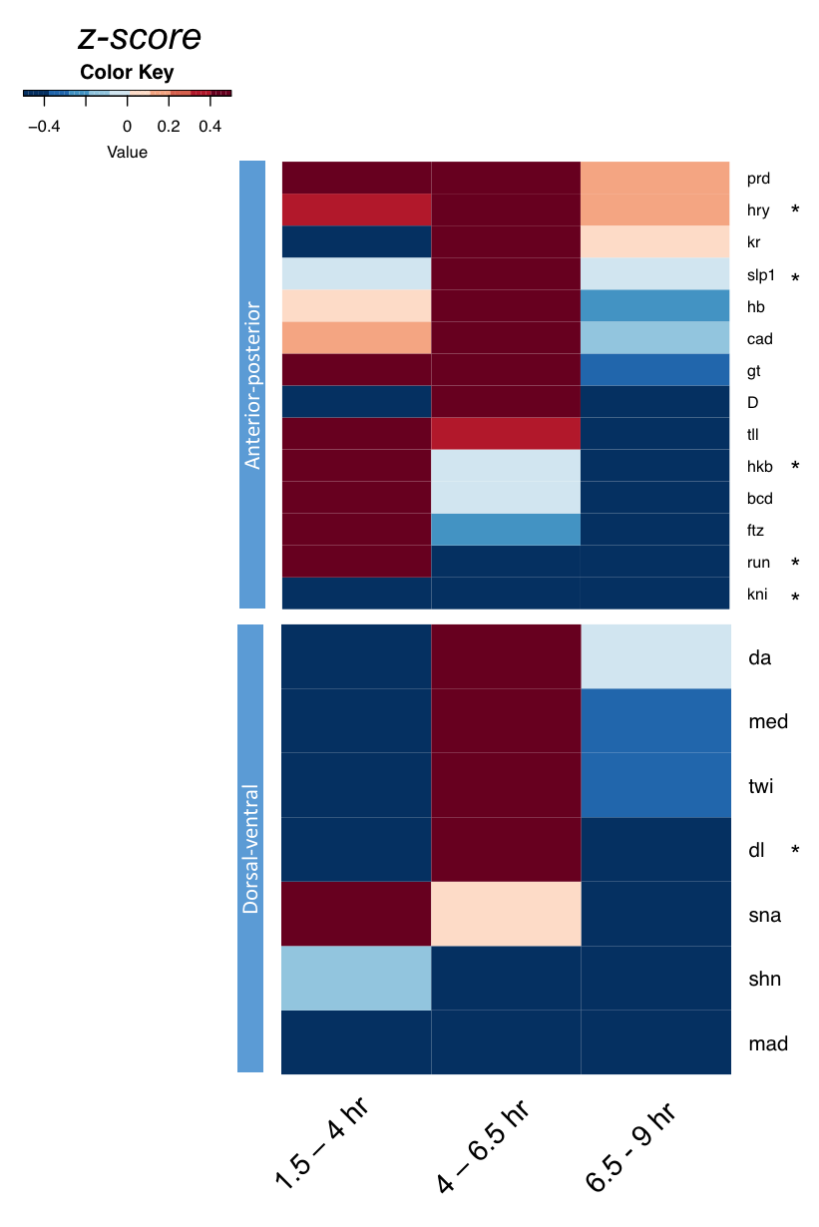
Gro colocalizes with multiple developmental factors

Slide 4
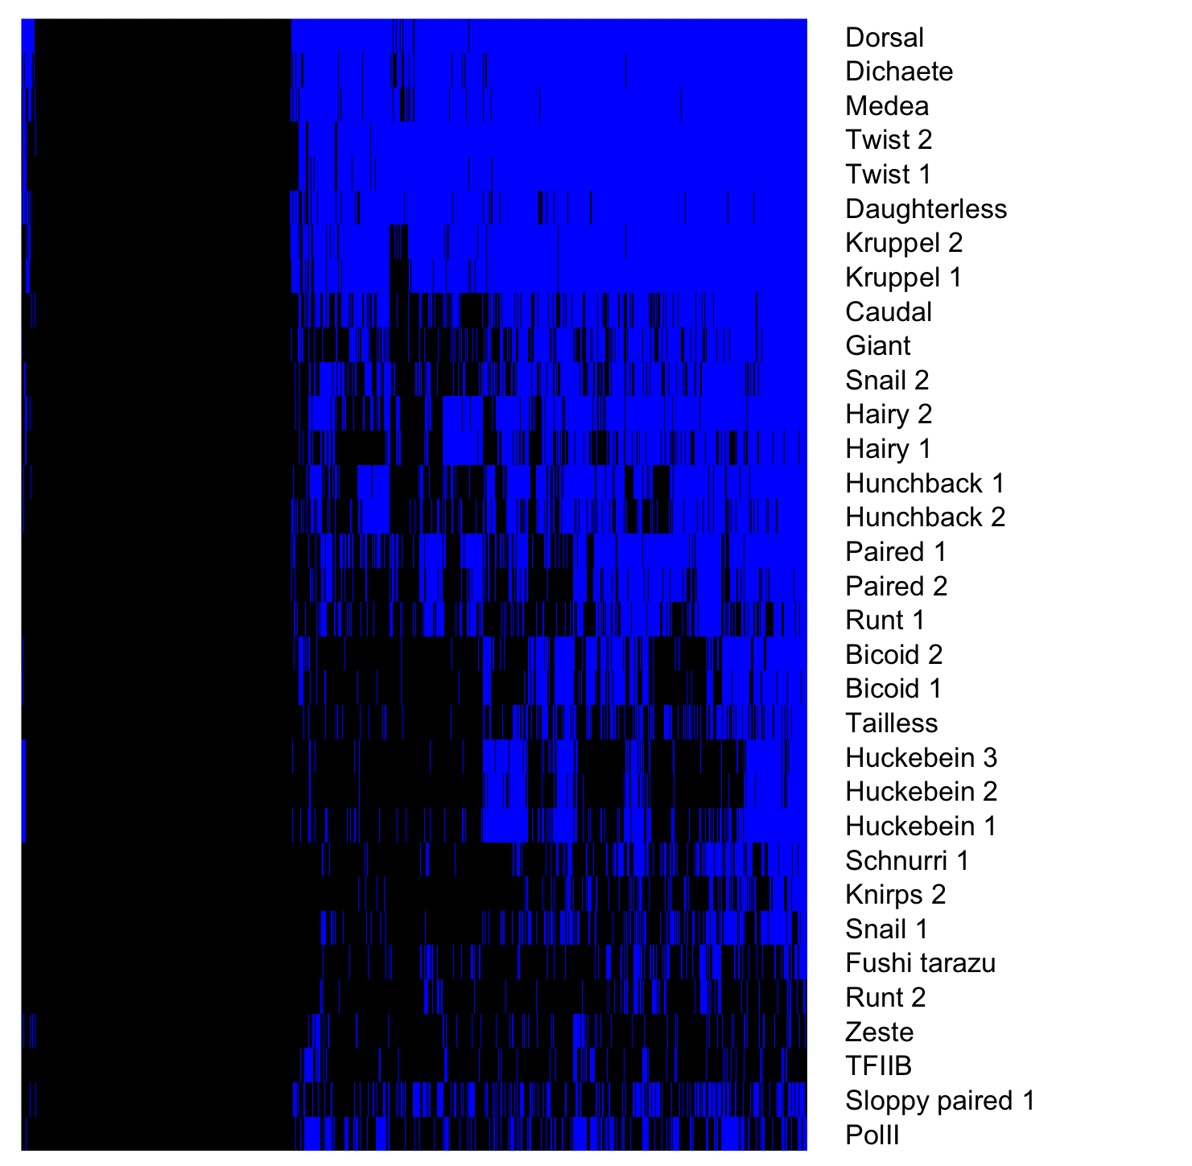
Gro binding sites overlap many additional TFs
Gro binding sites, 1.5 – 4 hr embryos
Factor occupancy

Slide 5
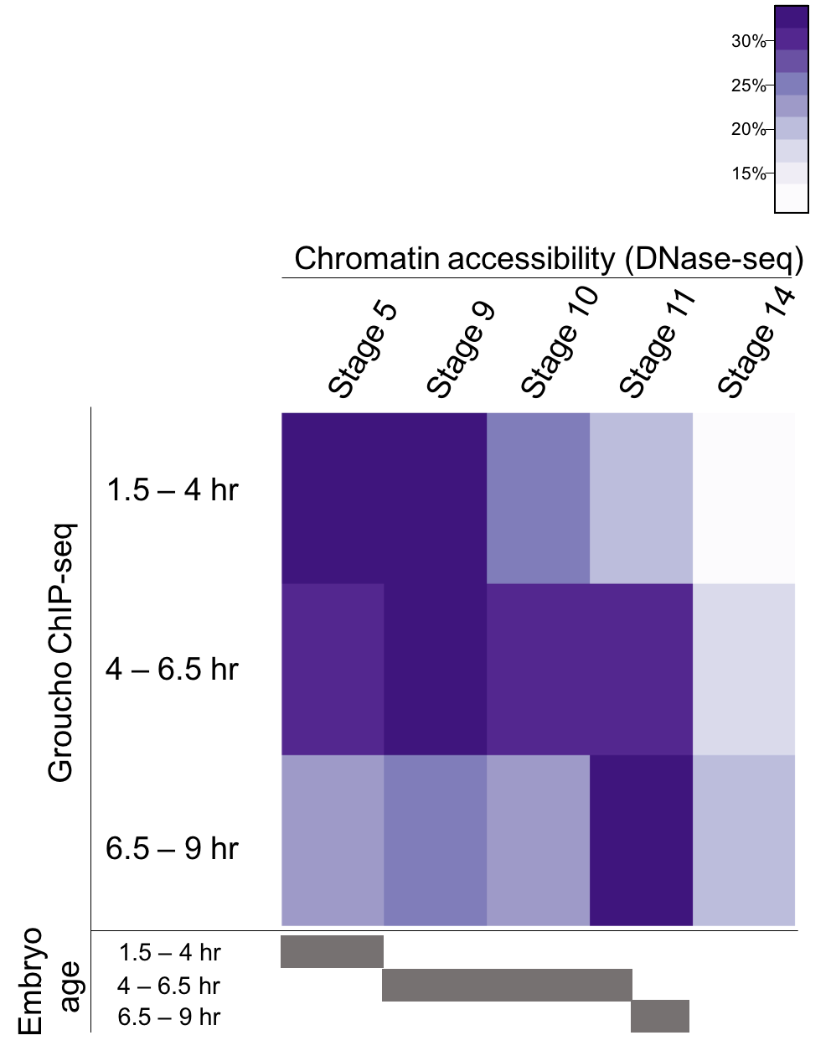
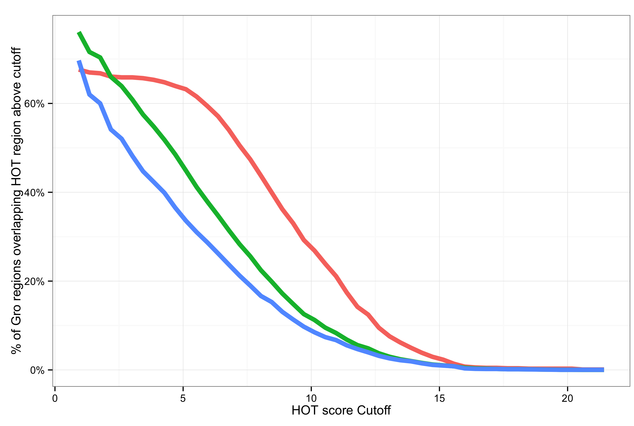
Gro is frequently recruited to areas of high TF density
Notes:
Legend
High accessibility
HOT region explanation

Slide 6
4 – 6.5 hr
3056
1.5 – 4 hr
6.5 – 9 hr
64
1409
782
717
2311

Slide 8
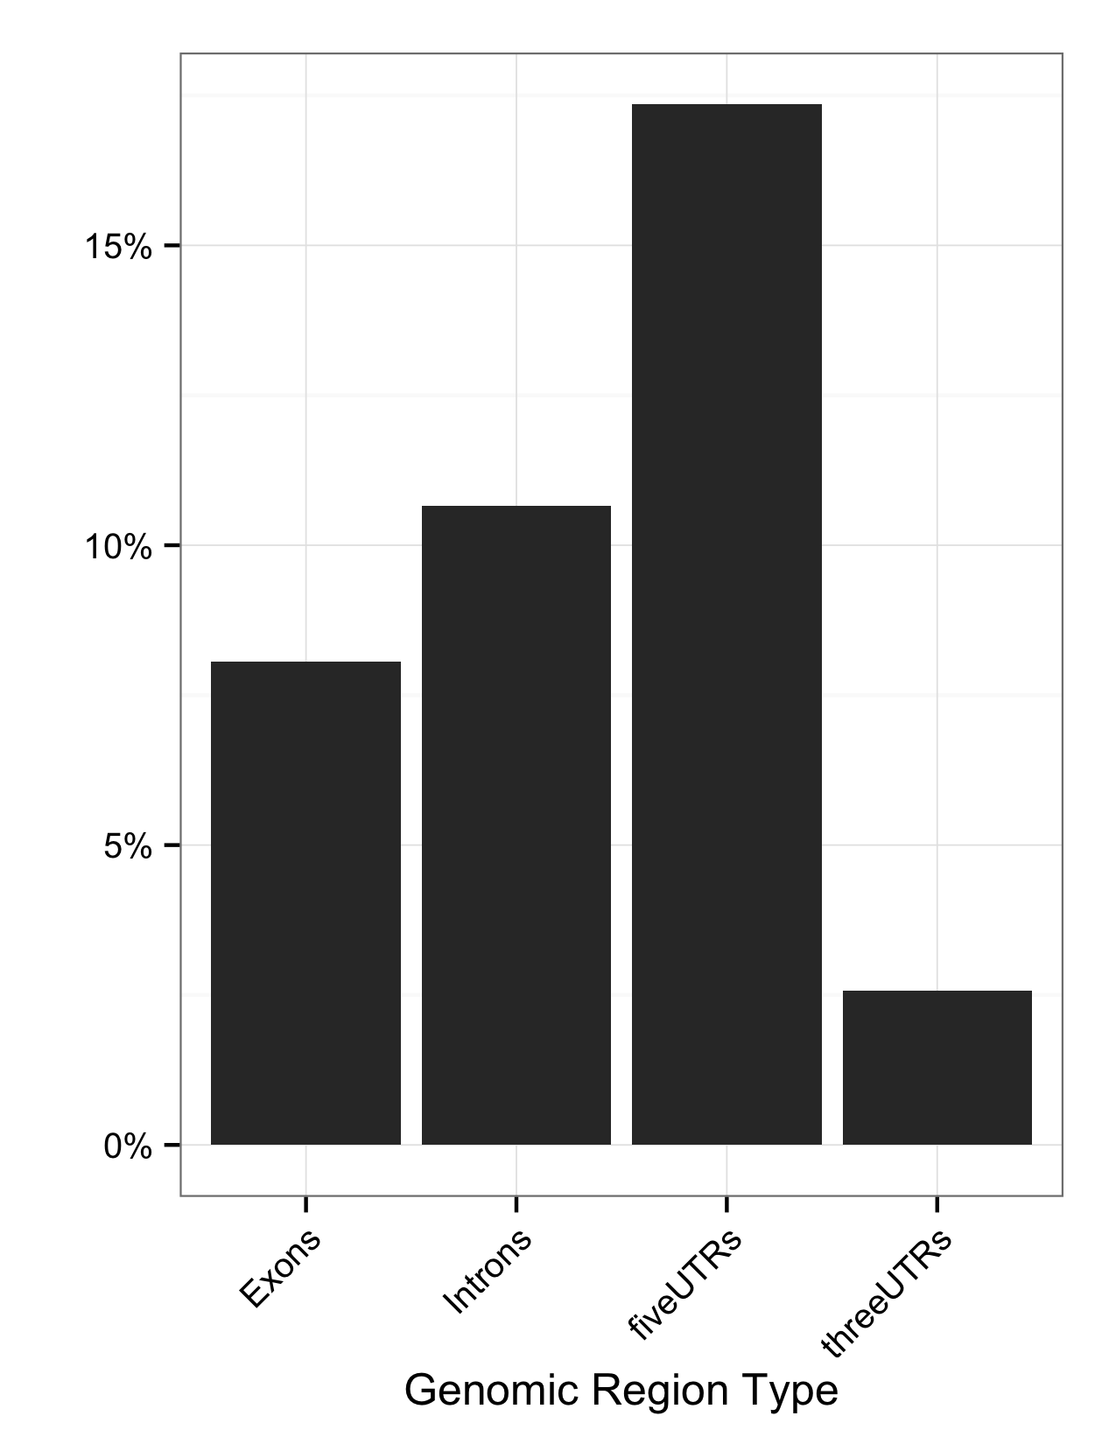
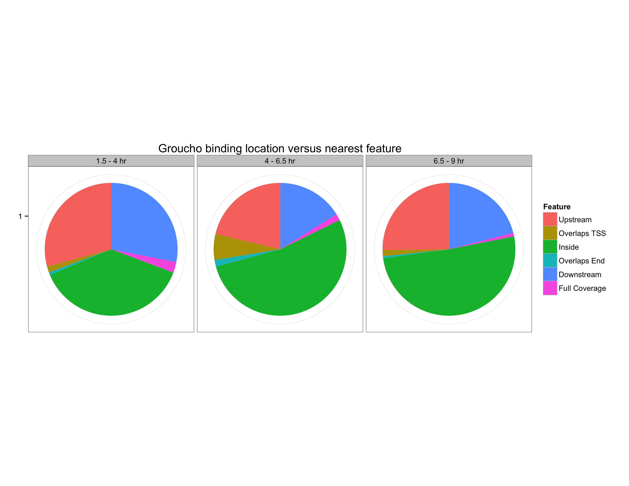
Gro binding is enriched within 5’ segments of genes
Fraction of Gro binding sites
Feature length normalized

Slide 9
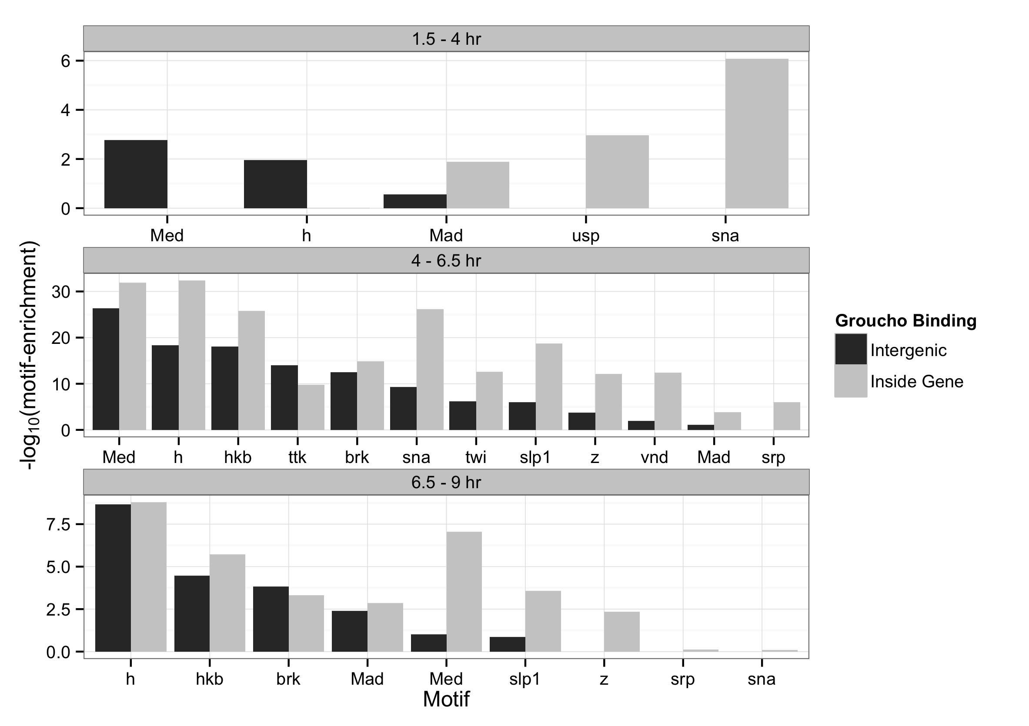
Binding sites are enriched for motifs of Gro-interacting factors

Slide 10
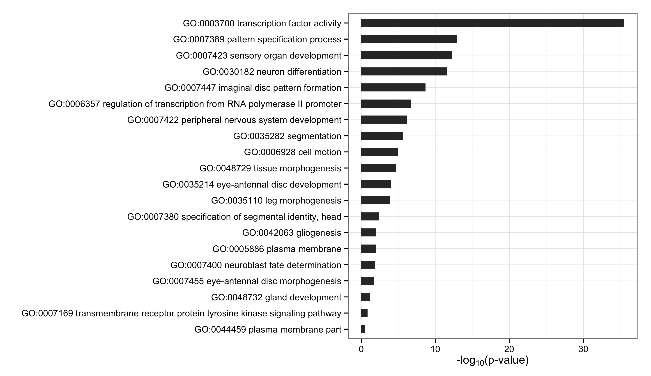
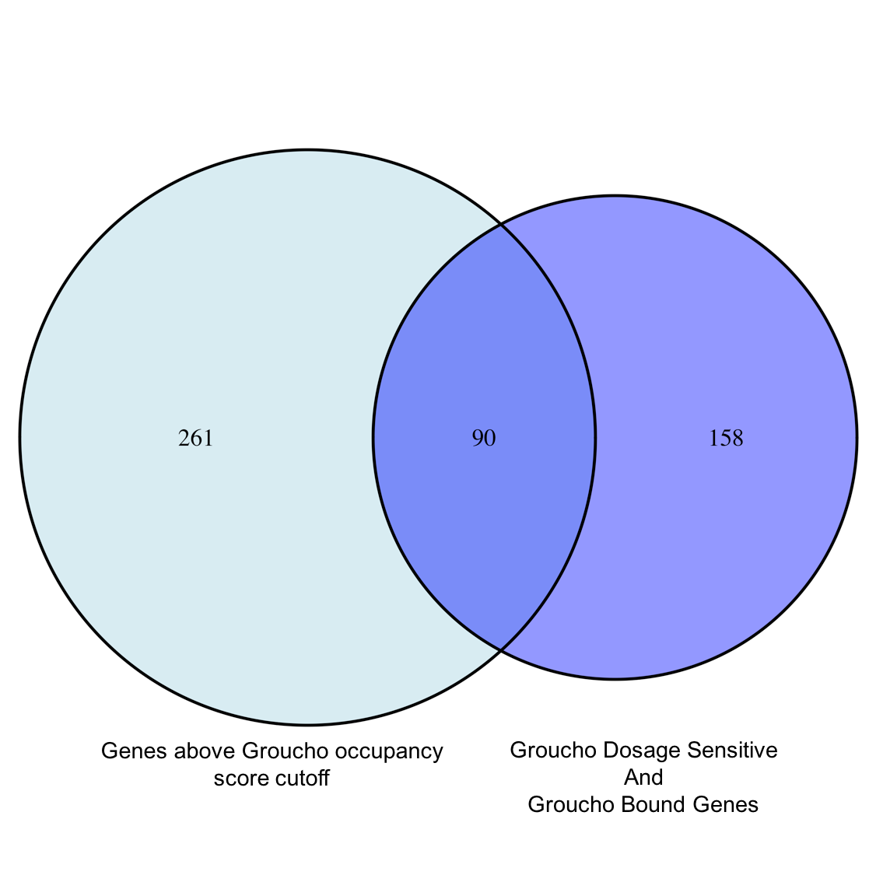
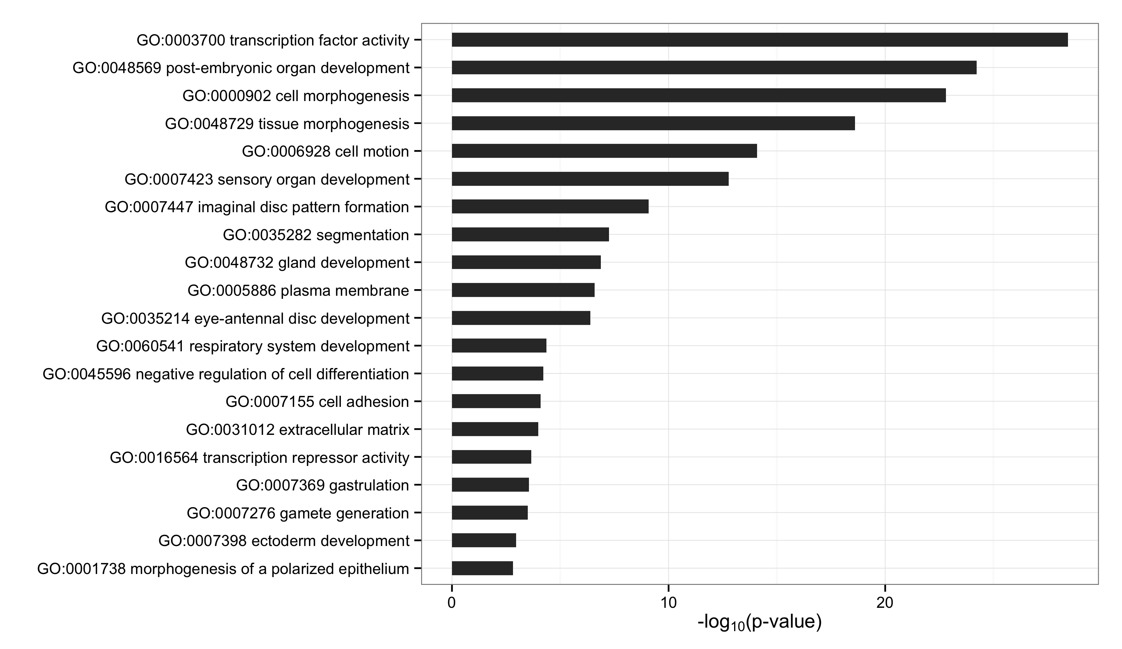
Gro Targets by Dosage Response
Gro Targets by Occupancy Score
Notes:
Focus on gro occupancy

Slide 11
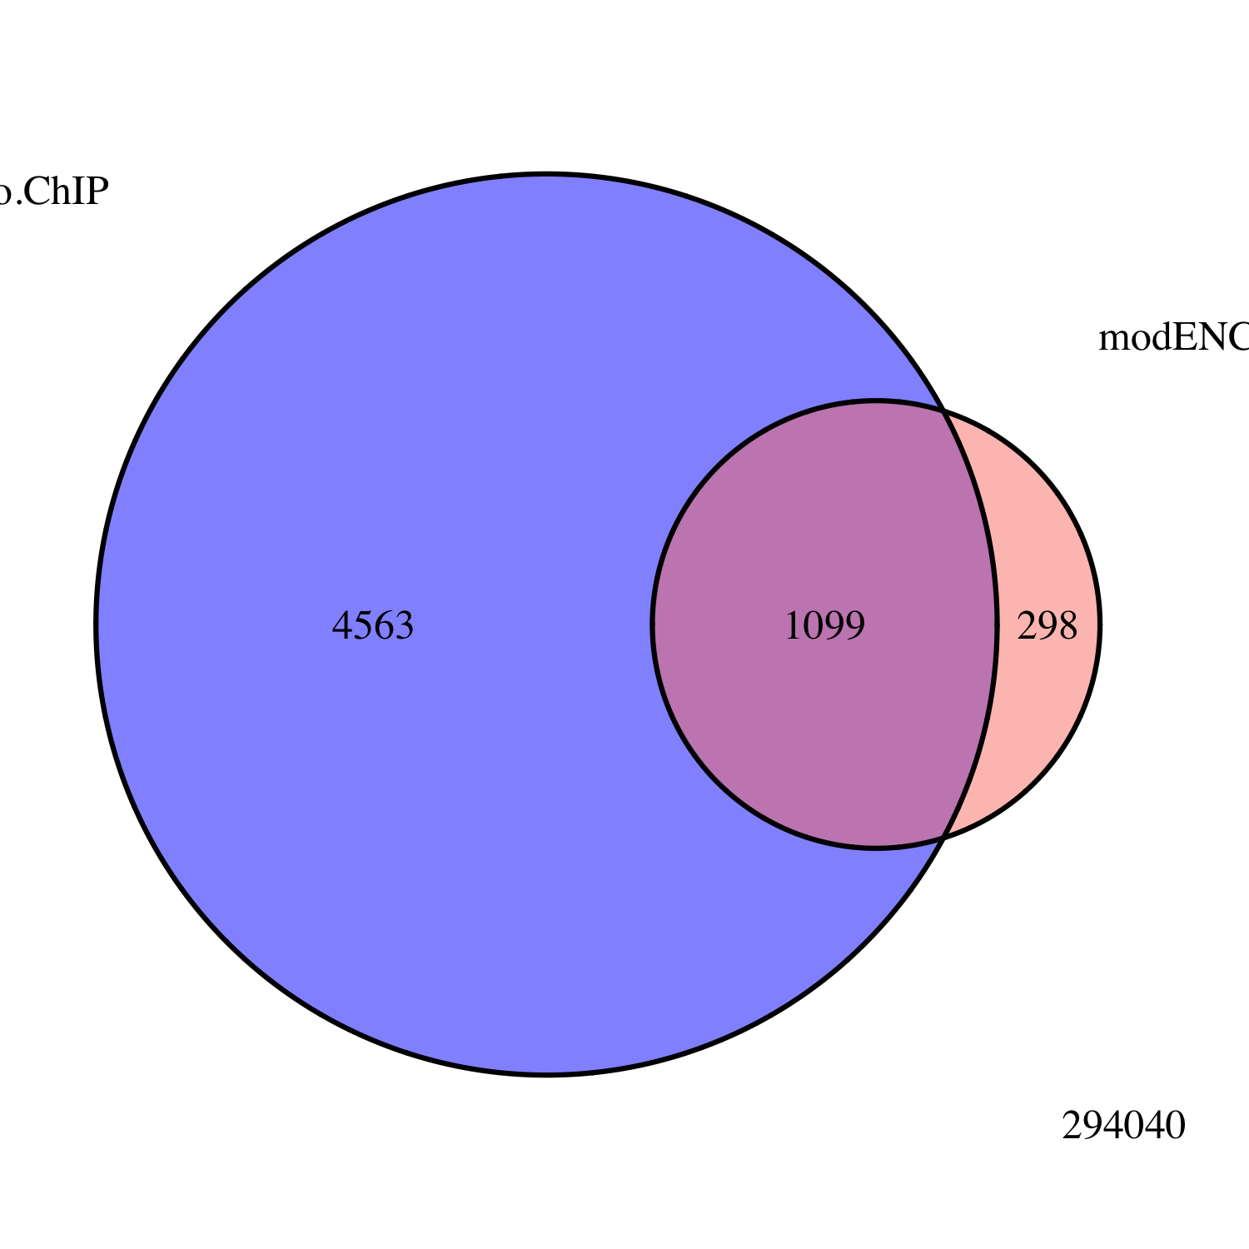
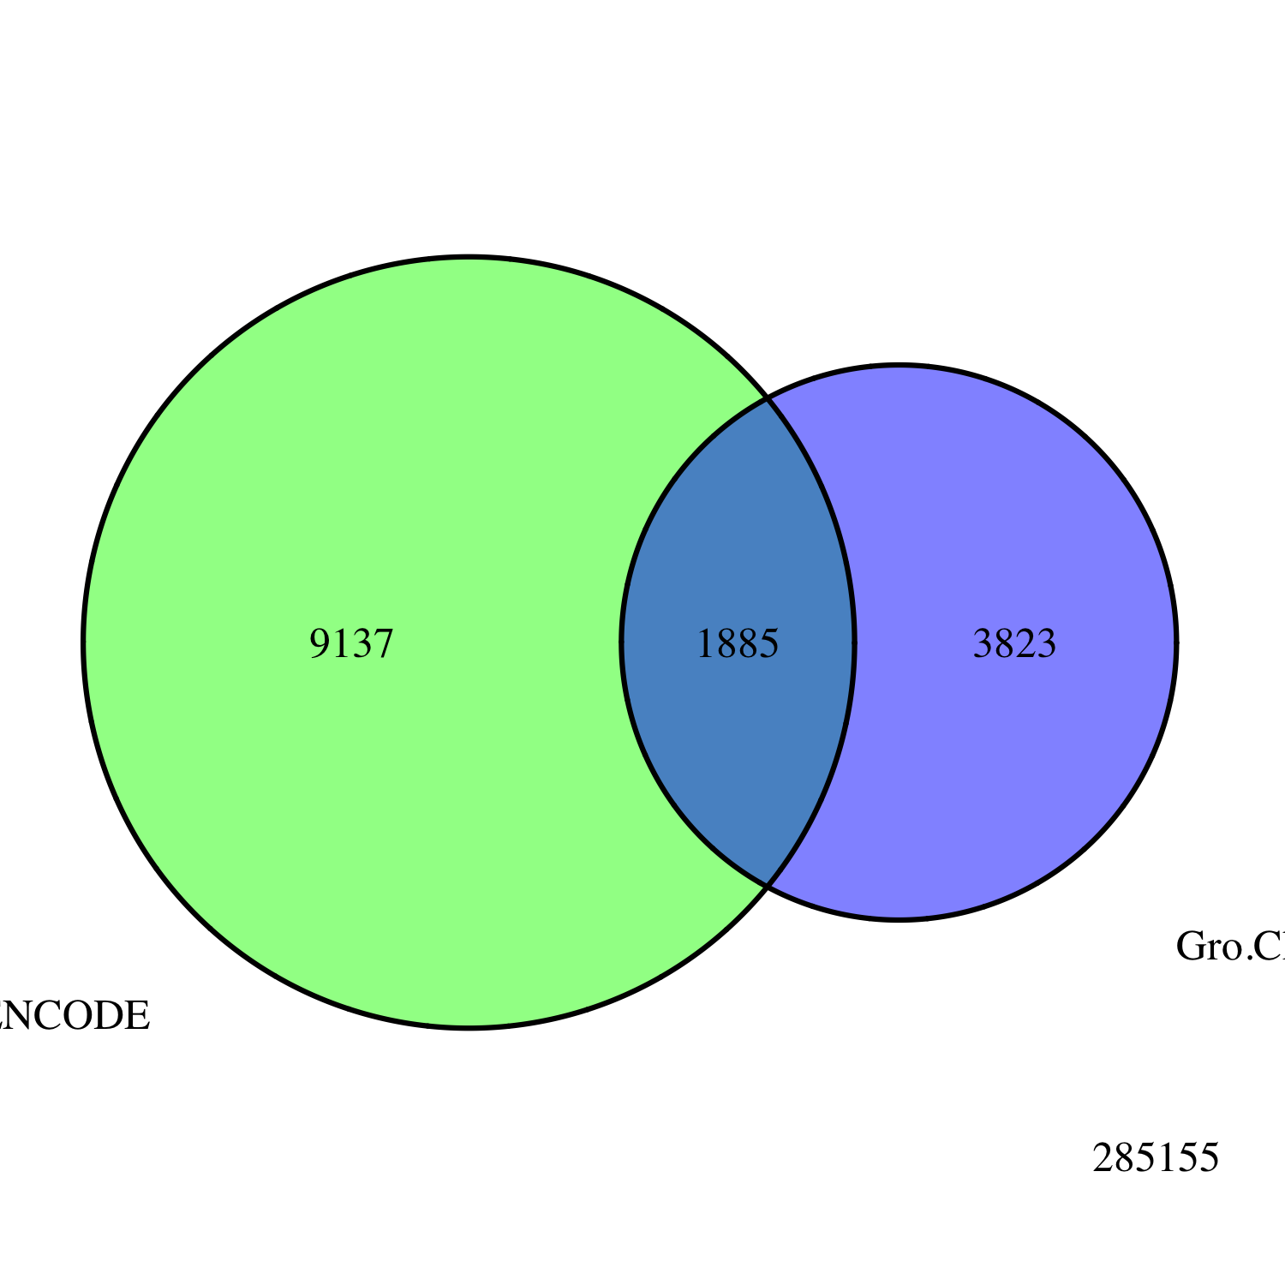
Embryo
Gro ChIP-seq
All Peaks
modENCODE
Embryo
Gro ChIP-chip
Embryo
Gro ChIP
All Peaks
modENCODE
White Pre-Pupae
Gro ChIP-chip
3823
1885
9137
Notes:
Title chip-seq validation

Slide 12
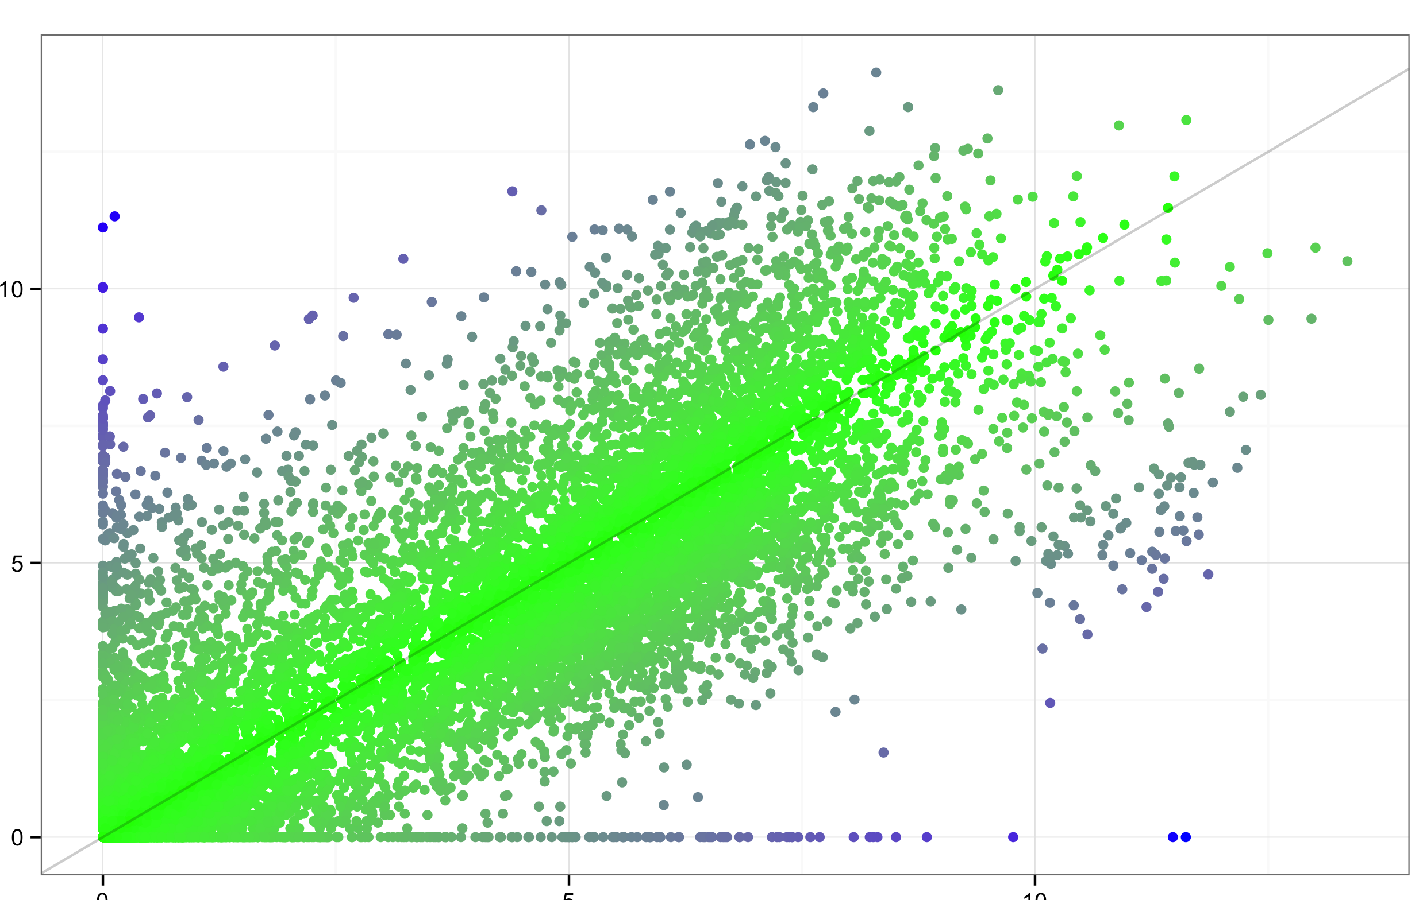
Nascent RNA
Normalized Expression Level (log₂FPM)
poly(A)+ mRNA
Normalized Expression Level (log₂FPM)

Slide 13
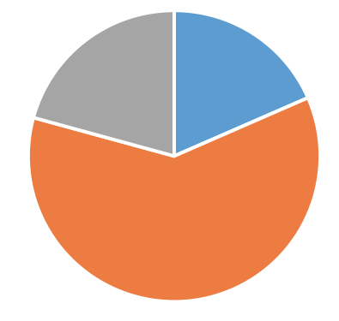
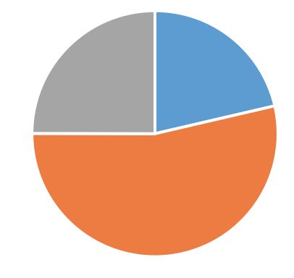
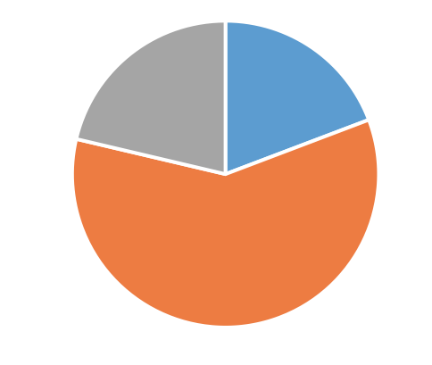

Slide 14
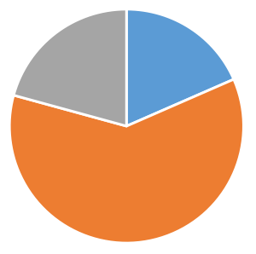
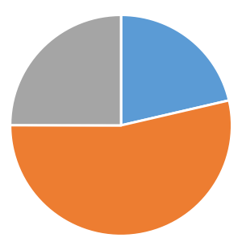
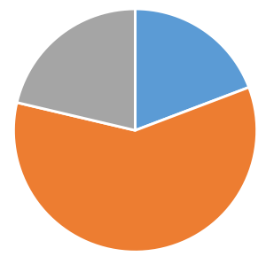

Slide 15
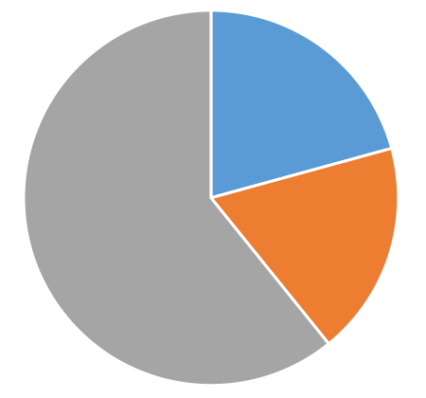
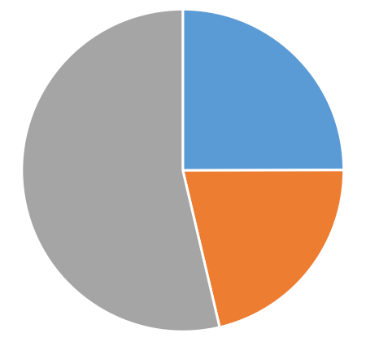


Slide 16
Genic
Intergenic
Intron
Exon
Upstream
Downstream
Distal Intergenic

Slide 17
Spreading or crosslinking as models of repression
R
R
Gro
Gro
Gro
Gro
Gro
Gro
Gro
Gro
Gro
Gro
Gro
Gro
Gro
Gro
Gro
R
Gro

Slide 18
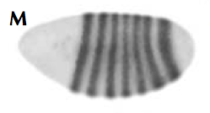
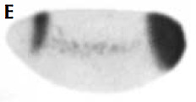

Slide 19
Repression
High affinity
Activation
Activation
Low affinity
Repression

Slide 20
If Gro spreading is rare, how does it participate in long-range repression?

