Slide 1
Genome-wide Analysis of Groucho Function in Drosophila Embryogenesis
Michael Chambers

Slide 2
Low
Dorsal ectoderm
Nuclear Dorsal
Neuroectoderm
High
Mesoderm

Slide 3


Genomic scale analysis will provide significant insight into Groucho’s functions in early fly development
Embryo
24 hr
Larva
4 days
Pupae
5 days
Adult
RNA-seq
Nascent-seq
ChIP-seq
mRNA accumulation
mRNA transcription rate
Groucho binding
Notes:
nascent-seq: Distribution of ternary elongation complexes
----- Meeting Notes (5/30/13 12:52) -----
Genome-wide instead of genomic scale
24 hr embryogenesis
Pupal 5 days ?
Histone marks under chip-seq

Slide 4
On
Co-R
On
Off
A
R
A
Co-A
On
F
F
Co-R
Off
F

Slide 5
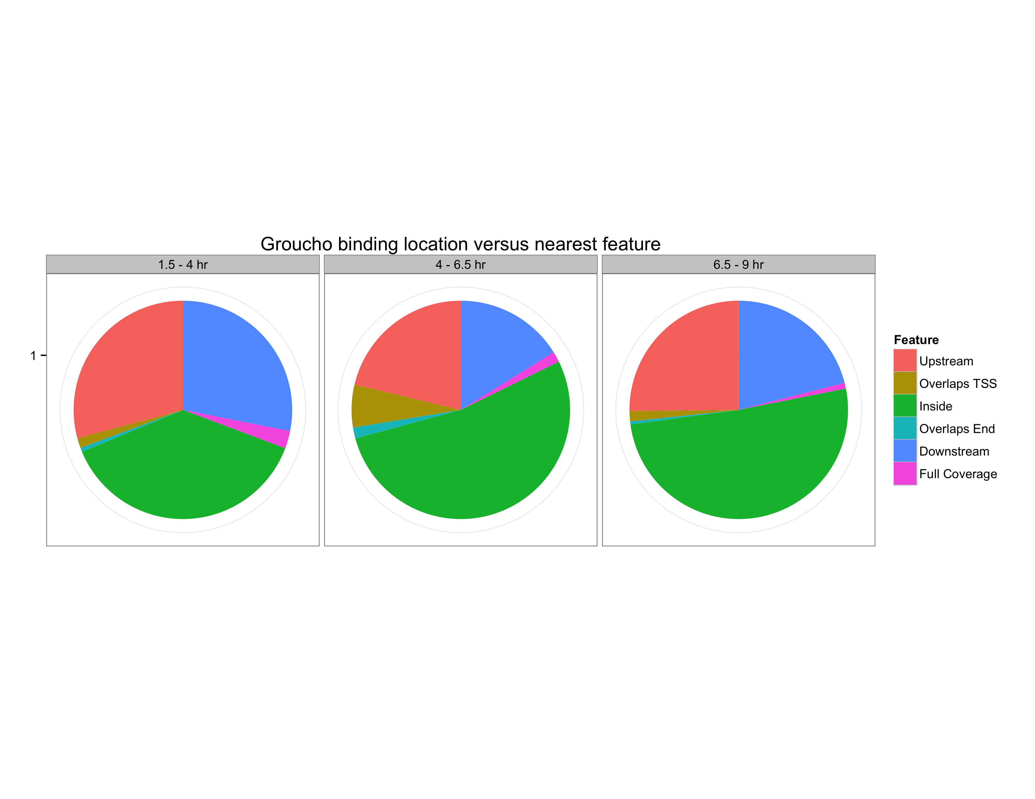

Slide 6
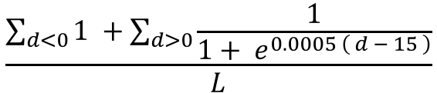
$$\frac{\sum_{d<0}{1 }+\sum_{d>0}{\frac{1}{1+ e^{0.0005 \left( d − 15 \right)}}}}{L}$$

