Slide 1
Genome-wide Analysis of Groucho Function in Drosophila Embryogenesis
Michael Chambers

Slide 2
Gene regulation through concerted action of activators and repressors
On
Co-R
On
Off
A
R
A
Co-A
On
F
F
Co-R
Off
F

Slide 3
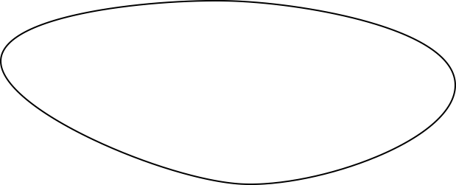
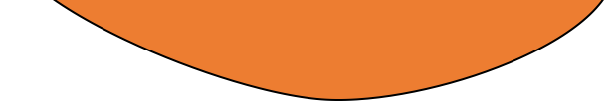
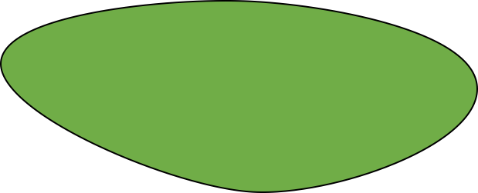
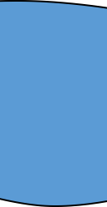
Spatial and temporal regulation of gene expression in development
On
A
Off
R

Slide 4
Morphogen gradients designate cell fate in embryogenesis
Low
Dorsal ectoderm
Embryo
Embryo
Cross-Section
Nuclear Dorsal
Neuroectoderm
High
Mesoderm

Slide 5
Groucho is a co-repressor integral to Drosophila development

Slide 6
Groucho is recruited by multiple sequence-specific factors
Dorsal-ventral patterning
Dorsal
Brinker
Ind
Vnd
Anterior-posterior patterning
Segmentation
Hairy
Runt
Even-skipped
Odd-skipped
Sloppy-paired 1
Engrailed
Knirps
Goosecoid
Terminal patterning
Capicua
Huckebein
Notch signaling
Su(H) E(spl)

Slide 7
Multiple potential mechanisms of Gro-mediated repression
Seikya and Zaret, 2007
Zhang and Emmons, 2002
Cai et al, 2003
Figures Turki-Judeh and Courey, 2012

Slide 8
Outline
A genome-wide survey of Groucho in the early embryo
Identifying components of the Groucho gene regulatory network
Groucho regulation and RNA PolII stalling

Slide 9


Genomic scale analysis will provide significant insight into Groucho’s functions in early fly development
Embryo
24 hr
Larva
4 days
Pupae
5 days
Adult
RNA-seq
Nascent-seq
ChIP-seq
mRNA accumulation
pre-mRNA profiling
Groucho binding
Notes:
nascent-seq: Distribution of ternary elongation complexes
----- Meeting Notes (5/30/13 12:52) -----
Genome-wide instead of genomic scale
24 hr embryogenesis
Pupal 5 days ?
Histone marks under chip-seq

Slide 10
Groucho is recruited to thousands of sites throughout the genome
4 – 6.5 hr
6.5 – 9 hr
1.5 – 4 hr

Slide 11
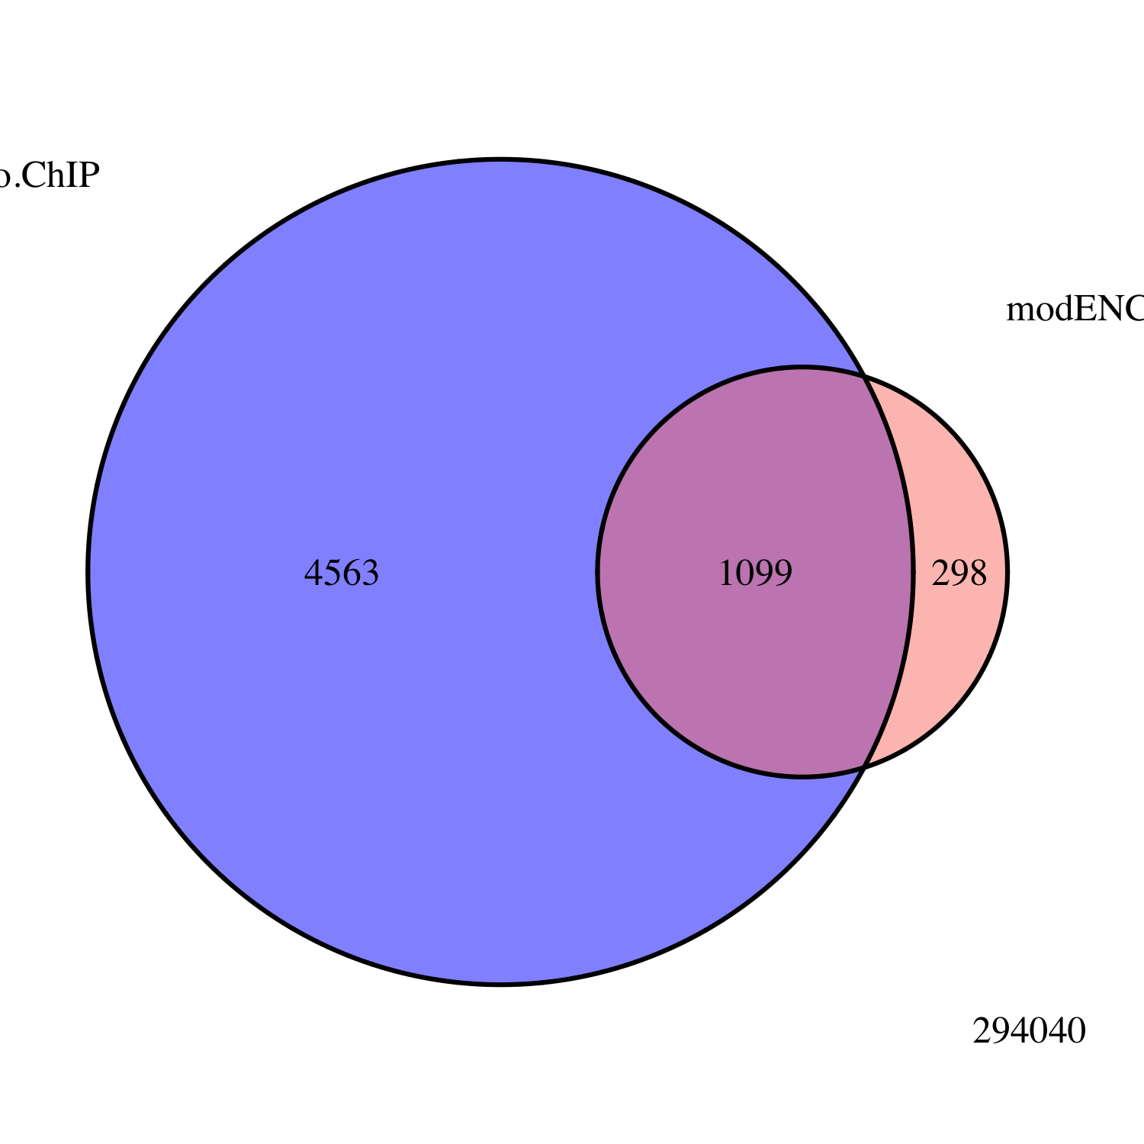
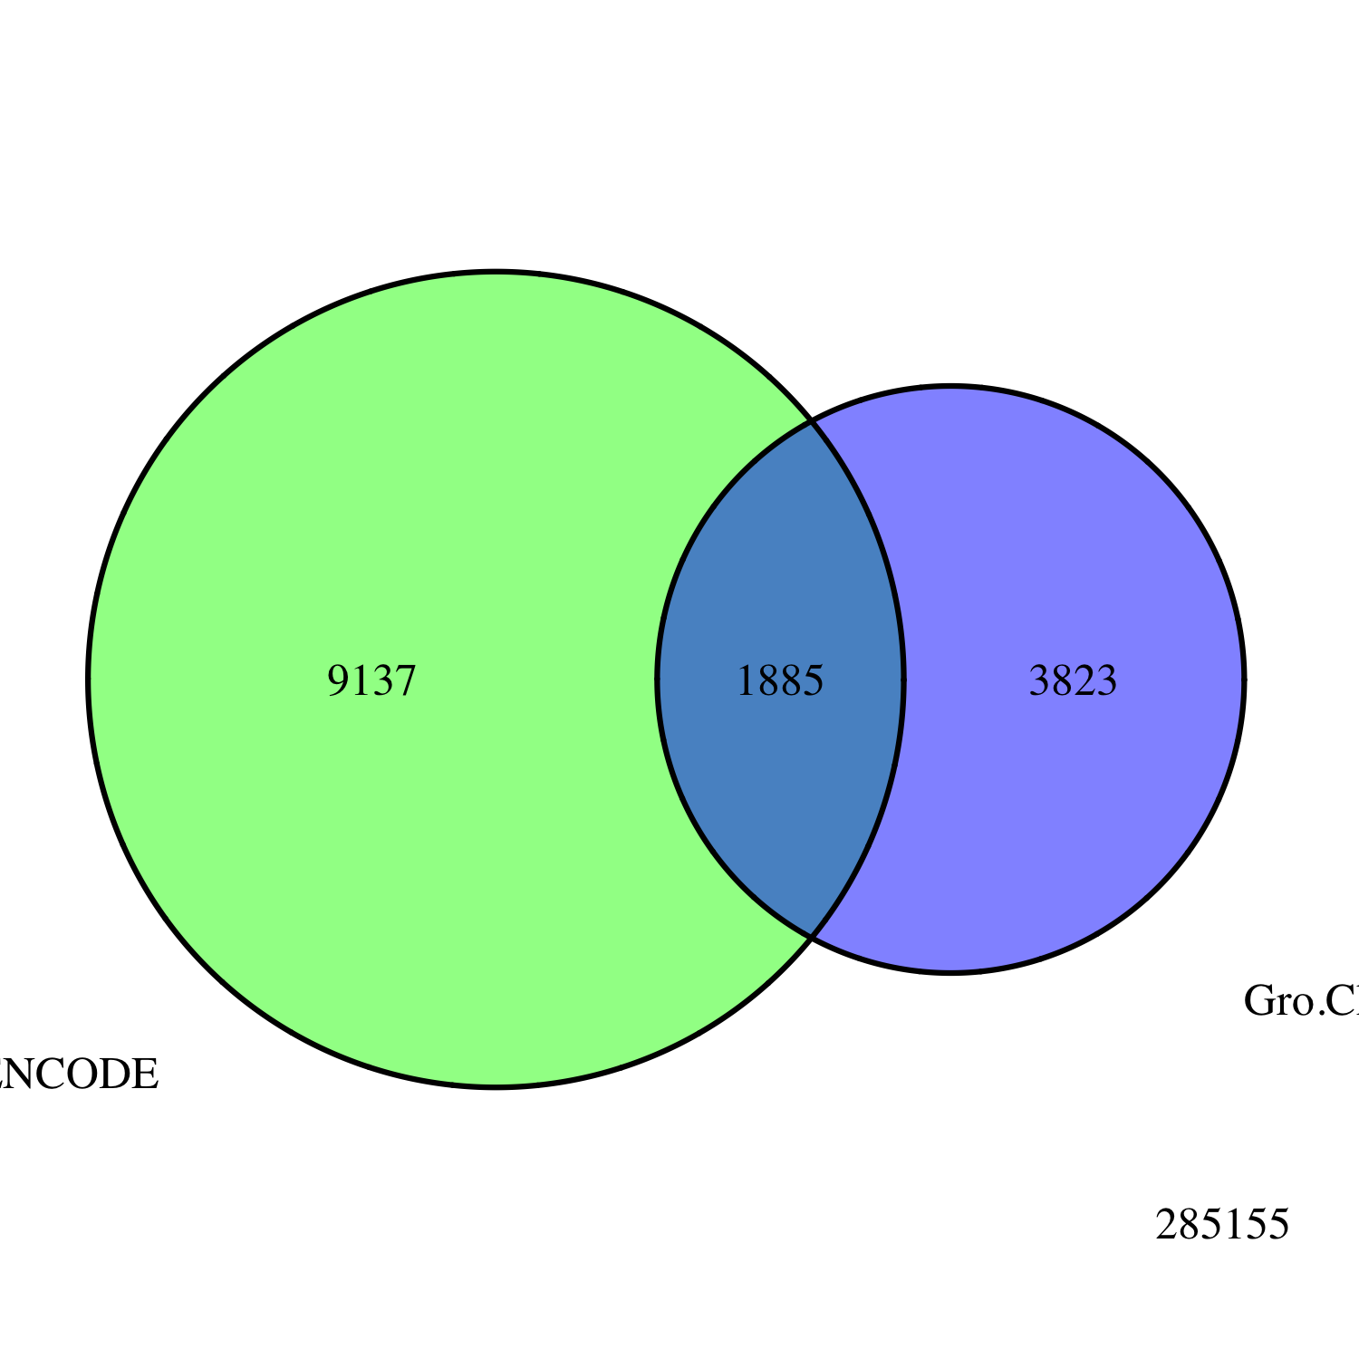
Embryo
Gro ChIP-seq
All Peaks
modENCODE
Embryo
Gro ChIP-chip
Embryo
Gro ChIP
All Peaks
modENCODE
White Pre-Pupae
Gro ChIP-chip
3823
1885
9137

Slide 12
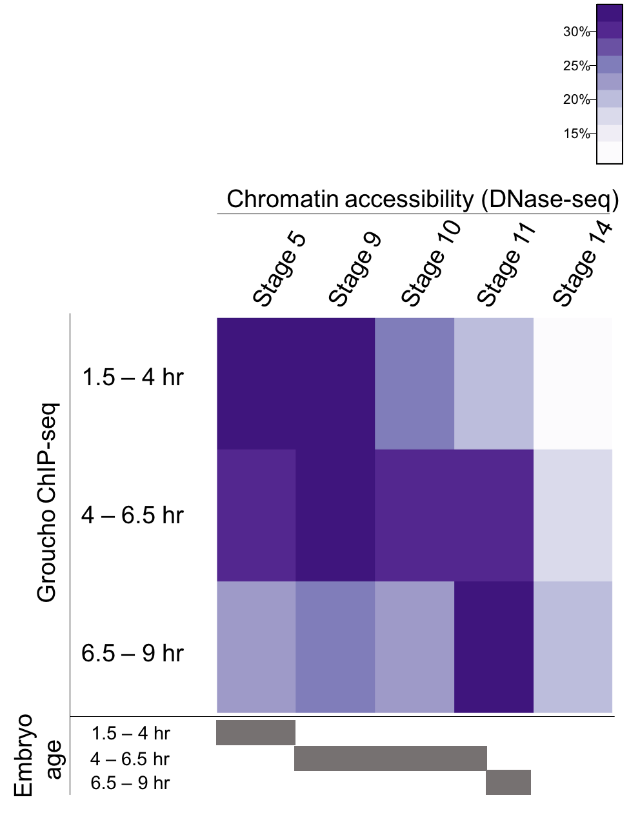
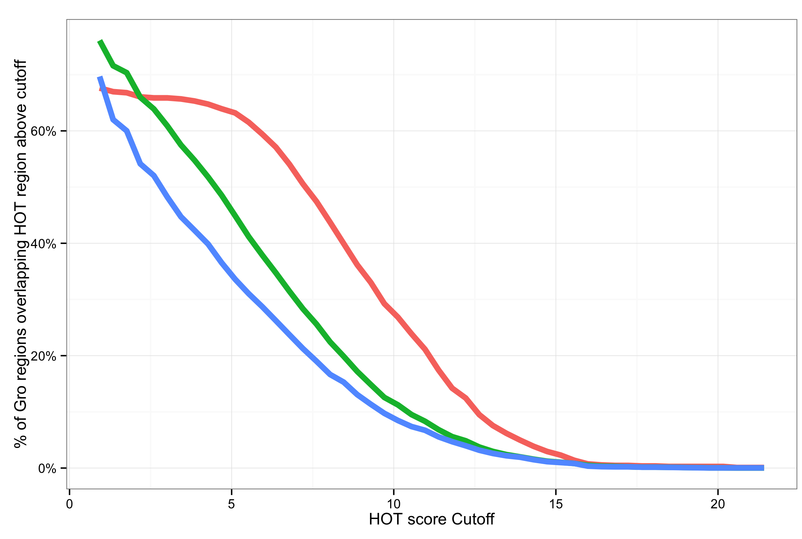

Slide 13
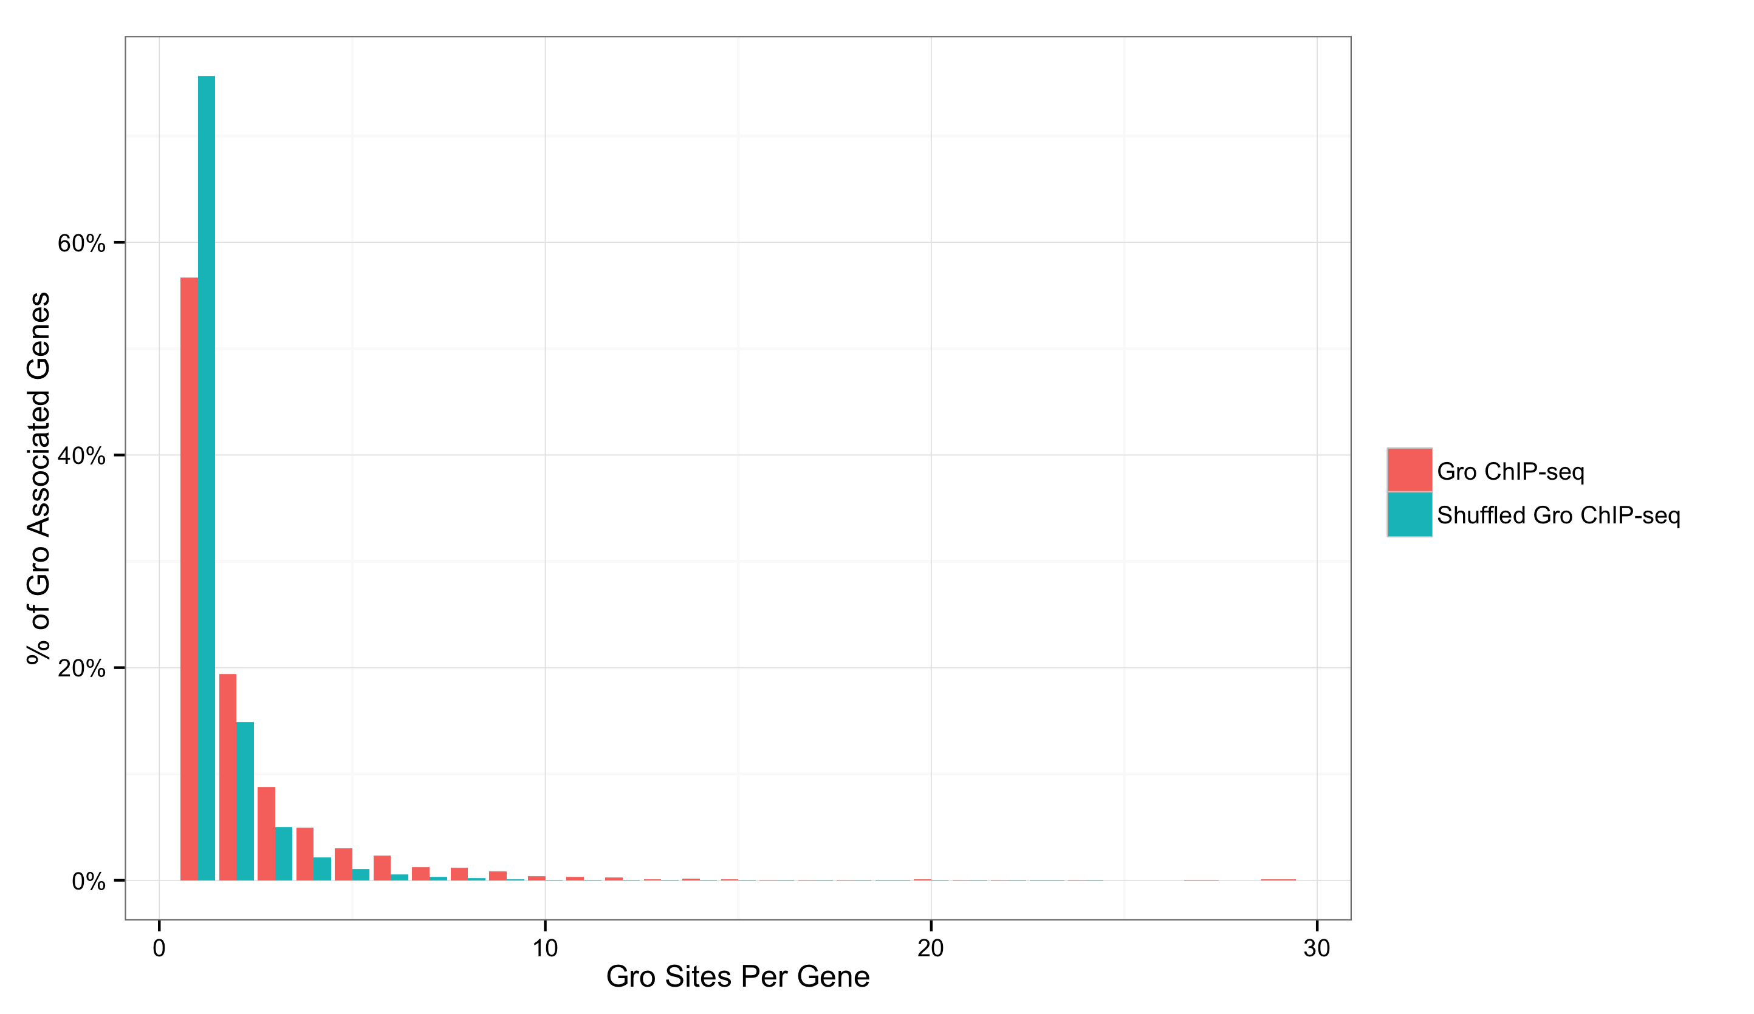
1
2
3
4
5

Slide 14
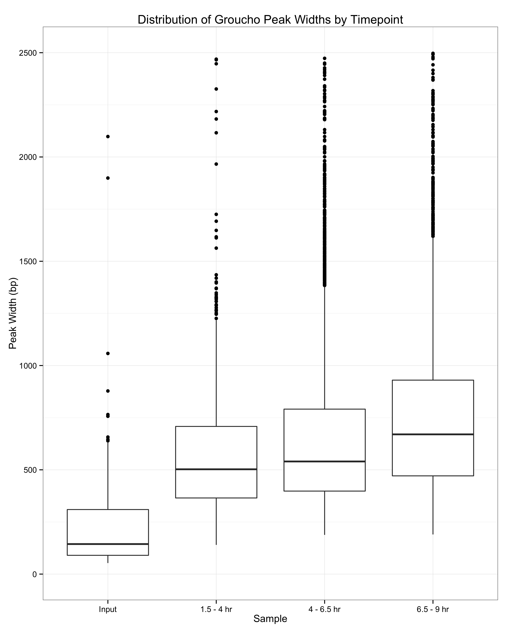
2500 -
2000 -
1500 -
1000 -
500 -
0 -
1.5 – 4 hr
4 – 6.5 hr
6.5 - 9 hr

Slide 15
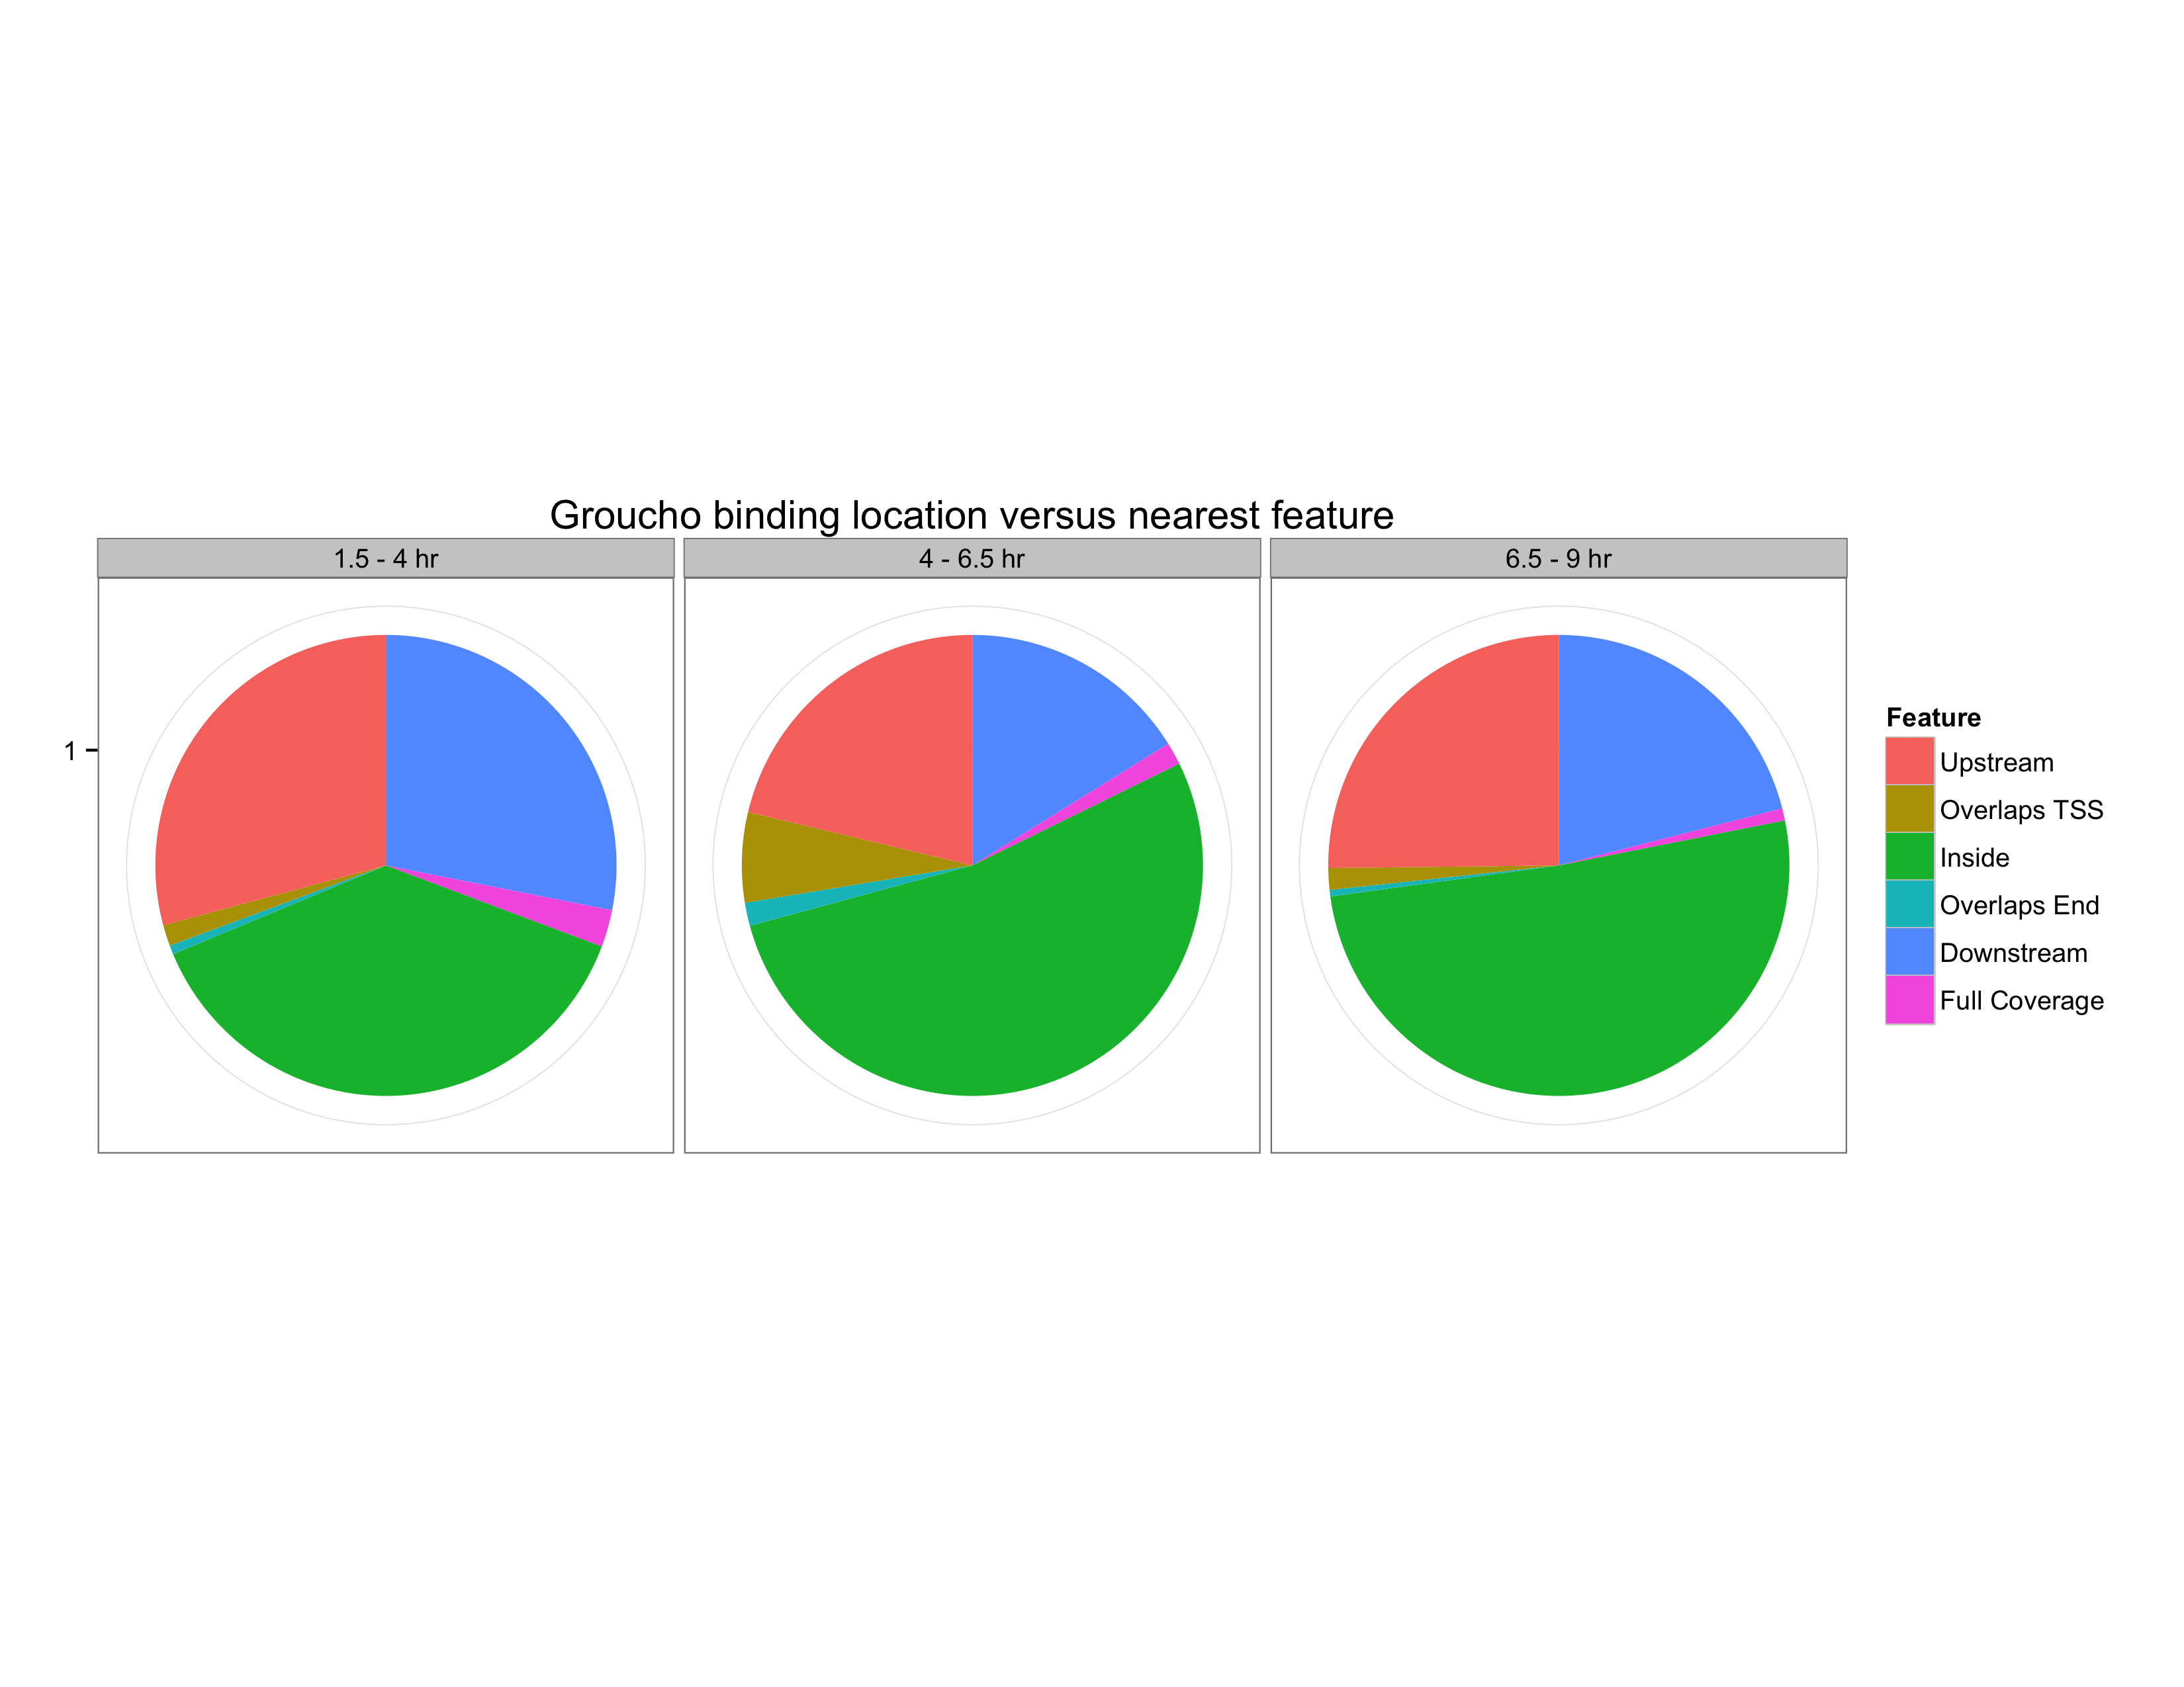
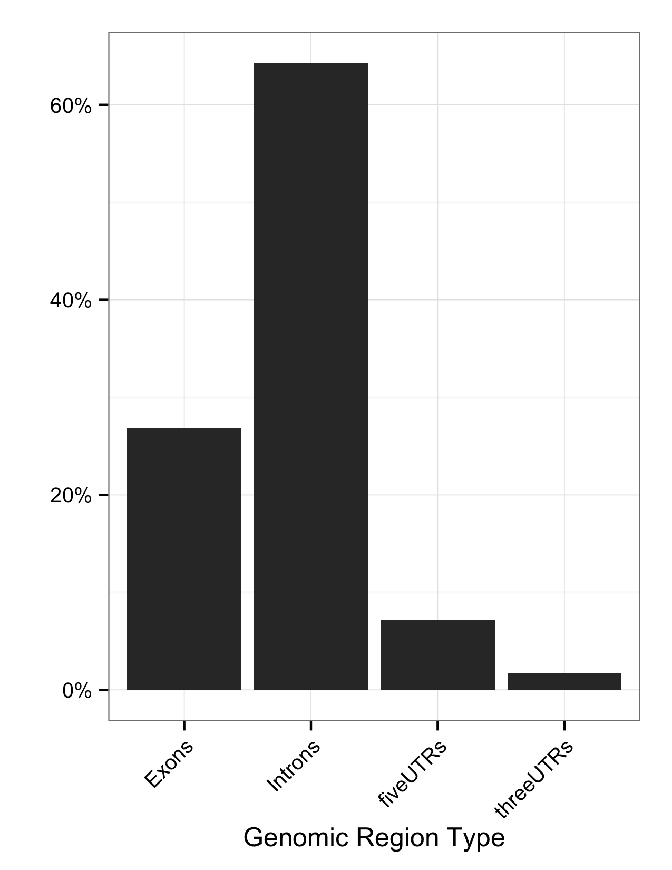

Slide 16
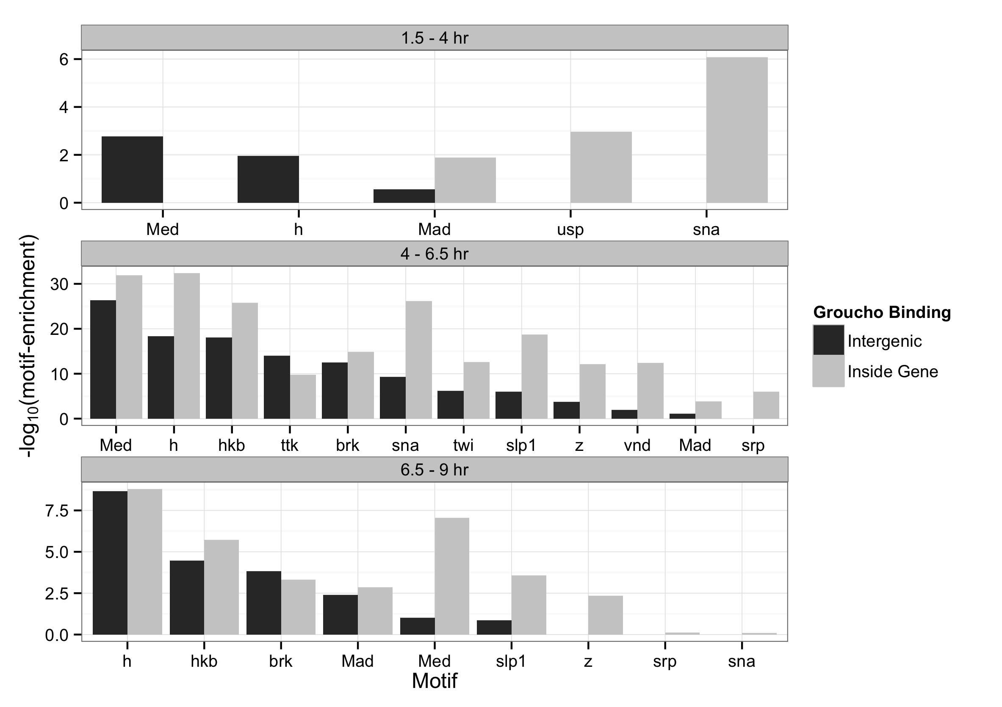

Slide 17
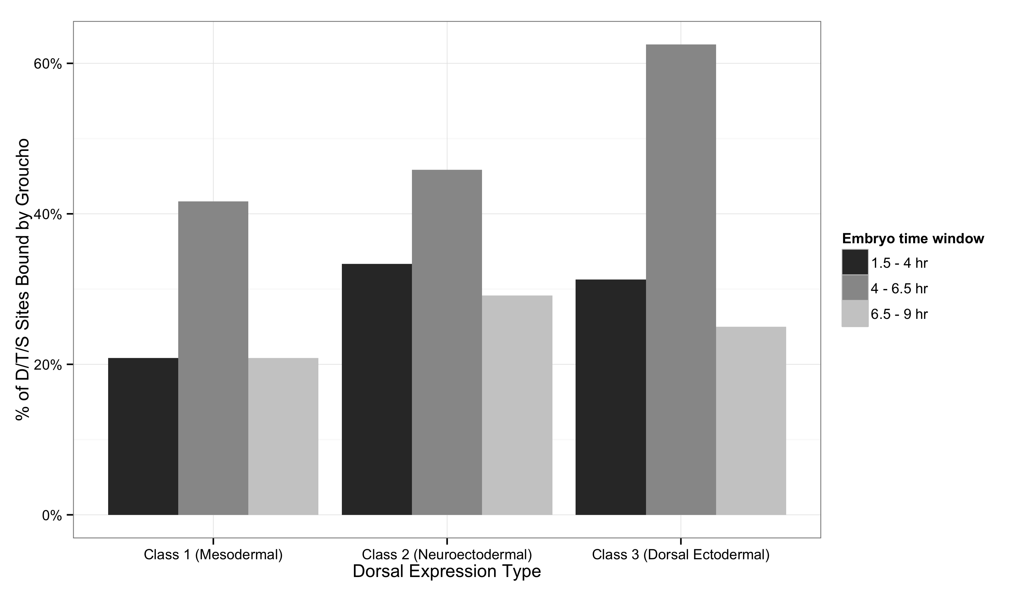

Slide 18
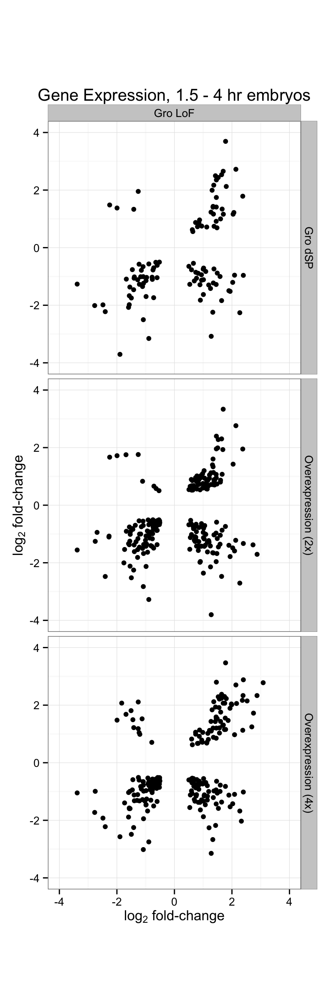
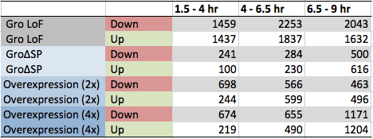

Slide 19
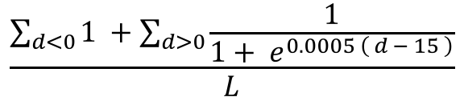
$$\frac{\sum_{d<0}{1 }+\sum_{d>0}{\frac{1}{1+ e^{0.0005 \left( d − 15 \right)}}}}{L}$$

Slide 21
Conclusion

Slide 22
Acknowledgements
Courey Lab
Albert Courey
Joseph Cao
Kenny Chen
Mitchell Kim
Pak Kwong
Wiam Turki-Judeh
Tom Yau
Committee
Dr. James Bowie
Dr. Michael Carey
Dr. Catherine Clarke
Dr. Volker Hartenstein
Collaborators
Sean Gallaher (Merchant Lab)
Kelvin Zhang (Zipursky Lab)

