Slide 1
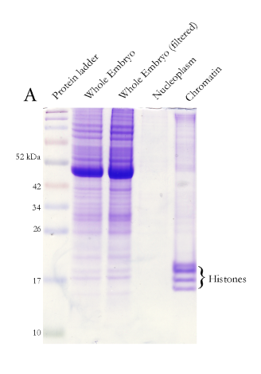
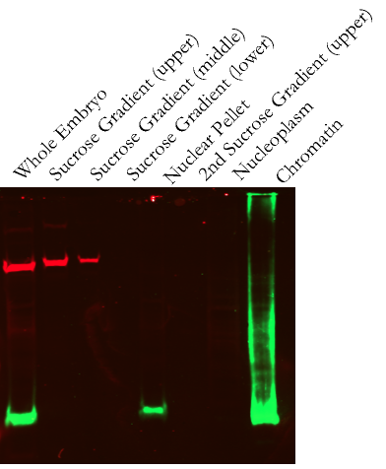
A
B
α-tubulin
α-H3

Slide 2
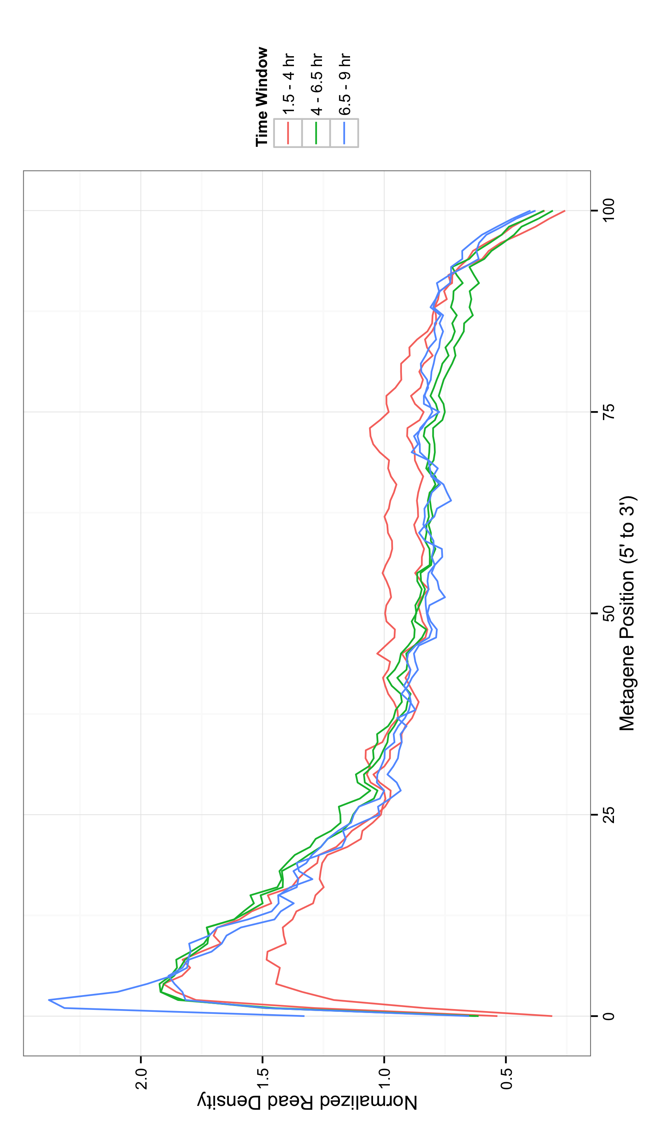

Slide 4
poly(A)+ RNA
gro^{MB36}
GroΔSP
Nascent RNA
Gro overexpression 1
Gro overexpression 2

Slide 5
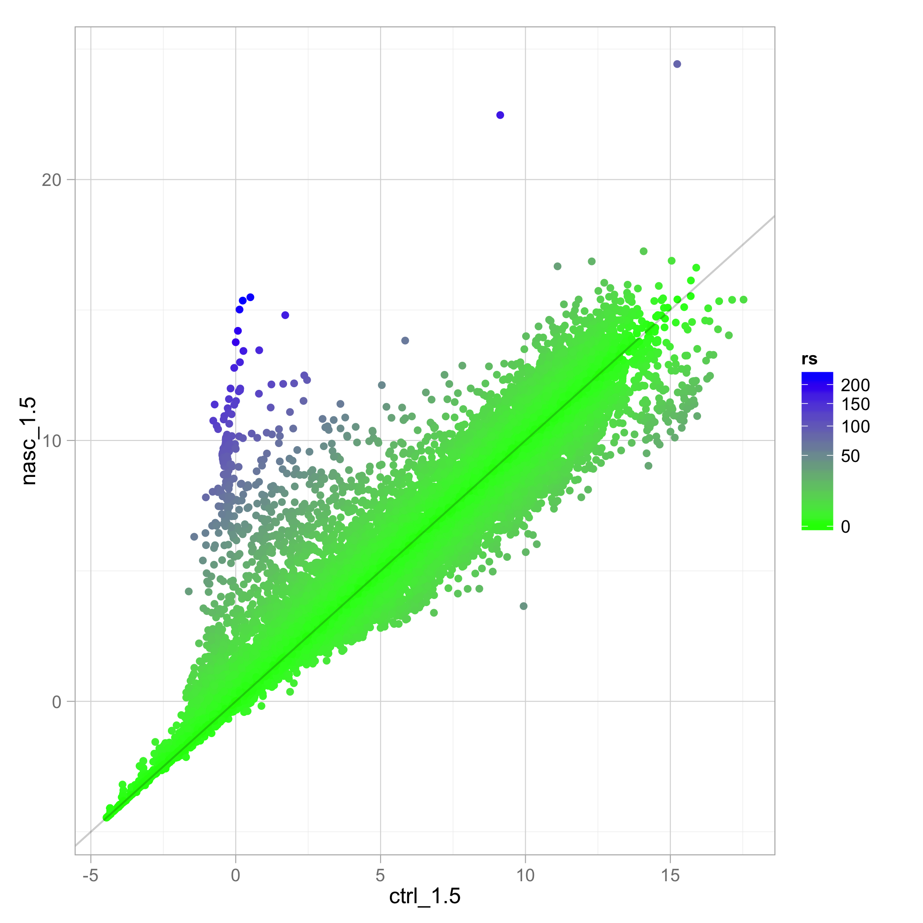
Expression Ratio
( Nascent:poly(A)+ )
Nascent RNA
Normalized Expression Level (FPKM)
poly(A)+ mRNA
Normalized Expression Level (FPKM)

Slide 6
A
B

Slide 7
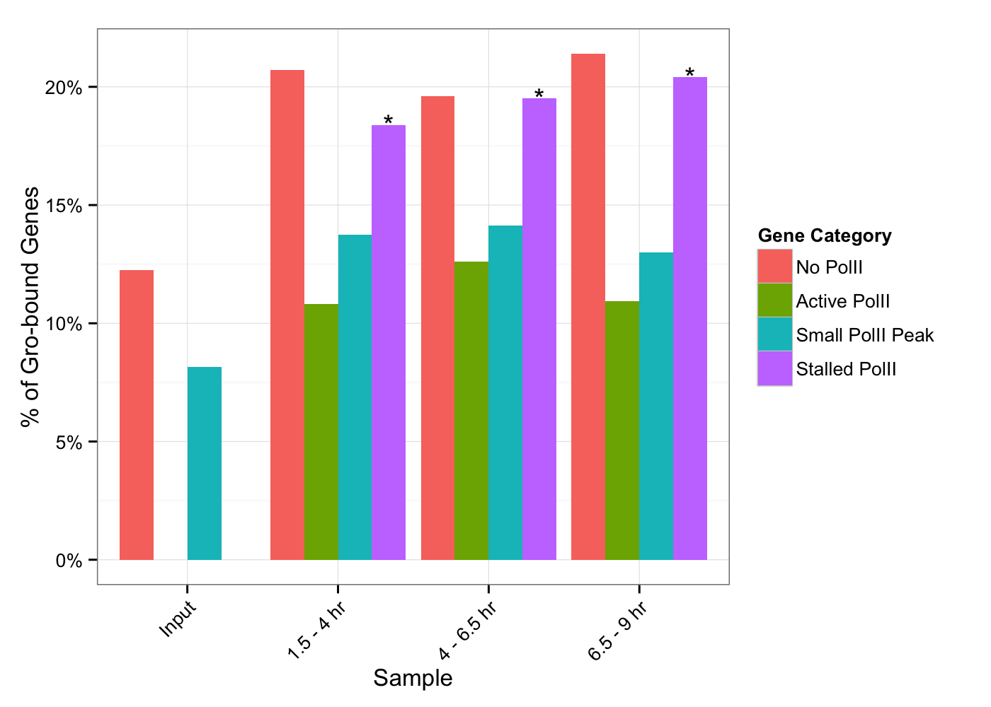
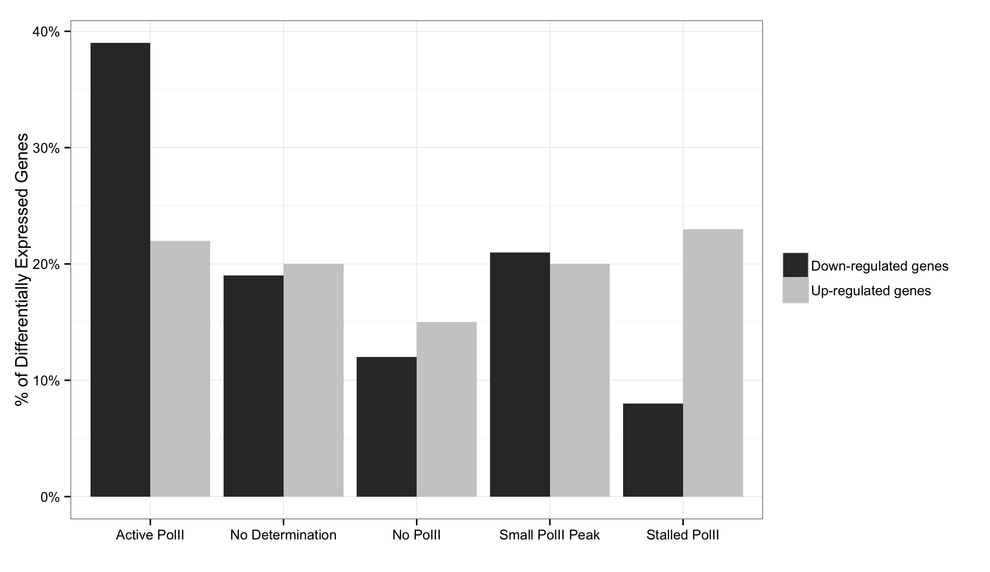
A
B
*
* p < 10⁻¹⁰
*
*
*

Slide 8
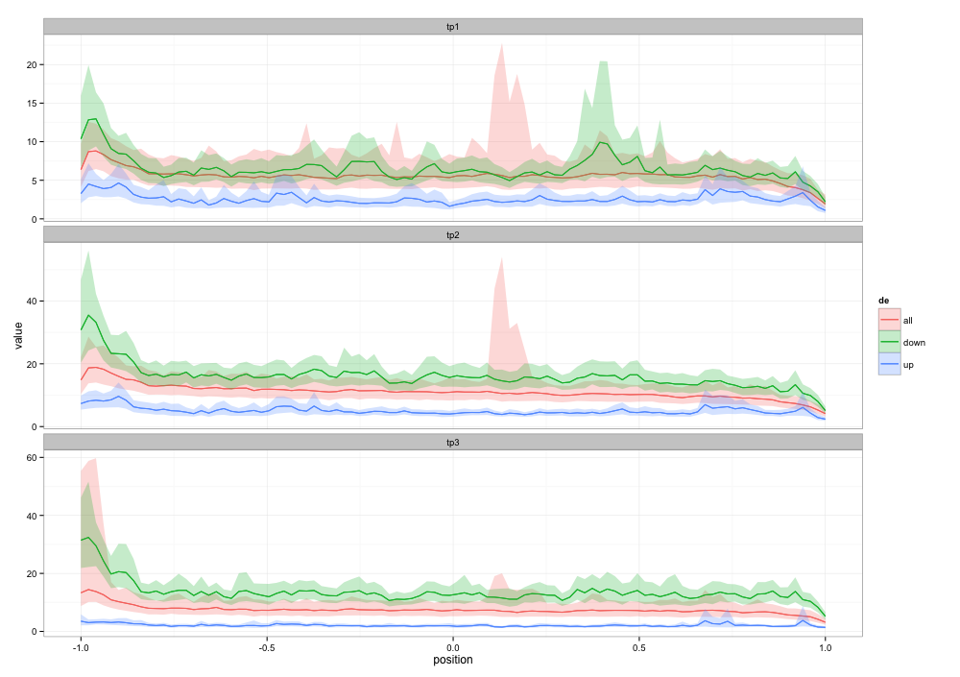
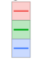
1.5 – 4 hr embryos
4 – 6.5 hr embryos
Normalized read density
6.5 – 9 hr embryos
Metagenomic position (5’ to 3’)
5’
3’
Response to Gro
overexpression
No change
Decreased expression
Increased expression

