Slide 1
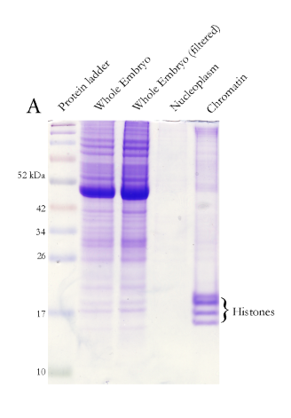
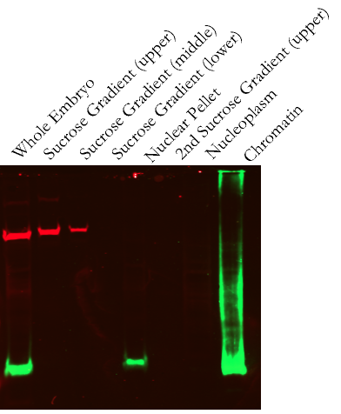
A
B
α-tubulin
α-H3

Slide 3
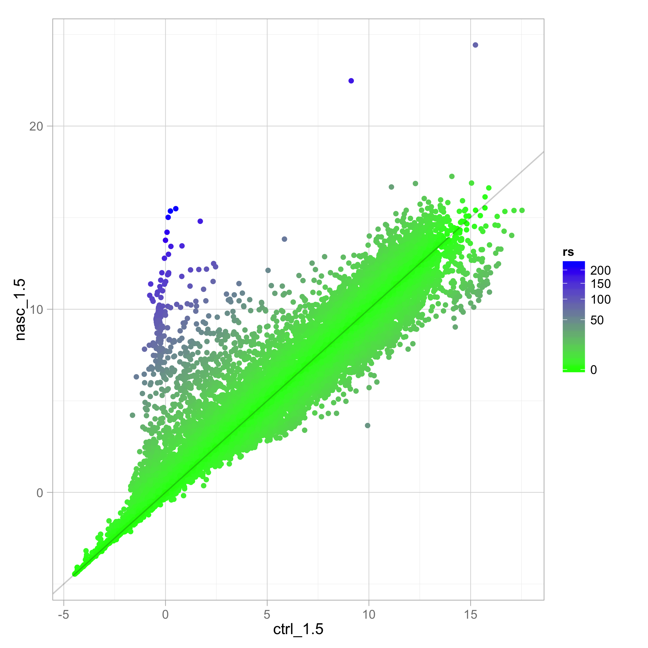
Expression Ratio
( Nascent:poly(A)+ )
Nascent RNA
Normalized Expression Level (FPKM)
Poly(A)+ mRNA
Normalized Expression Level (FPKM)

Slide 4
