Slide 1
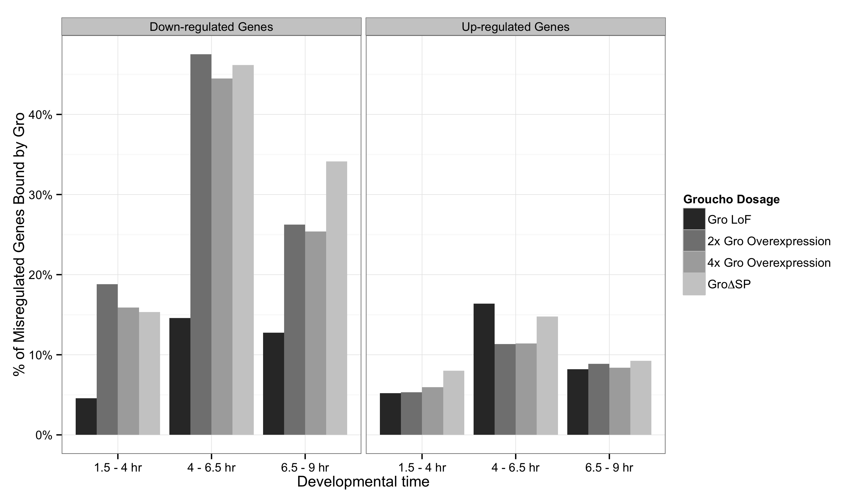
Groucho primarily functions as a repressor during development
Notes:
Genes down-regulated by Gro overexpression are significantly enriched for Groucho binding. A smaller percentage of genes up-reuglated upon Gro overexpression are also bound by Groucho. These may represent Groucho activated genes. However, while Gro-bound repressed genes are enriched for several GO groups relating to development and gene regulation, Gro-bound activated genes are not enriched for any GO groups, leading us to the conclusion that these represent more diverse secondary targets.

Slide 2
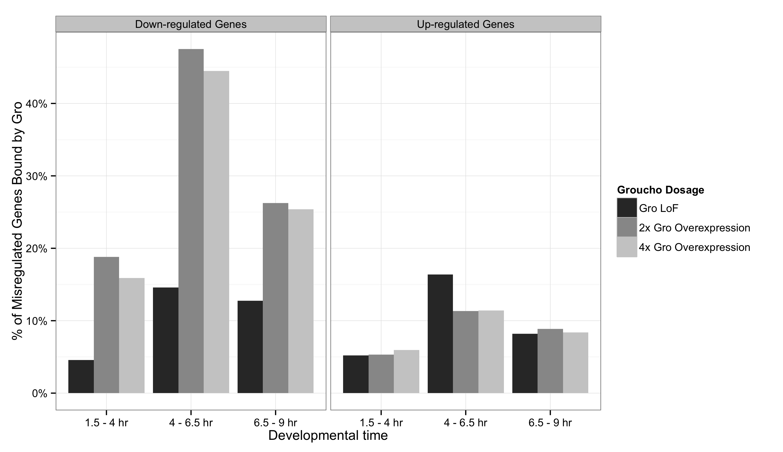
Groucho primarily functions as a repressor during development

Slide 3
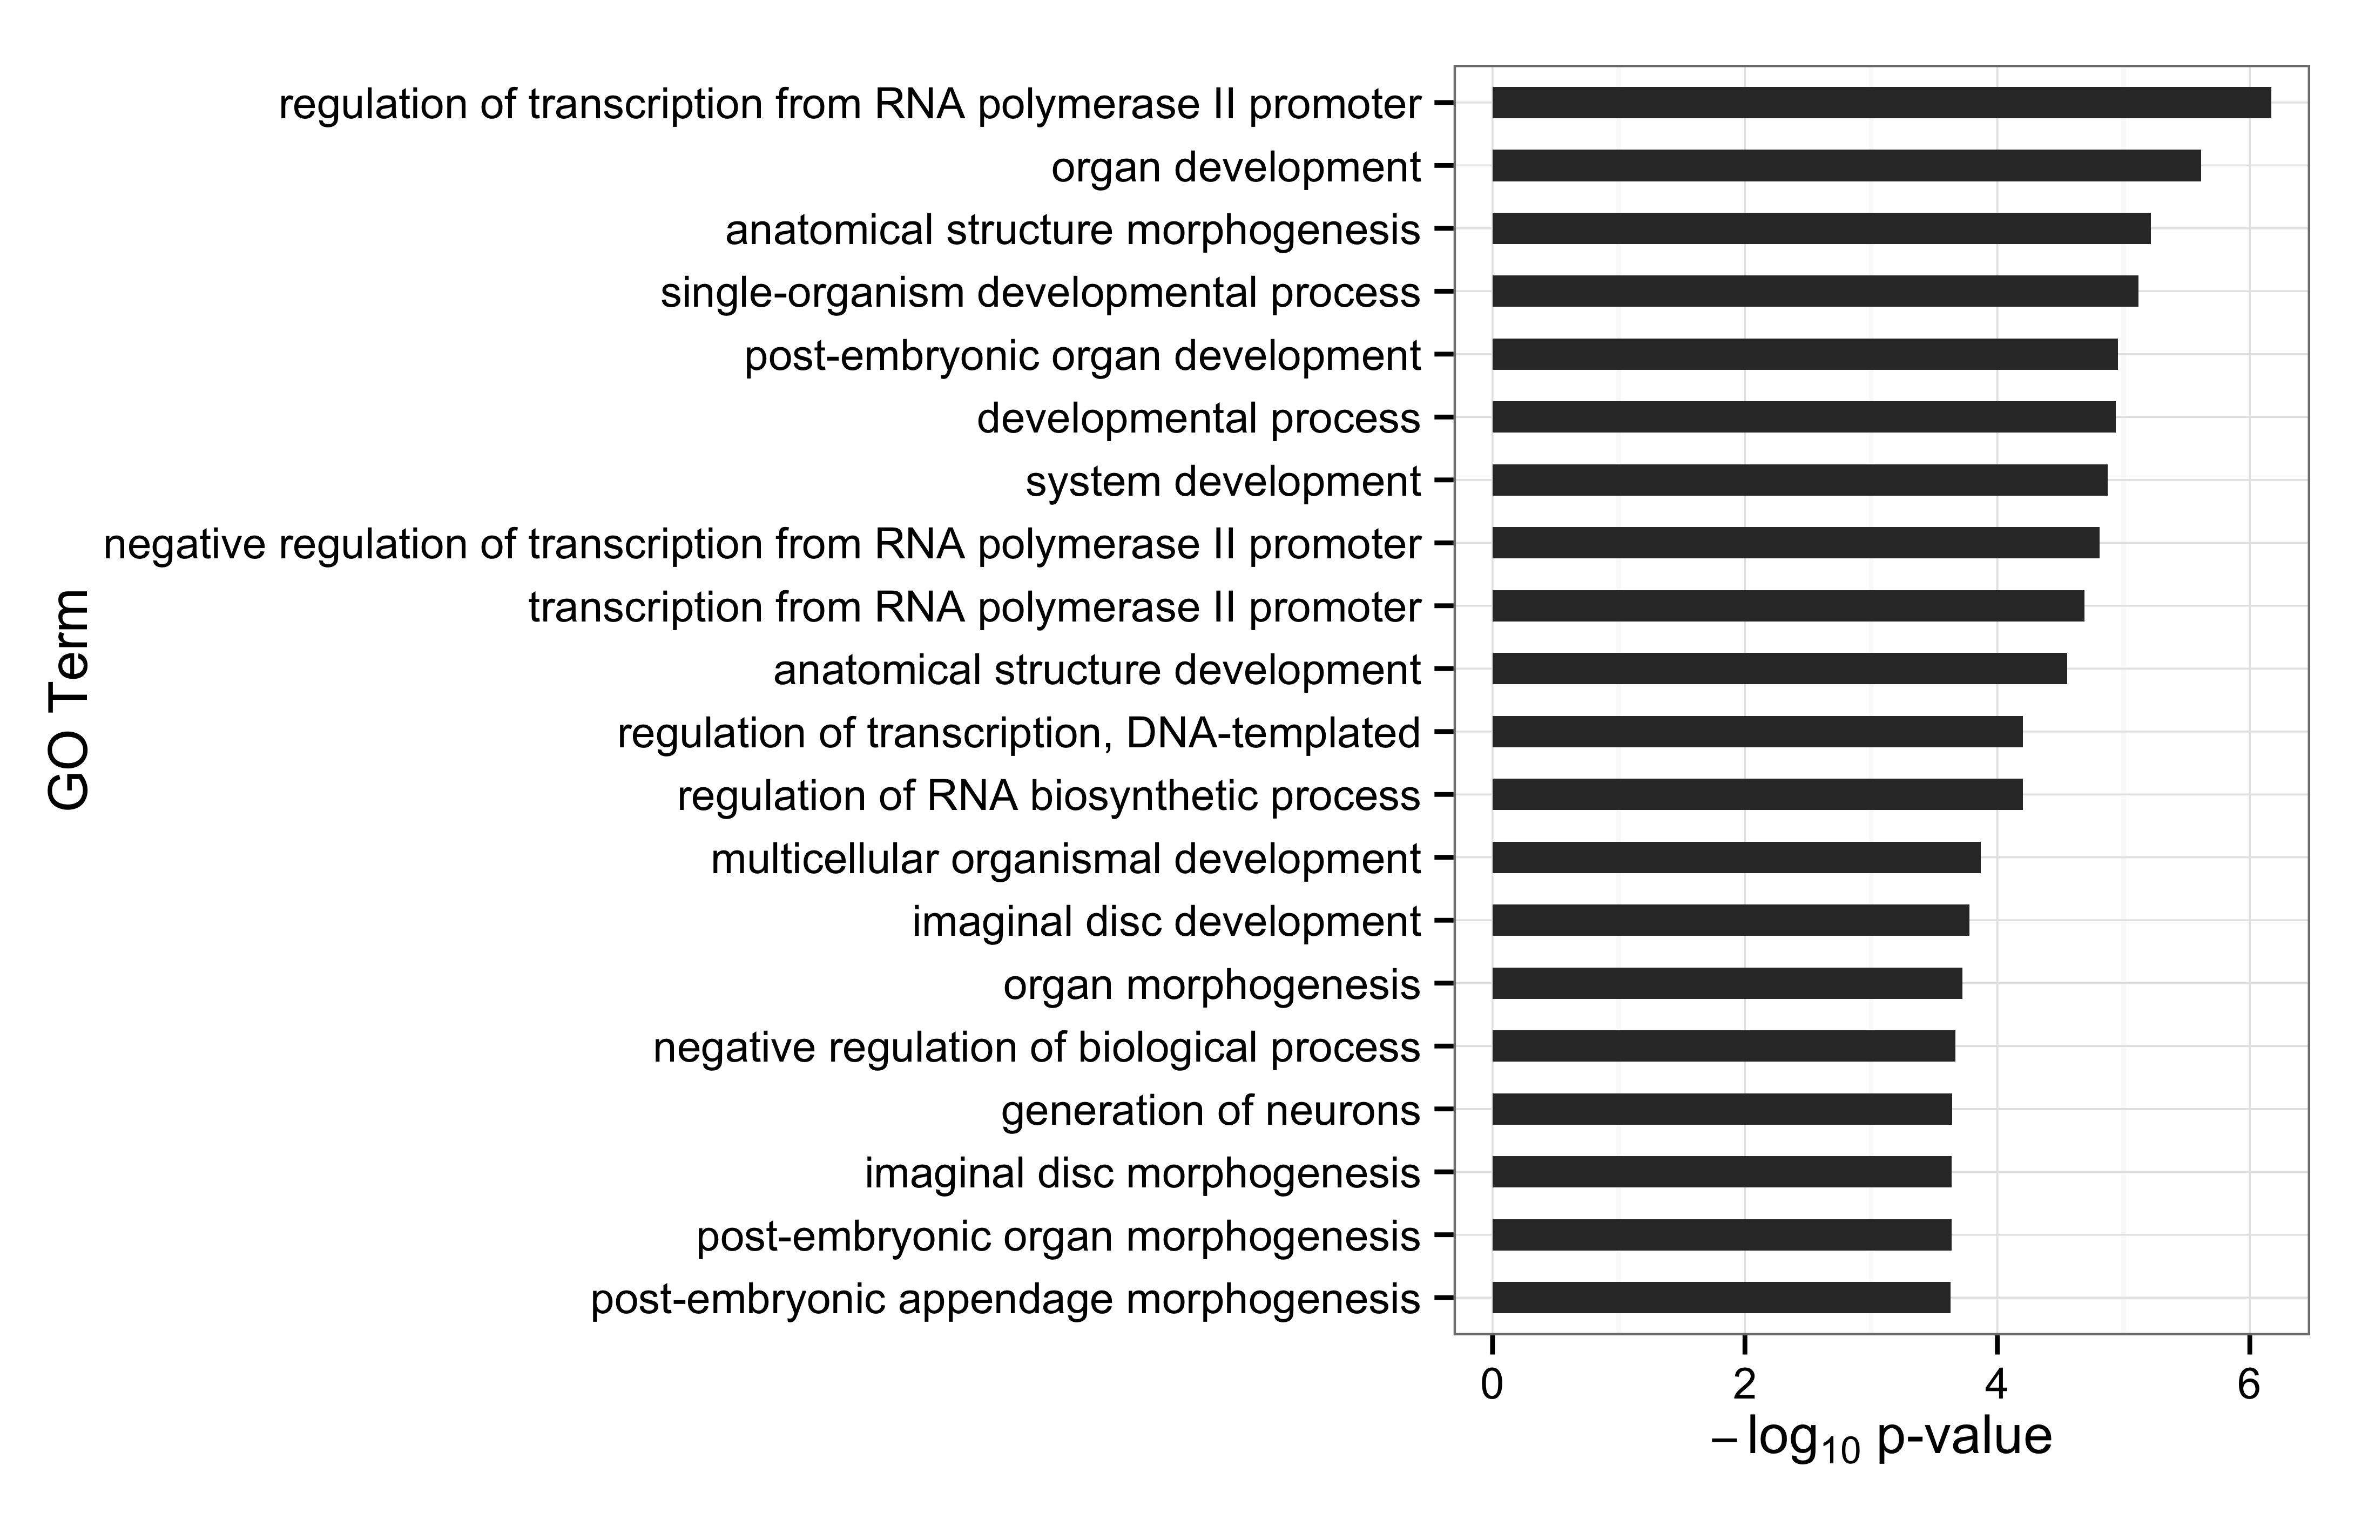
Genes bound and repressed by Gro are enriched for multiple gene ontologies

