Slide 1
EC504 Project: Tweet key word searching
Mingdao Che, Zhibin Huang, Ziyu Zhao
2019/12/9

Slide 2
Introduction
With given tweets as database and a sentence (string) as input query, we want to get the most relevant tweet in our database
Just like tweet searching engine of google search engine
Here, put a picture of our GUI

Slide 3

Data Structure
Tweets in database:
List of strings
Searching results:
Hash map
{t1: 2, t2: 1, t3: 6, … }
Query: string
“Hello word”
Hash map:
{hello:1,word:1}

Slide 4
Algorithm
For each query, assume it contains k key words, time for constructing a hash map will be
For i-th tweet, assume it contains words , time for calculating the number of key word in this tweet will be
Constructing the dictionary which maps tweets to number of keywords will be
Finally, sort the dictionary by its value using built-in function, should be

Slide 5
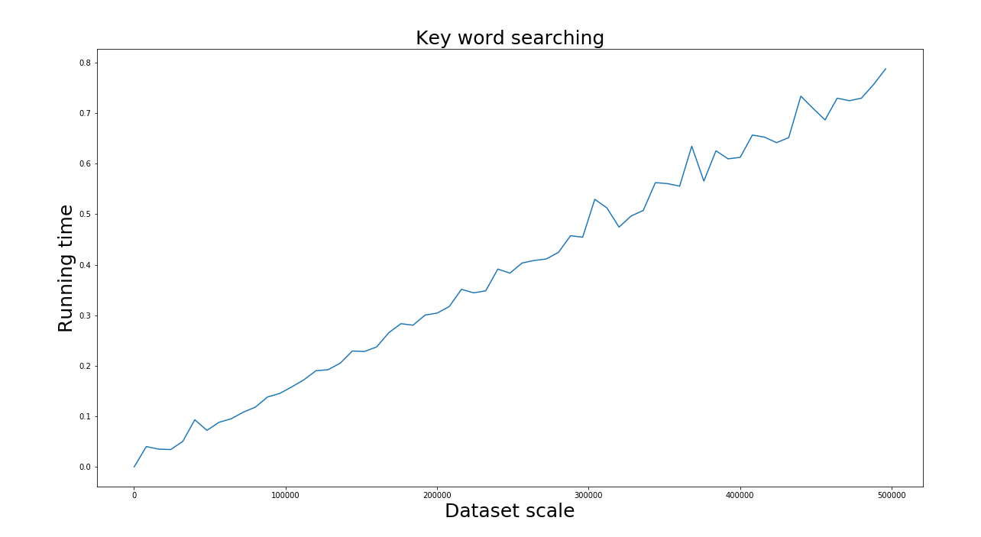
Time Complexity

Slide 6
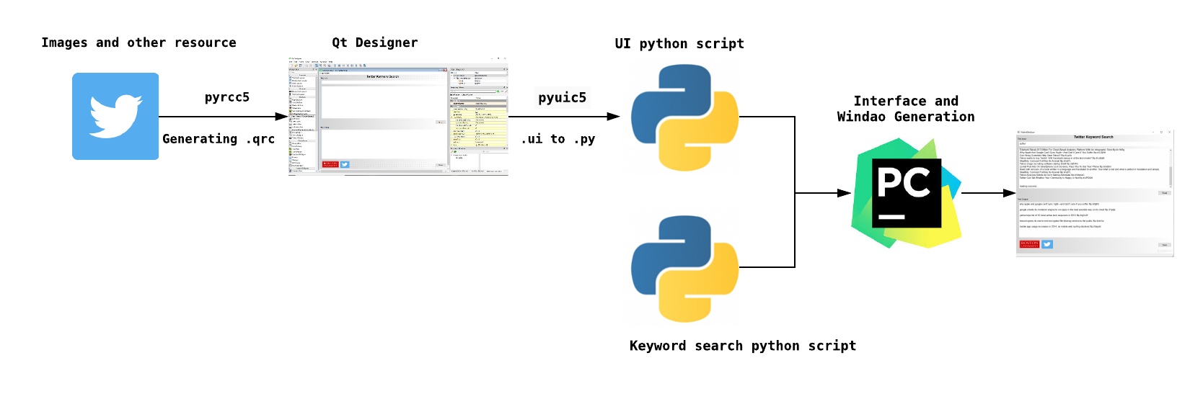
GUI Design
PyQt5
Technic Selection: Qt Designer + PyQt5 + Pycharm
The design diagram is as follows:

Slide 7
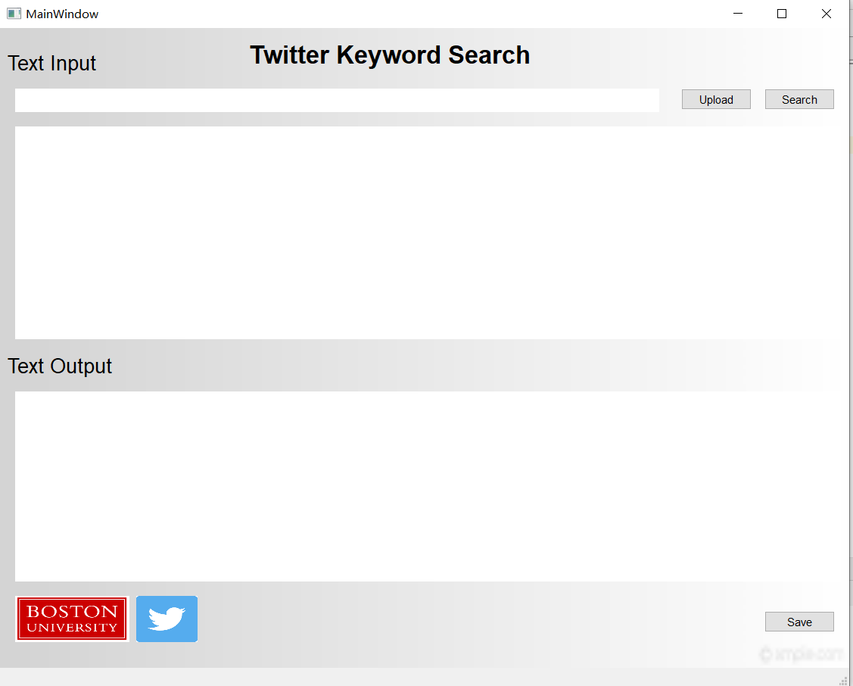
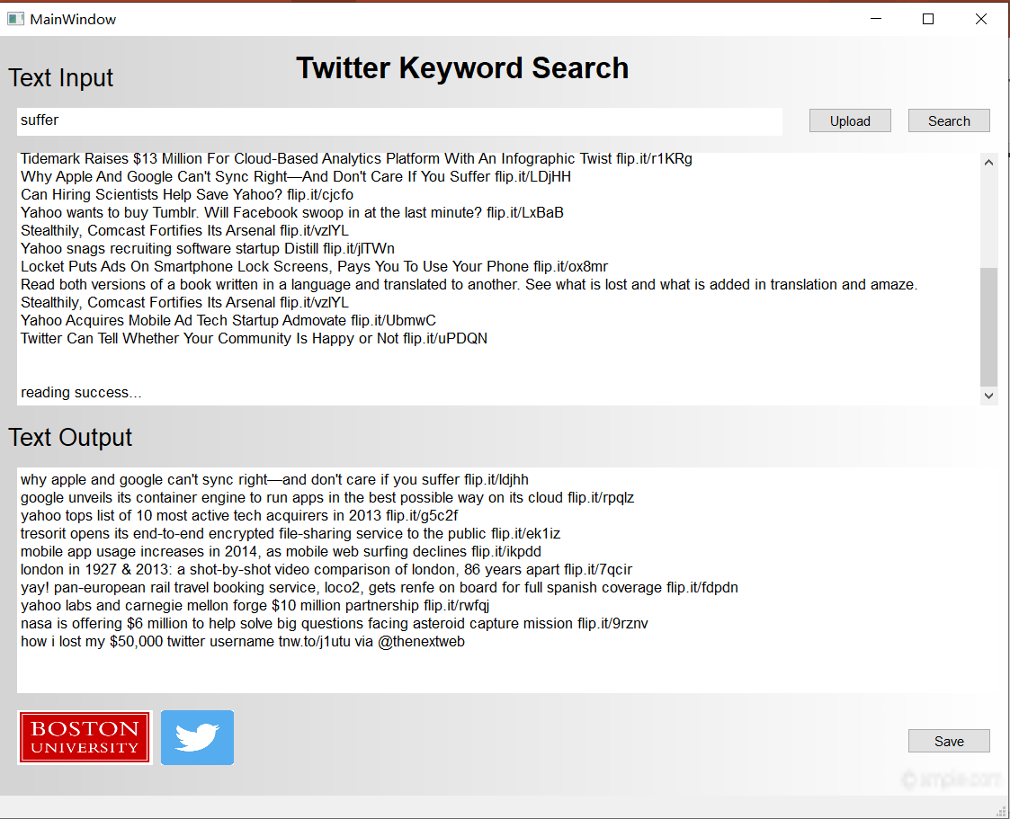
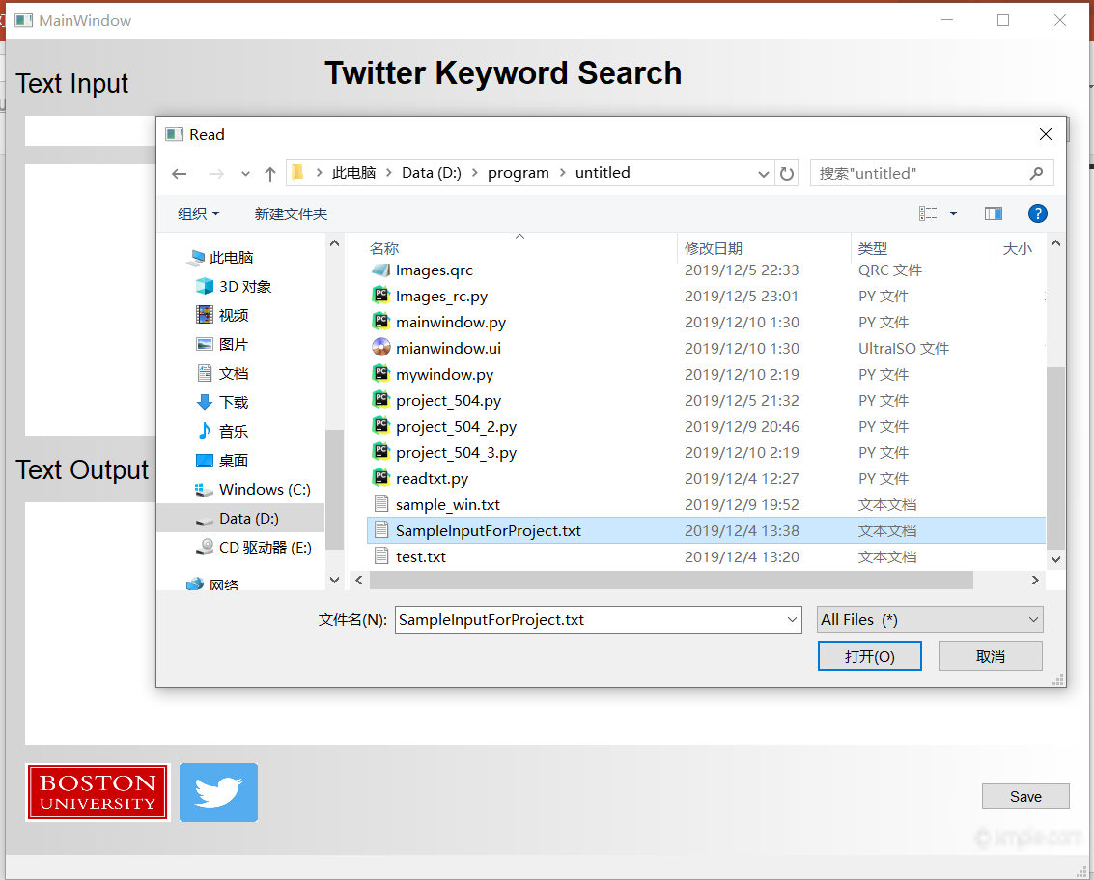
GUI Design
PyQt5
Demo:

Slide 8
Reference
The info at the top of the slide can be changed
Go to the View menu and choose Header and Footer
Then change the date and footer text
You can also enable or disable automatic slide numbering in the Header and Footer

