Slide 1

WIFI Details:

Slide 2
Login Details
Link: https://rdp.devopsplayground.com/#/
Username: Password:

Slide 4
Hands on with Cypress
(Digital Women in Tech DevOps Playground)
Marie Cruz
Notes:
So, the playground session for tonight will be about a new testing tool called Cypress. In this session, we’ll look at what Cypress is and how it differs from existing testing tools. We’ll walk you through how to setup cypress and write your first ever test.
By the end of this session, I hope that each and one of you will have a fairly good understanding as to what Cypress is about.

Slide 5
DevOps Playground
Inspiring tech-enthusiasts to explore new technology during hands-on monthly events.
Notes:
Before we start, I wanted to give an overview as to what DevOps playground is about to new joiners.
To provide a community with practical hands on examples using some of the latest DevOps and QA tools
To collaborate in an environment where we bring our ideas to life and learn how these technologies work

Slide 6
Digital Women in Tech
To support women who are interested in technology and socialise with other people with similar interests.
Notes:
Why Digital Women in Tech?
As part of our new initiative here at ECS Digital to address the gender gap in the tech industry, we are introducing this women in tech meetup to support women who are interested in technology.
Keep in mind though that although this meetup is targeted more to support women, everyone is still welcome to attend if they find that the topic to be presented is interesting.

Slide 7


About me
QA and Continuous Delivery Consultant at ECS Digital
Test Architect for The Sun (News UK client)
Full time mum
Let’s connect! Marie Cruz

Slide 8

About ECS Digital
Digital Practice of ECS Group (DevOps and QA)
Digital transformation consultancy and provide DevOps and Agile testing solutions to customers
Customers from startups to global enterprises in all sectors including Banking, Telecoms, Media, Oil and Gas
Teams based in London, Edinburgh, Singapore and Pune
Notes:
Just a quick overview as to who we are and what we do.
ECS Digital is the digital practice of ECS Group.
ECS Group is the 2nd Largest Independent IT Service Provider in UK. It’s a very Technical / progressive consultancy with more than 1000 engineers.
At ECS Digital, we mainly provide DevOps and Agile testing solutions to customers.
Some of our customers include small startups to global enterprises in the Banking sector, Telecoms, Media, Oil and Gas
Our team is based across London, Edinburgh, Singapore and Pune in India

Slide 9
Agenda
What is Testing and what is Cypress?
How is Cypress different?
Playground Overview
Hands on session
Q and A
Networking and more food

Slide 10
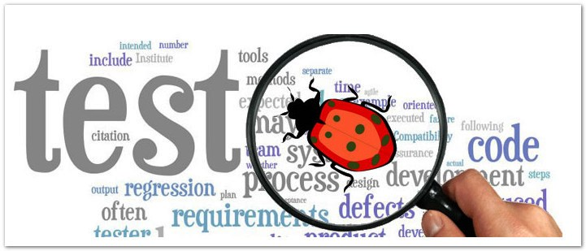
What is Testing?
Process of finding and eliminating bugs on your application
Notes:
Ask audience what they think testing is about
Why testing is important
Testing is the process of finding and eliminating bugs on your application
Ensure that the application does what it is supposed to do
Having automated tests can speed up the release of new features and ensures that existing functionalities are still working as expected

Slide 11

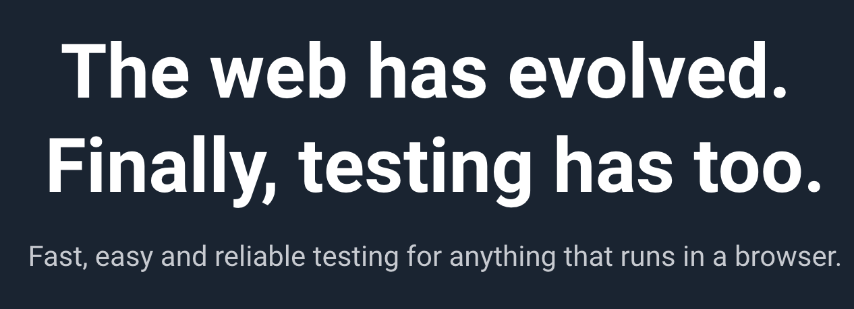
Tool which simulates browser actions like a real user
Provides an easy way for Developers and QAs to write tests
Testing tool written in JavaScript
Great alternative to Selenium
Notes:
- Cypress is a test automation tool, created by Brian Mann to help developers write automation tests from a user’s perspective
Any actions that users can do can be simulated such as clicking a button, typing values on forms, selecting checkboxes
Written purely in JavaScript
Often compared to Selenium but it’s actually different from Selenium. I’ll explain on the later slide as to how it’s different from Selenium.
More and more companies are introducing Cypress in their development workflow. As of now, there are more than 240,000 weekly downloads

Slide 12
Cypress Overview
Easy to set up - `npm i -D cypress`
Boilerplate created when you install cypress
Includes a UI test runner (open source) and a dashboard service (paid) to access recorded tests
Automatic waits on elements
Not just a tool for E2E tests but can also be used for unit and integration testing
Debugging made easy – access to dev tools and obvious error messages (no more long stack trace errors)
Notes:
Unit testing – there is a plugin `cypress-react-unit-test` which contains helper methods to write unit tests for your React components
Integration testing – cypress has a built in .request() method which can trigger api calls

Slide 13
Cypress Overview
Each test step allows you to revisit the state of your application (time travel)
Force click events
Easily write custom commands and assertions
Only supports Chrome at the moment (Including Canary, Chromium and Electron)
Doesn’t support xPath selectors
Notes:
Force click event – if your app has a CSS animation which requires you to hover on an element before clicking, Cypress can allow you to force click the element instead

Slide 14
How is Cypress different?
Isn’t it just any other testing tool like Selenium? (Frameworks built on top of Selenium already exists. We don’t need a new one! (e.g. WebdriverIO, Nightwatch, Protractor)
Cypress is not like Selenium.

Slide 15
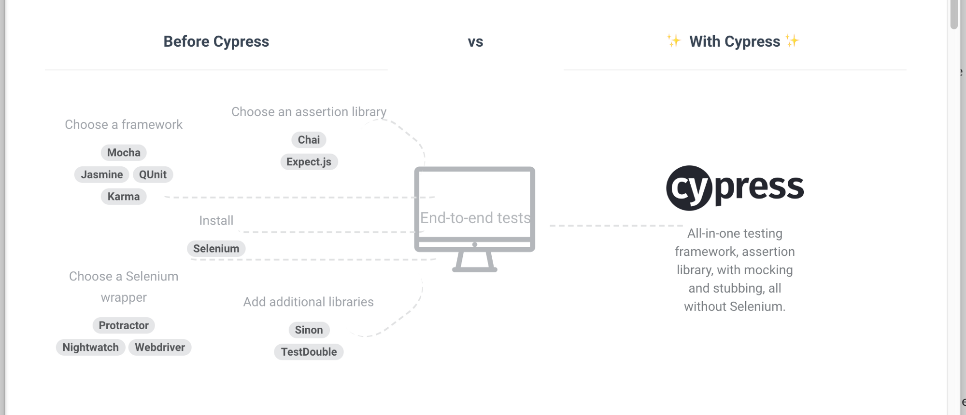
How is Cypress different?
Credit: https://codeburst.io/late-to-the-party-end-to-end-testing-part-4-7325f7203270
Notes:
Cypress is bundled with all other types of packages useful for testing.
Before Cypress, you ideally need to install other packages such as mocha, chai, selenium, wdio.
With cypress, everything that you need to start off writing automated tests is already bundled.

Slide 16
How is Cypress different?
Selenium | Cypress
Supports cross browser testing | Only supports Chrome (but slowly supporting cross browser soon)
Supports different programming languages (C#, Java, JavaScript, Ruby, Python) | Only supports Javascript
Install a Selenium wrapper framework (e.g WebdriverIO) Setup a selenium server Download and unpack ChromeDriver | Easy to set up - `npm i -D cypress`
Sends remote commands outside the browser | Runs directly on the browser
Requires a test runner, assertion library | Everything is included

Slide 17
Playground Overview
Setting up the sample project
Running our image gallery application
Cypress Test Runner
Writing our tests
Writing custom commands
Cypress CLI commands

Slide 18
Playground Recap
Explained what Cypress is and why Testing is important
Comparisons between Cypress and Selenium
Explored the Cypress Test Runner
Wrote our first Cypress test
Custom Cypress command
Example Cypress CLI commands

Slide 19

Thank you
Any questions? Stay for a chat!

