Slide 1

HR Dashboard Project
A Business Analysis Using Power BI

Slide 2

Introduction
The HR Dashboard developed in Power BI provides key insights into employee demographics, attrition trends, and job role analysis. It empowers data-driven decision-making for better workforce management.

Slide 3
Objectives
- Analyze attrition trends and factors.
- Identify patterns in employee demographics and compensation.
- Provide actionable insights for workforce planning.

Slide 4
Project- key points
• Data collection
• Data cleaning & wrangling
• Data modeling
• Data visualization
• Dashboard design
• Sharing Insights

Slide 5
Summary Metrics
- Total Employees: 1416
- Attrition Count: 229
- Attrition Rate: 16.2%
- Average Age: 37 years
- Average Salary: $6.5K
- Average Tenure: 7.0 years

Slide 6
Key Visuals and Insights
1. Highest attrition occurs in the 26-35 age group.
2. Life Sciences degree holders have the highest attrition.
3. Most attrition occurs in the $5K and below salary range.
4. Laboratory Technicians and Sales Executives face significant attrition.
5. Research & Development department experiences high attrition rates.

Slide 7
Recommendations
- Offer competitive compensation to younger employees.
- Develop skill training programs for high-attrition roles.
- Regularly monitor dashboard metrics for emerging trends.

Slide 8
Entities and Relationships
Data Sources
Represents the raw data tables or external data sources (e.g., SQL databases, Excel files, etc.).
Attributes: Source Name, Source Type, Connection Details, Update Frequency.
Data Transformation (ETL)
Represents transformations applied during data preprocessing in Power Query.
Attributes: Transformation Steps, Filters, Merged Columns.
Fact Table
Central table in the data model containing measures (numerical data to be analyzed).
Attributes: Measure IDs, Metrics (e.g., Sales, Profit), Date Keys, Category Keys.

Slide 9
Dimension Tables
Represent descriptive attributes or categorical data used for slicing and dicing.
Attributes:
Time Dimension: Date, Month, Year, Quarter.
Customer Dimension: Customer ID, Name, Segment, Region.
Product Dimension: Product ID, Category, Subcategory.
Visualization
Represents charts, dashboards, and reports built using Power BI.
Attributes: Chart Type, Filters Applied, Linked Measures and Dimensions.
Relationships
Define how data tables are related (e.g., one-to-many, many-to-one).
Relationship Types:
Fact-to-Dimension (e.g., Orders linked to Products via Product ID).
Dimension-to-Dimension (e.g., Customers linked to Geography).

Slide 10
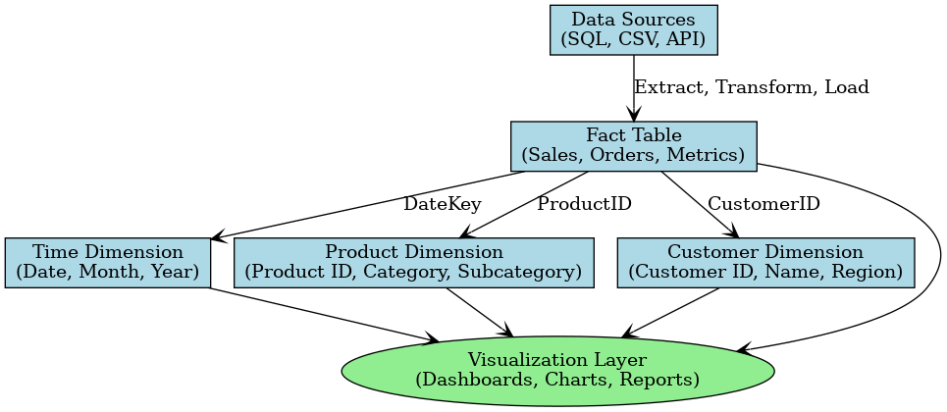
ER Diagram

Slide 11
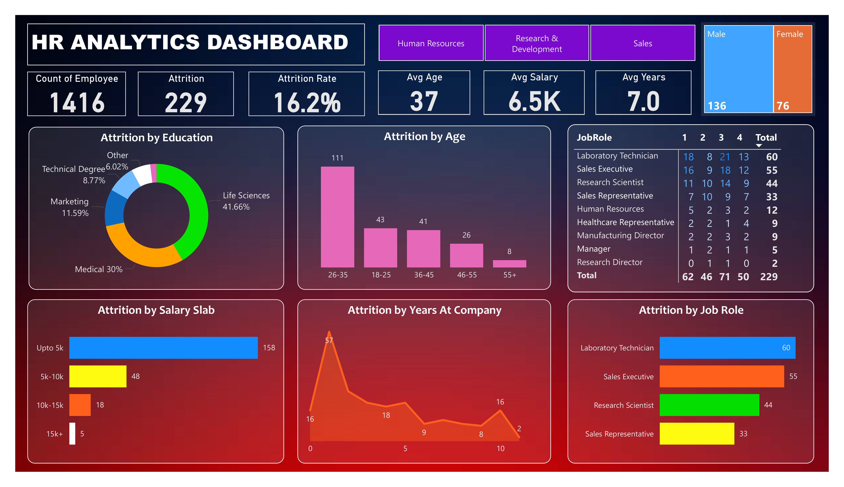
Dashboard Preview

