Slide 1
Novabank web api cloud modernization proof of concept

Slide 2
Context and requirements
Novabank wants to evaluate public cloud.
They have asked CloudNation to develop a proof of concept to migrate and modernize a Web API
Requirements
  Financial Services: regulated, EU data residency requirement applies
  Explicit availability target: 99.90%
  Disaster Recovery targets: RPO 1 hr, RTO 4 hrs
  Auditability: store and retain logs centrally for a defined term, control and restrict access

Slide 3
Current state assessment
Web API hosted in on-premise data center
Single VM
PostgreSQL database – assumed on a single VM
Single environment – no separate dev/test
No stated, evaluated availability target
Logs kept locally

Slide 4
Target architecture (1)
Cloud platform – Azure
  Driven by skills available in the project team
  Deployment to Azure meets stated requirements
  Other cloud platforms may be evaluated later
  Prefer Platform Services (PaaS) over Infrastructure (IaaS)
  Azure App Service and PostgreSQL Flexible Server
  Reduce operational overhead, improve security posture, built-in high availability features
  PostgreSQL server is VNET injected, it has no public endpoint
  Web App connects to database privately through VNET Integration

Slide 5
Target architecture (2)
  Primary – Disaster Recovery
  Primary: West Europe, DR: North Europe
  DR is only deployed when Primary fails – no running costs when not needed
  PostgreSQL database configured for Geo Redundant backup
    Data is copied asynchronously to North Europe, restored in DR
    Database is restored in North Europe from copy when needed
  Logging
  Logs sent to LogAnalytics Workspaces for each environment
  Retention set to 2 years
  Access to log content restricted to members of specific Entra Security Group with

Slide 6
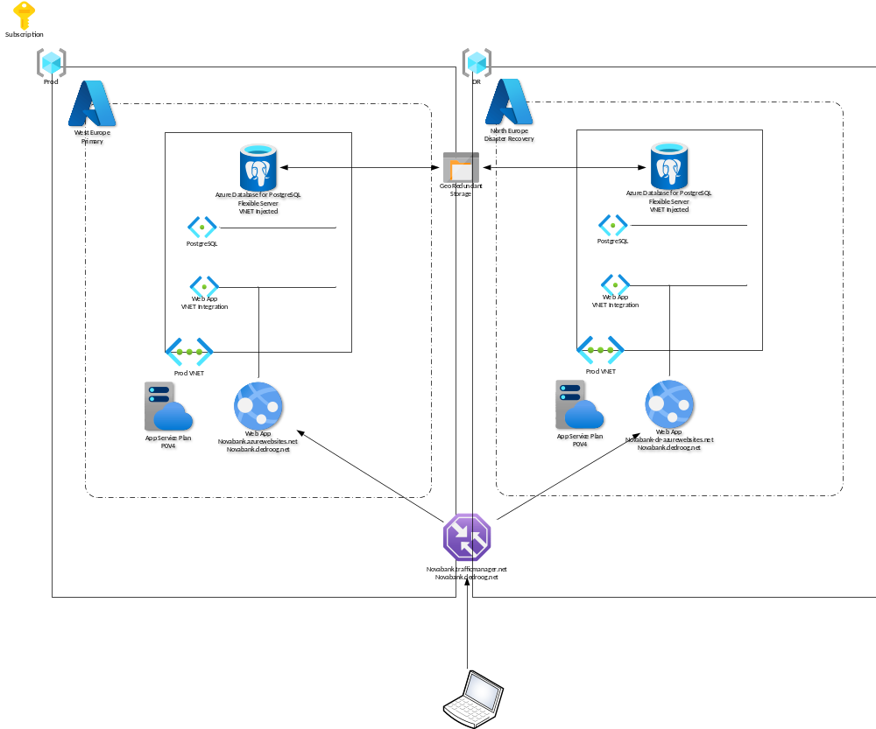

Slide 7
development
Infrastructure as Code
  Bicep – leveraging Azure Verified Modules where possible
  Single code base, parameterized for primary, dr and dev deployments
    deploymentMode = primary | dr
    environmentMode = prod | dev
  No secrets in code or parameter files, password passed in from environment variable
  No DNS reconfiguration in disaster situation
  Single, constant FQDN: Traffic Manager automatically routes traffic to live Web App
  Primary – Disaster Recovery
  In disaster, just redeploy main.bicep with deploymentMode set to dr, no other actions needed
  Database is automatically restored from copy
  Development environment
  Separate deployment
  Uses lower grade, cheaper component SKUs

Slide 8
Practical AI
  AI-assisted engineering
All Bicep code was developed in Visual Studio Code with GitHub Copilot
Copilot accelerated code generation, refactoring, troubleshooting, and documentation
Generated code remained subject to human review, Bicep validation, deployment testing, and architectural judgement
  AI-assisted operations – options
IaC review agent: Review pull requests for security, resilience, logging, tagging, and configuration gaps
Operations agent: Correlate Azure Monitor and Log Analytics data and summarize incidents
Cost agent: Identify underused capacity and recommend rightsizing, especially for development
DR assistant: Guide operators through the recovery runbook and verify completion of each step
Knowledge agent: Answer operational questions using approved architecture documentation and runbooks
AI supports engineers and operators, but production changes remain governed, auditable, and human-approved.

Slide 9
Demo deployment
Web API application
  API component from YADA demo app microsoft/YADA: Yet Another Demo App
  Container image deployed to Web App by IaC, environment variables set appropriately
  To avoid certificate complexities, the demo environment uses non-TLS secured (http://) connections
  (this will be changed for production)
  API exposes endpoints to:
    Query database for version
    Return client source IP
    Write client access events with source IP and timestamp to a table
  Database
  Empty / default PostgreSQL deployment, no data loaded

Slide 10
test
  Database version
  http://novabank.dedroog.net/api/sqlversion
{
"sql_output": "PostgreSQL 16.15 on x86_64-pc-linux-gnu, compiled by gcc (GCC) 13.2.0, 64-bit"
}
Client IP
  http://novabank.dedroog.net/api/sqlsrcip
{
"sql_output": "10.0.2.254"
}
  Create table
  http://novabank.dedroog.net//api/sqlsrcipinit
{
"table_created": "srciplog"
}
Log access
  http://novabank.dedroog.net//api/sqlsrciplog
{
"srciplog": {
"ip": "10.0.2.254",
"timestamp": "2026-10-07 16:12:45.271077"
}
}

Slide 11
THANK YOU
Marc de Droog
+31 6 55 29 00 07
marcdedroog@quicknet.nl

