Slide 1
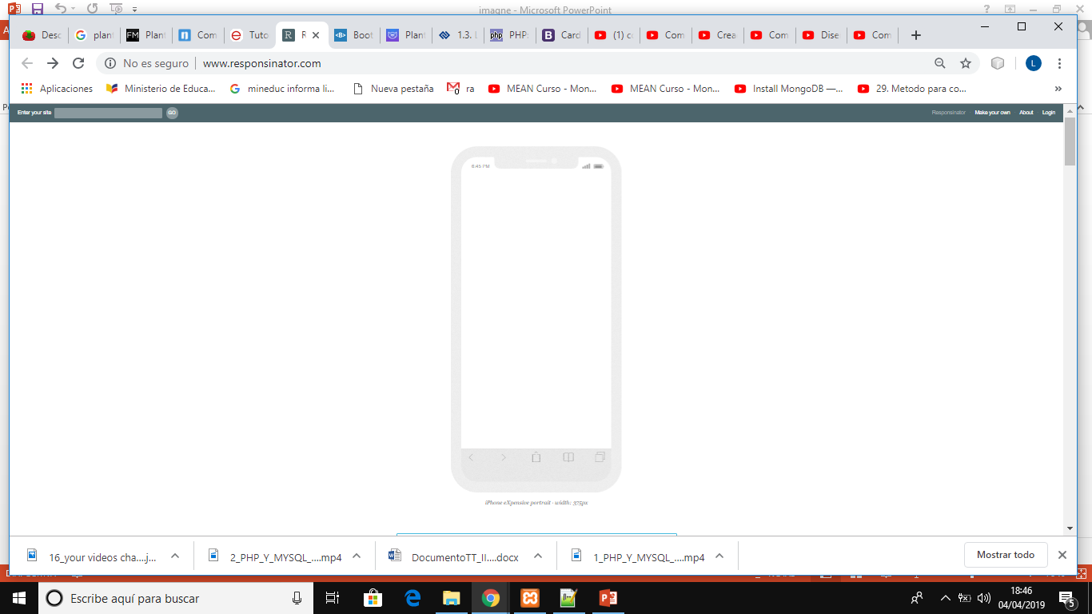
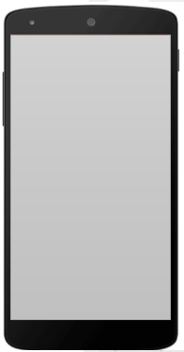
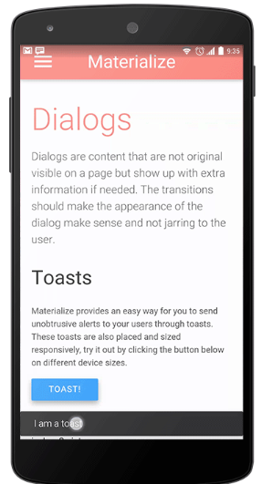

Slide 2
@media screen and (min-width:300px) and (max-width:800px) {
body{font-size:0.8em;}
sidebar{display:none;}
}
<link rel="stylesheet" media="screen" type="text/css" href="normal.css" />
<style type="text/css">
@media handheld
body{width:98%;font-family:Verdana;font-size:16px;}
</style>

Slide 3
@media screen and (min-width:300px) and (max-width:800px) {
body{font-size:0.8em;}
sidebar{display:none;}
}

Slide 4
https://norfipc.com/web/como-hacer-sitio-web-compatible-celulares-dispositivos-moviles.html

