Slide 1


FILE SHARING APPLICATION DEPLOYMENT ON AWS
ENGR-E516 Engineering Cloud Computing
By,
Mirva Dudhagara | Shubham Halvadia | Malhar Dhopate

Slide 2

Introduction & Scope
In today's tech-savvy age, ensuring the safety of file storage and transfer through cloud services remains a complex issue. Giants like Google and Microsoft have created numerous applications fortified with a range of security measures.
Our application is designed to securely upload files to Amazon S3 and provide a seamless method for users to share these files with their chosen recipients.
Goal: is to develop a File Share application that leverages the latest in data encryption standards. Our research delved into Amazon AWS offerings, including S3, Amplify, Lambda/IAM, and the axios API gateway.
We wanted to determine what kind of encryption protocol would be better for a user to, and depending on the user needs we wanted to determine if it is feasible to provide the users with the option to select the encryption method they wanted to share the data as well.
Notes:
In today's technological era, the escalating adoption of cloud-based technologies has introduced challenges in ensuring data security. Securing data storage and access, restricted solely to authorized users with appropriate credentials, has become imperative. Consequently, data encryption stands out as a persistent and paramount concern in cloud computing.

Slide 3


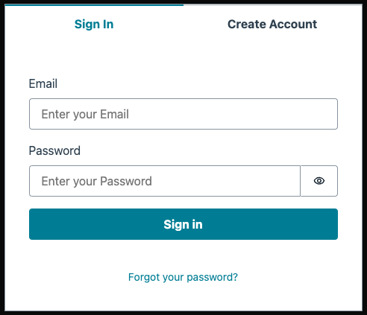
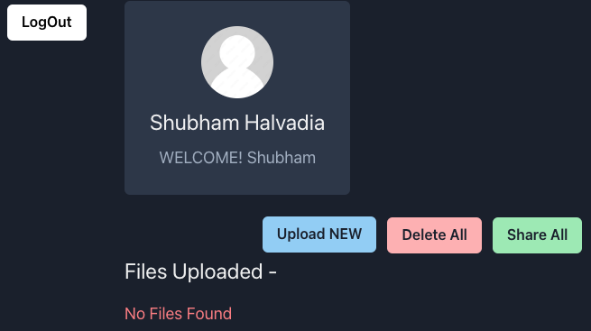


S3 bucket
App Design
Axios Api
Upload,
Delete,
Preview
User Dashboard
Login/SignUp Page
User
User Authentication through AWS Amplify
Share
Emailjs service

Slide 4
App Demo

Slide 5

Project Outcomes
Learning React Framework: We became somewhat proficient in React, allowing us to build responsive and interactive user interfaces. This included mastering components, state management, and lifecycle methods, which formed the foundation of our project's front end.
Utilizing AWS Services: Our experience with AWS services grew significantly, as we explored Amazon S3 for storage, Amplify for front-end development, and Lambda/IAM for serverless functions and permissions management. This exposure to AWS's robust cloud infrastructure provided us with a deeper understanding of scalable and secure cloud-based applications.
Credential Management on AWS: We gained valuable insights into creating and managing credentials on AWS. This involved learning how to use AWS Identity and Access Management (IAM) to establish roles, permissions, and policies, ensuring that our application had the necessary access while maintaining security best practices.
Connecting APIs to AWS: We learned how to integrate APIs with AWS services, particularly through the use of Amazon API Gateway and Axios. This enabled seamless communication between our front end and back end, allowing for efficient data exchange and robust connectivity.

Slide 6

Future App Development
Clean up the functionality
Integrate Encryption Methods while sharing files.
Add Additional Features to determine how many times a shared file has been accessed and set a limit
Provide options to the user to determine the way they want to share their files.
Develop the app to accept additional file data types.

Slide 7
Thank You

