Slide 1
Wedi Web data interpreter
Professor: Students:
Dr. Buraga Sabin Butnariu V. Vasile-Raducu
Deaconu C. Mihai
Sfirnaciuc D. Daniel-Ionut

Slide 2
Index
Introduction
Keywords
Functionality
Similarities
System Architecture
Implementation flow
Conclusion

Slide 3
Introduction
We noticed that many web pages started to include structured data into their HTML using markup standards such as RDFa, microdata and microformats.
Being aware with the fast changes on web data content for an user the need for a tool that provides a more human understandable representation of RDFa, microdata and microformats is imminent. With such a tool, the user can have in one place all the structured data.

Slide 4
Keywords
RDF
RDFa
microdata
microformats
browser extension

Slide 5
Functionality
Wedi is a cross browser extension that allows users to read metadata from web pages.
-Parse metadata (microdata, microformat and RDFa)
-Notification
-Visualiser

Slide 6
Similarities
Similar extension found on web browsers:
hNews Reader – is a Google Chrome extension for highlighting page conforming to the hNews microformat standard
Micorformats for Google Chrome – an extension that supports hCard, hCalendar, hReview
Talis Export – is a Firefox extension used for showing and exporting Microformats
Operator – is a Firefox extension that combine pieces of the informations on Web-Sites with applications in ways that are useful such as Flickr with Google Maps, Yahoo! Local with your address book

Slide 7
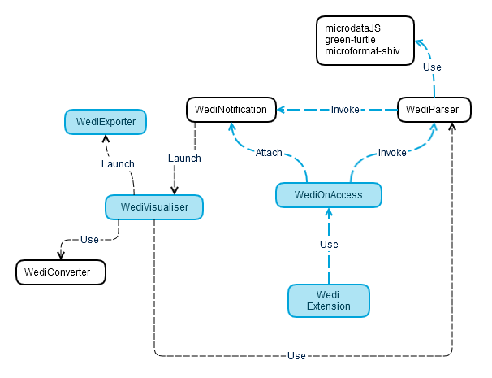
System Architecture

Slide 8
Libraries and frameworks
jQuery – javascript library
micodataJs – a jQuery plugin that provides and API for accessing Microdata inspired by the native DOM API
jsbeautify.js – Beautify JavaScript and HTML, make JSON/JSONP readable
microformat-shiv - a light-weight cross browser javascript microformats parser
To pack the extension for different browsers we will use :
Kango framework

Slide 9
REST API
Extract RDFa
GET /http://getschema.org/rdfaliteextractor
Content-Type: application/json
Parameters : {url : ‘www.google.ro’ , ‘out’: ‘json}
Response:
HTTP/1.1 200 OK
Content-Type: application/json; charset=utf-8
{ "_:gs0":
{ "http://www.w3.org/1999/02/22-rdf-syntax-ns#type": [
{ "type": "uri", "value": "http://schema.org/Review" }]
}

Slide 10
REST API
Convert RDFa to RDF/XML
POST /convert/{detect}/{pretty-xml}/{uri}
Parameters : {detect} – input , {pretty-xml} – output, {uri} - url
Response:
HTTP/1.1 200 OK
Content-Type: application/rdf+xml; charset=utf-8
<?xml version="1.0" encoding="utf-8"?>
<rdf:RDF xmlns:rdf=http://www.w3.org/1999/02/22-rdf-syntax-ns#
xmlns:rdfa="http://www.w3.org/ns/rdfa#" xmlns:schema="http://schema.org/">
<schema:Review rdf:nodeID="N81e6c286b22945d9a8e10c5c0812e166">
<schema:reviewRating>
</schema:reviewRating>
</schema:Review>
</rdf:RDF>
5/ 5stars

Slide 11
Implementation flow
Design
- Research
- Architecture
- Functionality
Implementation
- Use external libraries
- Use Kango Framework
- Implement components
- Implement UI
Test

Slide 12

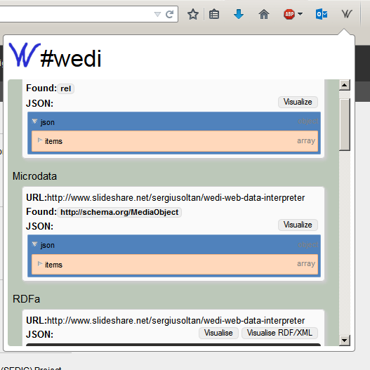
UI Design
Extension Icon
Viewer UI

Slide 13
Conclusion
Scope
Parse metadata (microdata, microformats and RDFa)
Cross-browser
Visualize parsed metadata
Future work
Validation
Save option (save as CSV or/and N-triples)

Slide 14
DEMO

Slide 15
Thank you!

