Slide 1
Math Feature Encodings
Sourajyoti Datta
Project – Collaborative Intelligence (DFKI)
Department of Computer Science
Technische Universität Kaiserslautern, Germany

Slide 2
Major encoding techniques
Numerical Mapping
Numerical Mapping and Fourier Transform
Chaos Game Representation
Entropy
Graphs
K-mer
Accumulated Nucleotide Frequency (ANF)
Open Reading Frame (ORF)
Fickett score
Pseudo K-tuple nucleotide composition
Xmer k-Spaced Ymer Composition Frequency (kGap)

Slide 3
Numerical Mapping
Binary
Encodes like one-hot encoding, except the dimension is flattened out as (A + C + T + G).
Dimensions: L*4 (L is the length of longest sequence). Zero Padding done at the end, if required.
E.g., AACTGT = [ 1,1,0,0,0,0, 0,0,1,0,0,0, 0,0,0,1,0,1, 0,0,0,0,1,0 ]
Real
Encodes each nucleotide to a fixed real value, keeping sequence intact.
Mapping: (A : -1.5, C : 0.5, G : -0.5, T : 1.5)
Dimensions: L (L is the length of longest sequence). Zero Padding done at the end, if required.
E.g., AACTGT = [ -1.5, -1.5, 0.5, 1.5, -0.5, 1.5 ]
Integer
Encodes each nucleotide to a fixed integer value, keeping sequence intact.
Mapping: (A : 2, C : 1, G : 3, T : 0)
Dimensions: L (L is the length of longest sequence). Zero Padding done at the end, if required.
E.g., AACTGT = [ 2, 2, 1, 0, 3, 0 ]

Slide 4
Numerical Mapping
Electron-Ion Interaction Pseudopotential (EIIP)
Encodes each nucleotide to a fixed real value, keeping sequence intact.
Mapping: (A : 0.1260, C : 0.1340, G : 0.0806, T : 0.1335)
Dimensions: L (L is the length of longest sequence). Zero Padding done at the end, if required.
E.g., AACTGT = [ 0.1260, 0.1260, 0.1340, 0.1335, 0.0806, 0.1335 ]
Atomic Number
Encodes each nucleotide to a fixed integer value, keeping sequence intact.
Mapping: (A : 70, C : 58, G : 78, T : 66)
Dimensions: L (L is the length of longest sequence). Zero Padding done at the end, if required.
E.g., AACTGT = [ 70, 70, 58, 66, 78, 66 ]
Complex Number
Encodes each nucleotide to a fixed complex value, keeping sequence intact.
Mapping: (A : (1+1j), C : (-1+1j), G : (-1-1j), T : (1-1j))
Dimensions: L (L is the length of longest sequence). Zero Padding done at the end, if required.
E.g., AACTGT = [ (1+1j), (1+1j), (-1+1j), (1-1j), (-1-1j), (1-1j) ]

Slide 5
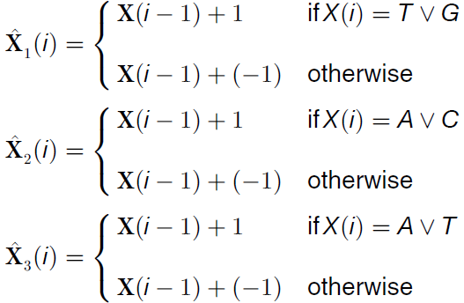
Numerical Mapping
Z-curve
Encodes each mol nucleotide ecule to three dimensions, and then flattened out.
Mapping:
Dimensions: L*3 (L is the length of longest sequence). Zero Padding done at the end, if required.
E.g., AACTGT = [ 1,2,1,0,1,0 1,2,3,2,1,0, 1,2,1,2,1,2 ]

Slide 6
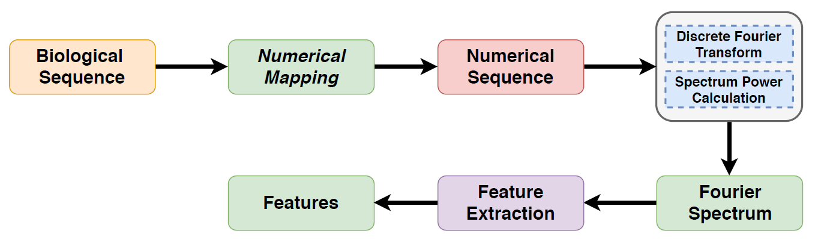
Numerical Mapping - Fourier Transform
First, all the numerical mappings are generated as before.
Then, Discreet Fourier Transform (DFT) is applied using Fast Fourier Transform (FFT)
Reveals hidden periodicities after transformation of time domain (sequence) data to frequency domain space.
Statistical features are then extracted to generate the dimensions
Dimensions: 19
Average
Median
Maximum
Minimum
Peak
Non-Elevated Peak
Sample Standard Deviation
Population Standard Deviation
15th Percentile
25th Percentile
50th Percentile
75th Percentile
Amplitude
Variance
Interquartile range
Semi interquartile range
Coefficient of variation
Skewness
Kurtosis

Slide 7
Chaos Game Representation
Makes use of Chaos Game and fractals, providing numerical as well as visual representation
Encodes nucleotide as well as sequence mapping
Begin with a square, where each vertex represents a nucleotide. Define an initial point.
CGR position of each nucleotide of the DNA sequence is calculated by moving a pointer to half the distance between the previous point and the corner square of the current nucleotide.
Classical CGR
The basic CGR representation as explained above.
Dimensions: L*2 (L is the length of longest sequence)
Classical CGR - Fourier
Once, the CGR representation is extracted, Discreet Fourier Transform is performed to map from time to frequency domain.
Statistical features are then extracted to generate the dimensions
Dimensions: 19
Fig: CGR for “GAATTC”

Slide 8
Chaos Game Representation
Frequency CGR (FCGR)
From the CGR representation, provides a matrix that contains the frequency of the k-mers extracted from the DNA sequences, normalized by the total number of windows
Dimensions: L-k+1 (L is the length of longest sequence, k is length of kmer).
Frequency CGR - Fourier
Once, the FCGR representation is extracted, Discreet Fourier Transform is performed to map from time to frequency domain.
Statistical features are then extracted to generate the dimensions
Dimensions: 19

Slide 9
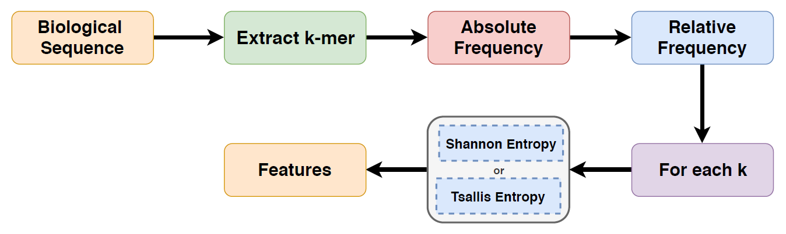
Entropy
Entropy is a measure of the uncertainty associated with a probabilistic experiment
In this method, each sequence is mapped in the frequency of neighboring bases k, generating statistical information.
Histograms with short bins are adopted, that occur for k = 1 [{A}, {C}], up to histograms with long sequence counting bins such as k = 7 [{AACCGTG, AGAGAAC}]
Generate relative frequencies from absolute frequencies of each k
Then the respective entropies are applied
Dimensions: k (k is the maximum length of k-mers)
Shannon
Quantifies the amount of information in a variable
Reaches a single value that quantifies the information contained in different observation periods (k-mers)
Tsallis
Generalized form of the Shannon's entropy

Slide 10
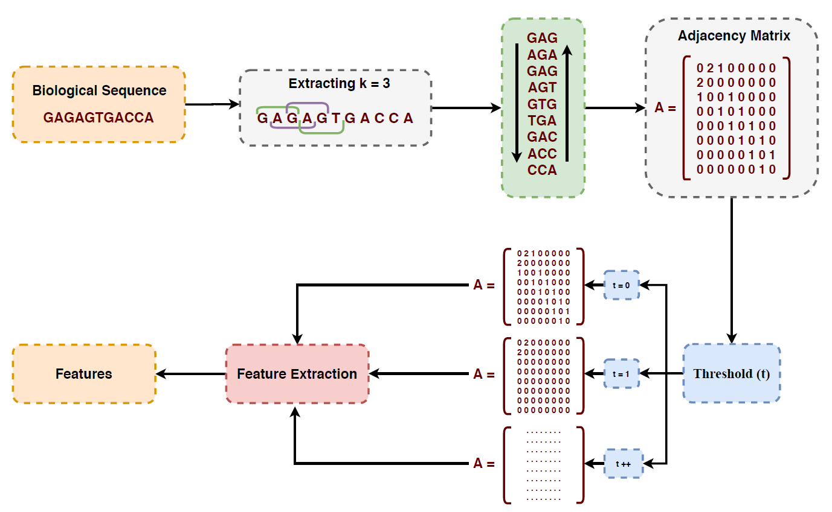
Graphs
Feature extraction model based on complex networks
Each sequence is mapped in the frequency of neighboring bases k (k = 3)
This mapping is converted to an undirected graph represented by an adjacency matrix
Feature extraction is performed using a threshold scheme
Complex Networks (with threshold)
Dimension: 12 * t (t is the threshold i.e.,
the number of subgraphs)
Complex Networks (without threshold - v2)
Dimension: 27 * k (k in k-mers)

Slide 11
K-mer
Basic K-mer
Generate all k-mers (for k = 1 .. k), for all sequences
Calculate their probabilities (i.e., count_of_kmers/windows_in_sequence)
Dimensions: 4^k (k is the maximum length of k-mers)
Reverse Complement K-mer
Generate all (complement of) k-mers (for k = 1 .. k), for all sequences
Complements are:
A <-> T
C <-> G
G <-> C
T <-> A
Calculate their probabilities (i.e., count_of_kmers/windows_in_sequence)
Dimensions: 4^k (k is the maximum length of k-mers)

Slide 12
K-mer
Nucleic Acid Composition (NAC)
Generate all 1-mers, for all sequences
Calculate their probabilities (i.e., count_of_kmers/windows_in_sequence)
Dimensions: 4
Di-nucleotide Composition (DNC)
Generate all 2-mers (for k = 2), for all sequences
Calculate their probabilities (i.e., count_of_kmers/windows_in_sequence)
Dimensions: 16
Tri-nucleotide Composition (TNC)
Generate all 3-mers (for k = 3), for all sequences
Calculate their probabilities (i.e., count_of_kmers/windows_in_sequence)
Dimensions: 64

Slide 13
Accumulated Nucleotide Frequency
Accumulated Nucleotide Frequency (ANF)
For each nucleotide in the sequence, their cumulative frequency (nucleotide-wise) is calculated
The frequency is standardized by dividing by their individual position in the sequence
Dimensions: L (L is the length of longest sequence, k is length of kmer)
Example:
Seq: “AAGTAC”
Mapping: [1/1, 2/2, 1/3, 1/4, 3/5, 1/6] = [1, 1, 0.333, 0.25, 0.6, 0.167]
Accumulated Nucleotide Frequency with Fourier (ANFF)
First, the ANF is generated.
Then, Discreet Fourier Transform (DFT) is applied using Fast Fourier Transform (FFT)
Reveals hidden periodicities after transformation of time domain (sequence) data to frequency domain space.
Statistical features are then extracted to generate the dimensions
Dimensions: 19 (Similar to the numerical-mapping Fourier transformed dimensions)

Slide 14

Open Reading Frame (ORF)
Features for discovering coding sequences
An ORF is a continuous stretch of codons that begins with a start codon (usually AUG/ATG) and ends at a stop codon (usually UAA/TAA, UAG/TAG or UGA/TGA)
For each sequence, the first codon is extracted for the lengths (k = 1,2,3), and moving forward, all non-overlapping 3-mers are extracted, for each of the start codons as follows:
Then, the metrics are generated per sequence. Dimensions: 10
Maximum ORF Length
Minimum ORF Length
Mean of ORF Length
Standard deviation of ORF Lengths
Coefficient of variation of ORF Lengths
Maximum GC Measure
Minimum GC Measure
Mean of GC Measures
Standard deviation of GC Measures
Coefficient of variation of GC Measures
* Where, ORF is each possible start/end combination as shown above
* Where, GC Measure is the percentage of G and C nucleotides in each of the ORFs

Slide 15
Fickett score
Measures the coding potential based on compositional bias between codon positions by estimating how asymmetric is the distribution of nucleotides at the three triplet positions in the sequence
Used to evaluate each base’s unequal content frequency and asymmetrical distribution in the positions of codons in one sequence
The Fickett score is computed for both the ORF’s and the complete sequence
Dimensions: 2

Slide 16
Xmer k-Spaced Ymer Composition Frequency (kGap)
For every sequence, generates features as the frequency of k-gapped mers characterized by the following parameters:
Frequency of kgap 1 = A_A, 2 = A__A, 3 = A___A...
Before 1 = A_A, 2 = AA_A, 3 = AAA_A...
After 1 = A_A, 2 = A_AA, 3 = A_AAA...
For all sequences, every possible combination of nucleotides is generated with the above parameters, and their counts as value for the dimension.
Dimensions: 4^{X} * 4^{Y} [X = before, Y=after]

