Slide 1
DNA Sequence Classification
Sourajyoti Datta
Supervisor: Muhammad Asim
Project – Collaborative Intelligence (DFKI)
Winter Semester 2020/21
Department of Computer Science
Technische Universität Kaiserslautern, Germany

Slide 2
Introduction
Why DNA Sequence Classification?
The genome of eukaryote species is embedded into the nuclei of their cells, packed as chromatin.
Nucleosomes form the first level of DNA compaction
About 147-150 base-pairs
Arrange themselves through successively higher-order structures to finally form the chromosomes (critical role in organization)
The genome-wide location of the nucleosomes is fundamental for many biological processes
Gene regulation, Co-transcriptional splicing, DNA replication, DNA repair
Nucleosomes are separated from each other by sequences of Linker DNA
Need to understand:
To what extent the DNA sequence specificity is solely responsible for nucleosome positioning.
Task:
Use only short DNA sequences (length of 150) to try to model a classification between the sequences being Nucleosomal vs. Linker

Slide 3
Datasets
4 different datasets explored, finalized and results presented for one:
Setting 1 Data:
Contains data from 4 different sets of DNA Sequences:
Homo Sapiens:
Nucleosomal: 2900 Linker: 2850
Caenorhabditis Elegans:
Nucleosomal: 2567 Linker: 2608
Drosophila Melanogaster:
Nucleosomal: 2273 Linker: 2300
Saccharomyces Cerevisiae:
Nucleosomal: 1880 Linker: 1740
Every DNA sequence is 150 characters long, containing only: Adenine, Cytosine, Guanine, and Thymine (ACGT) molecules
Fair division of classes in every species. Hence, no data bootstrapping/augmentation step performed.
For every model:
Data is divided into Stratified 10 Folds
Ensures better accuracy/precision of the results and their generalization

Slide 4
Approaches explored
CNN – RNN – FCNN hybrid architectures
Convolutional LSTM DLNN
Modified version: Convolutional LSTM DLNN CORENup (State-of-the-art)
Embeddings with ML/NN
Global DNA Embedding with Random Forest
Word2Vec with FCNN
ML/NN with Statistical Metrics
MathFeature
Random Forest
Extra Tree Forest
XGBoost
Convolutional LSTM DLNN
Deep Forest Architecture
AutoEncoders based
Cosine Similarity based AE with Deep Forest architecture
Bi-LSTM AE with FCNN

Slide 5
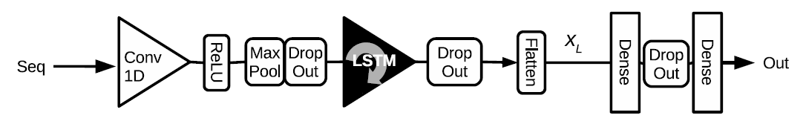
Approaches and Results
CNN – RNN – FCNN hybrid architectures
Convolutional LSTM DLNN
Total parameters: 584,051
Trained using:
Adam optimizer with Learning rate = 0.0003
For, 200 Epochs with Batch size of 64
Early Stopping criterion on validation-loss
Binary Cross-Entropy loss
Width = 2
Stride = 2
[3750]
[150 x 4]
P = 0.5
P = 0.5
50 Filters
(3 x 3) or (5 x 5)
Pad = Keep same
L2 Regularized, β = 0.001
50 Units
L2 Regularized, β = 0.001
150 Units
ReLU
1 Unit
Sigmoid
** The Hyperparameters: Epoch, Batch size and Early stopping criterion, is kept invariant across all NN models in the future

Slide 6
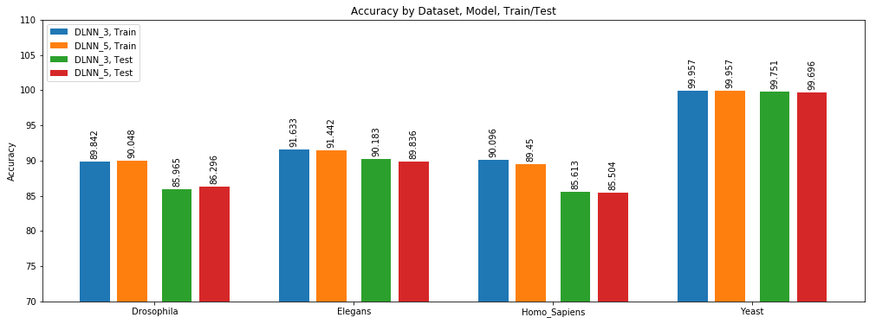
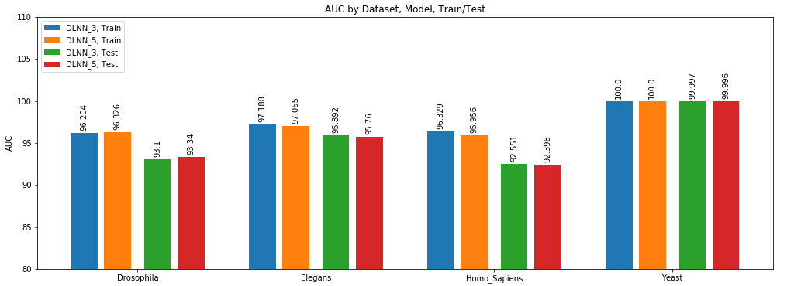
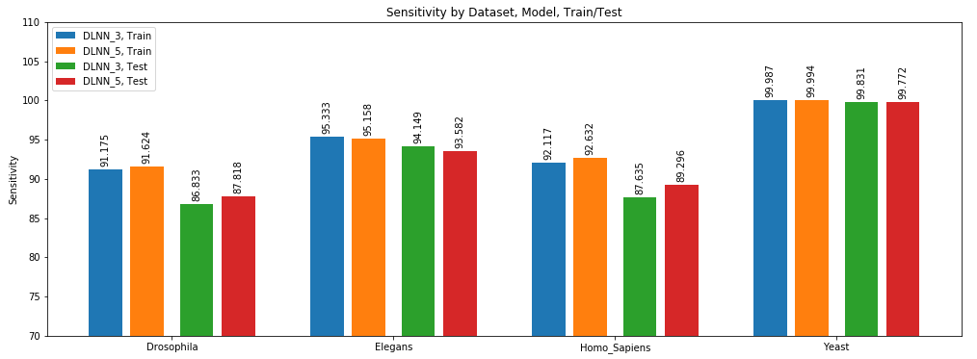
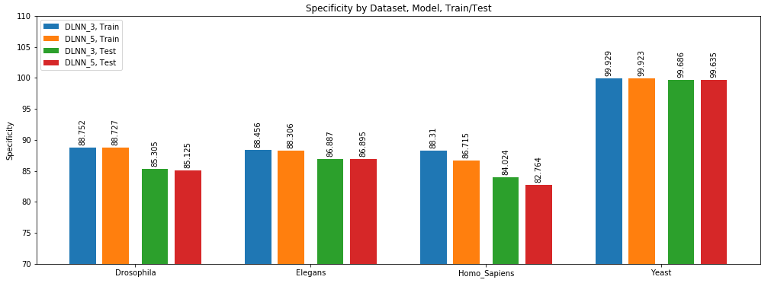
Approaches and Results
CNN – RNN – FCNN hybrid architectures
Convolutional LSTM DLNN

Slide 7
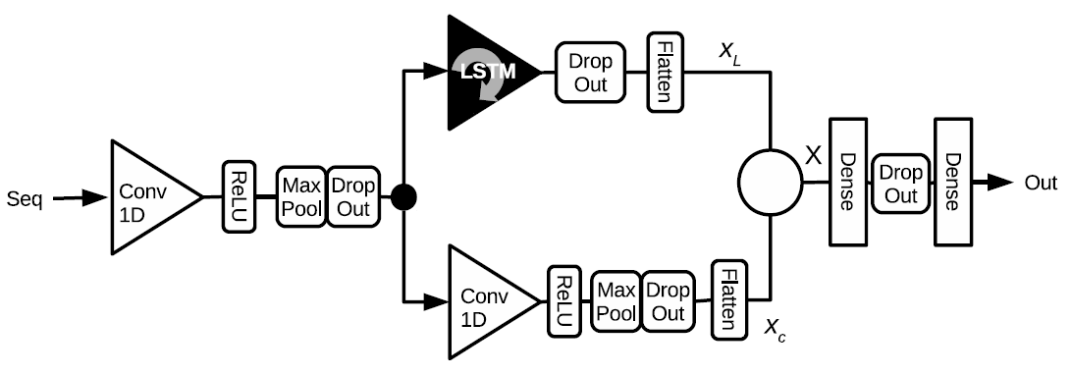
Approaches and Results
CNN – RNN – FCNN hybrid architectures
Modified Convolutional LSTM DLNN – CORENup model (State-of-the-art Architecture)
Total Parameters: 2,119,041
Similar training Hyper-Parameters as the parent architecture
Basis for all future model comparisons
P = 0.5
Width = 2
Stride = 2
50 Units
L2 Regularized, β = 0.001
P = 0.5
Width = 2
Stride = 2
[150 x 4]
50 Filters (5 x 5)
Pad = Keep same
L2 Regularized, β = 0.001
370 Units
ReLU
1 Unit
Sigmoid
P = 0.5
50 Filters (10 x 10)
Pad = Keep same
L2 Regularized, β = 0.001

Slide 8
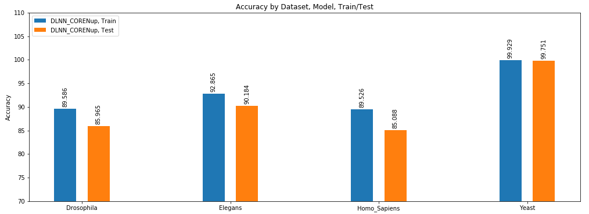
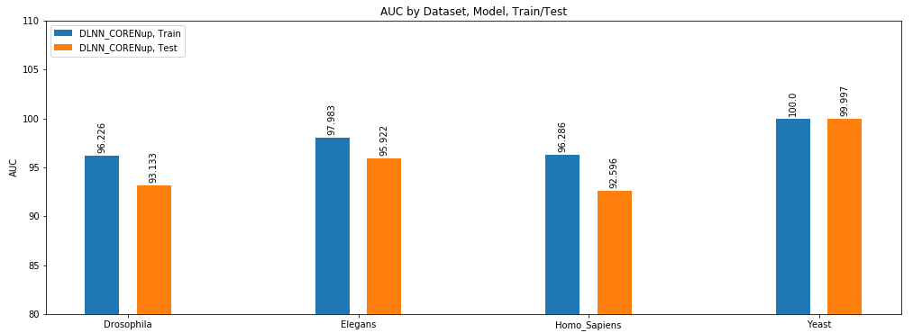
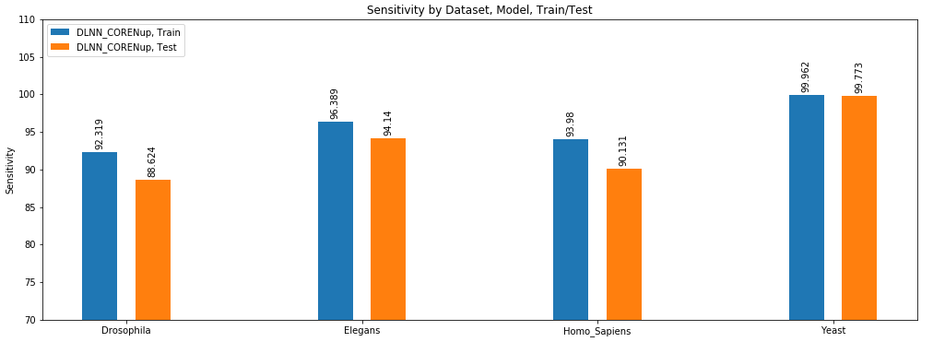
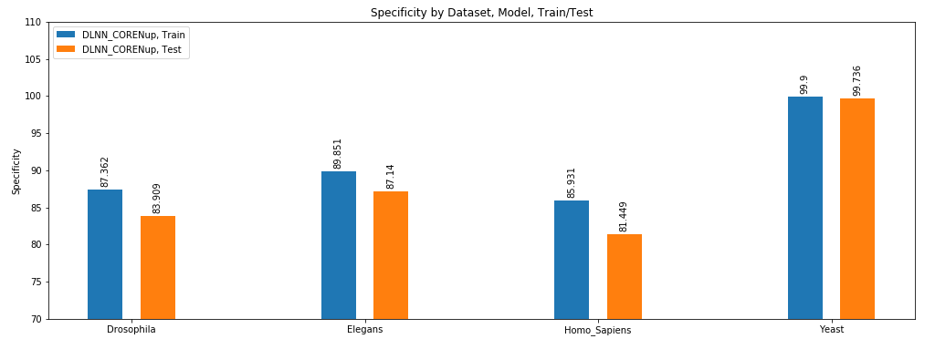
Approaches and Results
CNN – RNN – FCNN hybrid architectures
Modified Convolutional LSTM DLNN – CORENup model (State-of-the-art Architecture)

Slide 9
Approaches and Results
Embeddings
Global DNA Embedding with Random Forest

Slide 10
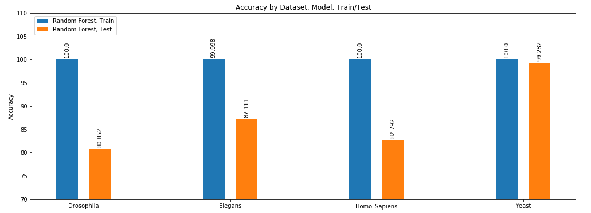

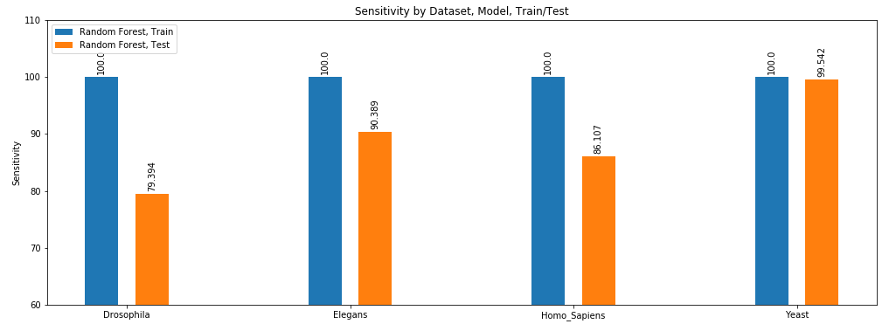
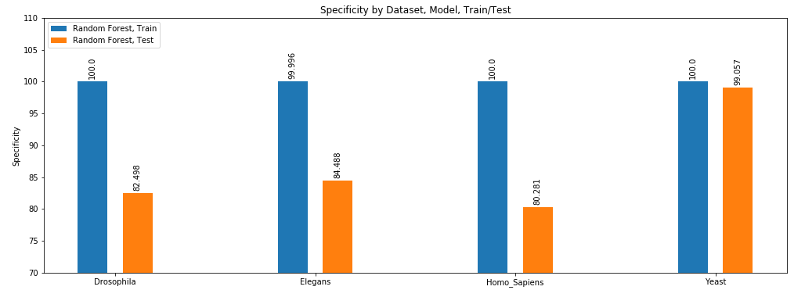
Approaches and Results
Embeddings
Global DNA Embedding with Random Forest
Notes:
Accuracy: A few percentage points below CORENup in test, better in training. Hence, needs more regularization to be performed.
AUC, Sensitivity, Specificity: difference is much higher in HOLD OUT DATASET.

Slide 11
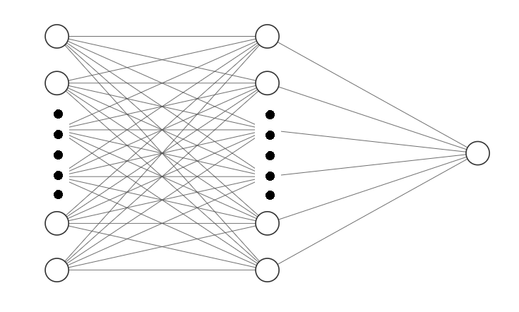
Approaches and Results
Embeddings
Word2Vec with FCNN
Uses Skip-Gram word2vec to embed k-mers
Then, leverages an existing sentence embedding technique to embed all sequences of specific samples
Finally, SVD is performed to limit the dimensions
Preserves relevant information about sequencing, such as k-mer context, sequence taxonomy, and sample class
Embedded using k-mer values: {3, 4, 5, 6, 7, 8}
Finally, classification is performed using a shallow FCNN
Trained using:
Adam optimizer with Learning rate = 0.0003
For, 200 Epochs with Batch size of 64
Early Stopping criterion on validation-loss
Binary Cross-Entropy loss
1 Unit
Sigmoid
Input
[64, ]
64 Units
ReLU

Slide 12
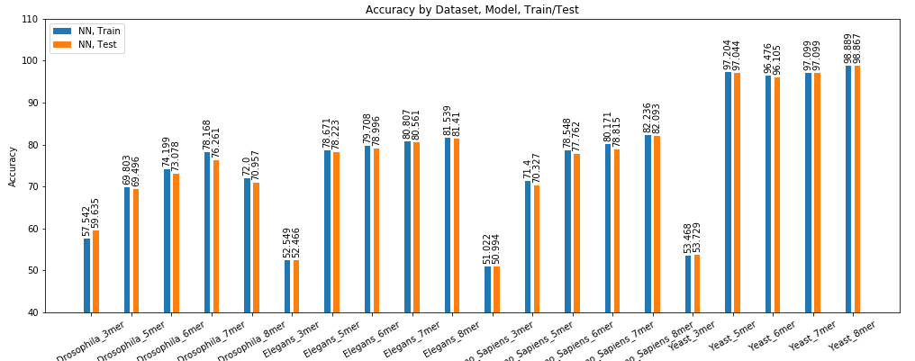
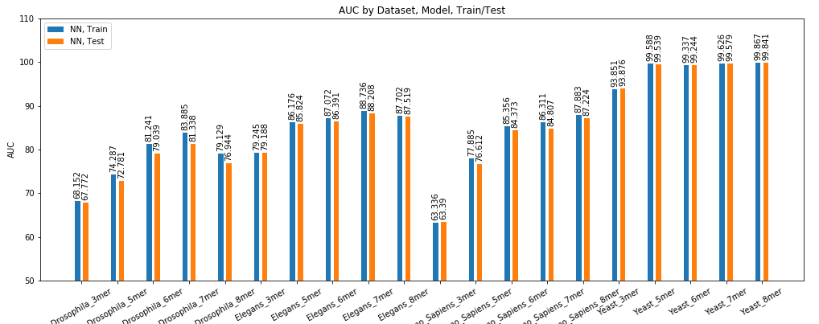
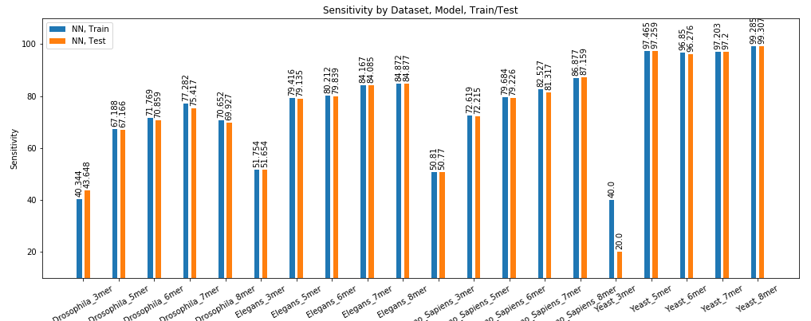
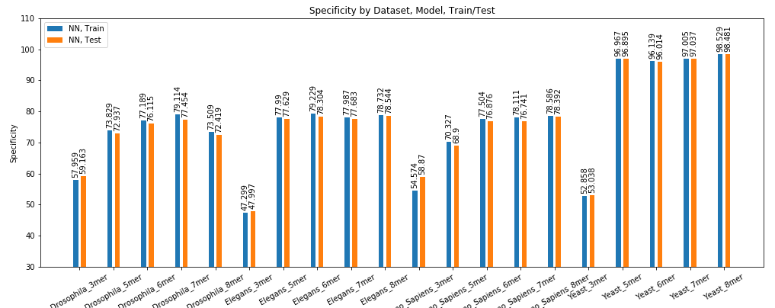
Approaches and Results
Embeddings
Word2Vec with FCNN
Notes:
Model is quite well regularized, very similar train/test performance.
Correlation between k-mer length and model performance. Both Increasing.
Compared to CORENup:
Model performs worse across the board.

Slide 13
Approaches and Results
Classification with Numerical Measures:
MathFeature:
Provides 20 approaches based on:
Various numeric mappings
Genomic signal processing
Chaos game theory
Entropy
Complex networks
Fourier Transformation of certain embeddings from the above
In total, about 34 different mappings, with a total of about 3217 factors
The total can vary depending on parameters for the numerical mappings, like k-mer values, strides, etc.

Slide 14
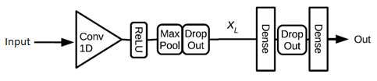
Approaches and Results
Classification with Numerical Measures
First approach: Train ML models with each of the 32 MathFeature mappings individually
Random Forest Classifier
Ensemble of 100 Decision Trees, with Gini impurity as criterion
Extra-Trees Classifier
Ensemble of 100 Trees, with Gini impurity as criterion
XGBoost
With a Binary Logistic objective
Second Approach: Train ML model by combining all the 32 MathFeature mappings into one vector of length 3217
Random Forest
Ensemble of 100 Decision Trees, with Gini impurity as criterion
Conv FCNN
Width = 2
Stride = 2
P = 0.5
50 Filters (5 x 5)
Pad = Keep same
L2 Regularized, β = 0.001
150 Units
ReLU
1 Unit
Sigmoid
Notes:
Similar to a Random Forest classifier we have the Extra Trees classifier. To introduce more variation into the ensemble, the features and splits are selected at random; hence, “Extremely Randomized Tree”.

Slide 15
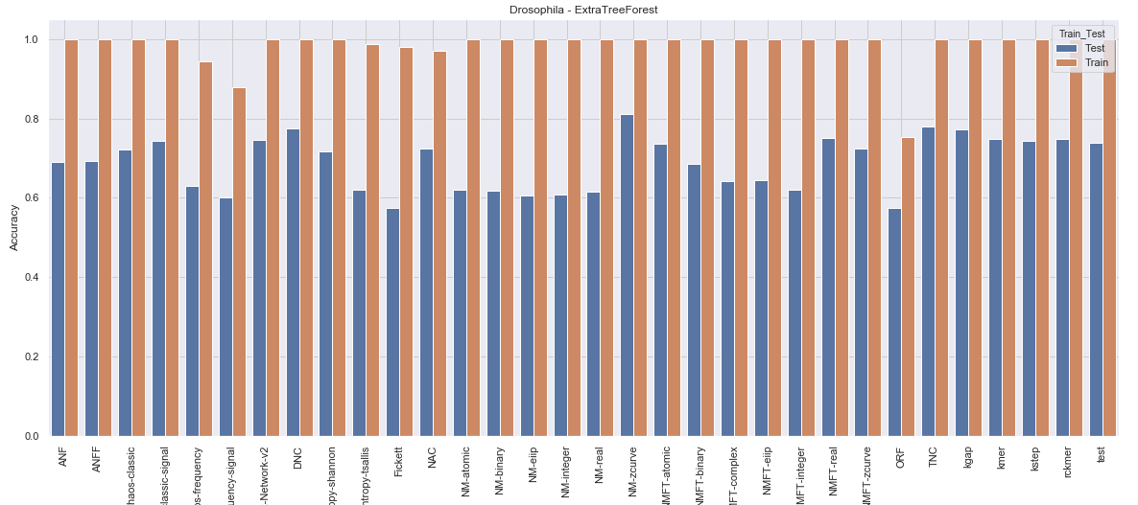
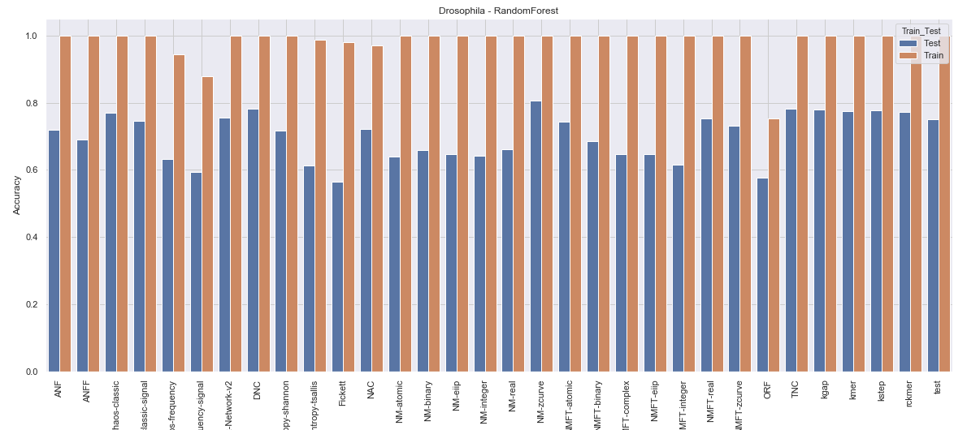
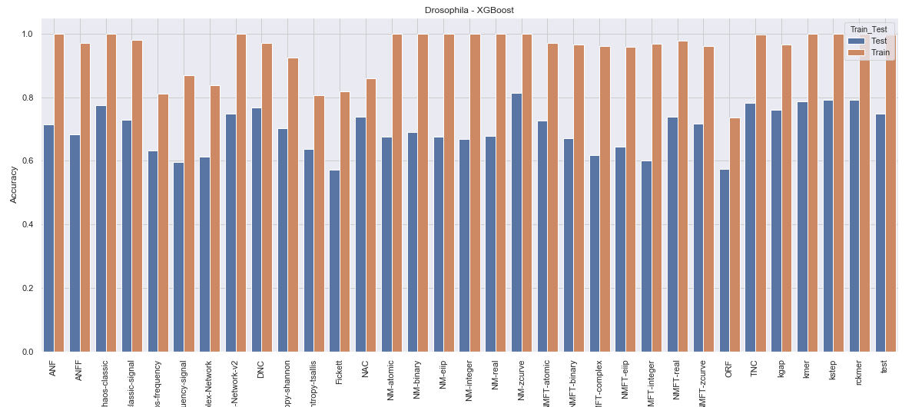
Approaches and Results
Classification with Numerical Measures
First approach
Results here indicates the comparison of predictive power between the different approaches incorporated in the MathFeature
Notes:
This is Accuracy for only Drosophilia.
Results are similar across the board – RandomForest marginally better than others
Compared to CORENup model: Performance falls by a few percentage points across the board for the HOLD OUT DATASET.

Slide 16
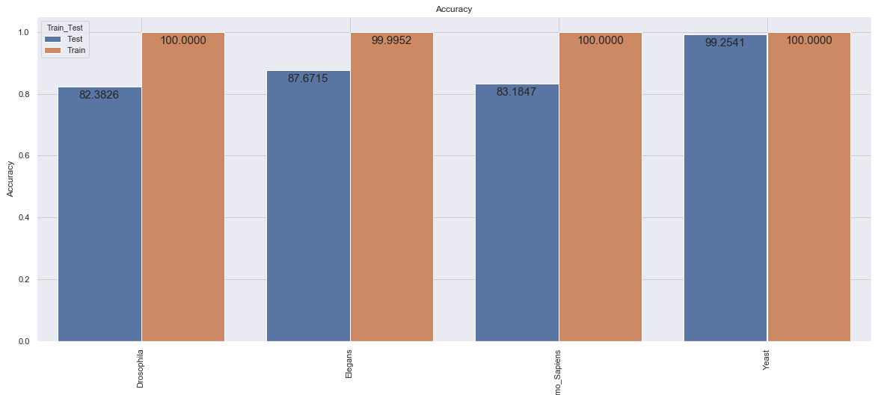

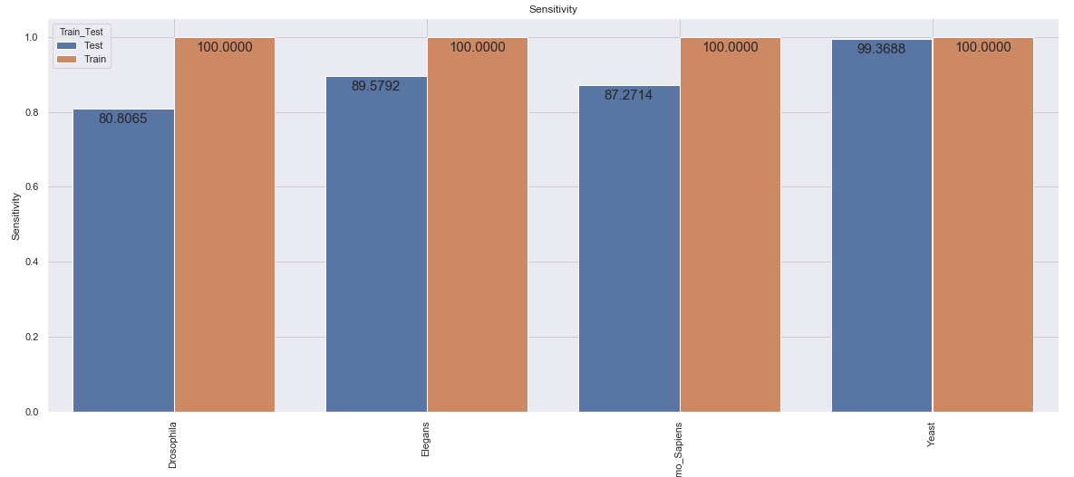
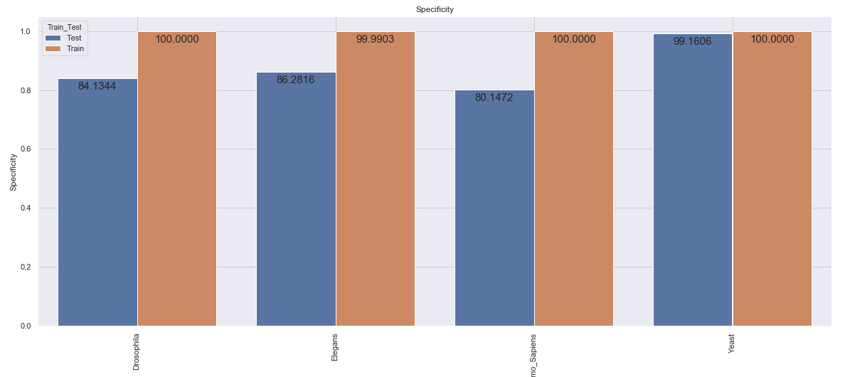
Approaches and Results
Classification with Numerical Measures
Second approach: Random Forest
Notes:
Almost similar performance as the SOTA – CORENup model in terms of Accuracy, a few percentage points below.
Has the potential. Might need some further tweaking, to regularize better.
Hopefully, will improve other metrics.
In a couple of tweaking experiments performed, the regularization was causing the Training performance to fall much more than increasing test performance.

Slide 17
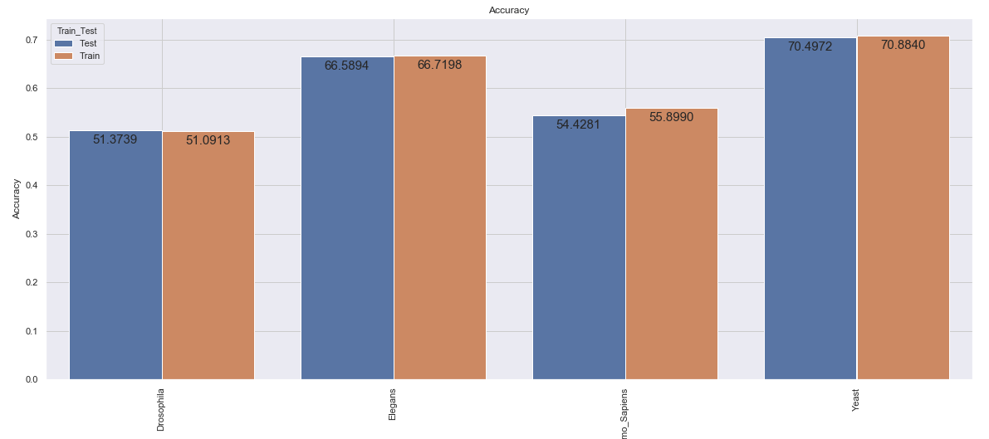
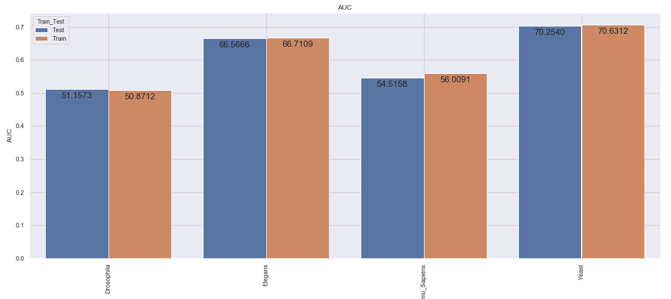
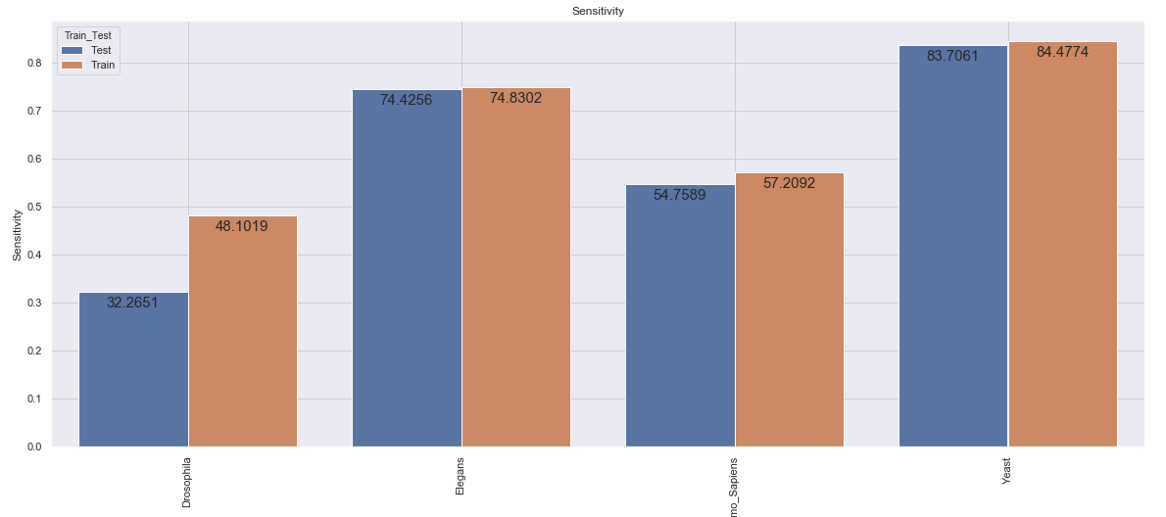
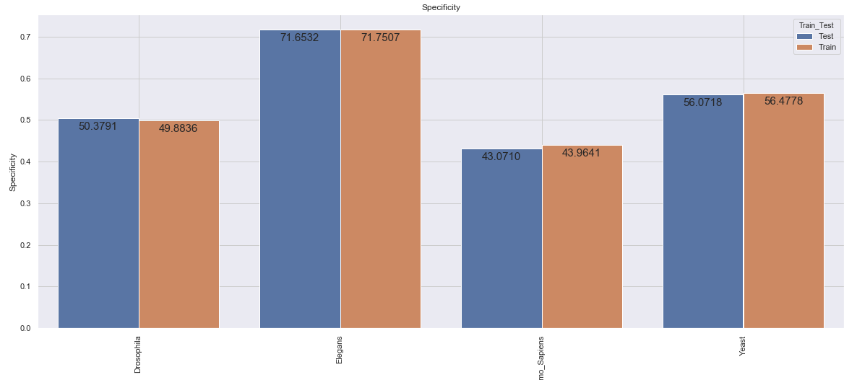
Approaches and Results
Classification with Numerical Measures
Second approach: Conv FCNN
Notes:
Worse performance across the board. Stating, that convolution operation is probably not a good candidate after any form of encoding/embedding.

Slide 18
Approaches and Results
Classification with Numerical Measures
Second Approach: Train ML model by combining all the 32 MathFeature mappings into one vector of length 3217
Deep Forest Architecture
Multi-grain scanning and Cascade Forest approach
Developed for lncRNA-miRNA interaction prediction, but repurposed to use numerical measures for classification
Notes:
two ensemble components:
multi-gained scanning, which scan local context from high dimensionality to learn representations of input data according to different random forests,
cascade forest, in which neurons of deep neural networks have been replaced with many different random forests.
In DeepForest, compared to DNN, fewer hyper-parameters and less parameter tuning skills in are required the training process.

Slide 19
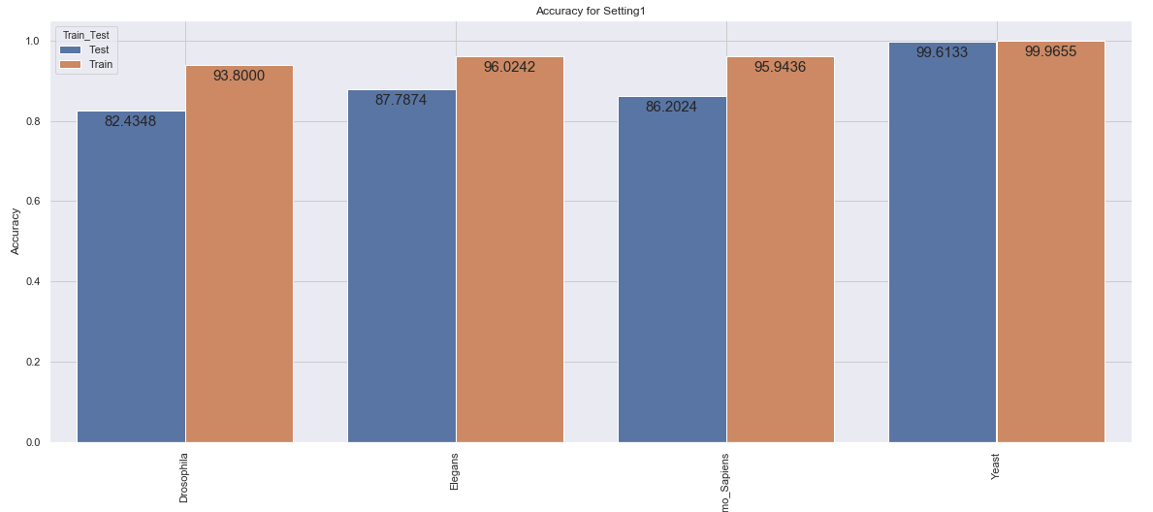

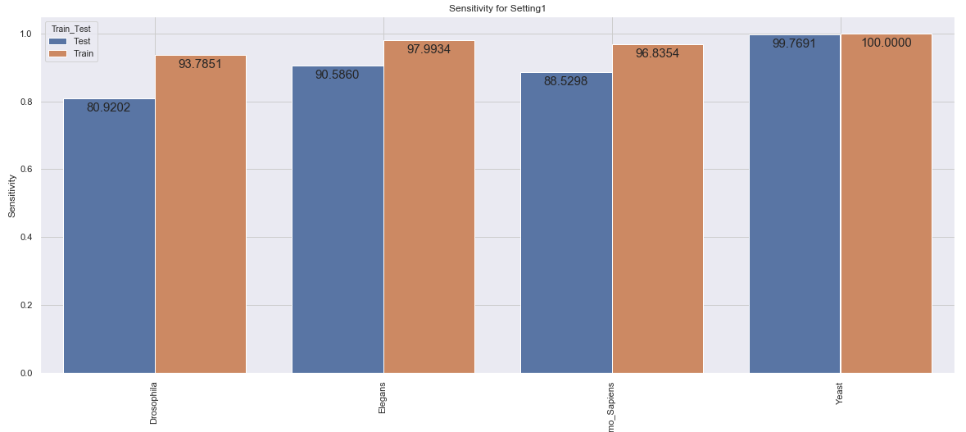
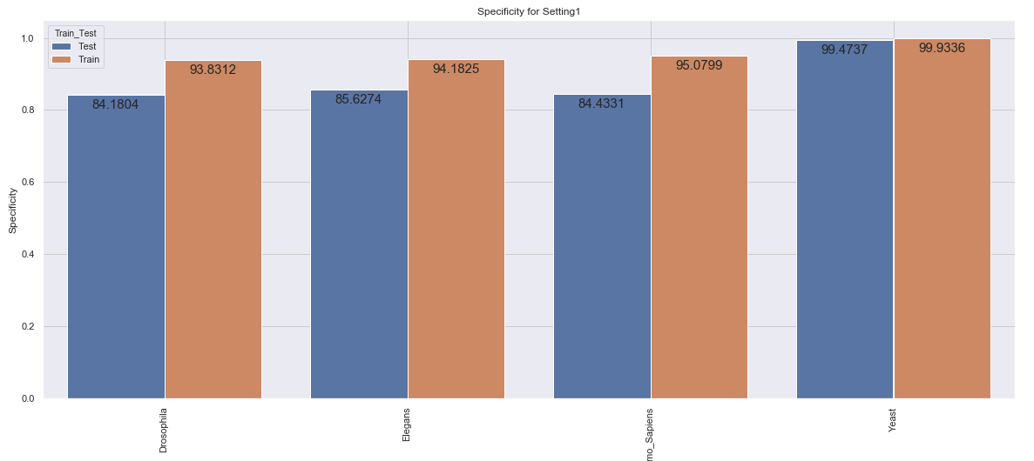
Approaches and Results
Classification with Numerical Measures
Second Approach: Deep Forest Architecture
Notes:
Almost similar performance as the SOTA – CORENup model in terms of Accuracy, a few percentage points below for test, above for train.
Has the potential. Might need some further tweaking, to regularize better.
Hopefully, will improve other metrics.

Slide 20
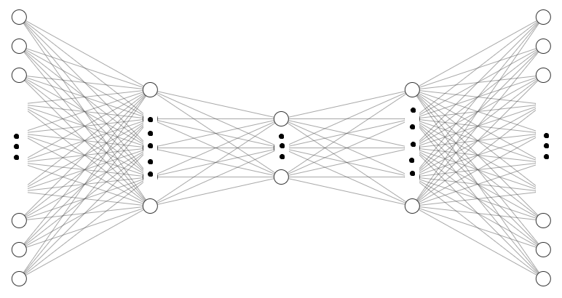
Approaches and Results
AutoEncoders
Cosine Similarity based AE with Deep Forest architecture
Using the MathFeature based numerical measures
Fully connected AutoEncoder without activation, using Cosine Similarity as loss function
Using the Second-approach data – combining all 32 MathFeature mappings
500 Units
1608 Units
1608 Units
[3217, ]
[3217, ]
Latent space: [500, ]

Slide 21
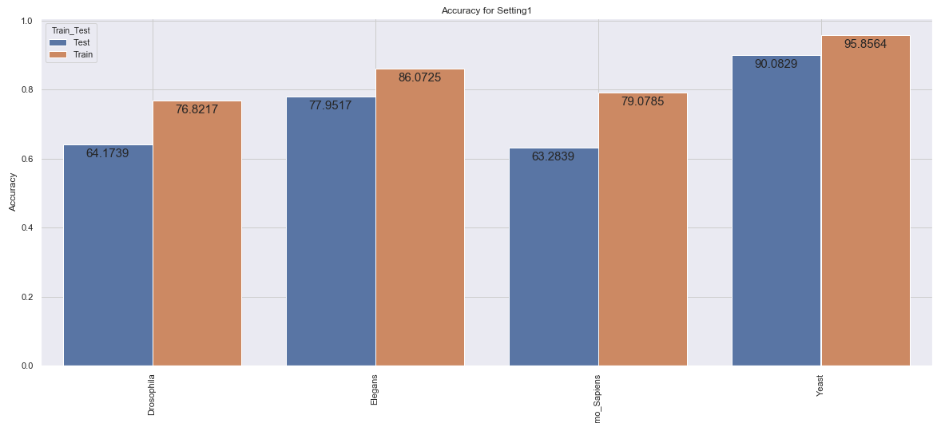

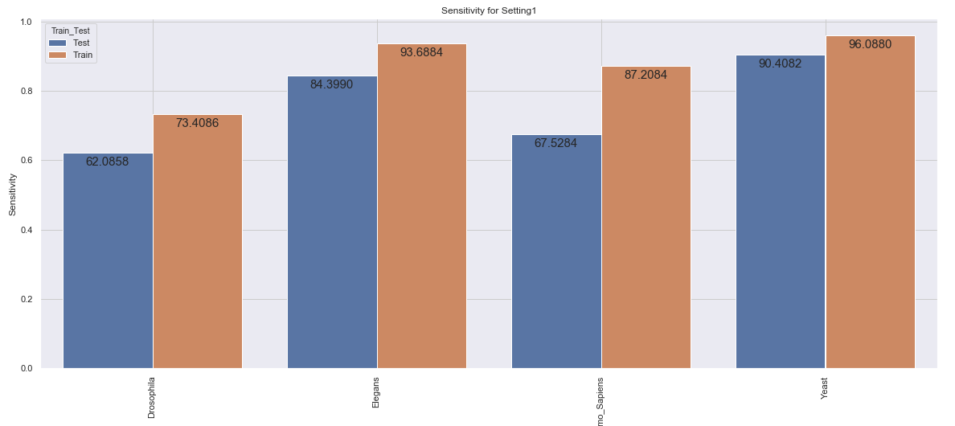
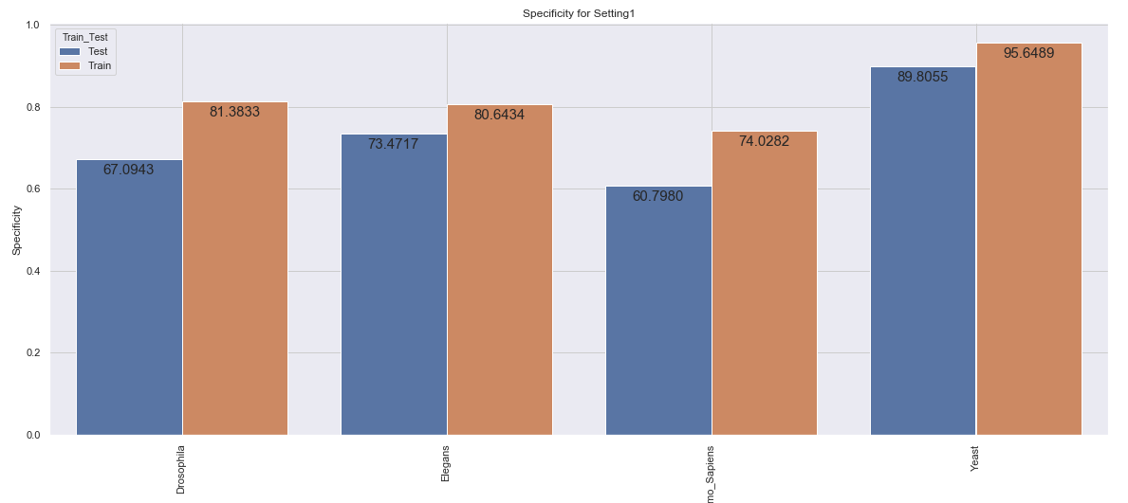
Approaches and Results
AutoEncoders
Cosine Similarity based AE with Deep Forest architecture
Notes:
AE might be the reason to falling performance, compared to the same experiment without the AE.

Slide 22
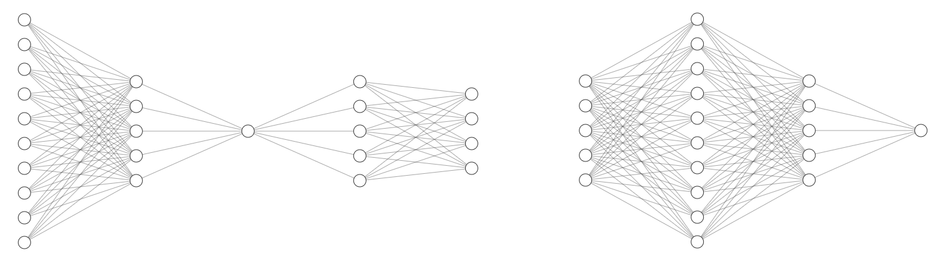
Approaches and Results
AutoEncoders
Bi-LSTM AE with FCNN
Bi-directional LSTM based AutoEncoder, using Categorical Cross Entropy loss
Then, Fully Connected Classification Network using latent representation, using Binary Cross Entropy loss
1 Unit
Output = Sequence Length vectors
1 Unit
Sigmoid
Time Distributed - 4 Units
Bi-LSTM Layer
150 Units
Softmax
LSTM Layer
150 Units
Input
[150, ]
150 Units
ReLU
Input
[150, 4]
300 Units
ReLU

Slide 23
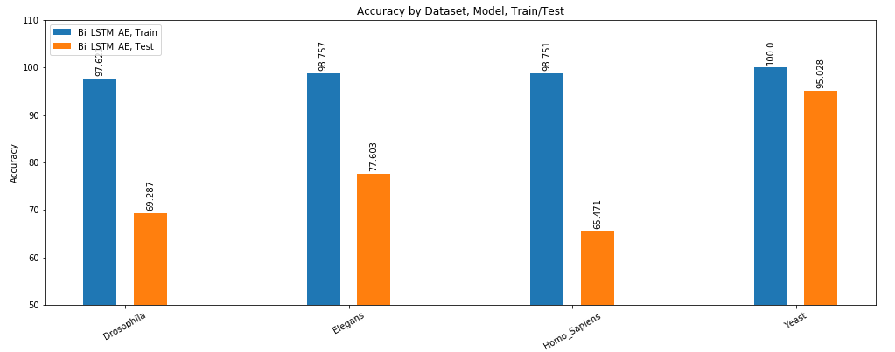
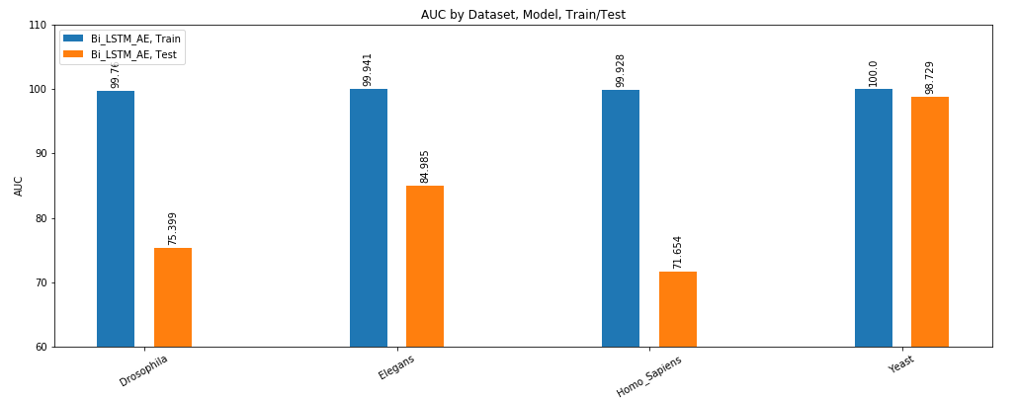
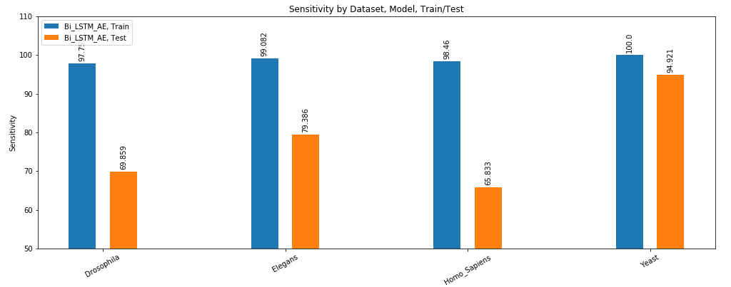

Approaches and Results
AutoEncoders
Bi-LSTM AE with FCNN
Notes:
Good learning capability, but drastic fall in performance in HOLD OUT DATA, compared to the CORENup model.

Slide 24
Conclusion
Conclusion of results
It is possible to model short DNA sequences
For classification between the sequences being Nucleosomal or Linker
With a certain accuracy
The Modified Convolutional LSTM DLNN – CORENup model is still the State-of-the-art based on the results of our experiments.
Certain techniques show potential:
Combining all MathFeature numerical measures together, and then perform classification using:
Random Forests
Deep Forest Architecture
Random Forests have marginally better training performance than Deep Forest, while very similar testing performance
Most of the results looks to have over-fitting issue
Even with the application of Early Stopping criterion

Slide 25
Future Work
There are many more techniques to explore. Some are:
GloVe
Unsupervised learning algorithm to obtain Global Vectors for Word representation
ULMFiT
Universal Language Model Fine-tuning for Text Classification
An Inductive Transfer Learning method that can be applied to any task in NLP
Modifications to presented techniques can be further experimented with:
Deep Forest Architecture directly with Sequences
Addition of Bi-LSTM to the CNN – RNN – FCNN (SOTA) hybrid architectures
Further analysis of the Regularization for the approaches done in the experiment

Slide 26
References
Github links
https://github.com/EESI/16s_embeddings
https://github.com/DeepLearningForSequence/CORENup-A-Combination-of-Convolutional-and-Recurrent-Deep-Neural-Networks-for-NucleosomePositioning
https://github.com/Bonidia/MathFeature
https://github.com/EESI/microbiome_embeddings
Papers referred
Di Gangi, Mattia & Gaglio, Salvatore & La Bua, Claudio & Lo Bosco, Giosuè & Rizzo, Riccardo. (2017). A Deep Learning Network for Exploiting Positional Information in Nucleosome Related Sequences. 524-533. 10.1007/978-3-319-56154-7_47.
Di Gangi, Mattia & Lo Bosco, Giosuè & Rizzo, Riccardo. (2018). Deep learning architectures for prediction of nucleosome positioning from sequences data. BMC Bioinformatics. 19. 10.1186/s12859-018-2386-9.
Amato, Domenico & Lo Bosco, Giosuè & Rizzo, Riccardo. (2020). CORENup: A combination of convolutional and recurrent deep neural networks for nucleosome positioning identification. BMC bioinformatics. 21. 326. 10.1186/s12859-020-03627-x.
Woloszynek, Stephen & Zhao, Zhengqiao & Chen, Jian & Rosen, Gail. (2019). 16S rRNA sequence embeddings: Meaningful numeric feature representations of nucleotide sequences that are convenient for downstream analyses. PLOS Computational Biology. 15. e1006721. 10.1371/journal.pcbi.1006721.
Pennington, Jeffrey & Socher, Richard & Manning, Christopher. (2014). Glove: Global Vectors for Word Representation. EMNLP. 14. 1532-1543. 10.3115/v1/D14-1162.
Wei, Dong-Qing. (2020). LMI-DForest: A deep forest model towards the prediction of lncRNA-miRNA interactions. Computational Biology and Chemistry. 89. 10.1016/j.compbiolchem.2020.107406.

