Slide 1
Did Crime Trends in Davidson County, TN Change During the COVID-19 Pandemic?
An exploration of what, if any, correlation exists between crime and COVID-19 in Davidson County, TN
Maggie DeCampo
Data Analytics 6: Nashville Software School
June 28, 2023

Slide 2


Data question
Why did I choose this project?

Slide 3
Data Sources
Nashville.gov Open Data Portal
Dataset: Metro Nashville Police Department Incidents: Details about Metro Nashville Police Department reported incidents from 2015 – 2022.
Last Updated: June, 2022
Link: Metro Nashville Police Department Incidents
Nashville.gov Open Data Portal
Dataset: Metro Nashville Police Department Incidents Metadata v2: Data dictionary for the above dataset.
Last Updated: September, 2020
Link: Metro Nashville Police Department Incidents Data Dictionary
TN.gov Department of Health
Dataset: County New: Details daily cases (confirmed and cumulative) of COVID-19 by County for the state of Tennessee. From March 2020 – June 2022.
Last Updated: June, 2022
Link: COVID-19 Cases by County

Slide 4
Data challenges
Nashville Metro Police, at times, respond to non-Davidson County incidents
Challenge: Remove incidents from the dataset that did not occur in Davidson County
Solution: Use a GeoJSON version of raw incident data to plot each incident against the Davidson County border in Tableau. Note each incident that occurred outside Davidson County and manually remove it from the data.
Metro Nashville Police Department data inconsistencies and cleanliness
Challenge: Clean a large (867k rows) dataset to create consistency between Offense Codes, Offense Descriptions, Weapons Code, Weapons Descriptions, and Victim Race
Solution: Use the provided Data Dictionary for this dataset to create Excel-based lookup tables. Using standardized codes and descriptions, use VLOOKUPS to create the desired data consistency.
Result: Incidents are now able to be aggregated and result in more meaningful, consistent insights
Metro Nashville Police Department dataset size
Challenge: Criminal incident data includes 7.5 years of data for each incident occurring in Davidson County, by day. This results in a large dataset consisting of 867k rows. Cleaning this data presented a challenge due to the size.
Solution: Eliminate data that would not be used in the project to reduce the size of the dataset. Otherwise, a lot of patience and constant saving / pushing to Github!

Slide 5
Definitions and notes
Incident: One or more crimes committed by an individual or a group of individuals acting in concert and at the same time and place.
Close Contact: Criminal offenses where there is a known human victim and the offense required close contact with the victim. *
No Contact: Criminal offenses that do not require close contact with another human. Often defined as crimes against “society” rather than a singular victim. *
2022: Data for the year 2022 is inclusive of January 2022 – May 2022. In some cases, this data has been filtered from charts to avoid skewing data unnecessarily.
COVID-19: Defined as the period from March 2020 – May 2022, as this is when the source data starts / ends.
COVID-19 Cases: Defined here as new, confirmed cases of COVID-19.
* Offenses where it’s unknown if a singular victim was involved have been excluded from these incidents.

Slide 6
Findings

Slide 7
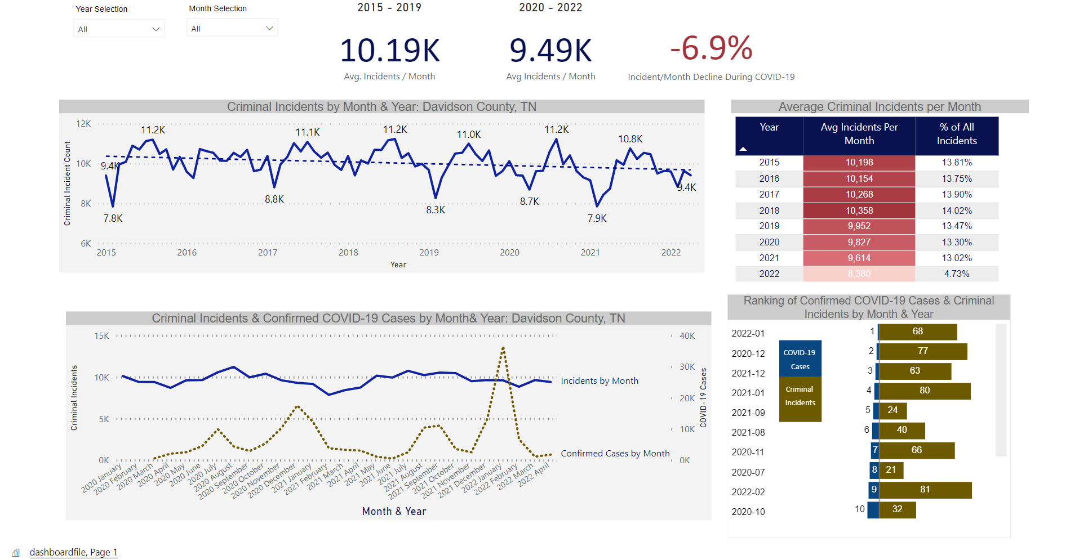
TRENDS IN CRIME & COVID-19
Criminal incidents per year are trending downward, with like months seeing fewer incidents per month, year over year
Overall crime decreased slightly during COVID-19, with a decrease in incidents per month of -6.9%
Notable decreases in crime coincide with “Stay at Home” events caused by COVID-19, as well as a severe winter storm:
Mar. 22, 2020: Governor institutes shutdown of gyms, fitness centers, limits restaurants to takeout only
Mar. 30, 2020: Governor institutes “Safer at Home” orders
Feb. 14 – 15, 2021: Davidson county experiences a severe winter storm

Slide 8
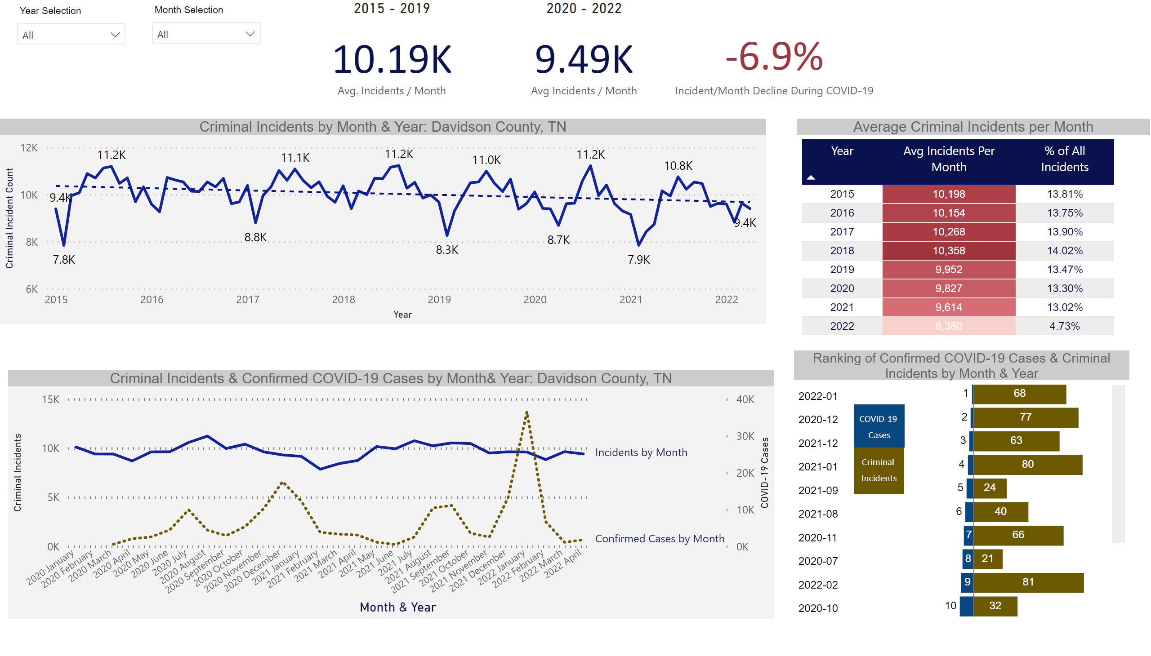
TRENDS IN CRIME & COVID-19
Average incidents per month declined year over year from 2020 – 2021
With only 5 months of data in 2022, the year may surpass all other years in the number of criminal incidents, should average incidents / month remain the same
While speculative, there may be a weak negative correlation between COVID-19 confirmed cases and a decrease in crime within Davidson County
Months ranking highest for COVID-19 cases ranked generally low for number of criminal incidents*
*There are 89 possible months in the Metro Nashville Police Department’s criminal incidents dataset

Slide 9
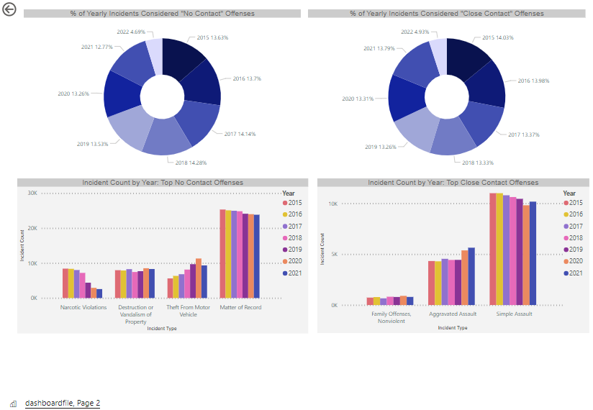
CRIMINAL OFFENSE TRENDS DURING COVID-19
There was no notable decrease in “close contact” offenses during the COVID-19 period (Mar. 2020 – May 2022)
2021 was the 3rd highest year for these offenses, with 13.8% of incidents considered “close contact”
Offense types trended similarly before and during COVID, with Family Offenses, Aggravated Assault, and Simple Assault remaining the top 3 close contact offenses year over year
Conversely, “no contact” offenses were at their lowest in 2021
Narcotic violations, Vandalism and Theft from Motor Vehicles all decreased from 2020 to 2021

