Slide 1
Did Crime Trends in Davidson County, TN Change During the COVID-19 Pandemic?
An exploration of correlation between crime and COVID-19 in Davidson County, TN
Maggie DeCampo
Data Analytics 6: Nashville Software School
June 28, 2022

Slide 2


Data question
Why did I choose this project?
Notes:
I chose this project for a number of reasons:
The first was primarily personal interest and a general sense of curiosity. As a resident of Davidson County I have a vested interest in the safety of my neighborhood, and as we all were and are impacted by COVID, combining the two seemed interesting
Second was data availability and recency. I chose data sets that were readily available from trustworthy sources, included enough information to establish a baseline for this project, and had complete enough data to form a story. However, this data presented several challenges as we’ll see in a few slides. I felt the sheer size of the data set and the necessity for cleaning the data would allow me to stretch myself personally with the tools we’ve utilized in this course; those tools, in this case, were Excel, SQL, and Power BI.
Let’s review the sources of that that were used, and those challenges I was presented with along the way.

Slide 3
Data Sources
Nashville.gov Open Data Portal
Dataset: Metro Nashville Police Department Incidents: Details about Metro Nashville Police Department reported incidents from 2015 – 2022.
Last Updated: June, 2022
Link: Metro Nashville Police Department Incidents
Nashville.gov Open Data Portal
Dataset: Metro Nashville Police Department Incidents Metadata v2: Data dictionary for the above dataset.
Last Updated: September, 2020
Link: Metro Nashville Police Department Incidents Data Dictionary
TN.gov Department of Health
Dataset: County New: Details daily cases (confirmed and cumulative) of COVID-19 by County for the state of Tennessee. From March 2020 – June 2022.
Last Updated: June, 2022
Link: COVID-19 Cases by County

Slide 4
Data challenges
Nashville Metro Police, at times, respond to non-Davidson County incidents
Challenge: Remove incidents from the dataset that did not occur in Davidson County.
Solution: Use a GeoJSON version of raw incident data to plot each incident against the Davidson County border in Tableau. Note each incident that occurred outside Davidson County and manually remove it from the data.
Metro Nashville Police Department data inconsistencies and cleanliness
Challenge: Clean a large (867k rows) dataset to create consistency between Offense Codes, Offense Descriptions, Weapons Code, Weapons Descriptions, and Victim Race.
Solution: Use the provided Data Dictionary for this dataset to create Excel-based lookup tables. Using standardized codes and descriptions, use VLOOKUPS to create the desired data consistency.
Result: Incidents are now able to be aggregated and result into more meaningful, consistent insights.
Metro Nashville Police Department dataset size
Challenge: Criminal incident data includes 7.5 years of data for each incident occurring in Davidson County, by day. This results in a large dataset consisting of 867k rows. Cleaning this data presented a challenge due to the size.
Solution: Eliminate data that would not be used in the project to reduce the size of the dataset. Otherwise, a lot of patience and constant saving / pushing to Github!

Slide 5
Definitions and notes
Incident: One or more crimes committed by an individual or a group of individuals acting in concert and at the same time and place.
Close-contact: Criminal offenses where there is a known human victim and the offense required close contact with the victim. *
No-contact: Criminal offenses that do not require close contact with another human. Often defined as crimes against “society” rather than a singular victim. *
2022: Data for the year 2022 is inclusive of January 2022 – May 2022. In some cases, this data has been filtered from charts to avoid skewing data unnecessarily.
COVID-19: Defined as the period from March 2020 – May 2022, as this is when the source data starts / ends.
COVID-19 Cases: Defined here as new, confirmed cases of COVID-19.
* Offenses where it’s unknown if a singular victim was involved have been excluded from these incidents.
Notes:
Here I’ve defined a few key terms I’ll use throughout this presentation.

Slide 6
Findings

Slide 7
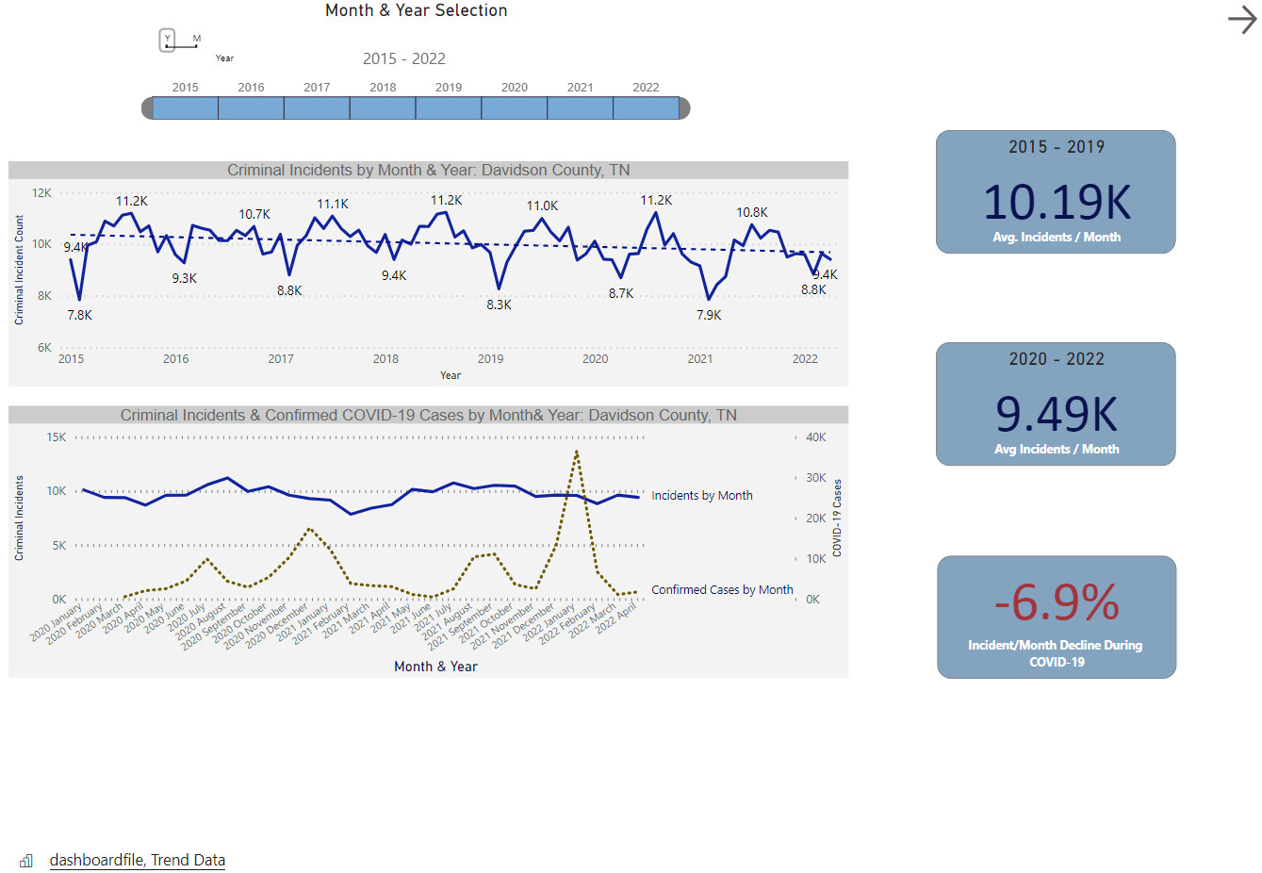
TRENDS IN CRIME & COVID-19
Criminal incidents per year are trending downward, with like months seeing fewer incidents per month, year over year.
Overall crime decreased during COVID-19. Incidents / month decreased -6.9% between 2020 – 2022.
Notable decreases in crime coincide with “Stay at Home” events caused by COVID-19, as well as a severe winter storm:
Mar. 22, 2020: Governor institutes shutdown of gyms, fitness centers, limits restaurants to takeout only
Mar. 30, 2020: Governor institutes “Safer at Home” orders
Feb. 14 – 15, 2021: Davidson county experiences a severe winter storm
Notes:
I’ll start with a high-level overview of trends in both criminal activity, our top line chart, along with an overlay of criminal activity and COVID-19 cases.
This data is live and embedded from Power BI, so refreshes may take just a moment.
Defining here the period of “pre-covid” as 2015 – 2019, and Covid19 as 2020 – 2022, there is a 6.9% decline in criminal incidents per month during the COVID-19 period. I’ll caution here that this does not necessarily indicate causation. In this slide and those that follow, we’ll review potential drivers of this decline.
To understand changes in crime during this period, I’ve established a baseline of 4 years here. There are notable similarities yearly; as an example, there are sharp decreases in crime in February of each year. In fact, for each year from 2015 – 2019, February is the month with the least number of incidents per Month. In 2020, the first year of COVID, that trend shifts, and March and April see less criminal incidents than February.
However, you’ll also notice a downward trend in criminal incidents by month and year starting in 2019. So while there may be a correlation in the decrease in crime and COVID-19, this seems to be driven mostly by “stay at home events”
In late March, 2020, the Governor issued Nashville’s “safer at home” plan, coinciding with the shutdown of most public establishments – gyms, restaurants, bars, schools, etc. This is likely the driving cause of the lower incidents in March and April of 2020.
You’ll notice another sharp, stronger-than-usual decline in incidents in February 2021. (click to February in all months) In this month, Nashville experienced a sever winter storm that significantly impacted the ability to travel safely, and caused many businesses to remain closed for at least a week.
Looking to our second line chart, it’s clear that in most months, there is not a strong correlation between peaks in confirmed COVID-19 cases and a change in criminal incidents. The combination of these two data sets appears to be an indicator that events occurring during COVID impacted criminal incidents more than the pandemic itself.

Slide 8
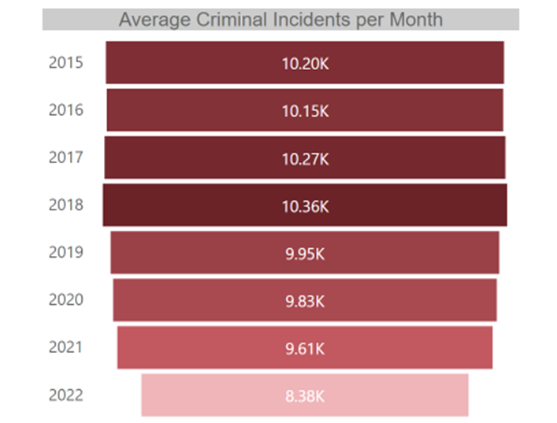
TRENDS IN CRIME & COVID-19
Average incidents per month declined yearly from 2019 – 2021.
2022 appears to be a continuation of this trend, though there are only 5 months of data to draw from.
While speculative, there may be a weak negative correlation between COVID-19 confirmed cases and a decrease in crime within Davidson County.
Notes:
Examining my newly found hypothesis, that criminal activity did indeed decrease during COVID-19, but that this is a continuation of a trend that started before the pandemic. We’re looking now at average incidents per month from 2015 – 2019. Again we see that from 2019 onward, average incidents per month did indeed decline.
2022 is, thus far, the year with the lowest incidents per month, on average. 2020, which we can consider the “start” of the pandemic and the year with the most restrictions in place, saw only a small decrease in incidents from 2019. This is further indication that, despite the unknowns regarding risk of COVID-19, and heavily restrictive measures in place, crime continued in a typical fashion. In subsequent years, 2021 and 2022, where unknowns and restrictions were fewer, crime continued to decrease. So it seems, crime is trending downward and while COVID-19 may be a contributor, there’s no indication it’s a driving factor.

Slide 9
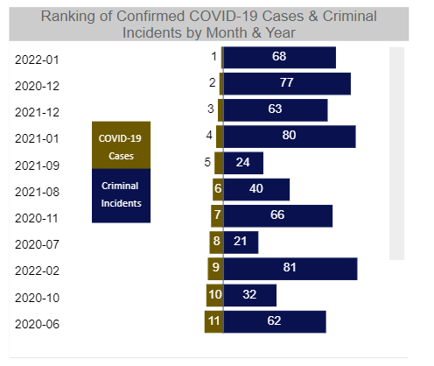
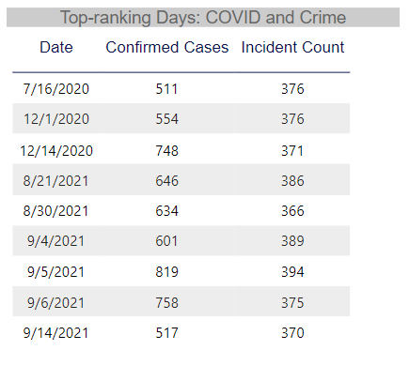
TRENDS IN CRIME & COVID-19
*There are 89 possible months in the Metro Nashville Police Department’s criminal incidents dataset
Months ranking highest for COVID-19 cases ranked low for number of criminal incidents.*
Of the 11 months shown, only one month (July 2020) correlates to a top-ranking month in criminal incidents.
July 2020 ranks in the top 25% for number of criminal incidents in a single month.
From March 2020 – May 2022, only 9 days peak for both confirmed COVID-19 cases and criminal incidents.
Notes:
To this point, all data seems to indicate that there is little correlation between COVID and crime in Davidson County. What correlation we have seen is a weak negative correlation, and isolated to specific months and events.
To fully prove this point, I further reviewed overlap between peaks in COVID-19 confirmed cases, which you’ll see here. The tornado chart on the left shows the top 10 months by year for COVID cases, while the right-hand side shows the rank for those months in number of criminal incidents. For reference, there are 89 months of data in the criminal incidents data set.
Notably, months ranking highest for COVID-19 cases did not correlate to a high-ranking month for criminal incidents. In fact, of the 10 months shown, only one month, July 2020, correlates to a top-ranking month for criminal incidents.
To the right, I reviewed all days where COVID-19 cases peaked, along with a correlating peak in Criminal incidents. Across 3 years, there are only 10 days where both confirmed cases and criminal incidents were at their highest.
Combining the data we’ve reviewed thus far, I felt the hypothesis that crime and COVID-19 were not correlated had been sufficiently proven. But at this point, I’ve only reviewed crime as a whole.

Slide 10
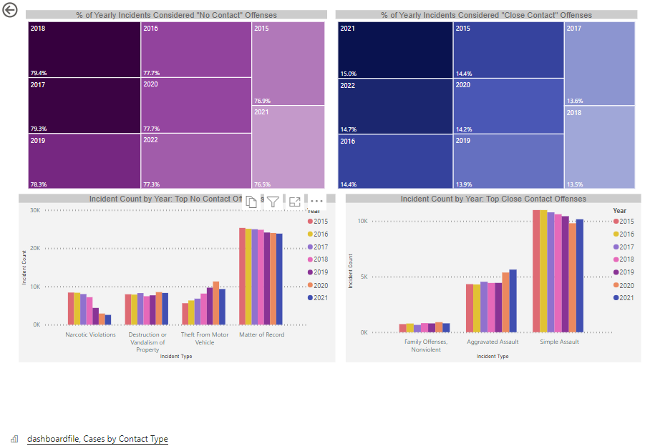
CRIMINAL OFFENSE TRENDS DURING COVID-19
There was no notable decrease in “close-contact” offenses during COVID-19
2021 was the highest year for these offenses. 15% of incidents were considered close-contact.
Offense types trended similarly before and during COVID-19. Family Offenses, Aggravated Assault, and Simple Assault remain the top 3 close-contact offenses each year.
Conversely, “no-contact” offenses were at their lowest in 2021.
Narcotic violations, Vandalism, and Theft from Motor Vehicles decreased from 2020 to 2021
Notes:
Within the criminal incidents data set, each incident has an offense description. To further understand any driving force of COVID on criminal activity, I classified each offense as “close contact,” a crime that requires close contact with another human, and no contact, a crime which did not require human contact.
If crime and COVID truly were interrelated, I would expect that close-contact offenses would decrease during COVID. To the right, a donut chart shows the percent of incidents in that year that are considered close contact. Notably, there is no decrease in close contact offenses during covid. In fact, 2021 was the 3rd highest year for these offenses. 13.8% of incidents were considered close-contact.
Types of close contact offenses also did not change, with the top 3 offenses – family offenses, aggravated assault, and simple assault – remains the same year over year.
Interestingly, no-contact offenses did decrease during the covid pandemic. These offense types were at their lowest in 2021. Hopefully this does not indicate that non-contact offenders began committing close-contact crimes, as we did see an increase in close-contact offenses in this same year.
As a positive note, narcotic violations did decrease during COVID-19, although this offense type remains a top offense in Davidson County. Other no-contact offenses, vandalism and theft from motor vehicles, also decreased from 2020 to 2021.

Slide 11
Conclusion
Data does not suggest that COVID-19 is a strong driver of crime in Davidson County, either upward or downward.
Incidents of crime have decreased in recent years, but declines began pre-COVID-19, in 2019.
In periods coinciding with severe weather events and stay-at-home orders, there is a negative correlation between COVID-19 and criminal incidents. Otherwise, correlation is weak negative or nominal.
Peak months for COVID-19 do not coincide with peak months for criminal incidents.
Close-contact offenses did not notably decline during COVID-19, indicating that criminals were not deterred by the risk of contracting COVID-19 from their victims.
In 2021, close-contact offenses increased 80bps from the previous year. No-contact offenses decreased -120bps.

Slide 12
Questions?

