Slide 1
MISHRA DEEPAK SURYABHAN SEAT No- 4103729

Slide 2

Predicting Car Price using
Regression Techniques

Slide 3
Why this Topic/Project?

Slide 4
Introuction
The focus of this project is developing machine learning models that can accurately predict the price of a car based on its features, in order to make informed purchases.

Slide 5
Tools & Techniques
Tools:
Python for model development using libraries like pandas, numpy, matplotlib, seaborn, scikitlearn, imblearn etc.
IDES - Jupyter notebook , Spyder
Techniques:
Histograms, reg plots, bar plots and density plots for data visualization and feature selection.
Scatter plots and heat maps to detect correlation and tune feature selection.
In-built algorithms to develop predictive models and cross-validation for evaluation.

Slide 6
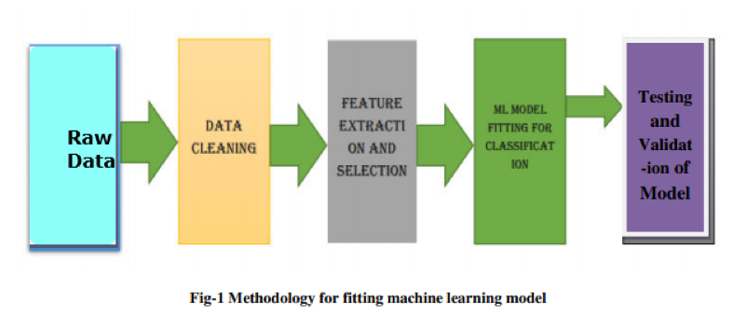
Methodology :

Slide 7
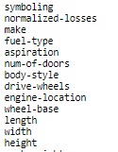
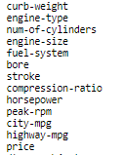
Dataset
data source: https://archive.ics.uci.edu/ml/machine-learning-databases/autos/imports-85.data
data type: csv
Available Features:

Slide 8
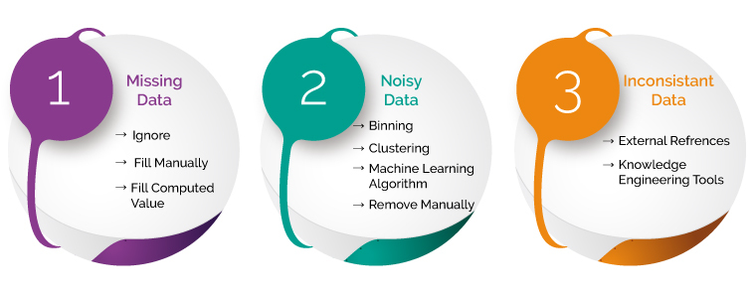
Data Preprocessing
Identify and handle missing values
Correct data format
Data Standardization
Data Normalization
Binning
Indicator variable or dummy variable

Slide 9
Identify missing values
"normalized-losses": 41 missing data
"num-of-doors": 2 missing data
"bore": 4 missing data
"stroke" : 4 missing data
"horsepower": 2 missing data
"peak-rpm": 2 missing data
"price": 4 missing data
Deal with missing data
drop data a. drop the whole row b. drop the whole column
replace data a. replace it by mean b. replace it by frequency c. replace it based on other functions

Slide 10
Replace by mean:
"normalized-losses": 41 missing data, replace them with mean
"stroke": 4 missing data, replace them with mean
"bore": 4 missing data, replace them with mean
"horsepower": 2 missing data, replace them with mean
"peak-rpm": 2 missing data, replace them with mean
Replace by frequency:
"num-of-doors": 2 missing data, replace them with "four".
Reason: 84% sedans is four doors. Since four doors is most frequent, it is most likely to occur
Drop the whole row:
"price": 4 missing data, simply delete the whole row
Reason: price is what we want to predict. Any data entry without price data cannot be used for prediction; therefore any row now without price data is not useful to us

Slide 11
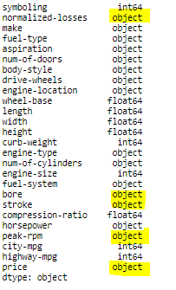
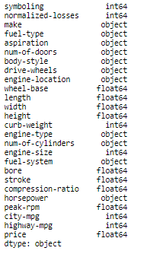
Correct data format
Before
After

Slide 12


Data Standardization
Transform mpg to L/100km:

Slide 13
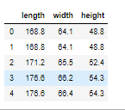
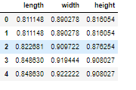
Data Normalization
we've normalized "length", "width" and "height" in the range of [0,1].

Slide 14
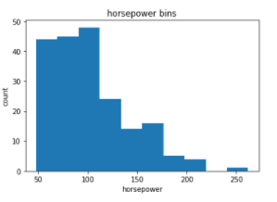
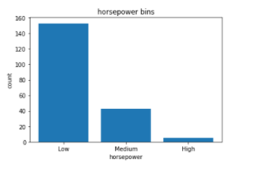
Handle Noisy Data using Binning Method
Fig. 1
Fig. 2
Fig 1: In our dataset, "horsepower" has 57 unique values.
Fig 2: "horsepower" with 3 categories ("Low","Medium" and "High")

Slide 15

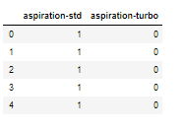
Indicator variable or dummy variable
column "fuel-type“ and aspiration has two unique values
Regression doesn't understand words, only numbers.

Slide 16
EXPLORATORY DATA ANALYSIS
(EDA)

Slide 17
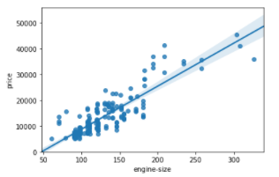
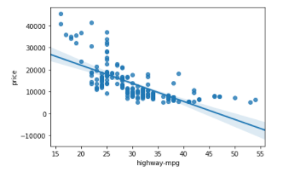
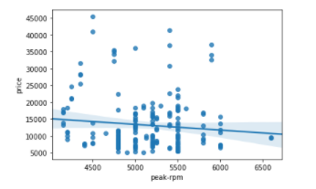
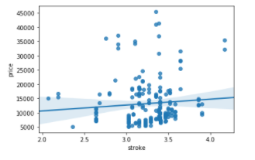
Analyzing Individual Feature Patterns using Visualization
Continuous numerical variables:

Slide 18
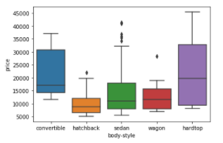
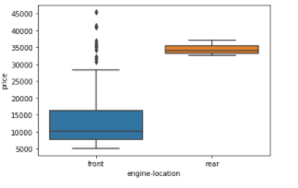
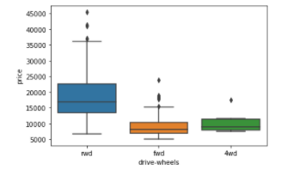
Categorical variables

Slide 19
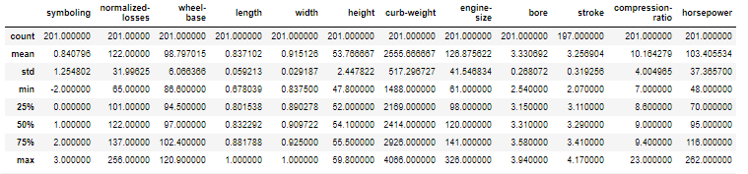
Descriptive Statistical Analysis
This will show:
the count of that variable
the mean
the standard deviation (std)
the minimum value
the IQR (Interquartile Range: 25%, 50% and 75%)
the maximum value

Slide 20
Important Variables
Continuous numerical variables:
Categorical variables:
Length
Width
Curb-weight
Engine-size
Horsepower
City-mpg
Highway-mpg
Wheel-base
Bore
Drive-wheels

Slide 21
Model Development
1. Simple Linear Regression.
Linear function:
𝑌ℎ𝑎𝑡=𝑎+𝑏𝑋
𝑌: response/dependent variable
𝑋: predictor/independent variable
a: refers to the intercept
b: refers to the slope

Slide 22
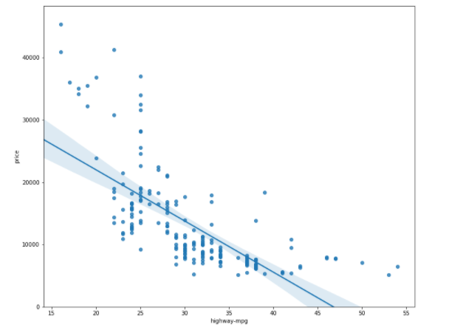
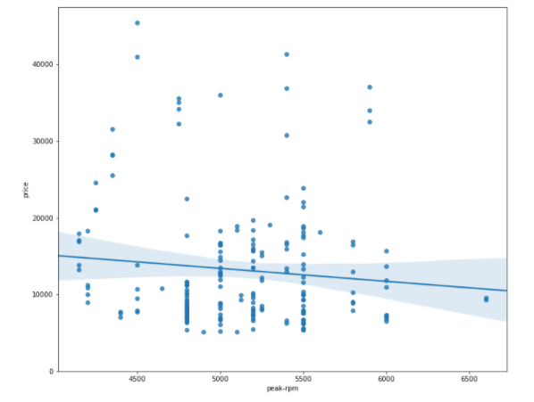
SLR Model Evaluation using Visualization
price is negatively correlated to “highway-mpg”
"peak-rpm" have more spread around the predicted line

Slide 23
2 : Multiple Linear Regression
Linear function:
𝑌ℎ𝑎𝑡 = 𝑎 + 𝑏1𝑋1 + 𝑏2𝑋2 + 𝑏3𝑋3 + 𝑏4𝑋4
𝑌:𝑅𝑒𝑠𝑝𝑜𝑛𝑠𝑒 𝑉𝑎𝑟𝑖𝑎𝑏𝑙𝑒
𝑋1:𝑃𝑟𝑒𝑑𝑖𝑐𝑡𝑜𝑟 𝑉𝑎𝑟𝑖𝑎𝑏𝑙𝑒 1
𝑋2:𝑃𝑟𝑒𝑑𝑖𝑐𝑡𝑜𝑟 𝑉𝑎𝑟𝑖𝑎𝑏𝑙𝑒 2
𝑋3:𝑃𝑟𝑒𝑑𝑖𝑐𝑡𝑜𝑟 𝑉𝑎𝑟𝑖𝑎𝑏𝑙𝑒 3
𝑋4:𝑃𝑟𝑒𝑑𝑖𝑐𝑡𝑜𝑟 𝑉𝑎𝑟𝑖𝑎𝑏𝑙𝑒 4
𝑎:𝑖𝑛𝑡𝑒𝑟𝑐𝑒𝑝𝑡
𝑏1:𝑐𝑜𝑒𝑓𝑓𝑖𝑐𝑖𝑒𝑛𝑡𝑠 𝑜𝑓 𝑉𝑎𝑟𝑖𝑎𝑏𝑙𝑒 1
𝑏2:𝑐𝑜𝑒𝑓𝑓𝑖𝑐𝑖𝑒𝑛𝑡𝑠 𝑜𝑓 𝑉𝑎𝑟𝑖𝑎𝑏𝑙𝑒 2
𝑏3:𝑐𝑜𝑒𝑓𝑓𝑖𝑐𝑖𝑒𝑛𝑡𝑠 𝑜𝑓 𝑉𝑎𝑟𝑖𝑎𝑏𝑙𝑒 3
𝑏4:𝑐𝑜𝑒𝑓𝑓𝑖𝑐𝑖𝑒𝑛𝑡𝑠 𝑜𝑓 𝑉𝑎𝑟𝑖𝑎𝑏𝑙𝑒 4

Slide 24
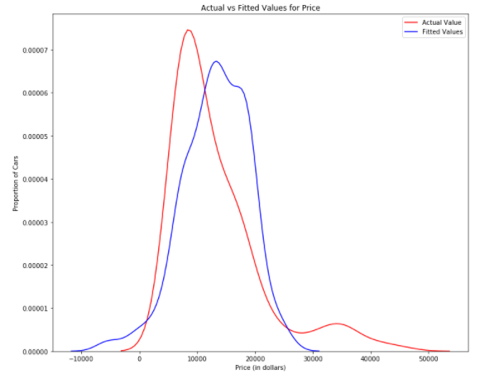
MLR Model Evaluation using Visualization
We can see that the fitted values are reasonably close to the actual values, since the two distributions overlap a bit

Slide 25
3: Polynomial Regression
different orders of polynomial regression:
Quadratic - 2nd order
𝑌ℎ𝑎𝑡 = 𝑎 + 𝑏1𝑋2 + 𝑏2𝑋2
Cubic - 3rd order
𝑌ℎ𝑎𝑡 = 𝑎 + 𝑏1𝑋2 + 𝑏2𝑋2 + 𝑏3𝑋3
Higher order:
𝑌= 𝑎 + 𝑏1𝑋2 + 𝑏2𝑋2 + 𝑏3𝑋3....

Slide 26
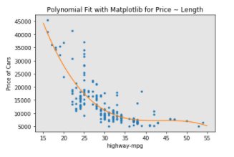
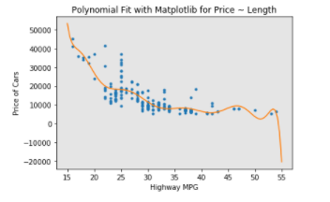
Polynomial Regression Model Evaluation using Visualization
We can already see from plotting that this polynomial model performs better than the linear model. This is because the generated polynomial function "hits" more of the data points.
The analytical expression for Multivariate Polynomial function gets complicated.

Slide 27
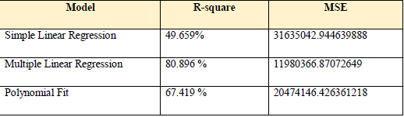
Measures for In-Sample Evaluation
Two very important measures that are often used in Statistics to determine the accuracy of a model are:
R^2 / R-squared
Mean Squared Error (MSE)

Slide 28
Decision Making: Determining a Good Model Fit
the model with the higher R-squared value is a better fit for the data.
the model with the smallest MSE value is a better fit for the data.

Slide 29
Conclusion:
Comparing these three models, we conclude that the MLR model is the best model to be able to predict price from our dataset. This result makes sense, since we have 27 variables in total, and we know that more than one of those variables are potential predictors of the final car price.

Slide 30

Training and Testing
Now we randomly split our data into training and testing data using the function train_test_split.
number of test samples : 81
number of training samples: 120
Accuracy results of training and testing data

Slide 31

Cross-validation Score

Slide 32
References:
GitHub (Project Source Code) Reference : https://github.com/mdeepak6411/M.Sc-IT_Project
data source: https://archive.ics.uci.edu/ml/machine-learning-databases/autos/imports-85.data
Other References :
https://www.leadingindia.ai/downloads/projects/BS/bs_7.pdf
http://www.temjournal.com/content/81/TEMJournalFebruary2019_113_118.pdf
https://www.ijeat.org/wp-content/uploads/papers/v9i1s3/A10421291S319.pdf
http://ripublication.com/irph/ijict_spl/ijictv4n7spl_17.pdf

Slide 33
Thank You ☺

