Slide 1
MISHRA DEEPAK SURYABHAN SEAT No- 4103729

Slide 2

Predicting Car Price using
Regression Techniques

Slide 3
Why this Topic/Project?
As a beginner in data science field its quite interesting to work with numeric variables
And the another reason is – a data science project requires atleast some basic domain knowledge and as a user we all know about it.

Slide 4
Introduction
The focus of this project is developing machine learning models that can accurately predict the price of a car based on its features, in order to make informed purchases.
We implement and evaluate various machine learning methods on a dataset consisting of the sale prices of different makes and models.

Slide 5
Tools & Techniques
Tools:
We use Python for model development using libraries like pandas, numpy, matplotlib, seaborn, scikitlearn, etc.
Pandas is the most popular python library that is used for data manipulationdata and analysis.
Numpy is mainly used for data manipulation and processing in the form of arrays.
Techniques:
Histograms, reg plots, bar plots and box plots for data visualization and feature selection.
Scatter plots and heat maps to detect correlation and tune feature selection.
In-built algorithms to develop predictive models and cross-validation for evaluation.

Slide 6
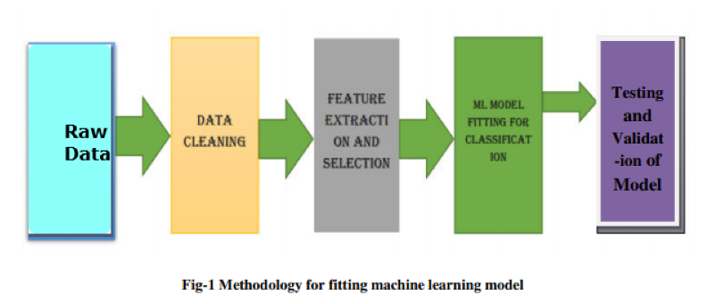
Methodology :

Slide 7
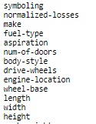
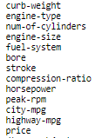
Dataset
For this project we use an automobile dataset from an online data source
data source: https://archive.ics.uci.edu/ml/machine-learning-databases/autos/imports-85.data
data type: csv
Available Features:

Slide 8
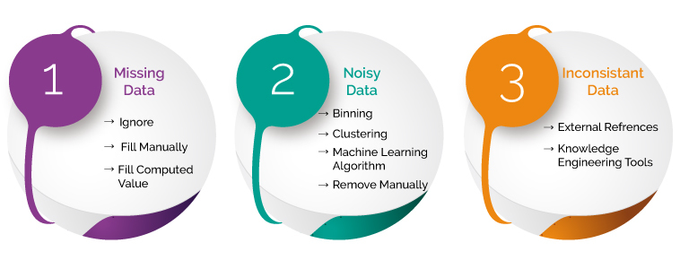
Data Preprocessing
is a Technique to transform raw data into useful and efficient format.
In this phase we perform various tech. to clean our data
Identify and handle missing values
Correct data format
Data Standardization
Data Normalization
Binning
Indicator variable or dummy variable

Slide 9
Identify missing values
"normalized-losses": 41 missing data
"num-of-doors": 2 missing data
"bore": 4 missing data
"stroke" : 4 missing data
"horsepower": 2 missing data
"peak-rpm": 2 missing data
"price": 4 missing data
Deal with missing data
drop data a. drop the whole row b. drop the whole column
replace data a. replace it by mean b. replace it by frequency c. replace it based on other functions

Slide 10
Replace by mean:
"normalized-losses": 41 missing data
"stroke": 4 missing data
"bore": 4 missing data
"horsepower": 2 missing data
"peak-rpm": 2 missing data
Replace by frequency:
"num-of-doors": 2 missing data, replace them with "four".
Reason: 84% sedans is four doors. Since four doors is most frequent, it is most likely to occur
Drop the whole row:
"price": 4 missing data, simply delete the whole row
Reason: price is what we want to predict. Any data entry without price data cannot be used for prediction; therefore any row now without price data is not useful.

Slide 11
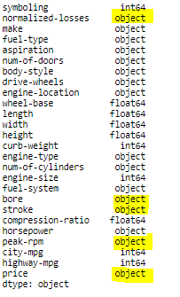
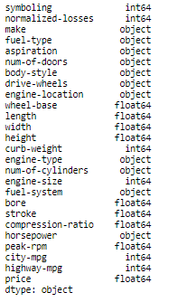
Correct data format
Before
After

Slide 12


Data Standardization
Standardization is the process of transforming data into a common format
Transform mpg to L/100km:

Slide 13
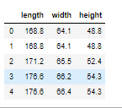
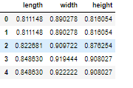
Data Normalization
Normalization is the process of transforming values of several variables into a similar range.
we've normalized "length", "width" and "height" in the range of [0,1].

Slide 14
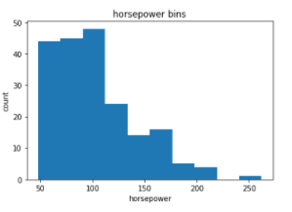
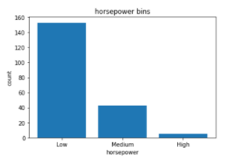
Binning
Binning is a process of transforming continuous numerical variables into discrete categorical 'bins', for grouped analysis.
Fig. 1
Fig. 2
Fig 1: In our dataset, "horsepower" has 57 unique values.
Fig 2: "horsepower" with 3 categories ("Low","Medium" and "High")

Slide 15

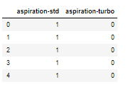
Indicator variable or dummy variable
An indicator variable is a numerical variable used to label categories. They are called 'dummies' because the numbers themselves don't have inherent meaning.
The column "fuel-type“ and aspiration has two unique values
Regression doesn't understand words, only numbers.

Slide 16
EXPLORATORY DATA ANALYSIS
(EDA)

Slide 17
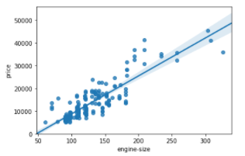
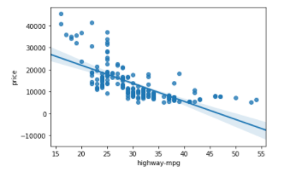
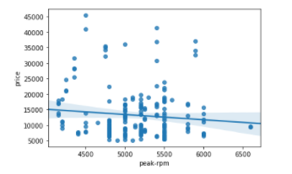
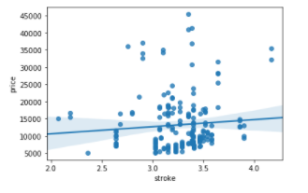
Analyzing Individual Feature Patterns using Visualization
Continuous numerical variables:
In order to start understanding the (linear) relationship between an individual variable and the price.
We can do this by using "regplot", which plots the scatterplot plus the fitted regression line for the data.
Positive linear relationship
Engine size seems like a pretty good predictor of price since the regression line is almost a perfect diagonal line.

Slide 18
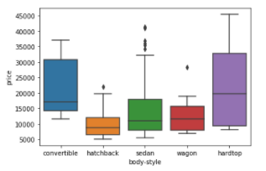
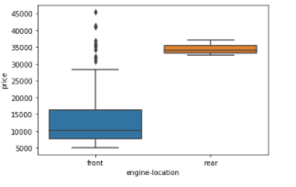
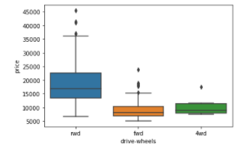
Categorical variables
A good way to visualize categorical variables is by using boxplots.
1 We see that the distributions of price between the different body-style categories have a significant overlap, and so body-style would not be a good predictor of price.
2 we see that the distribution of price between these two engine-location categories, front and rear, are distinct enough to take engine-location as a potential good predictor of price.
3 we see that the distribution of price between the different drive-wheels categories differs; as such drive-wheels could potentially be a predictor of price.

Slide 19
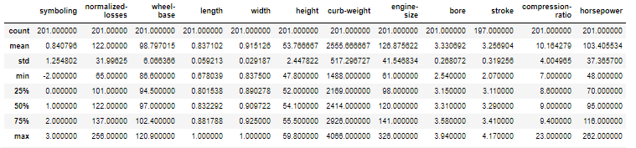
Descriptive Statistical Analysis
The describe function automatically computes basic statistics for all continuous variables.
This will show:
the count of that variable
the mean
the standard deviation (std) - Standard Deviation is a measure of how spread out numbers are.
the minimum value
the IQR (Interquartile Range: 25%, 50% and 75%) - is a measure of variability, based on dividing a data set into quartiles.
the maximum value

Slide 20
Important Variables
now we have a better idea of what our data looks like and which variables are important to take into account when predicting the car price.
Continuous numerical variables:
Categorical variables:
Length
Width
Curb-weight
Engine-size
Horsepower
City-mpg
Highway-mpg
Wheel-base
Bore
Drive-wheels

Slide 21
Model Development
1. Simple Linear Regression.
Simple Linear Regression is a method to help us understand the relationship between two variables:
Linear function:
𝑌ℎ𝑎𝑡 = 𝑎+𝑏𝑋
𝑌: response/dependent variable
𝑋: predictor/independent variable
a: a refers to the intercept of the regression line0, in other words: the value of Y when X is 0
b: b refers to the slope of the regression line, in other words: the value with which Y changes when X increases by 1 unit

Slide 22
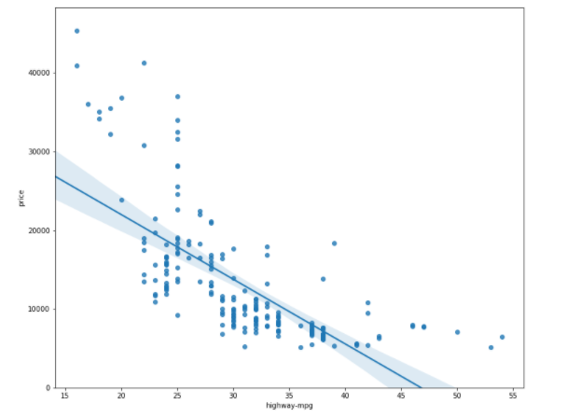
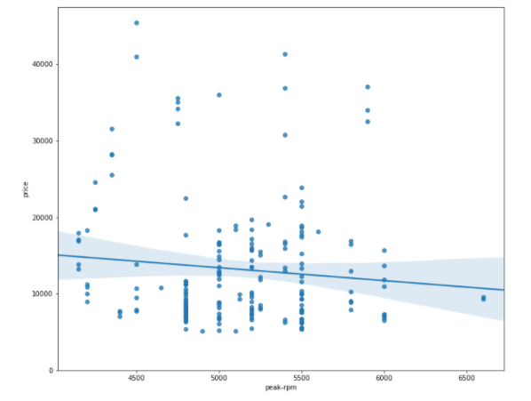
SLR Model Evaluation using Visualization
an excellent way to visualize the fit of our model is by using regression plots.
price is negatively correlated to “highway-mpg”
"peak-rpm" have more spread around the predicted line
1 We can see from this plot that price is negatively correlated to highway-mpg
2 The points for "peak-rpm" have more spread around the predicted line, and it is much harder to determine if the points are decreasing or increasing as the "highway-mpg" increases.

Slide 23
2 : Multiple Linear Regression
MLR is very similar to Simple Linear Regression, but this method is used to explain the relationship between one continuous dependent variable and two or more predictor (independent) variables..
Linear function:
𝑌ℎ𝑎𝑡 = 𝑎 + 𝑏1𝑋1 + 𝑏2𝑋2 + 𝑏3𝑋3 + 𝑏4𝑋4
𝑌:𝑅𝑒𝑠𝑝𝑜𝑛𝑠𝑒 𝑉𝑎𝑟𝑖𝑎𝑏𝑙𝑒
𝑋1:𝑃𝑟𝑒𝑑𝑖𝑐𝑡𝑜𝑟 𝑉𝑎𝑟𝑖𝑎𝑏𝑙𝑒 1
𝑋2:𝑃𝑟𝑒𝑑𝑖𝑐𝑡𝑜𝑟 𝑉𝑎𝑟𝑖𝑎𝑏𝑙𝑒 2
𝑋3:𝑃𝑟𝑒𝑑𝑖𝑐𝑡𝑜𝑟 𝑉𝑎𝑟𝑖𝑎𝑏𝑙𝑒 3
𝑋4:𝑃𝑟𝑒𝑑𝑖𝑐𝑡𝑜𝑟 𝑉𝑎𝑟𝑖𝑎𝑏𝑙𝑒 4
𝑎:𝑖𝑛𝑡𝑒𝑟𝑐𝑒𝑝𝑡
𝑏1:𝑐𝑜𝑒𝑓𝑓𝑖𝑐𝑖𝑒𝑛𝑡𝑠 𝑜𝑓 𝑉𝑎𝑟𝑖𝑎𝑏𝑙𝑒 1
𝑏2:𝑐𝑜𝑒𝑓𝑓𝑖𝑐𝑖𝑒𝑛𝑡𝑠 𝑜𝑓 𝑉𝑎𝑟𝑖𝑎𝑏𝑙𝑒 2
𝑏3:𝑐𝑜𝑒𝑓𝑓𝑖𝑐𝑖𝑒𝑛𝑡𝑠 𝑜𝑓 𝑉𝑎𝑟𝑖𝑎𝑏𝑙𝑒 3
𝑏4:𝑐𝑜𝑒𝑓𝑓𝑖𝑐𝑖𝑒𝑛𝑡𝑠 𝑜𝑓 𝑉𝑎𝑟𝑖𝑎𝑏𝑙𝑒 4

Slide 24
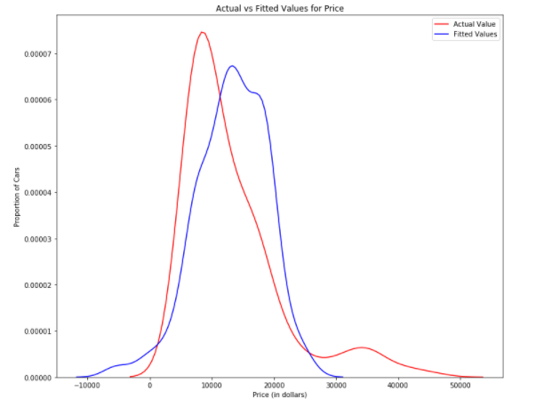
MLR Model Evaluation using Visualization
We can see that the fitted values are reasonably close to the actual values, since the two distributions overlap a bit

Slide 25
3: Polynomial Regression
Polynomial regression is a particular case of the general linear regression model or multiple linear regression models.
We get non-linear relationships by squaring or setting higher-order terms of the predictor variables.
different orders of polynomial regression:
Quadratic - 2nd order
𝑌ℎ𝑎𝑡=𝑎+𝑏1𝑋2+𝑏2𝑋2Yhat=a+b1X2+b2X2
Cubic - 3rd order
𝑌ℎ𝑎𝑡=𝑎+𝑏1𝑋2+𝑏2𝑋2+𝑏3𝑋3Yhat=a+b1X2+b2X2+b3X3
Higher order:
𝑌=𝑎+𝑏1𝑋2+𝑏2𝑋2+𝑏3𝑋3....

Slide 26
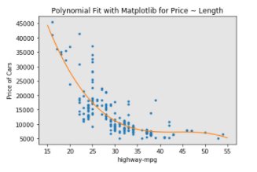
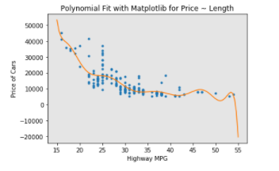
Polynomial Regression Model Evaluation using Visualization
We can already see from plotting that this polynomial model performs better than the linear model. This is because the generated polynomial function "hits" more of the data points.
The analytical expression for Multivariate Polynomial function gets complicated.

Slide 27
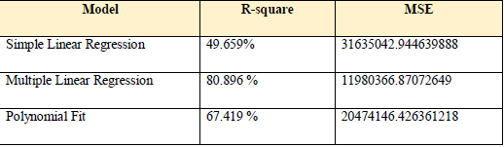
Measures for In-Sample Evaluation
Two very important measures that are often used in Statistics to determine the accuracy of a model are:
R^2 / R-squared
Mean Squared Error (MSE)
R-squared
R squared (coefficient of determination) is a measure to indicate how close the data is to the fitted regression line.
Mean Squared Error (MSE)
The Mean Squared Error measures the average of the squares of errors, that is, the difference between actual value (y) and the estimated value (ŷ).

Slide 28
Decision Making: Determining a Good Model Fit
the model with the higher R-squared value is a better fit for the data.
the model with the smallest MSE value is a better fit for the data.
This R-squared in combination with the MSE show that MLR seems like the better model fit in this case, compared to SLR.

Slide 29
Conclusion:
Comparing these three models, we conclude that the MLR model is the best model to be able to predict price from our dataset. This result makes sense, since we have 27 variables in total, and we know that more than one of those variables are potential predictors of the final car price.

Slide 30

Training and Testing
Now we randomly split our data into training and testing data using the function train_test_split.
number of test samples : 81
number of training samples: 120
Accuracy results of training and testing data

Slide 31

Cross-validation Score
Sometimes we don’t have sufficient testing data; as a result, we require to perform Cross-validation..
cross_val_score.

Slide 32
Conclusion
Car price prediction can be a challenging task due to the high number of attributes that should be considered for the accurate prediction. The major step in the prediction process is collection and pre-processing of the data. In this project we were built to normalize, standardize and clean data to avoid unnecessary noise for machine learning algorithms and finally we have developed a MLR model to predict the car price.

Slide 33
References:
GitHub (Project Source Code) Reference : https://github.com/mdeepak6411/M.Sc-IT_Project
data source: https://archive.ics.uci.edu/ml/machine-learning-databases/autos/imports-85.data
Other References :
https://www.leadingindia.ai/downloads/projects/BS/bs_7.pdf
http://www.temjournal.com/content/81/TEMJournalFebruary2019_113_118.pdf
https://www.ijeat.org/wp-content/uploads/papers/v9i1s3/A10421291S319.pdf
http://ripublication.com/irph/ijict_spl/ijictv4n7spl_17.pdf

Slide 34
Thank You ☺

