Slide 1
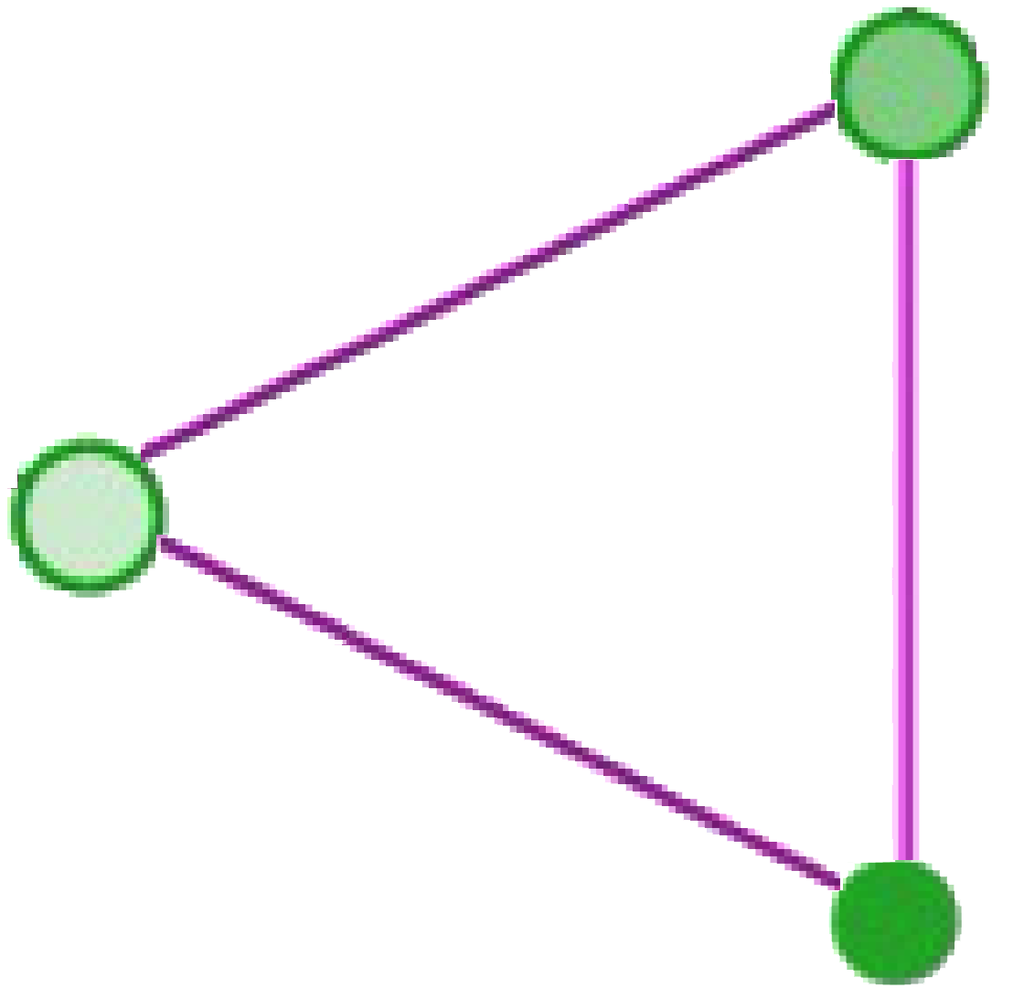
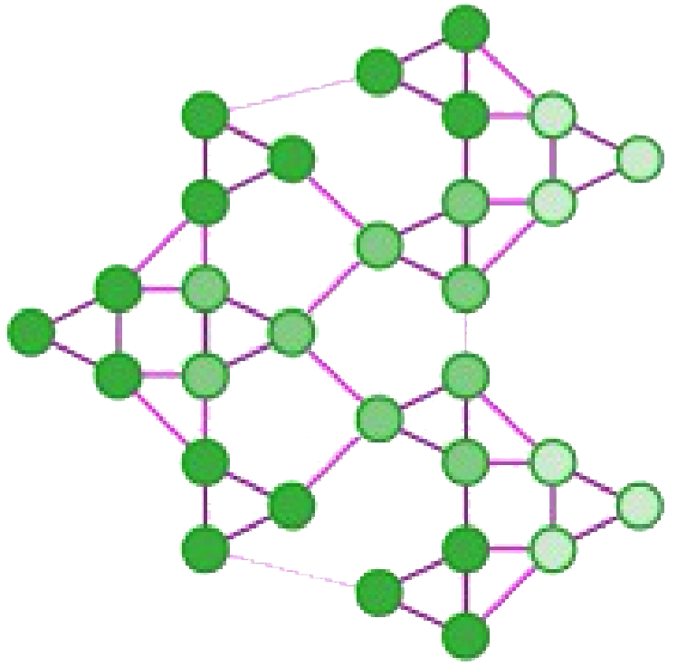
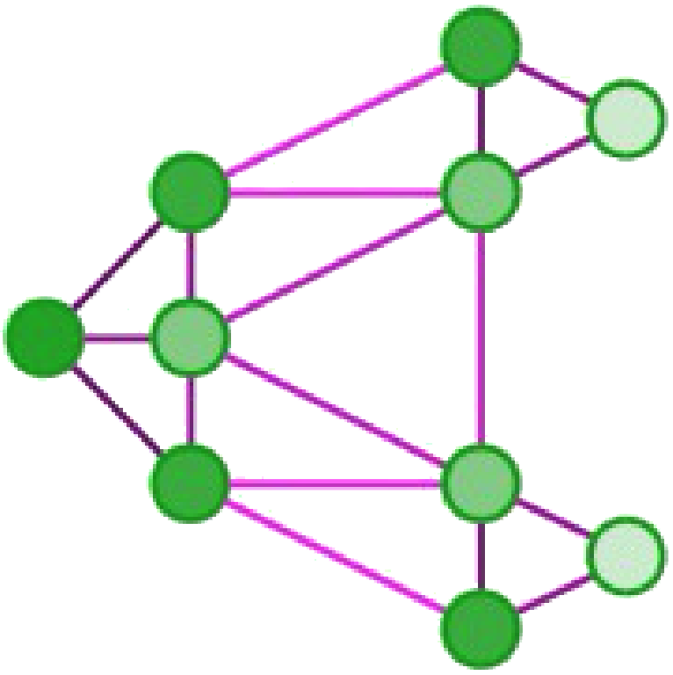
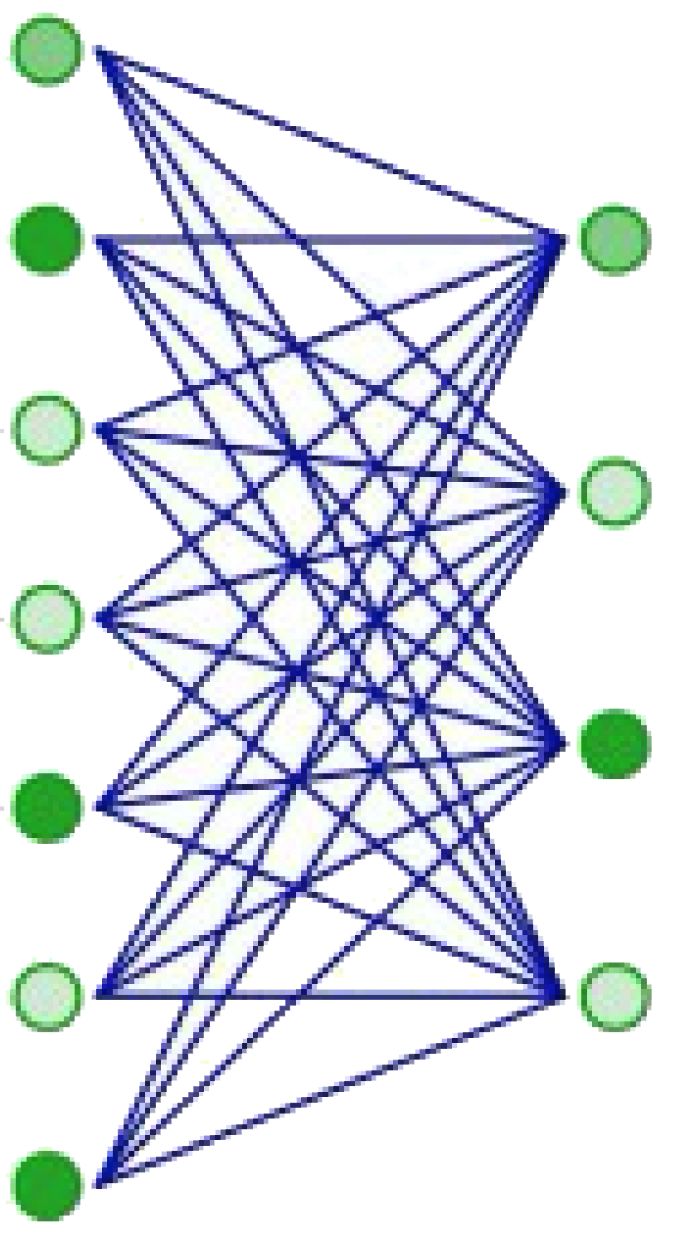
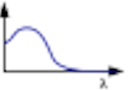
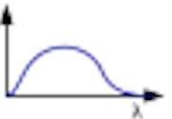
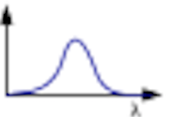
ReLu activation
+
Graph coarsening
Factor 2^{p}
Pre-computed
+
Pooling (GPUs)
Spectral Filters
O(K) parameters
O(E.K) operations (GPUs)
…
Graph
Ex: social, biological,
telecommunication graphs
Output signal
Class labels
Input signal
on graphs
Graph convolutional layers
(extract local stationary features on graphs)
Fully connected layers
Notes:
16
x \in \mathbb{R}^n
x^{l=0} \in \mathbb{R}^{n_{l=0}}
x^{l=1} \in \mathbb{R}^{n_0F_1}
\theta^{l=1} \in \mathbb{R}^{K_1F_1}
n_1=n_0/2^{p_1}
x^{l=5} \in \mathbb{R}^{n_4F_5}
y \in \mathbb{R}^{n_c}
\theta^{l=6} \in \mathbb{R}^{n_5n_c}
12
G=G^{l=0}
g_{\theta^{K_1}}^{1}
F_l = \textrm{nb spectral filters}
x^l = \textrm{downsampled signals}
\theta^l = \textrm{nb parameters}
n_c = \textrm{nb classes}
p_l = \textrm{coarsening degree}
g_{\theta^{K_l}} = \textrm{spectral filters}
l = \textrm{coarsening level}

Slide 2
Notation:
ReLu activation
+
Graph coarsening
Factor 2^{p}
Pre-computed
+
Pooling (GPUs)
Spectral Filters
O(K) parameters
O(E.K) operations (GPUs)
…
Graph
Ex: social, biological,
telecommunication graphs
Output signal
Class labels
Input signal
on graphs
Graph convolutional layers
(extract local stationary features on graphs)
Fully connected layers
Notes:
16
x \in \mathbb{R}^n
x^{l=0} \in \mathbb{R}^{n_{l=0}}
x^{l=1} \in \mathbb{R}^{n_0F_1}
\theta^{l=1} \in \mathbb{R}^{K_1F_1}
n_1=n_0/2^{p_1}
x^{l=5} \in \mathbb{R}^{n_4F_5}
y \in \mathbb{R}^{n_c}
\theta^{l=6} \in \mathbb{R}^{n_5n_c}
12
G=G^{l=0}
g_{\theta^{K_1}}^{1}
F_l = \textrm{nb spectral filters}
x^l = \textrm{downsampled signals}
\theta^l = \textrm{nb parameters}
n_c = \textrm{nb classes}
p_l = \textrm{coarsening degree}
g_{\theta^{K_l}} = \textrm{spectral filters}
l = \textrm{coarsening level}

Slide 3
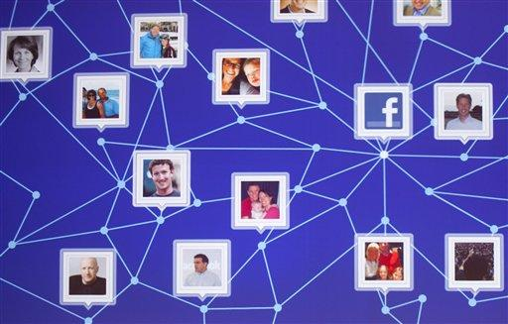
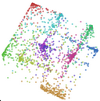
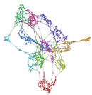
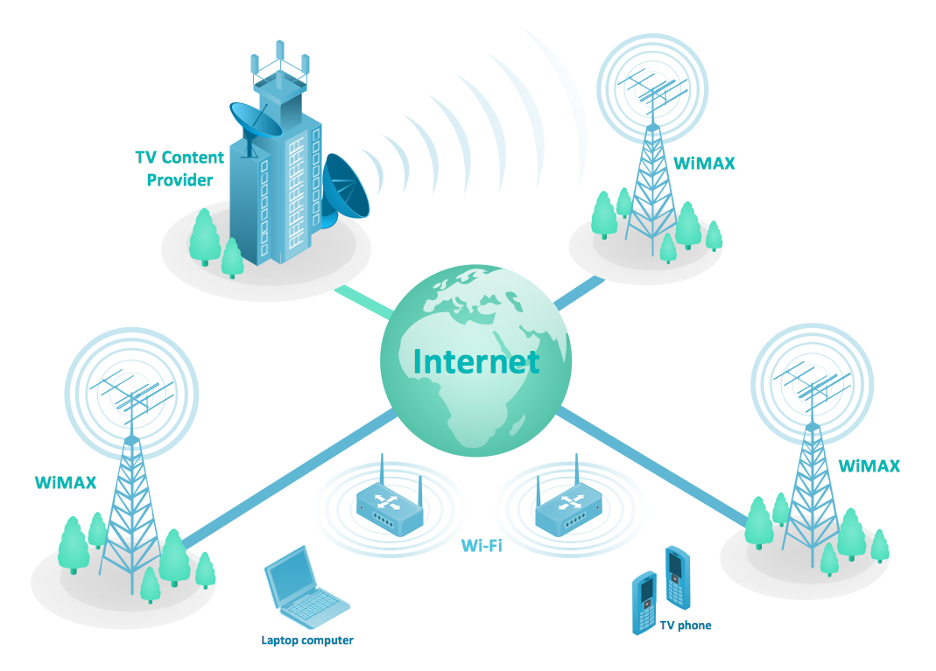

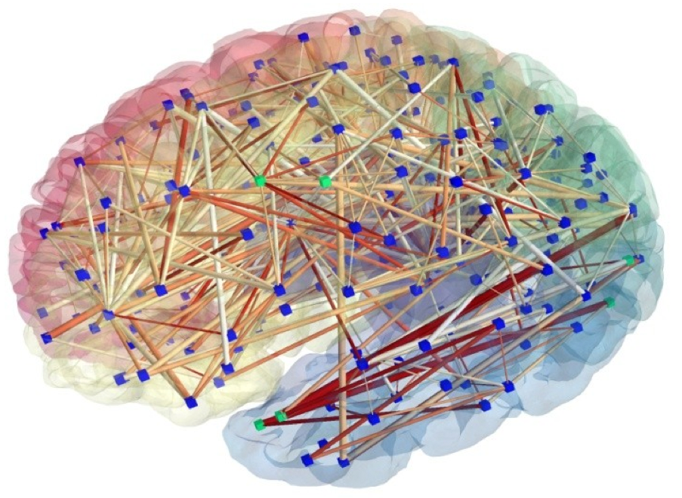
•
•
•
•
•
•
•
•
•
Social networks
…
=
Telecommunication
networks
Fully Connected
Network
Brain structure
Graph or network
of data
Sparse Feature Extraction with
Graph Filters
(Filters are automatically learned)
Graph Coarsening
+ Connected Network
+ Non-linear Activation
Multiple
Layers
(Deep architecture)
Classification
(SVM on graphs)

