Slide 1
GAP MVS Multi Virus Scanner

Slide 2
Self-monitoring and Recovering provides high availability
A web-based UI console allows administrators to :
monitor status of all processes and critical MVS system objects
Stop/start/restart/disable individual processes
Status of DATs files with alerts if DATs are not being updated within the defined time period.
Physical resource configuration is automatically adjusted to the deployed hardware
Depending on the configuration option DATs are downloaded either from the Internet or locally from the S3 bucket.
Single Input Queue and Single Output Queue for ALL Drop Zones
Support of Two Scanning Paths
AWS SQS
Kafka messages
Integrated with up domaining flow

Slide 3
Supports up to 19 AV engines (currently Clamav, and McAfee AV angines configured and activated)
Configuration files allow MVS to run in a docker container, or Kubernetes pods
Batch oriented scanning to increase efficiency.
Highly parallel execution
Parallel downloads
Simultaneous scanning of each object by all AV engines and object-level collection of results
Batch size-driven dynamically created thread pool scans a set of files in parallel.
Results of AV scanning engines are summarized and clean/infected status is determined for each scanning object.
Object has a clean status only when ALL AV engines mark it as clean

Slide 4
Objects are moved/downloaded from the source to MVS scan area
After scan
All objects are deleted from the scan area
AWS scanned objects
Clean objects - keys are posted on AWS SQS output queue
Clean objects - only tag information is sent to AWS S3 objects
Infected objects – moved from input to infected bucket and tagged with scan info including detected virus names from each engine
Non-cloud based objects
Clean objects moved to the output area
Infected objects moved to the infected area

Slide 5
Objects tagged with scanned information
AWS scanned objects Tagged with:
List of AV engines
Signatures
Results from each engine
Timestamp
Non-cloud based objects provided with the same scan tagging information in Kafka output message

Slide 6
MVS Logging
Accessible from outside container
Log Hierarchy
Root Log directory on the host - /srv/mvs-log
Operational logs information
MVS System Monitor log – monit.log
MVS initialization and processes and critical files status updated every 60 secs
DATs downloads switch log – main_switch.log
Logs MVS instance ID and DATs definition origin (internet/remote or local)
Clamav log dir – DATs download detailed information
Mcafee log dir – DATs download detailed information

Slide 7
MVS Logging cont.
MVS scan logs
Time rotated logs periodically archived by a separate app.
top log directory - /srv/mvs-log/multiav
Separate scan master logs for cloud objects (S3) and non-cloud objects (FS)
Each mater log contains a timestamped chronological set of records of each object including download, scan, result, and all errors and exceptions generated
A separate log for each drop zone with a timestamped chronological set of records for each object including download, scan, result

Slide 8
MVS Auto-Scaling support
To reduce scanning latency the MVS is configured for AWS Auto Scaling
Horizontal Scaling out and Scaling in is accomplished through:
a launch template for EC2 instance
CloudWatch alarms for AWS SQS metrics (ApproximateAgeOfOldestMessage)
Step scaling policies
Scaling triggers

Slide 9
MVS Auto-Scaling support cont..
Current default configuration of auto-scaling is set to be:
triggered when the SQS messages are on the queue longer than 10 min.
Scaling out MVS to up to five instances
Scaling in back to one instance when the SQS messages stay less than 5 mins on the queue.
Triggers and scaling configuration can be modified on-the-fly and take immediate effect by changing auto-scaling behavior.

Slide 10
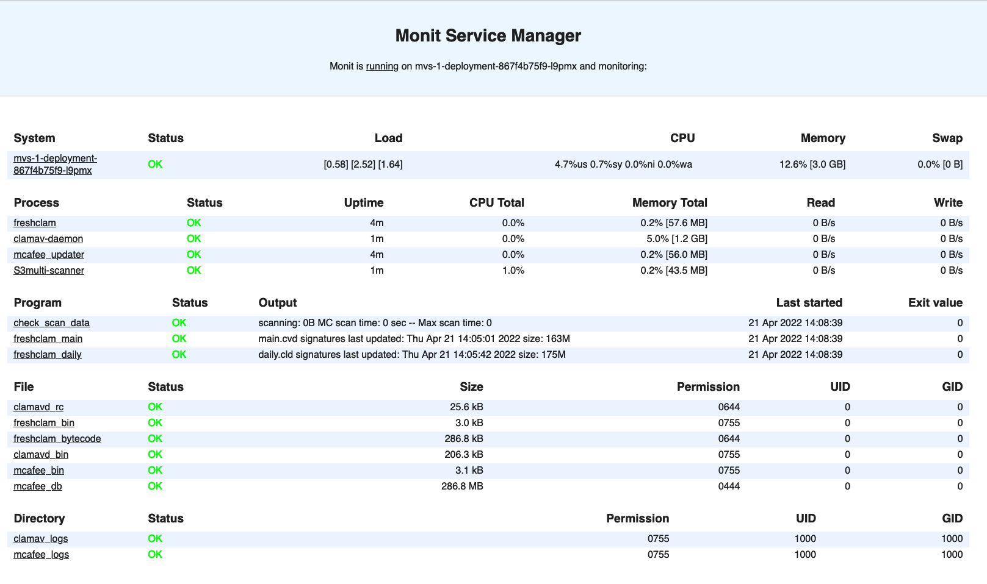
MVS Console for Cloud-Based Cponfiguration

Slide 11
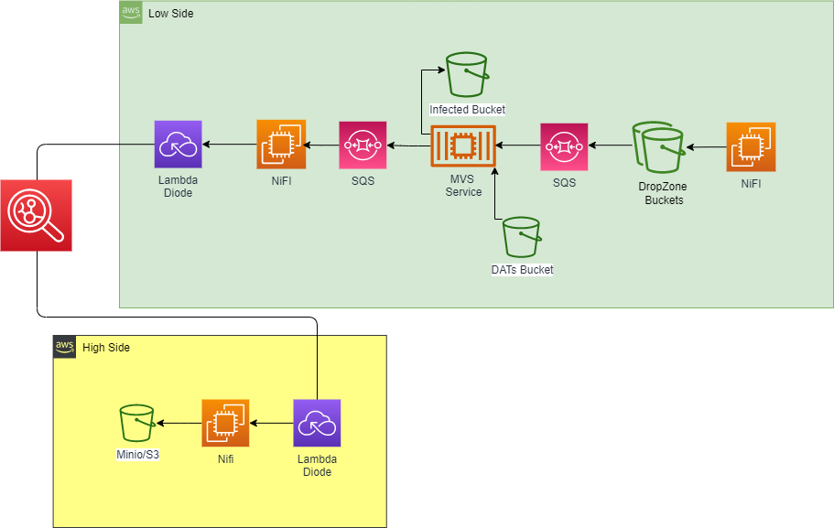

Slide 12
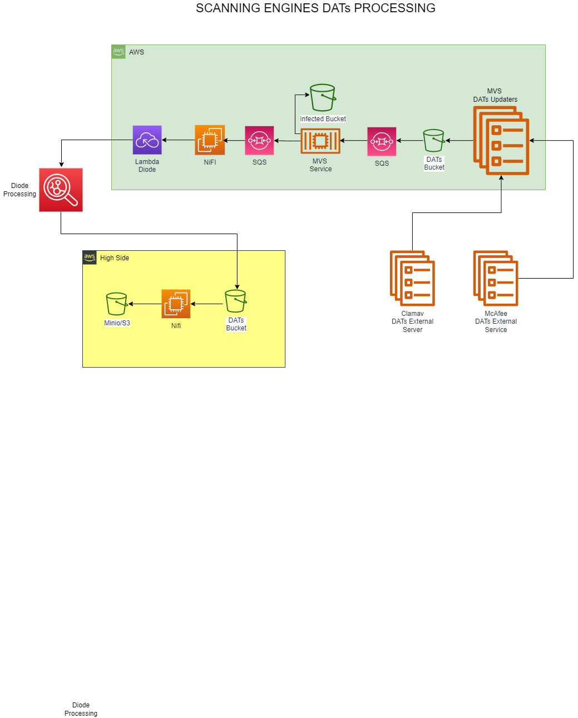

Slide 13
Non-cloud based Scanning
The MVS can be configured to scan input files in non-cloud based environment.
Utilizing NiFi flows converting request messages into Kafka messages
Reference the NiFi MVS Input Flow and the MVS Output flow templates provided can be integrated with locally deployed updomaining NiFi flow
Input flow monitors the input directory for dropped in files, converts the notifications into JSON flow files, and composes and posts Kafka messages on the topic kafka-mvs-src.
The MVS pulls messages from the Kafka Server, parses it, and copies the file to the scan directory.

Slide 14
Non-cloud based Scanning cont…
Scanning results for each file are collected and the overall scan status is determined (CLEAN or INFECTED)
CLEAN files are moved to the output directory and Kafka messages containing, the file name, overall scan result, the result for each engine, engines used (McAfee, Clamav), and the date of the scan are posted to the Kafka server for the topic kafka-mvs-dst.
INFECTED, the files are moved into the infected directory and a Kafka message is posted containing the same information as for clean files but also including the virus name found by each of the engines.
The NiFI MVS Output Flow consumes Kafka messages posted by the MVS to kafka-mvs-dst topic and continues processing clean files according to the deployment specific requirements.

Slide 15
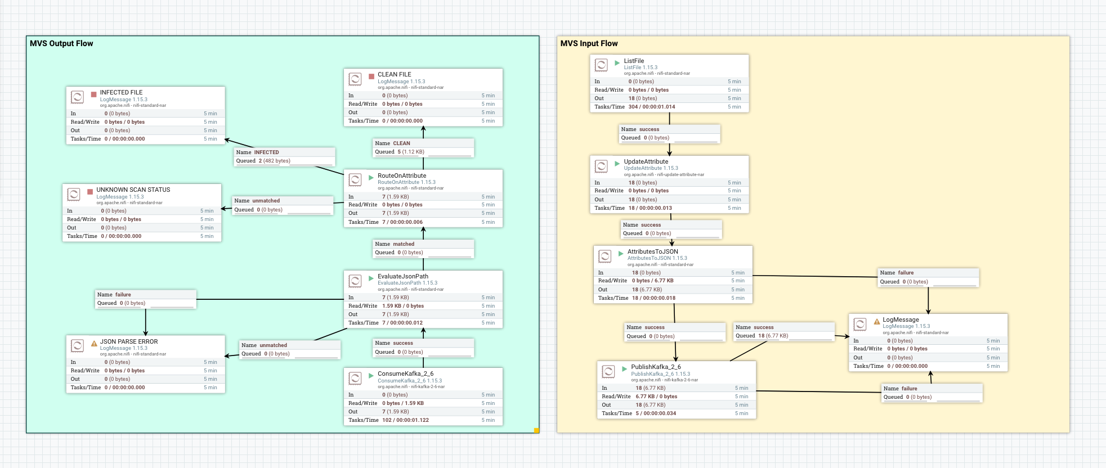
NiFi Templaces for Non-Cloud Based MVS scan

Slide 16
Non-Cloud Based MVS Output Examples
CLEAN file message output example
INFECTED file message output example

Slide 17
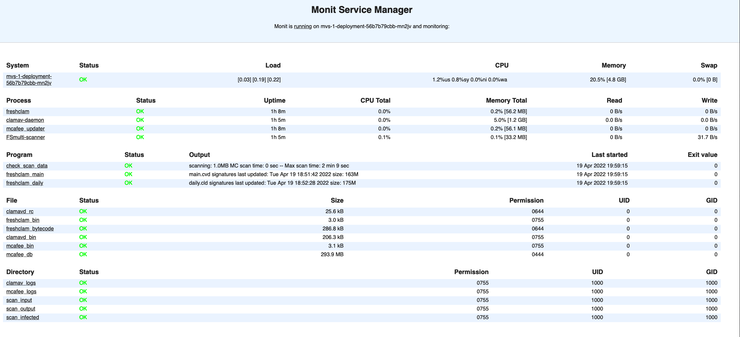
MVS Console for Non-Cloud Based Configuration

