Slide 1

Dart
Iván Zaera Avellón
Co: izaera@gmail.com
Tw: @izaera

Slide 2
Table of contents
Language features
  Data typing
  Specific language constructions
  Modularity and visibility
  Mixins
  Arithmetic
Concurrency model
  Async, Futures, Completers
  Isolates
Testing
  Tests
  Mocks
More resources
  Development tools
  Dart project's management
  Libraries and APIs
  Code example: cipher library

Slide 3

Introduction

Slide 4

Language features

Slide 5
Data typing
Optional typing
Dynamic keyword
Implicit interfaces
Implements and extends are interchangeable
Is and is! operator
Checked runtime mode

Slide 6
Specific language constructions (1/2)
Cascade .. operator
Closures
One line functions (=>)
Optional arguments
Named arguments

Slide 7
Specific language constructions (2/2)
Factory constructors
Named constructors
Initialization of fields with this. syntax
Getters, setters, and final
Const

Slide 8
Modularity and visibility
Libraries and parts
Visibility
  Public
  Library private
Concise private modifier: _
Cannot extend library private classes

Slide 9
Mixins
Orthogonal functionality
Used where OO is-a relation does not apply
Keyword: with
Only static mixins, not runtime (like Groovy's metaClass, for instance)

Slide 10
Arithmetic
Base num type with double and int subtypes
All nums are signed
Integers have infinite precision (VM handles two internal subtypes for efficiency)
Doubles are stored in IEEE format
Integers are implemented as doubles when compiled to Javascript :-(

Slide 11
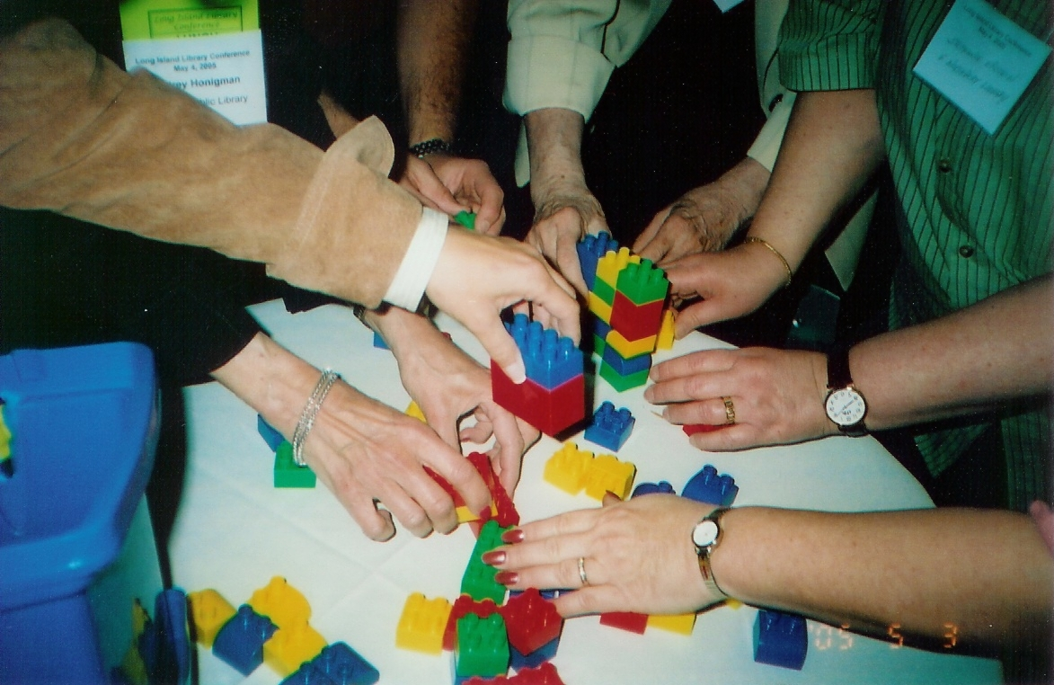
Concurrency model

Slide 12
Async, Futures, Completers
Async execution due to event loop (like JS)
Futures
  Promise to provide a result of some computation some time in the future
  Difficult and cumbersome error handling
Completers
  Low level construction to signal Future finalization
  Should be used with care because makes error handling more difficult than Futures

Slide 13
Isolates
Alternative to threads
Message passing paradigm
  Shared memory not allowed
  Use SendPort for sending messages
Less error prone
But less efficient

Slide 14

Testing

Slide 15
Tests
DSL: group(), test(), expect()
Matchers similar to Hamcrest Java library
void main() {
group( “converters:”, () {
test( "toUint32()", () {
expect( toUint32( 0x100000000 ), 0x00000000 );
expect( toUint32( -1 ), 0xFFFFFFFF );
});
});
}

Slide 16
Mocks
Mock by extending Mock class
class MockObjectory extends Mock implements Objectory {}
test( "getById() llama a Objectory.findOne() con la query correcta", () {
final id = "test_object_id";
final db = new MockObjectory();
final mockEntity = new MockEntity();
db.when( callsTo("findOne",anything) ).alwaysReturn( new Future.value(mockEntity) );
final dao = new TestObjectoryDao( "collection", db );
return dao.getById(id).then( (entity) {
var query = db.getLogs( callsTo("findOne", anything ) ).first.args[0].toString();
expect( query, equals("ObjectoryQueryBuilder(collection {_id: ObjectId(${id})})") );
});
});

Slide 17

More resources

Slide 18
Development tools
Dart editor
  Lightweight
  Static analyzer
  Refactor tools
Dart Javascript compiler
  Tree shaking
  Minifying
Pub for dependency handling

Slide 19
Dart project's management
Two mailing lists:
  misc@dartlang.org : for common questions
  web@dartlang.org : for client side framework (Polymer) questions
Bugtracking
  http://dartbug.com : redirects to Google Code
Version control system
  http://github.com/...
  Latest commits: https://code.google.com/p/dart/source/list
Standardization
  ECMA is working on Dart's standard
  http://www.ecma-international.org/memento/TC52.htm

Slide 20
Libraries and APIs (1/2)
dart:async
dart:chrome (client)
dart:collection
dart:core
dart:html (client)
dart:indexed_db (client)
dart:io (server)
dart:isolate
dart:json
dart:math
dart:mirrors
dart:svg (server)
dart:typed_data
dart:utf
dart:web_audio (client)
dart:web_gl (client)
dart:web_sql (client)

Slide 21
Libraries and APIs (2/2)
args: a library to handle command line arguments
crypto: a library with hash algorithms
fixnum: fixed size ints (32 and 64 bits)
intl: I18N support
logging: standard logging
meta: meta annotations library (for example: @deprecated y @override).
serialization: object serialization support
unittest: unit testing library
mock: mocking library for unit testing (similar to mockito)
matchers: matchers library for unit testing (similar to Hamcrest)

Slide 22
Code example: cipher library
Cryptography library
Code based on Bouncy Castle java library
https://github.com/izaera/cipher

