Slide 1
Liferay Module Framework
Why modularity matters
Miguel Ángel Pastor Olivar

Slide 2
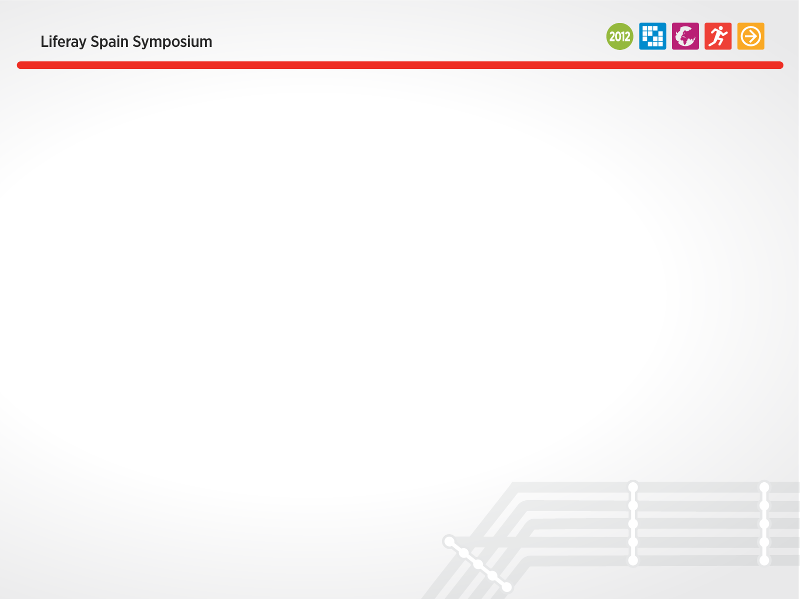
A little bit about me
Working at the "infrastructure" side
Cloud computing and distributed systems
Interests in concurrent and distributed programming. Functional programming advocate!
Scala, OSGI and AspectJ enthusiast. Erlang aficionado
Email: miguel.pastor at liferay dot com
Twitter handler: miguelinlas3

Slide 3
The need for modularity

Slide 4
What does modularity mean?
Systems composed of relatively small self-contained units
Clear interfaces defined between them

Slide 5
The need for modularity
Large systems are extremely complex to develop and maintain
Highly coupled systems
Cloud computing
  Multiple deployments are co-located
Footprint and performance
Distributed development

Slide 6
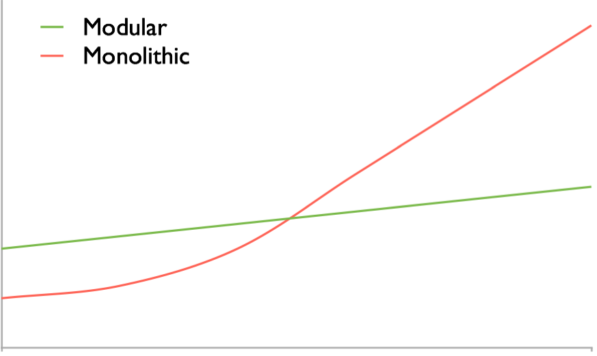
Complexity vs cost
Cost
unmanageable
Small focused
pieces
Complexity

Slide 7
What are you looking for?
Modules
Deployment mechanism
Dependency management
Dynamism
Encapsulation
Versioning

Slide 8
Liferay & Modularity

Slide 9
“Inside” benefits
Decoupled and highly focused components
Easier development process
Simplify current implementations/patterns
Easier to implement new features
Highly focused teams
Easier distributed development

Slide 10
“Outside” benefits
More frequent delivery of new features or improvements
Less bugs due to higher degree of focus
Quicker and simpler delivery of patches for bugs and security issues
Robustness
Footprint

Slide 11
Becoming real!
OSGI (Open Service Gateway Initiatives) as foundation
Currently in development. Available in 6.2
Let's see some insights!

Slide 12
A quick intro to OSGI

Slide 13
OSGI features/benefits
  Reduce complexity
    Developing bundles
  Dynamism
    Real world is dynamic; deal with it!
  Deployment mechanism
    Determine how components are installed and managed
  Dynamic updates
    Do not bring down the whole system

Slide 14
OSGI features/benefits
  Versioning
    Multiple versions of the same component
  Small and fast
    About 300K jar file
  Non intrusive. Runs everywhere.
  Widely used
    Eclipse, Glassfish, JBoss, Virgo RT, . . .

Slide 15
OSGI architecture
Services
S
e
c
u
r
i
t
y
Bundles
Lifecycle
Modules
Executing environment
Java Virtual Machine
Operating system

Slide 16
OSGI architecture
  Bundles
    OSGI components
  Services
    Connecting in a dynamic way. POJOs.
  Life-cycle
    How to install, start, stop, update and uninstall bundles

Slide 17
OSGI architecture
  Modules
    About encapsulating and importing/exporting code
  Security
    All aspects related to security
  Execution environment
    What methods and classes are available

Slide 18
OSGI lifecycle
REFRESH, UPDATE
INSTALL
INSTALLED
STARTING
RESOLVE
START
REFRESH, UPDATE
UNINSTALL
RESOLVED
ACTIVE
UNINSTALL
STOP
STOPPING
UNINSTALLED

Slide 19
Liferay Module Framework internals

Slide 20
Main points
  Embedded OSGI framework
    Ideally should be “agnostic”
  HTTP Service implementation
  Backwards compatible
  Enabled by a configuration property

Slide 21
100000 feet architecture
Webapp Server
Plugin A
Plugin B
Traditional deployment mechanism
Liferay Portal
OSGI container
OSGI based plugins
Plugin X
Plugin Y

Slide 22
How it works?
Deployment
Folder
AutoDeploy
listeners
Web Bundle Processor
Monitored by
the OSGI
framework
Blocked
Valid WAB
bundle
Web Bundle Processor
Container
notifies the
deployer
OSGI
Container
Web Bundle Deployer

Slide 23
Leveraging all the power!
The module admin portlet

Slide 24
Leveraging all the power!
New kind of plugins

Slide 25
Q & A

