Slide 1


Database versioning with FlywayDB
Manuel de la Peña
Software Engineer
@mdelapenya

Slide 2


Why DB migration tools?
Lots of developers!!!
Development
CI
Pro
Test
Pre
https://cdn1.iconfinder.com/data/icons/database/PNG/256/Database_3.png
Notes:
Many developers adding changes to the database
Several environments to maintain

Slide 3
…in the code side…
Version Control
Release tool/plugins on CI
Notes:
Most common choices

Slide 4
…but in the Database…

Slide 5
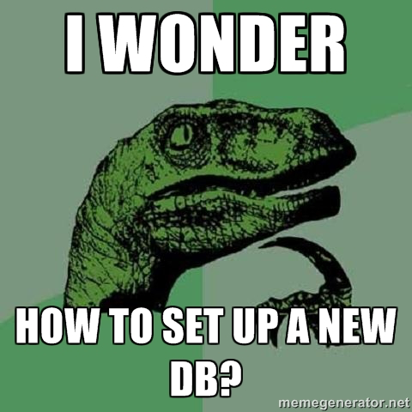

Slide 6
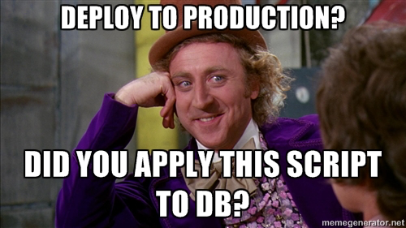

Slide 7
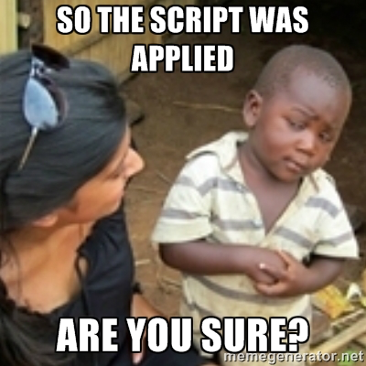

Slide 8
Which version is your DB?

Slide 9


Slide 10
What we’d love is…
Recreate DB from scratch
Make it clear the state of the DB
Migrate in a deterministic way!!

Slide 11
Database migrations
Made easy

Slide 12
How FlywayDB works
Metadata table (SCHEMA_VERSION)
Classpath search for migrations
SQL or Java
Sorted by version, and applied in order
Compared against current version
Checksum change-detection validation

Slide 13
Supported DB’s
PostgreSQL
Oracle
HSQL
SQL Azure
SQL Server
Derby
Android SQLite
MariaDB
DB2
MySQL
Google Cloud SQL
H2

Slide 14
Executing FlywayDB
flyway.properties
Command Line
jars dir
Maven Plugin
migrations dir
Ant
flyway migrate
Gradle
SBT (Scala Build Tool)
Java classes
API
Spring configuration

Slide 15
Migrations

Slide 16
Versions
One or more numeric parts
Separated by a dots or an underscore
Underscores are replaced by dots at runtime
Leading zeros are ignored on each part

Slide 17
Version examples
1
205.68
001
20130115113556
5.2
2013.1.15.11.35.56
5_2 (5.2 at runtime)
2013.01.15.11.35.56
1.2.3.4.5.6.7.8.9

Slide 18
SQL Migrations

Slide 19
Discovery
Automatically at runtime
Classpath location
Filesystem location

Slide 20
Naming
prefix: Configurable, default: V
version: Dots or underscores separate the parts,
as many parts as you like
separator: Configurable, default: __ (2 underscores)
description: Underscores or spaces to separate
the words
suffix: Configurable, default: .sql

Slide 21
Sample SQL versions
V_1__Add_phone_number_to_user.sql
V_2__Remove_picture_to_user.sql
V_3__Add_folders_to_article.sql

Slide 22
Syntax
Single/multiline statements
Single/multiline comments
Placeholder replacements
DB specific extensions

Slide 23
Java Migrations

Slide 24
¿Java migrations?
Advanced Bulk data operations
C/LOB changes

Slide 25
Discovery
flyway.setLocations(…)

Slide 26
Naming
prefix: Always V
version: Underscores separate the parts, as many
parts as you like
separator: __ (2 underscores)
description: Underscores to separate the words

Slide 27
Sample Java versions
V_1__Add_phone_number_to_user.java
V_2__Remove_picture_to_user.java
V_3__Add_folders_to_article.java

Slide 28
Usage
Implements JdbcMigration
Extracts the version from class name
Wraps the migration in a transaction

Slide 29
Advanced usage
MigrationProviderInfo:
redefine prefix, version, separator...
MigrationChecksumProvider:
getChecksum()
Spring support:
implements SpringJdbcMigration
(JdbcTemplate)

Slide 30
Migrating existing databases

Slide 31
Steps
Take a DDL from production
Add inserts for all reference data you need
Give relevant version number (V1__Base-.version.sql)
Clean all databases
Remove their contents with flyway:clean
Align databases with production
Exactly the same DDL
The objects they migrate must be identical to what is present in production.
Give databases initial version

Slide 32
More advanced usage

Slide 33
Advanced usage
OSGi support
Cluster migrations in parallel
Multiple schema support
Placeholder replacements ${placeholder}
Before-Hibernate-Export integration
Notes:
- Parallel migrations: locking technology of DB’s
-

Slide 34
Drawbacks

Slide 35
Drawbacks
Rollback migrations with destructive changes
Initial schema not retrieved from existing database
DB-specific code must be separated by locations
Notes:
- Destructive changes: drop delete, truncate…

Slide 36
FlywayDB
Demo
Notes:
mysql -uflyway -pflyway
drop database flywaydb;
create database flywaydb character set utf8;
use flywaydb;
show tables -> zero tables
Show and explain the program
Run the program
Show the database
show tables -> two tables
select * from Person; -> 100 rows
Run the program again
“INFORMACIÓN: Current version of schema `flywaydb`: 6
nov 06, 2014 8:06:35 PM org.flywaydb.core.internal.command.DbMigrate logSummary
INFORMACIÓN: Schema `flywaydb` is up to date. No migration necessary.”

Slide 37
Thank you!
Questions?

