Slide 1
Agenda
Why Data protection?
Main techniques for trusted remote computation
How does Confidential computing works
Confidential Computing –Use Cases
How do we choose Confidential computing
What is Confidential Containers?

Slide 2
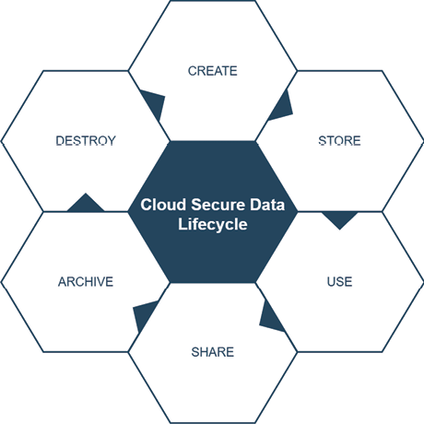
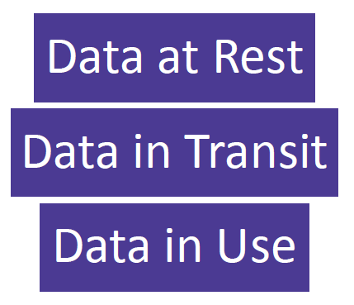
Cloud data lifecycle

Slide 3
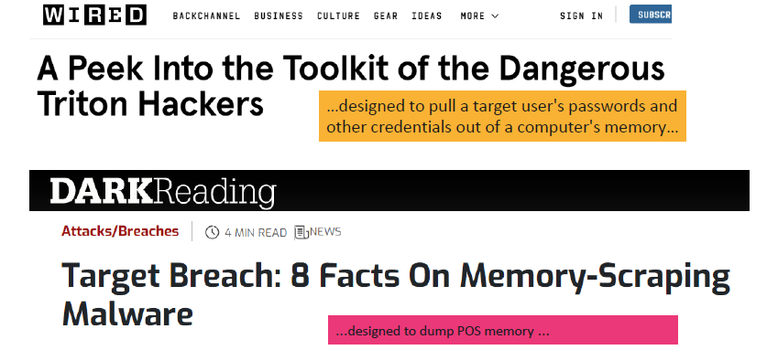
Why data protection important

Slide 4
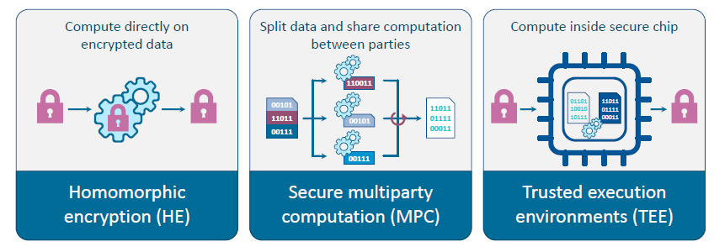
Main techniques for trusted remote computation

Slide 5
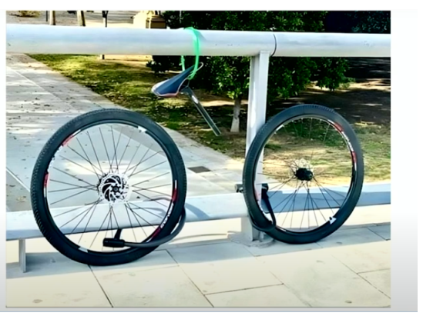

Slide 6
Confidential computing
Confidential computing is a cloud technology that encrypts data in use—also known as enclaving—so that it's only accessible to authorized code. This is a game-changer because it means that data can be processed in the cloud without exposing it to the cloud provider, or anyone who might compromise the cloud provider

Slide 7
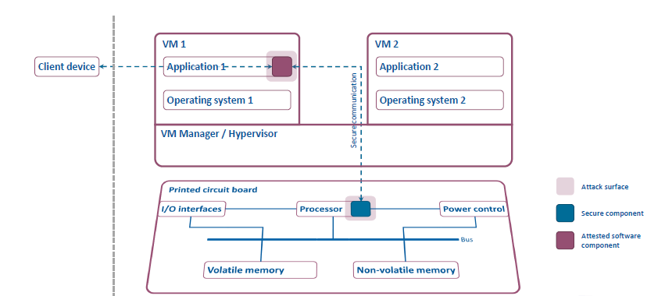
Confidential computing protects data at this sensitive stage through the use of Trusted Execution Environments (TEEs), which establish a secure enclave within the CPU for processing data. They operate by encrypting data before it enters the TEE and only decrypting it within this secure space. Confidential computing also uses attestations to validate the integrity and security of these environments
Confidential computing

Slide 8
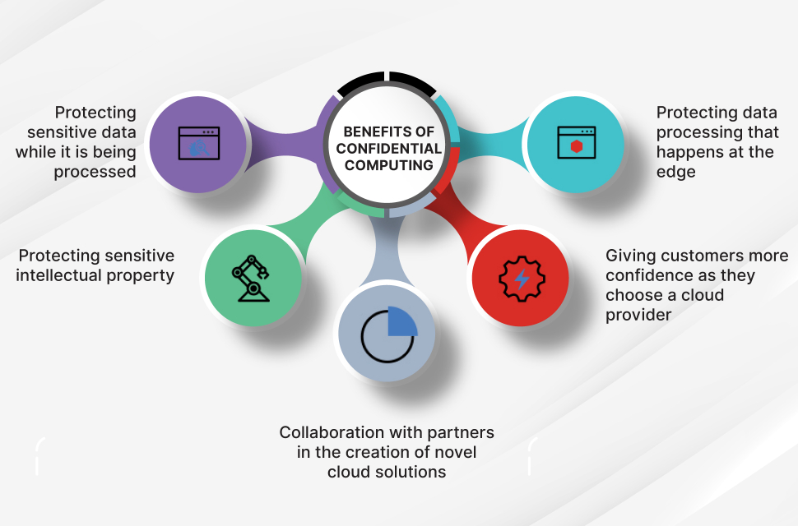
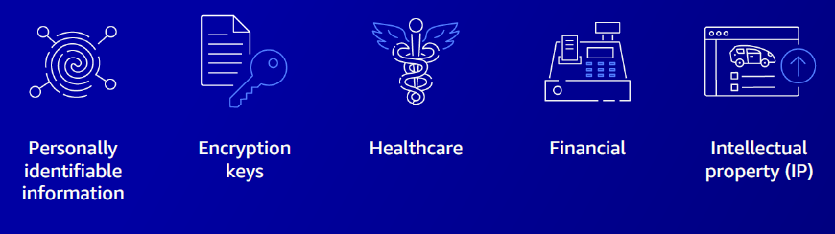
Confidential Computing –Use Cases

Slide 9
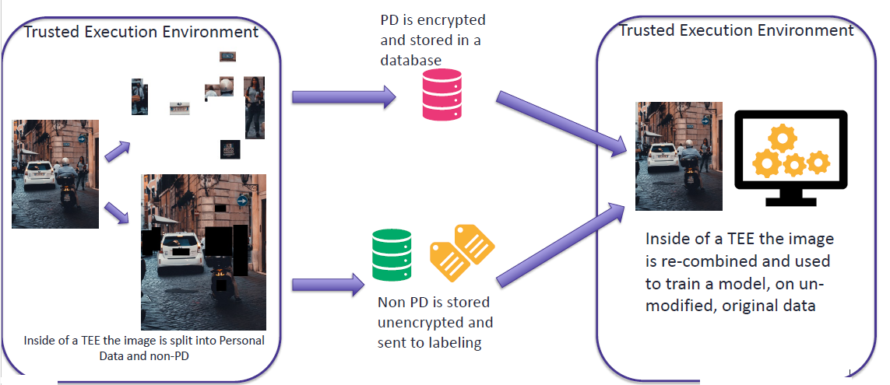
COCO Scenario Vehicle AI Model Training Train an AI model on vehicle camera data Problem: Privacy regulations like the GDPR require companies to minimize collection of personal data (PD), protect it at all times (e.g. with encryption), and delete it as soon as practicable. It is infeasible to obtain and manage consent from all individuals whose images might be captured by vehicle cameras Solution: Use de-identification and training in a TEE to retain efficacy of data and protect privacy when sharing data with third parties

Slide 10
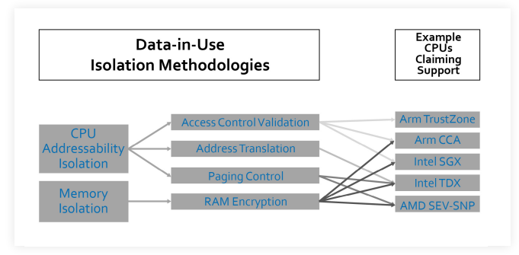
How does Confidential computing works
Confidentiality is delivered at runtime through various isolation methodologies. It’s a value proposition of CPU and memory at the same time for data and code .

Slide 11
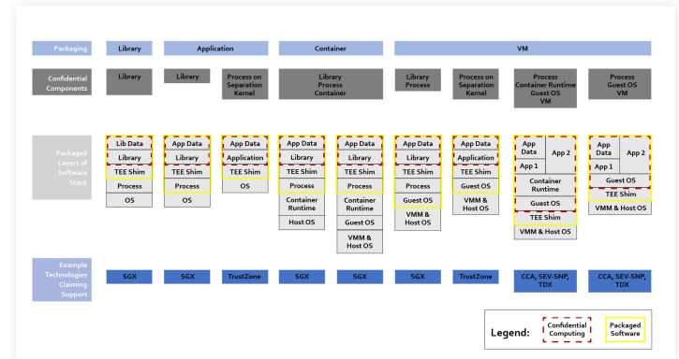
How does Confidential computing works
Ref: https://confidentialcomputing.io/wp-content/uploads/sites/10/2023/03/Common-Terminology-for-Confidential-Computing.pdf

Slide 12
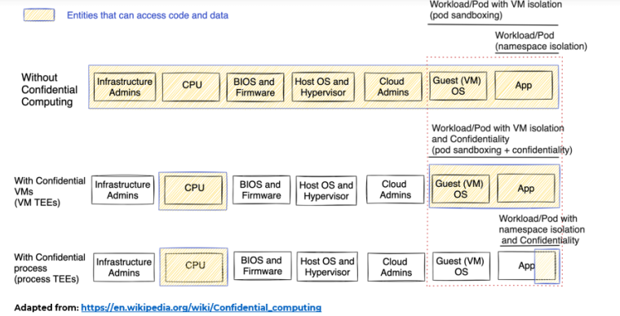
How does Confidential computing works

Slide 13
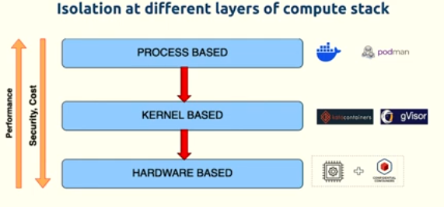
How do we choose Confidential computing
Factor | Consideration
Hardware | Intel SGX, AMD SEV, or ARM TrustZone
Cloud provider | Azure Confidential Computing, AWS Nitro Enclaves, or Google Cloud Confidential Computing
Application compatibility | Legacy vs. cloud-native applications
Scalability | Current and future workload demands
Ref: https://confidentialcomputing.io/wp-content/uploads/sites/10/2023/03/Common-Terminology-for-Confidential-Computing.pdf

Slide 14
Azure Confidential computing portfolio

Slide 15
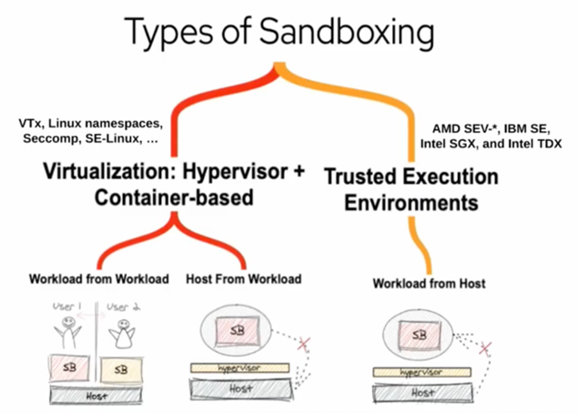
What is Confidential Containers?
An open-source CNCF Sandbox project aimed at securing containerized applications by protecting their in-memory data.
Purpose : Extend Confidential Computing to Kubernetes workloads.

Slide 16
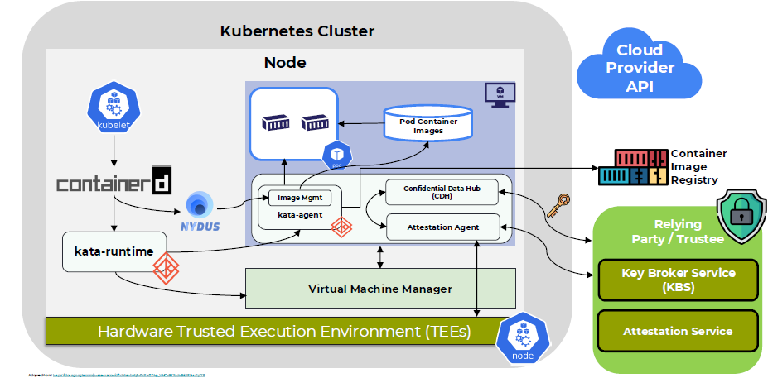
What is Confidential Containers?
Confidential containers using VM-based TEEs on a local hypervisor
Confidential containers using VM-based TEEs on a remote hypervisor typically on public cloud
Confidential containers using process-based TEEs with enclave-cc and intel SGX support

Slide 17
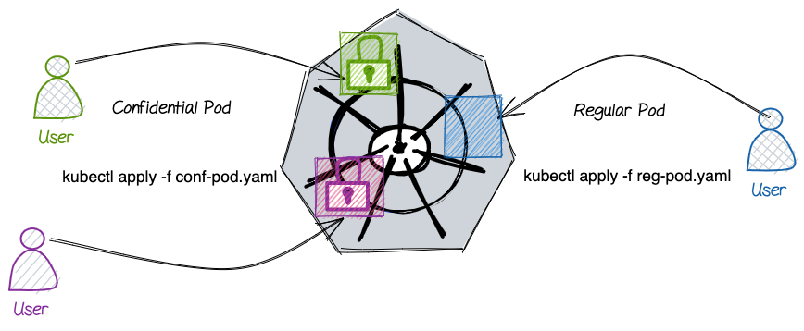
what coco solve in terms of security
Threat Vectors: Pod Images: Risk of tampering/access. Pod Memory: Infrastructure provider access. Pod Data: Provider tampering/access
Mitigations Images: ● Controlled by workload based on attestation and verification ● Encrypted/signed Memory: Runs in confidential memory Storage: Encrypted & integrity-maintained volumes

Slide 18
Reference Links
https://confidentialcomputing.io/projects/current-projects/
https://github.com/NVIDIA/nvtrust
https://github.com/dragonflyoss/nydus/blob/master/docs/containerd-env-setup.md
https://signal.org/blog/private-contact-discovery/
https://arxiv.org/pdf/2409.03992 -Confidential Computing on NVIDIA Hopper GPUs

