Slide 1

Identifying Tactical Assignments w/ Football Coordinate Data
Matthew de Marte

Slide 2
Using Coordinate Data, Identify What Tactical Unit A Player Belongs To – My Approach
Step1 – Organize / clean data
Unpack coordinate data to be in a usable format (from list to dataframe)
Combine player data and coordinate data
Fill in null values for trackable_object variable for appropriate player
Remove referee data
Step2 – Identify dependent variable
Split players into 4 tactical groups (GK, DEF, MID, ATT)
Step3 – Create variables for modeling (data aggregated so there was one observation per player per game)
Split the pitch into a defensive / middle / and attacking third
Calculate % of time spent in each third
Calculate % of time spent in each third for what location on the pitch the ball was
Calculate average distance from midfield for what location on the pitch the ball was
Calculate average distance from players own goal for what location on the pitch the ball was
Players movement is highly dependent on ball location – thus this drives our model
Step 4 – Create model(s) and evaluate performance
Tested KNN & multinomial logistic regression with aggregated data
Step 5 – Choose best model
KNN model performed the best

Slide 3

Poor Tactics – The Difficulties I Faced
There were several limitations with the data
A significant amount of data was missing for each player (especially goalkeepers)
A significant amount of data was missing for the location of the ball
Difficult to accurately discern who was in possession of the ball
Difficult to accurately discern when there was a specific action occurring (dribble / pass / shot)
Difficulty finding differentiating tendencies for players who were part of one tactical line, but moved about the pitch like they were part of a different unit
Difficulty attributing player movement due to what was happening on the pitch (providing context to player movement)

Slide 4
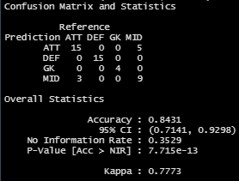
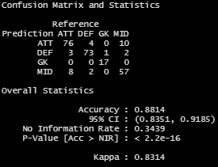
The Good & The Bad – Model Evaluation
The Good
Overall model performance was solid
Model did an excellent job of handling GK & Defenders
KNN model was simple (k = 5)
Model was easy to understand
The Bad
Sweeper keepers… Manual Neuer was predicted as a defender once
Attackers with low attacking rates often were predicted as midfielders
Midfielders with high attacking rates often were predicted as attackers
Image 1: Test Data Confusion Matrix
Image 1: Test Data Confusion Matrix
Image 2: Full Data Confusion Matrix

Slide 5
Room For Improvement
More data
9 games is a rather small sample
Only big clubs were included in data, could create bias if applied to other games
Complete data for all games, each player had a significant amount of missing coordinate data
Data that provides context as to what is going on in the game
Who has possession of the ball
When a dribble is occurring
When a pass is initiated
When a shot is initiated
Game score
Set pieces / play stoppages / throw-ins / etc.
Strategic information
Information pertaining to what formation and tactics a team deployed to start the game

Slide 6
Model Application
Player Personnel
Identify players whose movements across the pitch are undervalued, underutilized, or are moving like they are apart of a different tactical unit than the one they are assigned to
Tactical Strategy
Help identify ideal movement profiles across the pitch for players to emulate the best players at their positions in the world / identify team tendencies to employ better tactics

