Slide 1
Oforos
Organization for organizations
Mike DeMaso and Matthew Massery

Slide 2
Outline
Project overview
Inspiration
Goals
People
Events
Communication
Technologies
Mock-ups
Code

Slide 3
Project Overview
The organization and centralizing of a group’s information and correspondence.
Keeping track of member’s information and activities.
Most organizations have a problem trying to inform its members.
Make the management of members easier.

Slide 4
Project Overview (Inspiration)
Phi Sigma Pi
Terrible record keeping
Poor attendance
Member and group tasks are very unclear
Non-standard communication
CTL (Center for Teaching and Learning)
Hard to use interface
Inflexible for scheduling appointments

Slide 5
Goals (People)
Let people have their own calendar
Give them a personalized home view were their most recent conversations and upcoming events are located front and center
Make it easy for them to talk and alert other people to what they are doing, via email or on the site
Make it easy to use and understand

Slide 6
Goals (Events)
Attendance keeping
Including who is expected to show up
Track individual absences
Alerts and reminders for events
Weekly summary and look ahead

Slide 7
Goals (Communication)
Centralize all organization communication
Target those conversations to people who want or need to be a part of it
Allow anyone in the group to post important news and sent our group wide alerts

Slide 8
Goals (Technologies)
MySQL
Tested, trusted and easy to deploy
Not good for scaling, but for our target it is sufficient
PHP (Hypertext Preprocessor)
Test and used environment
Easy to code and scale
Built-in support for MySQL and many other things we need

Slide 9
Goals (Technologies) Cont.
HTML 5
Local storage, good for limiting the number of SQL queries
Javascript
Used for user experience
CSS (Cascading Style Sheets)
Simplify the code for the user interface, helps with lowering the amount of data transmitted for each page

Slide 10
Goals (Technologies) Cont.
Apache
Helps simplify and make the URL (Universal Resource Location) user readable
Not much has been implemented in this yet

Slide 11
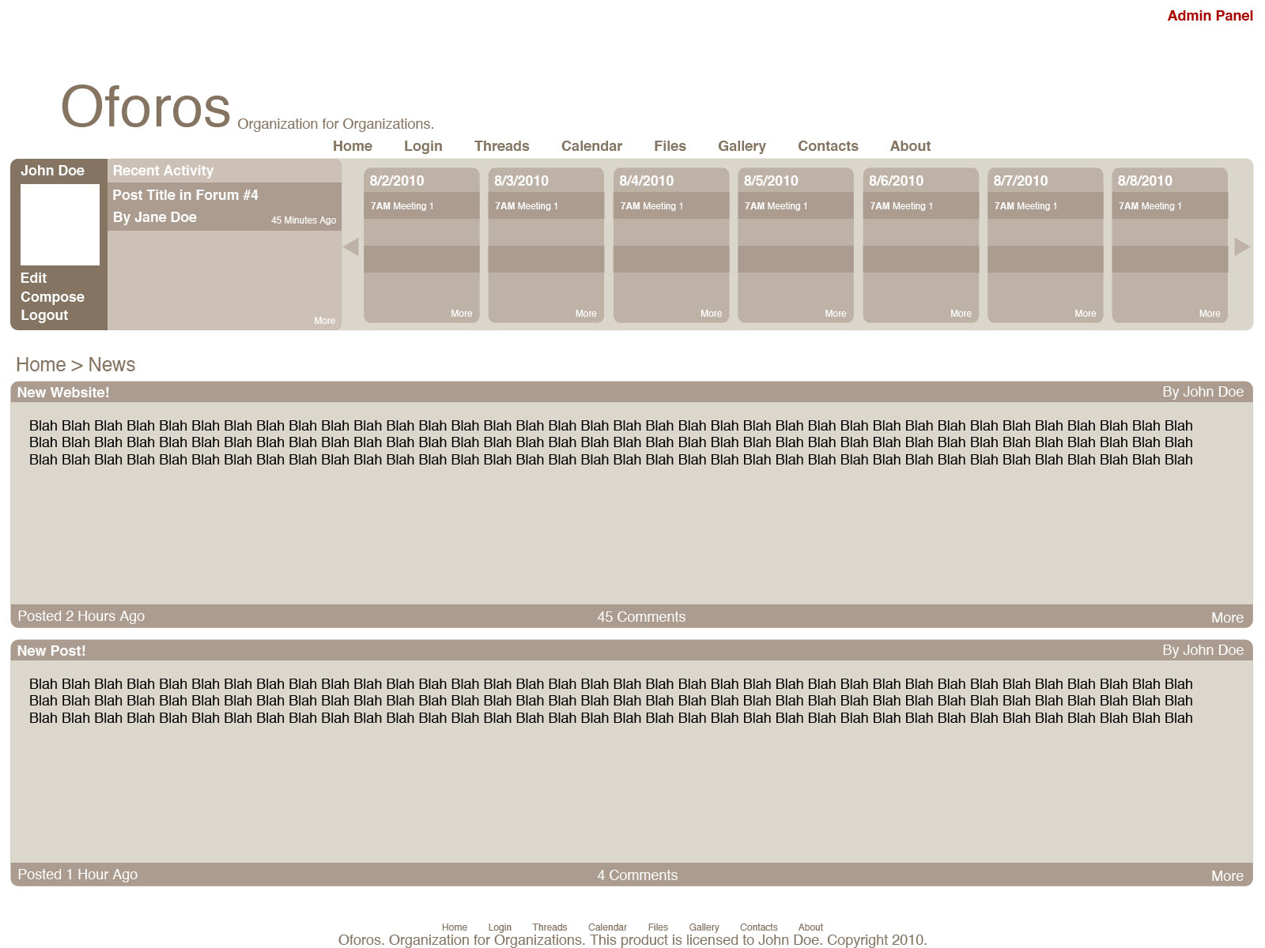
Mock-Ups (Site Design)

Slide 12
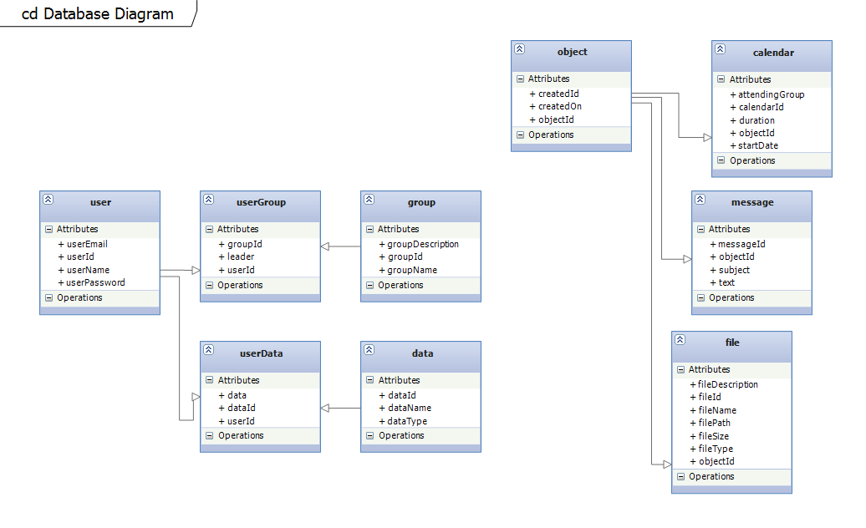
Mock-Ups (Database)

Slide 13
Code (Main Entrance)
<?php
$GLOBALS['page'];
$GLOBALS['tags'];
require_once('php/commonFunctions.php');
connectToDatabase();
require_once('html/index.php');
?>

Slide 14
Code (Index.php)
<?php
// Bring in all the required HTML generating functions
require_once('htmlHead.php');
require_once('header.php');
require_once('navigation.php');
require_once('login.php');
require_once('footer.php');
require_once('contentCreator.php');
// Generates HTML based on which function is called
echo $GLOBALS['langArray']['documentType'] ?>
<html>
<head>
<?php htmlHead() ?>
</head>
<body>
<div id="bodyContainer">
<div id="header">
<?php pageHeader() ?>
</div>
<div id="navigation">
<?php headerNavigation() ?>
</div>
<?php loginControl() ?>
<div>
<?php pageContent($page) ?>
<?php $GLOBALS['langArray']['time'] ?>
</div>
<div id="footer">
<?php footer() ?>
</div>
</div>
</body>
</html>

Slide 15
Code (Part of sqlFunctions.php)
// Cleans the SQL query if data comes from a user
function clean_sql($query) {
$query = stripslashes($query);
$query = mysql_real_escape_string($query, mysql_connect('tvolvedblogger.db.3250439.hostedresource.com', 'tvolvedblogger', 'C@naryy3llow'));
return $query;
}
// Returns attendingGroup, calendarId, duration, startDate, createdBy, createdOn, o.objectId, parent, privateOwner, title
function getCalendarObjects() {
$query = "SELECT attendingGroup, calendarId, duration, startDate, createdBy, createdOn, o.objectId, parent, privateOwner, title
FROM calendar AS c
JOIN object AS o
WHERE o.objectId = c.objectId";
return $query;
}
// Returns messageId, text, createdBy, createdOn, o.objectId, parent, privateOwner, title
function getMessageObjects() {
$sql = "SELECT messageId, text, createdBy, createdOn, o.objectId, parent, privateOwner, title
FROM message AS m
JOIN object AS o
WHERE o.objectId = m.objectId";
return mysql_query($sql);
}

Slide 16
Code (english(us).php)
<?php
$GLOBALS['page'] = "index";
// template variables
session_start();
import_request_variables('gpc');
// Set up the langArray
$GLOBALS['langArray'] = array(
'title' => "Oforos. Organization for organizations.",
'description' => "",
'keywords' => "",
'author' => "Michael DeMaso (mdemaso@gmail.com); Matthew Massery ()",
'documentType' => "<!DOCTYPE html PUBLIC '-//W3C//DTD XHTML 1.0 Strict//EN' 'http://www.w3.org/TR/xhtml1/DTD/xhtml1-strict.dtd'>",
'siteURL' => "http://oforos.tvolved.com/",
'homeURL' => "home/",
'home' => "home",
'loginURL' => "login/",
'login' => "login",
'threadsURL' => "threads/",
'threads' => "threads",
'calendarURL' => "calendar/",
'calendar' => "calendar",
'filesURL' => "files/",
'files' => "files",
'contactsURL' => "contacts/",
'contacts' => "contacts",
'aboutURL' => "about/",
'about' => "about",
'user_id' => $_SESSION['SESS_MEMBER_ID'],
'user_name' => $_SESSION['SESS_MEMBER_USER_NAME'],
'time' => date("D, M j Y G:i:s T")
);
?>

Slide 17
Code (pageContent() From contentCreator.php)
function pageContent($page) {
// Gets messageId, text, createdBy, createdOn, o.objectId, parent, privateOwner, title
$result = getMessageObjects();
if (!$result) {
$GLOBALS['langArray']['message'] = "Error, error in the database!";
}
if (mysql_num_rows($result) == 0) {
$GLOBALS['langArray']['message'] = "Error, returned no result!";
}?>
<div id="pageContent">
<?php
while ($row = mysql_fetch_assoc($result)) { ?>
<h2><?php echo $title ?></h2>
<p><?php echo $text ?></p>
<span id="createdBy"><?php echo $createdBy ?></span>
<span id="createdOn"><?php echo $createdOn ?></span>
<?php
}?>
</div>
<?php
}

