Slide 1
Different Algorithms for Few-shot Learning

Slide 2
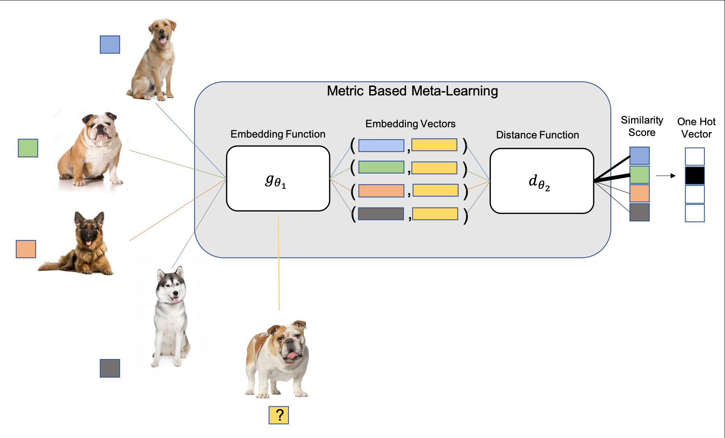
Basic Metric-Learning
Metric Learning is the task of learning a distance function over data samples. Consider two image-label pair (x 1 ,y 1 ) and (x 2 ,y 2 ) and a distance function d to measure the distance between two images. If we were to assign a label to a query image x 3 , we could compute the two distances d(x 1 ,x 3 ) and d(x 2 ,x 3 )) and assign the label corresponding to the image with a shorter distance, which is also the key idea in nearest neighbors algorithms (k-NN).

Slide 3
Metric-based Siamese network
Siamese Neural Networks are a pair of identical neural networks with shared weights originally proposed for signature verification. The two networks are joined at their output, where the joining neurons measures the distance between the feature vector output of each network. The network was trained to recognize if the two images belong to the same class or not. The network outputs a probability score (similarity) of the two images belonging to the same class.

Slide 4
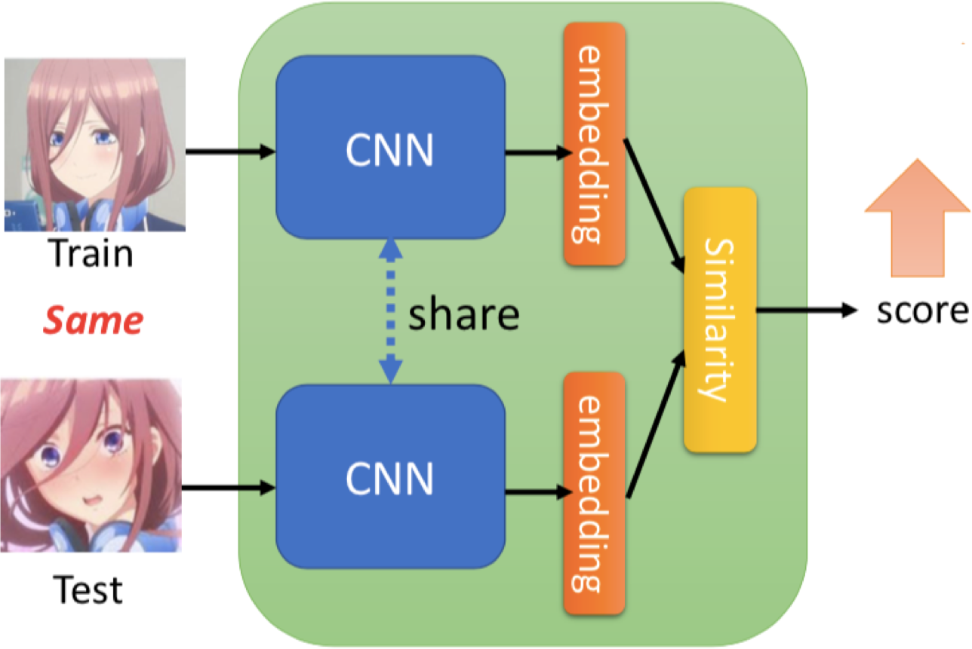
Metric-based Siamese network
Learn to compare!
Siamese network
Prototypical network
Matching network

Slide 5
Metric-based Prototypical network
Prototypical Networks use a CNN as an embedding function g . A prototype for each class is defined by taking an average of embedding vectors obtained from the support images belonging to that class. The similarity is measured by calculating the squared euclidean distance between the query’s embedding and each class prototype. The output probability over classes is calculated by taking a softmax over the negative distances.

Slide 6
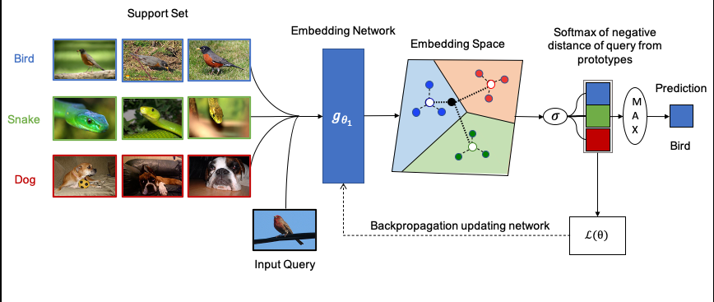
Metric-based Prototypical network
Siamese network
Prototypical network
Matching network

Slide 7
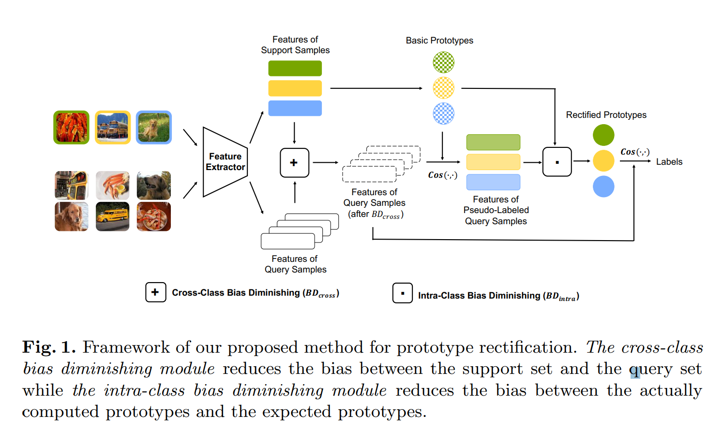
Prototype Rectification for Few-Shot Learning (BD-CSPN)

Slide 8
Prototype Rectification for Few-Shot Learning
In this paper, they propose a powerful method of prototype rectification in few-shot learning, which is to diminish the intra-class bias and the cross-class bias of class prototypes. Our theoretical analysis verifies that, the proposed bias diminishing method is effective in raising the lower bound of the expected performance. Extensive experiments on three few-shot benchmarks demonstrate the effectiveness of our method. The proposed bias diminishing method achieves significant improvements in transductive setting by large margins (e.g. 8.47% on 1-shot miniImageNet and 9.54% on 1-shot tieredImageNet).

Slide 9
Metric-based Matching network
Given a support set S and a query x , Matching Networks define a probability distribution over the output labels y using an attention kernel a. The attention kernel basically computes the cosine similarity between the embeddings of support and query examples and then normalize the similarity score by taking a Softmax.

Slide 10
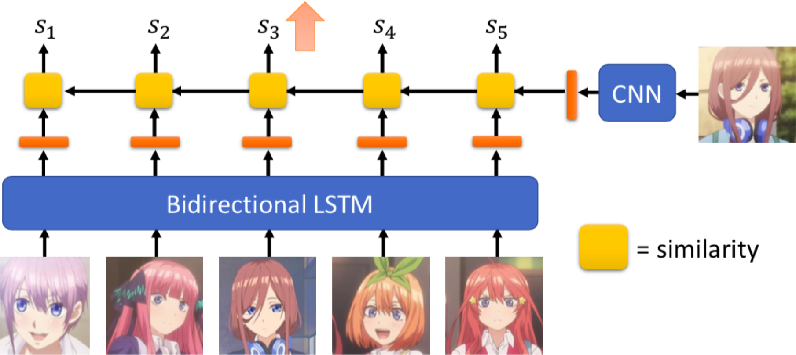
Metric-based Matching network
Learn to compare!
Siamese network
Prototypical network
Matching network

Slide 11
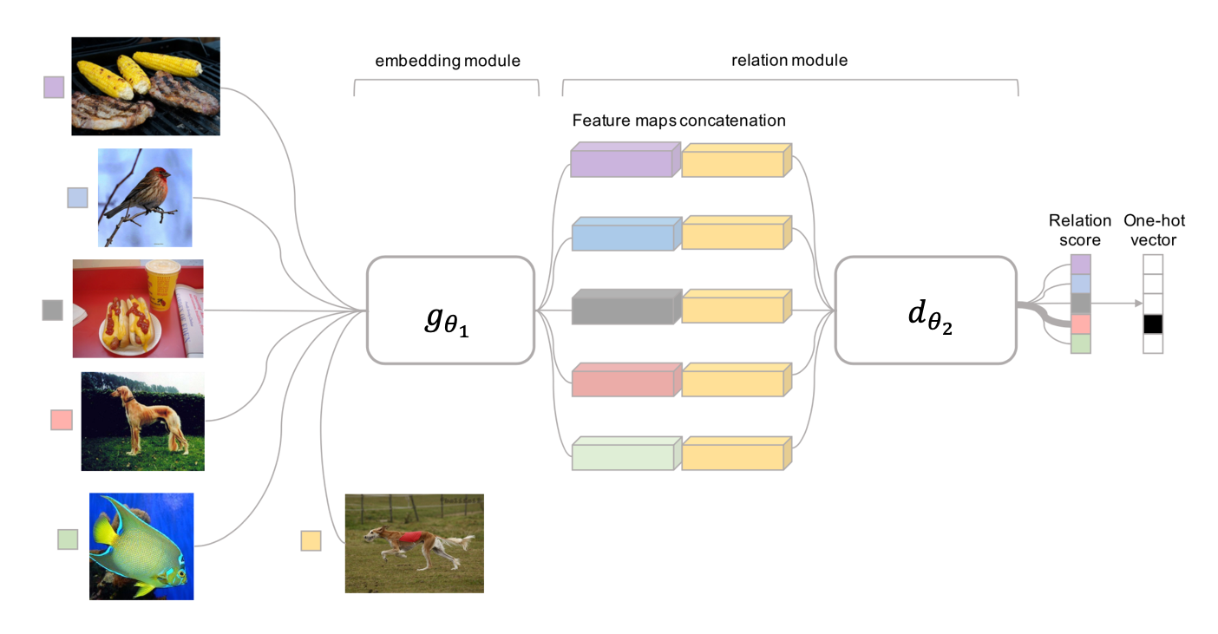
Metric-based Relation network

Slide 12
Optimization-based outdated
MAML
Reptile

Slide 13
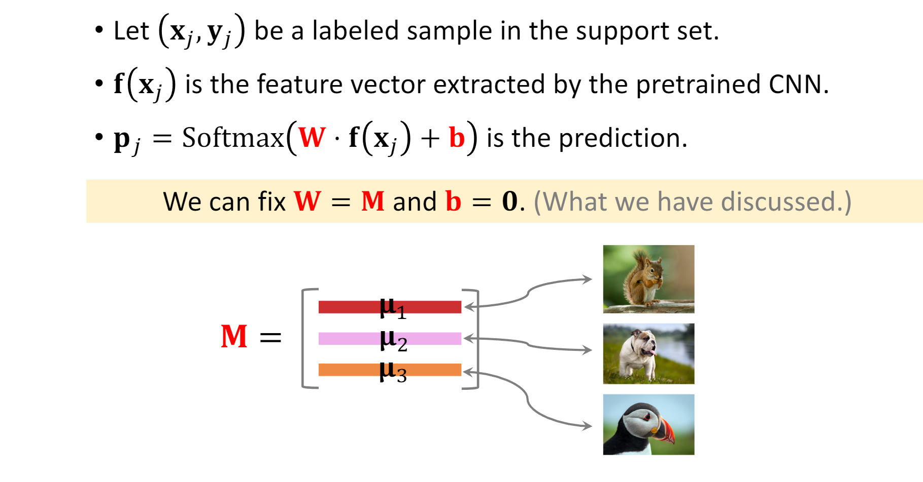
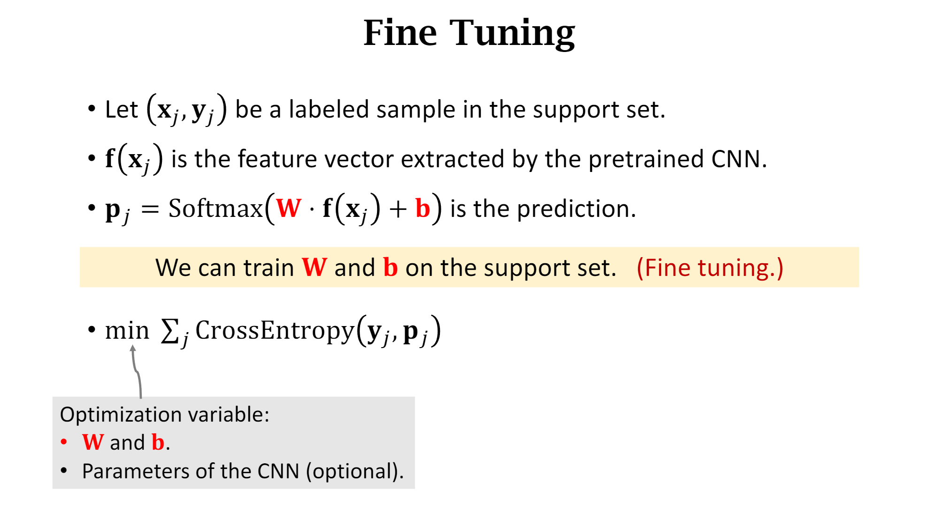
Transfer Learning Finetuning
Pretraining/embedding

Slide 14
Hybrid-Algorithms Transductive Finetuning
Although, meta-learning is an effective strategy for few-shot learning as it aims at generalizing to unseen classification tasks, the fundamental difficulty with learning with scarce data remains for a novel classification task. One way to achieve larger improvements with limited amount of training data is to consider relationships between instances in the test set and thus predicting them as whole, which is referred to as transduction or transductive inference. The examples in the support and query sets are modeled as nodes of a graph. The labels of the support set nodes are known and the task is to predict the labels of the query set nodes which is achieved using their label propagation algorithm.

