Slide 1
What is Software
Engineering?
Lesson 1
CSCE593 Intro to Software Engineering

Slide 2
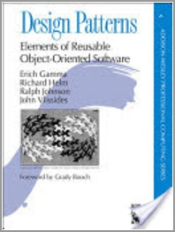
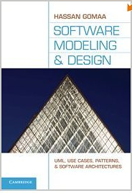
Overview
What is software engineering?
Software engineering is a __________ activity
Nature of software problems
How is software different?
The problem of scale
The problem of security
Design Patterns by Erich Gamma
Agenda
Course Overview
Group Project
GIT
C++

Slide 3
Software Engineering
A “statement of aspiration”
The establishment and use of sound engineering principles in order to obtain economical software that is reliable and works efficiently on real machines (Naur and Randell, 1969)
A label applied to a set of current practices for software development (Shaw and Garlan, 1996)
IEEE Standard 610.12-1990 definition
The application of a systematic, disciplined, quantifiable approach to the development and operation, and maintenance of software; that is, the application of engineering to software
The study of the approaches above

Slide 4
What is Engineering?
Creating cost-effective solutions…
…to practical problems…
…by applying scientific knowledge
…building things…
…in the service of mankind
Engineering isn’t just about solving problems with economical use of all resources, including money.
Engineering deals with practical problems whose solutions matter to people outside the engineering domain: the customers.
Engineering solves problems in a particular way: by applying science, mathematics, and design analysis.
Engineering emphasizes the solutions, which are usually tangible artifacts.
Engineering not only serves the immediate customer, but also develops technology and expertise that will support the society.

Slide 5
Question
Is Software Engineering really engineering?
How is software engineering different from programming?

Slide 6
Software Engineering is a…
Modeling activity
Models simplify complexity and focus attention
Problem-solving activity
Software is a solution to a user’s problem
Knowledge acquisition activity
Software engineers use many kinds of knowledge in problem solving
Rationale-driven activity
Recording the context and reasons for decisions is essential to successful software maintenance
(Bruegge and Dutoit, 2004)

Slide 7
Modeling
A model is an abstraction
Reflects only the information essential to its purpose
Why build models?
Analyze before building
Control complexity
Communicate with customers
Estimate cost and schedule
Predict performance
Simulation
Almost all Models are wrong. Some models are useful.

Slide 8
Software Models
Two types of models
Product models that result from each transformation (including code)
Process models of the transformations themselves
Much of the course will focus on product models
We will follow the object-oriented modeling paradigm
We will use the Unified Modeling Language (UML)
We will use a mixture of RUP and SCRUM processes
Problem Description
Executable code

Slide 9
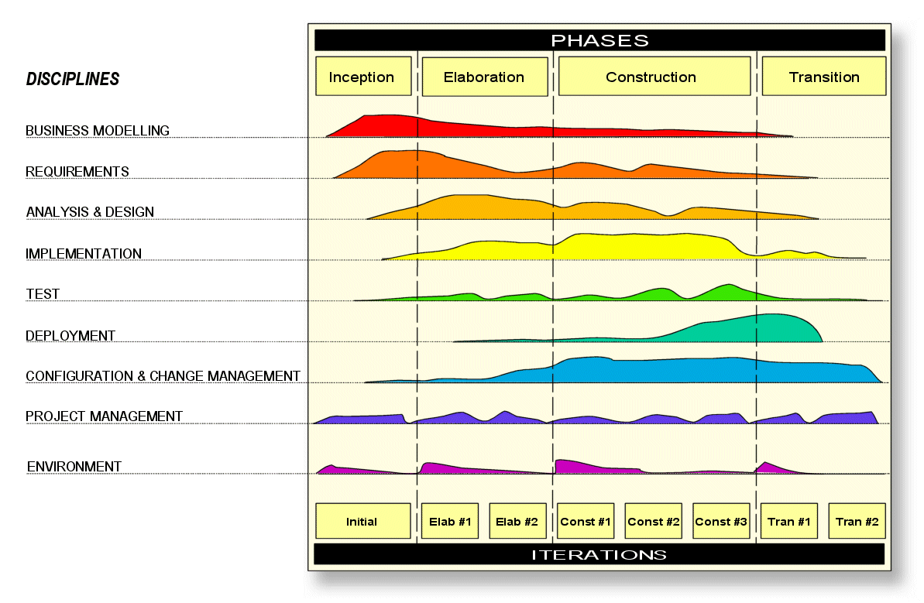
First Look at the RUP

Slide 10
Focus on the Product
The entire purpose of software engineering is to produce working software
Not to:
Create requirements documents / business modeling
Create use cases
Create UML diagrams
Learn new hardware / software technologies
Document processes
These methods and tools can be useful but they can, sadly, become ends unto themselves

Slide 11
Rationale-Driven
Rationale is the justification of decisions
Why a specific design was selected over others
Critical for evolution—assumptions change
Example:
Cutting off both ends of the ham before putting it in the oven (Bruegge and Dutoit, 2004)
Secure enough for dial-up mainframe 3270 terminals vs. secure enough for web access via the internet
The gorillas and the bananas
Capturing and accessing the rationale of a software system is not trivial

Slide 12
Question
How is software different from other engineered artifacts?
Software is invisible and intangible
Software is designed, but not manufactured
Partially implemented software can be executed
Software doesn't wear out or break
Does Software align with modern economics?

Slide 13
The Problem of Scale
Picture what happens as projects grow in size (and scale)
Building a doghouse, a single-family home, or a skyscraper
Throwing a backyard barbecue, a wedding, or a state dinner
Developing a class assignment, a mass-market game, or software that runs the international space station
What happens?
Large projects are more complex
and more subject to change

Slide 14
Addressing Scale
Increase productivity of workers
High-level languages
Development tools and methods
Management tools and methods
Add more workers
Specialize
Work concurrently
Decompose
The process
The product
Progress is too
slow to satisfy
demand for
complex products
Teams get unwieldy
above 5 to 7 people
Challenging, but
ultimately the most
successful approach

Slide 15
The Problem of Security
Most computer security problems are caused by bad software
Connection of mission critical systems to the global internet has aggravated this problem
Heartbleed (OpenSSL), printf
https://raygun.com/blog/10-costly-software-errors-history/
Software can be exploited in many ways
Most invalidate assumptions made during design
Example: removing the client, when client input is trusted by server software
Security cannot be added to software “later”

Slide 16
Summary of Key Points
Almost all models are wrong. Some models are useful.
Focus on the product
Software must have visible structure
Implementation (programming) ≠ manufacturing
Partially implemented software can be executed
Software doesn’t wear out or break, but it does deteriorate / age
Large projects are more complex and more subject to change
Security cannot be added to software “later”

Slide 17
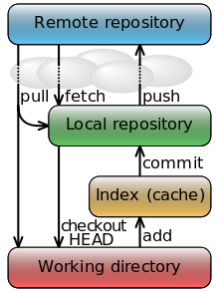
Homework
Form Design Teams
Mixture of skills
Introduce our tools of the trade
MSVC 2019
https://www.visualstudio.com/downloads/
GIT
https://git-scm.com/downloads
https://tortoisegit.org/
Ubuntu (install Linux as Windows Subsystem)
Re-implement 01HelloWorld.cpp
Use GCC or MSVC
Practice your C++

Slide 18
Homework
C++ YouTube Videos
Herb Sutter “Back to the Basics!”
https://www.youtube.com/watch?v=xnqTKD8uD64
Bjarne Stroustrup “Learning & Teaching Modern C++”
https://www.youtube.com/watch?v=fX2W3nNjJIo
Scott Meyers “Type Deduction & Why You Care”
https://www.youtube.com/watch?v=wQxj20X-tIU
Jason Turner “Practical C++17”
https://www.youtube.com/watch?v=nnY4e4faNp0
Alisdair Meredith “C++17 in Breadth”
https://www.youtube.com/watch?v=22jIHfvelZk
Howard Hinnant “A <chrono> Tutorial”
https://www.youtube.com/watch?v=P32hvk8b13M

