Slide 1
Inheritance, Abstract Classes, Interfaces, and Design Patterns
Lesson 4
CSCE 593 Intro to Software Engineering

Slide 2
Overview
Inheritance
Polymorphism
Abstract Classes
Interfaces
Design Patterns
Strategy Pattern
Observer Pattern

Slide 3
Inheritance
A kind of animal that has a spine
The “IS-A” relationship
Subclasses inherit features of their superclass
Vertebrate
A kind of vertebrate that has hair, nurses its young and is warm blooded
Mammal
Fido : Dog
A kind of mammal that eats meat, is domesticated, is social, and may understand some English
Dog
Generalization is the defining feature of object orientation

Slide 4
Inheritance
A superclass is also known as a base class, parent class or ancestor
A subclass is also known as a derived class, child class or descendant
Subclasses can add new features the superclass lacks (i.e. attributes, operations, or associations)
Subclasses inherit all* the features of the superclass (i.e. attributes, operations, and associations)
Public → Inherits all members as is
Protected → Parent’s public / protected → locally protected
Private attributes are not inherited in C++

Slide 5
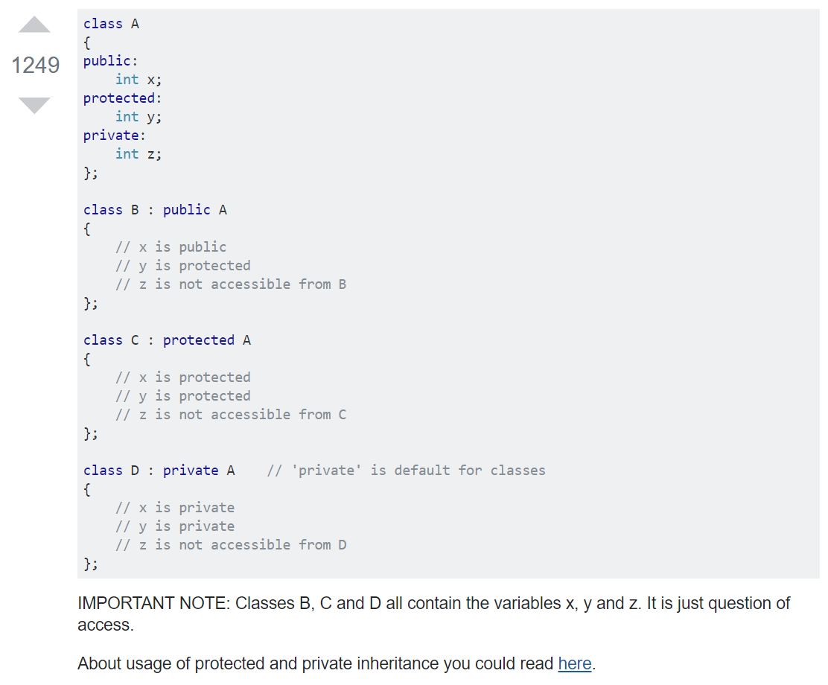
https://stackoverflow.com/questions/860339/difference-between-private-public-and-protected-inheritance
Link at bottom:
https://stackoverflow.com/questions/374399/private-protected-inheritance/374423

Slide 6
Polymorphism
Subclasses can modify or override the implementation of operations from the superclass (override == virtual)
Each can have its own way of implementing it
The subclass implementations should respect the contract of the operation in the superclass
Overridden operations are called polymorphic
Adorned with prefixed keyword virtual in C++
Polymorphism is a Greek word meaning “Many-Shaped”
From the superclass’s perspective, the operation has many implementations (which are called methods)

Slide 7
Polymorphism
Liskov’s substitution principle
A subclass object can be used anywhere that an object of the superclass is expected. For any subclass, in general, “expect no more, require no less”
Person
Black Beard : Person
has a ▼
pet
has a ▼
pet
Animal
Rocky : Parrot
Dog
Cat
Parrot

Slide 8
Abstract Classes
Abstract classes are partial implementations
They consolidate shared functionality (i.e. what can be reused)
An abstract class might do stuff, but you’ll never meet one
What would an Animal object look like and do?
May define virtual methods, leaving the implementation to the subclasses
Person
has a ▼
pet
Animal
Dog
Cat
Parrot

Slide 9
Interfaces
Interfaces are purely virtual
Provide no implementation
Are a contract for what methods an object must have
Example
To the Bank, Dogs are just another Customer
Bank
«interface» Customer
◄ owned by
Account
Animal
◄ has a pet
Person
Cat
Parrot
Dog

Slide 10
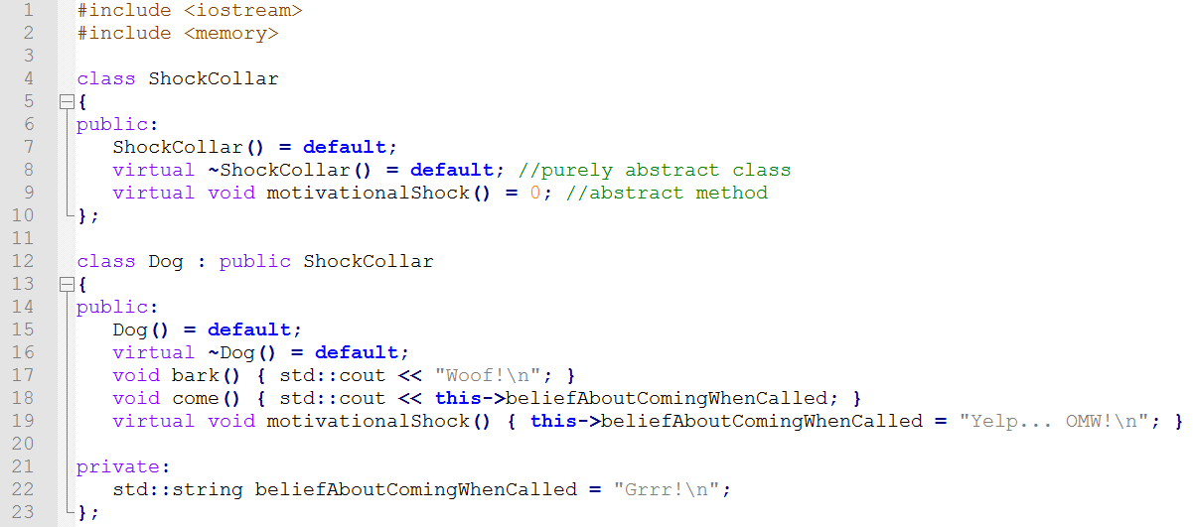
Interfaces in C++
C++ does not have a keyword for Interface (ish, Concepts)
The functional equivalent can easily be created
Multiple interfaces supported via Multiple Inheritance

Slide 11
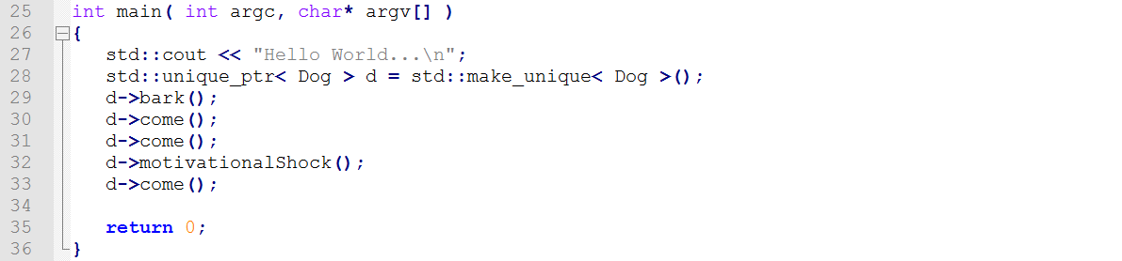
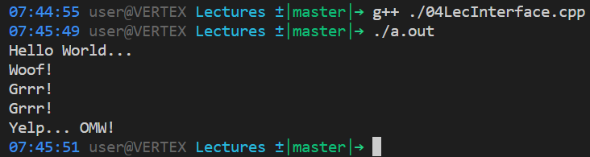

Slide 12
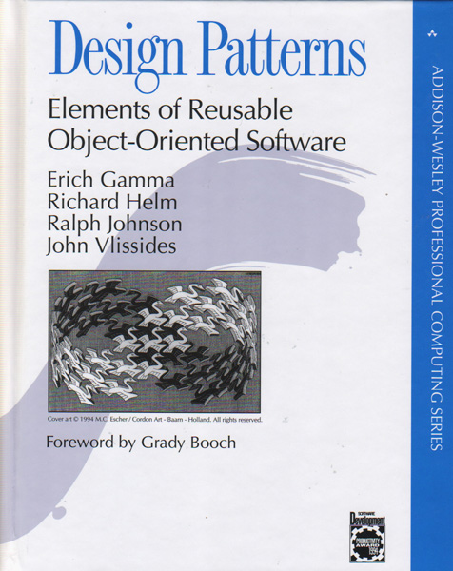
Design Patterns
Reusable solutions to a commonly occurring software problem
Creational Patterns
Structural Patterns
Behavioral Patterns
Concurrency Patterns
Gang of Four (GoF; Gamma, et al. 1994)

Slide 13
Strategy Pattern
Defines a family of algorithms
Encapsulated to make them interchangeable
Lets the client behavior be set or change at runtime
Textbook, Page 315-324
Duck
«interface» QuackBehavior
QuackBehavior quackBehavior
quack()
fly()
performQuack()
setQuackBehavior()
swim()
// other duck like methods
Quack
Squeak
MuteQuack
quack() { … }
quack() { … }
quack() { … }
Mallard
RubberDucky
DecoyDuck

Slide 14
Strategy Pattern
Shipment
«interface» TransportStrategy
TransportStrategy strategy
move()
transport()
getBill()
// other Shipment like methods
Walk
Drive
Fly
move() { … }
move() { … }
move() { … }
FedEx
UPS
USPS

Slide 15
Observer Pattern
«interface» Subject
notifies ►
*
«interface» Observer
registerObserver()
removeObserver()
notifyObservers()
update()
Also called Publish/Subscribe
Allows two objects to interact with very limited knowledge of each other—i.e. loose coupling
Decouples high-level objects from the “nuts and bolts”
Allows notifications to flow to higher implementation layers
Observers register with a Subject, which then notifies the Observers by calling their update method when something changes in the Subject

Slide 16
Observer Pattern
Example: Computer Pro Shop mailing list
«interface» Subject
notifies ►
*
«interface» Observer
registerObserver()
removeObserver()
notifyObservers()
update()
Concrete Subject
Concrete Observer
◄ subscribes to
Computer Pro Shop
Person
registerObserver() { … }
removeObserver() { … }
notifyObservers() { … }
// other subject methods
update() { … }
// other person methods

Slide 17
Summary
Inheritance
Polymorphism
Abstract Classes
Interfaces
Design Patterns
Strategy Pattern
Observer Pattern

