Slide 1
Software Life Cycle Models and Processes
Lesson 2
CSCE593 Intro to Software Engineering

Slide 2
Overview
What is a software life cycle?
Phased approach to software development
A framework – tasks required to build quality software
Software Process Models
Waterfall – limitations of Waterfall Model
Exploratory - throwaway prototyping
Incremental - evolutionary prototyping
Spiral model – risk driven process model
RUP – full-spectrum approach with varying focus
SCRUM – rapid iterations over specific objectives

Slide 3
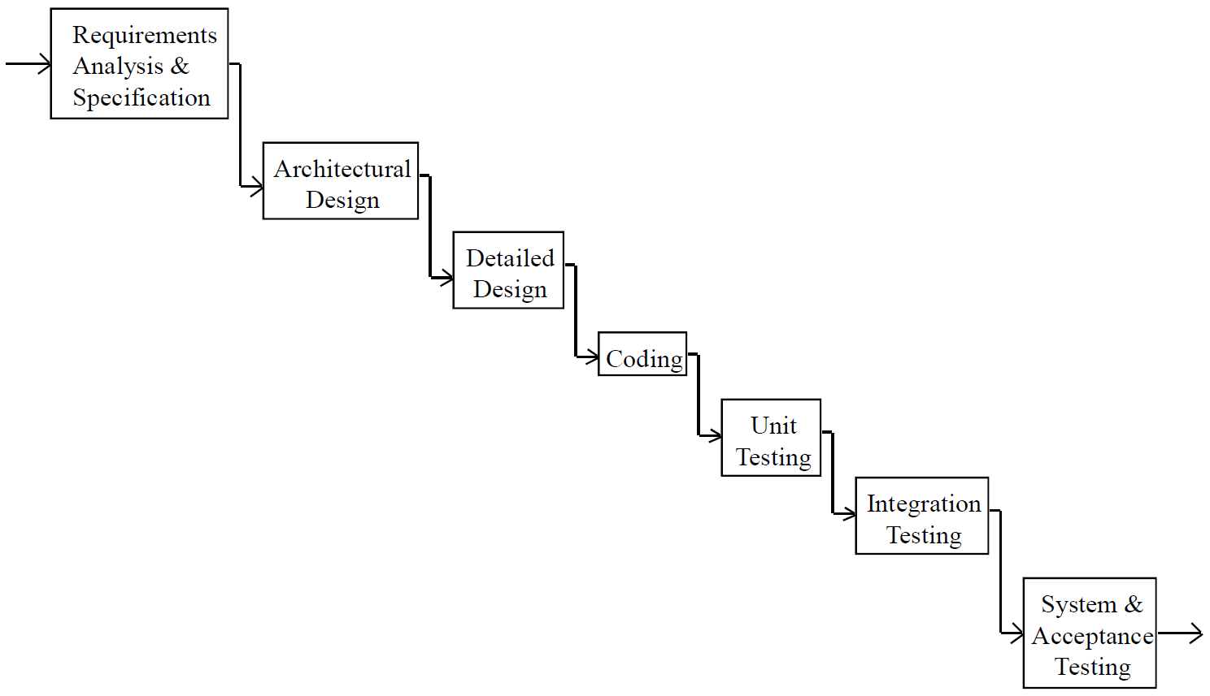
Waterfall Model
Definition
Construction
Integration & Test

Slide 4
Definition Phase
Requirements Analysis and Specification
Analysis of user's problem
Specification of "what" system shall provide user
Architectural Design
Specification of "how" system shall be structured into components
Specification of interfaces between components

Slide 5
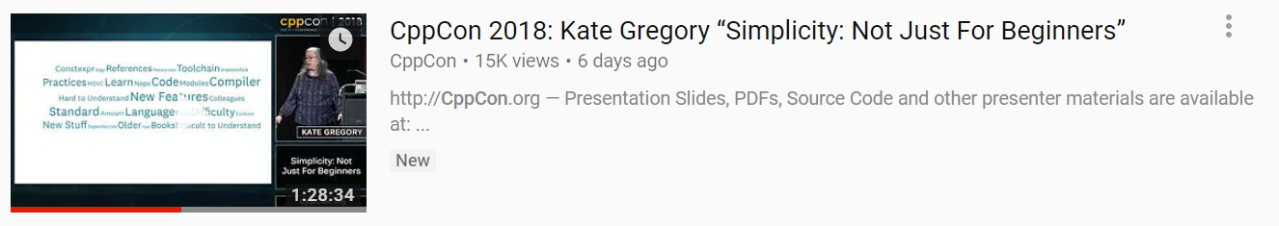
Note on Interfaces
https://www.youtube.com/watch?v=n0Ak6xtVXno
Much Harder Problem than initially perceived

Slide 6
Waterfall Model
Definition
Construction
Integration & Test

Slide 7
Construction Phase
Detailed Design
Internal design of individual components
Design of logic and data structures
Coding
Map component design to code
Unit Testing
Test individual components

Slide 8
Waterfall Model
Definition
Construction
Integration & Test

Slide 9
Integration & Test Phase
Integration Testing
Gradually combine components and test combinations
System Testing
Test of entire system against software requirements
Acceptance Test
Test of entire system by user prior to acceptance

Slide 10
The Tragedy of the Waterfall
The original “waterfall paper”
A reasonable approach proposed in 1970 by Dr. Winston W. Royce (TRW)
Misinterpreted and seldom read
Actually endorsed iterative and evolutionary development
Mandated by DOD-STD-2167 (until 1994)
still widely (mis)used on DoD projects
Overcoming difficulties: ITERATE!

Slide 11
Waterfall Failure Research
A study of 1,027 IT projects in the UK (Thomas, 2001)
Only 13% of the projects didn’t fail
Scope management related to waterfall practices (detailed upfront requirements) was the single largest contributing factor for failure, being cited in 82% of the projects as the number one problem
Another study of 6,700 projects (Jones, 1995)
4 of 5 key factors contributing to project failure were associated with and aggravated by the waterfall process
Inability to deal with changing requirements
Problems with late integration
(Larman, 2004)

Slide 12
Waterfall Failure Research
A study of $37 billion worth of DoD software projects (Jarzombek, 1999) concluded:
75% of the projects failed or were never used
46% (of the 75%) did not meet the users real needs (although they met the specification) and were never used
20% (of the 25% non-failures) needed extensive rework to meet the true needs (rather than the specifications) before they could be used
(Larman, 2004)

Slide 13
Waterfall Failure Research
Consequently, a task force led by Fred Brooks in 1987 recommended that DOD-STD-2167 “needs a radical overhaul to reflect modern best practice.”
“Experience with confidently specifying and painfully building mammoths has shown it to be simplest, safest and even fastest to develop a complex software system by building a minimal version, putting it into actual use, and then adding functions [and other qualities] according to the priorities that emerge from actual use”
“Evolutionary development is best technically, and it saves time and money
(Larman, 2004)

Slide 14
Waterfall Failure Research
In a study of over 400 waterfall-oriented projects averaging six-month cycles (CLW, 2001)
Only 10% of the developed code was actually deployed
Only 20% of the deployed code was used
Why?
Users couldn’t provide much feedback before delivery
Changes in the business since the requirements phase
Requirements and business operations were misunderstood
(Larman, 2004)

Slide 15
Waterfall as a Standard
DoD-STD-2167 (late 1970s)
Mandated waterfall—led to project failures
DoD-STD-2167A (Feb. 1988)
Push by the Ada community for more incremental and iterative development friendly standard
Task Force (Brooks) recommended “radical overhaul”
“Although the waterfall diagrams did not have any legal impact, I could not get them removed because the military logistics people would not agree with my assessment that they would continue to foster the waterfall mindset.” – Don Firesmith (he was right!)
(Larman, 2004)

Slide 16
Waterfall as a Standard
DoD-STD-2167A is viewed by many as the epitome of a waterfall specification
Failures continue after 1988…
Another task force in 1994
DoD must manage programs using iterative development
Apply evolutionary development with rapid development of initial functional capability
MIL-STD-498 supersedes 2167A in Dec 1994
Removes the waterfall bias
DoD 5000.2 acquisition “instruction” released in 2000
Recommends use of iterative and incremental development
(Larman, 2004)

Slide 17
Waterfall as a Standard
The single pass waterfall has been favored by some management because
It gives the illusion of an orderly, predictable, accountable, and measurable process, with simple document-driven milestones (such as “requirements complete”)
There is a special irony in choosing a simple-to-track process that yields higher levels of overall project risk.
(Larman, 2004)

Slide 18
Waterfall as a Standard
The Capability Maturity Model (CMM) from the Software Engineering Institute (SEI)
Early CMM discussions had a tone of document-driven, phase-oriented, and predictive planning
Many early CMM certifiers and consultants had a background in waterfall values and practices.
The Project Management Body of Knowledge (PMBOK) from the Project Management Institute
Some early PMBOK had a tone of “plan the work, work the plan” more consistent with predictable manufacturing projects
(Larman, 2004)

Slide 19
Throwaway Prototyping
Waterfall Con:
Software requirements are tested late in life cycle
Use throw-away prototyping
Prototyping During Requirements Phase
Prototyping During Design Phase
Help ensure requirements are understood
Also first attempt at designing system
Design of key file and data structures
Design of user interface
Early design tradeoffs

Slide 20
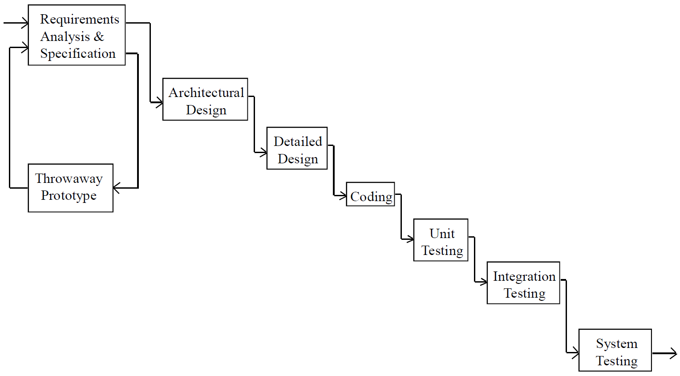
Throwaway Prototyping
Definition
Construction
Integration & Test

Slide 21
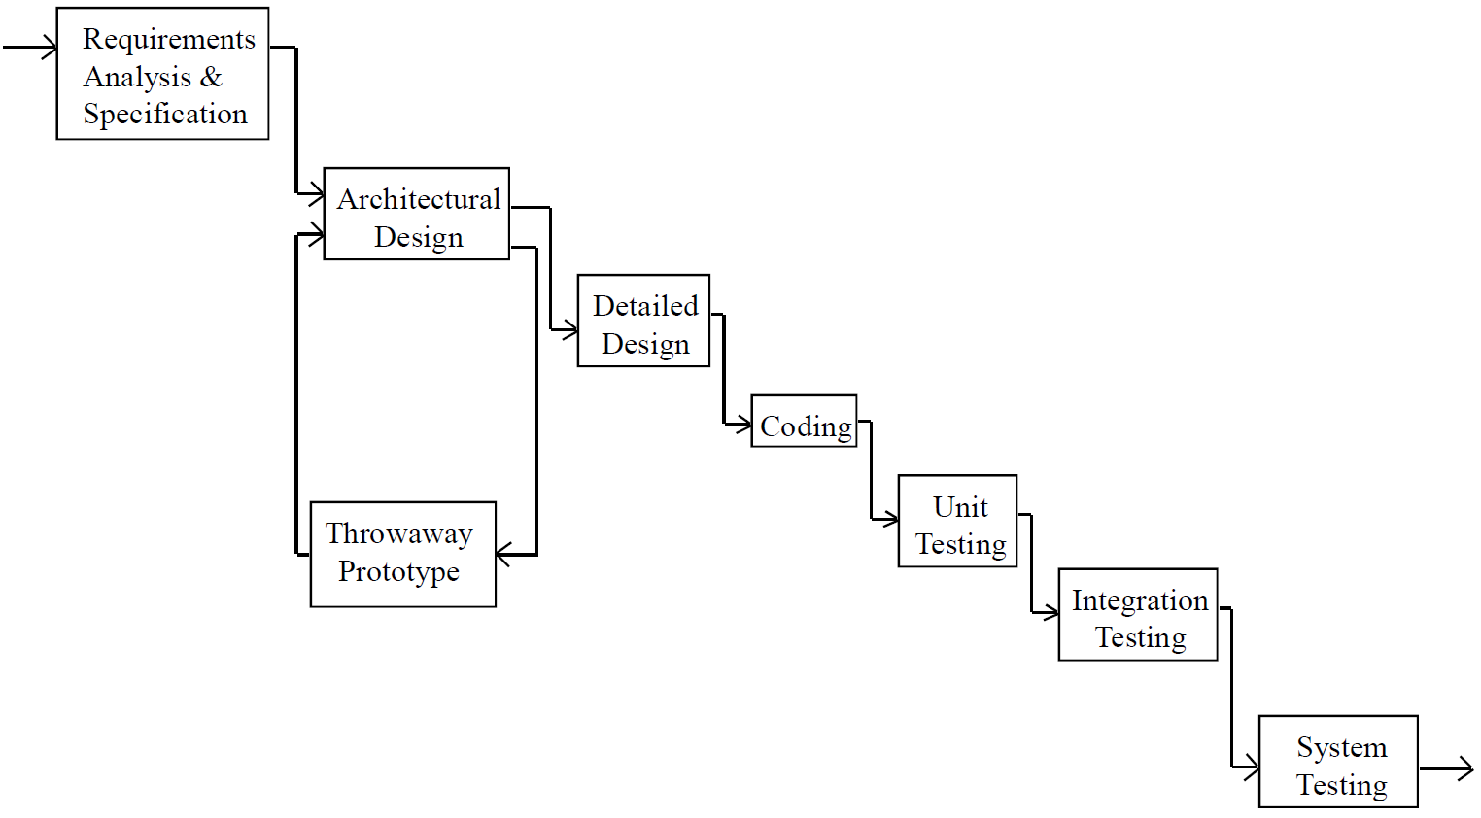
Throwaway Prototyping
Definition
Construction
Integration & Test

Slide 22
Incremental Development
Prototyping Con:
Operational system available late in life cycle
Use incremental development (a.k.a. evolutionary prototyping)
Subset of system working early
Gradually build on
Prototype evolves into production system

Slide 23
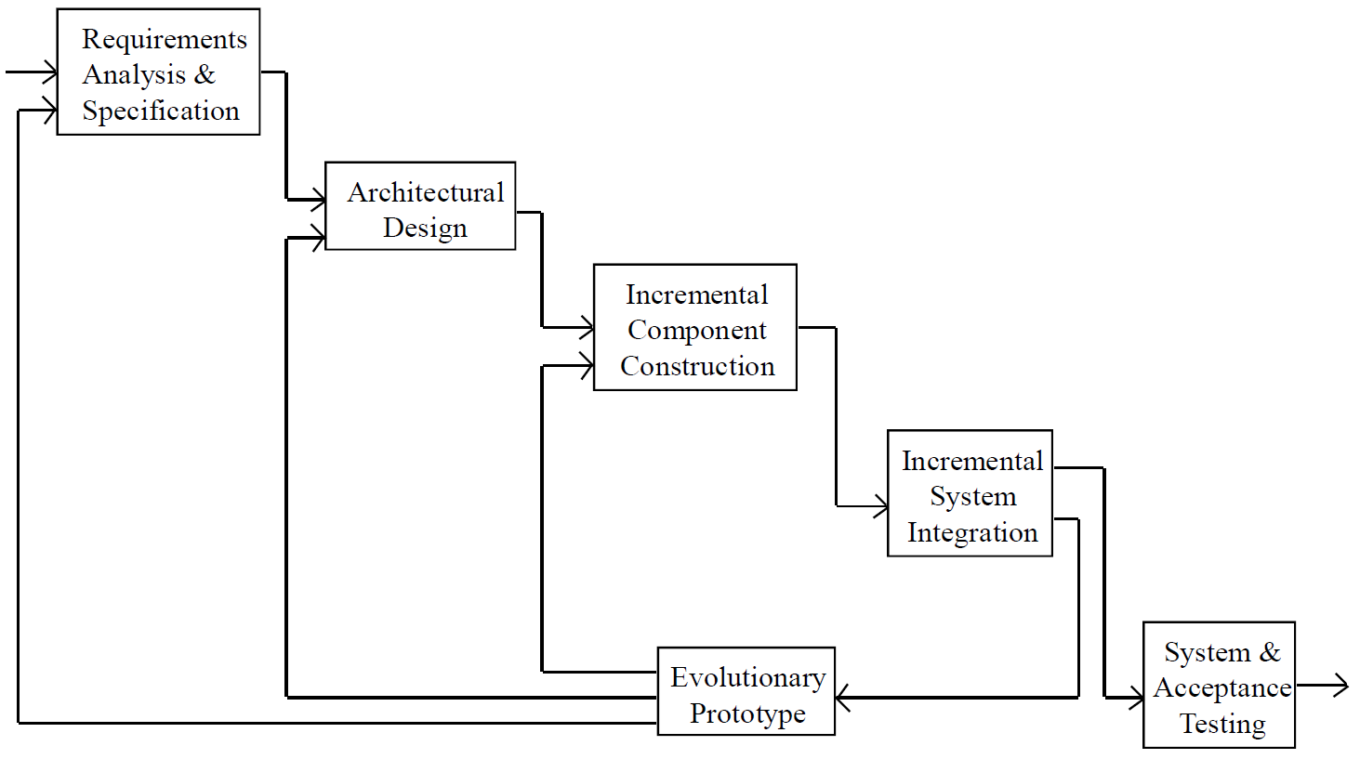
Incremental Development
Definition
Construction
Integration & Test

Slide 24
Question?
Should Prototype Evolve into Production System?
Notes:
Tradeoff
Rapid development
Quality of product
Throw-away prototype
Speed, not quality is goal
Must not evolve into production system
Evolutionary prototype
Must emphasize quality
Maintainability is key issue

Slide 25
Question?
Should Prototype Evolve into Production System?
Tradeoff
Rapid development
Quality of product
Throw-away prototype
Speed, not quality is goal
Must not evolve into production system
Evolutionary prototype
Must emphasize quality
Maintainability is key issue

Slide 26
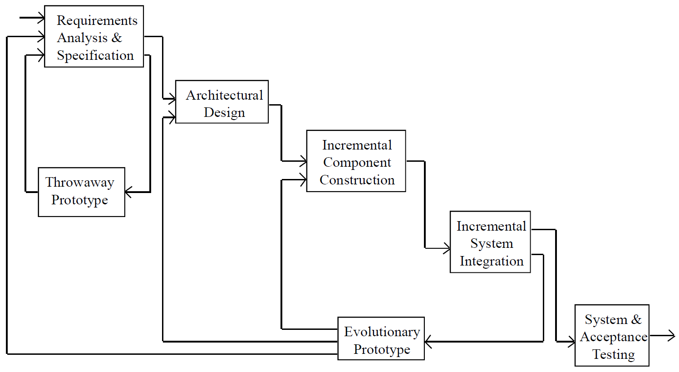
A Hybrid Process
Definition
Construction
Integration & Test

Slide 27
Spiral Process Model (SPM)
SPM consists of four main activities that are repeated
Defining objectives, alternatives and constraints
Analyzing risks
Developing and verifying product
Spiral planning
Number of cycles is project specific
Risk driven process
Analyze risks in second quadrant

Slide 28
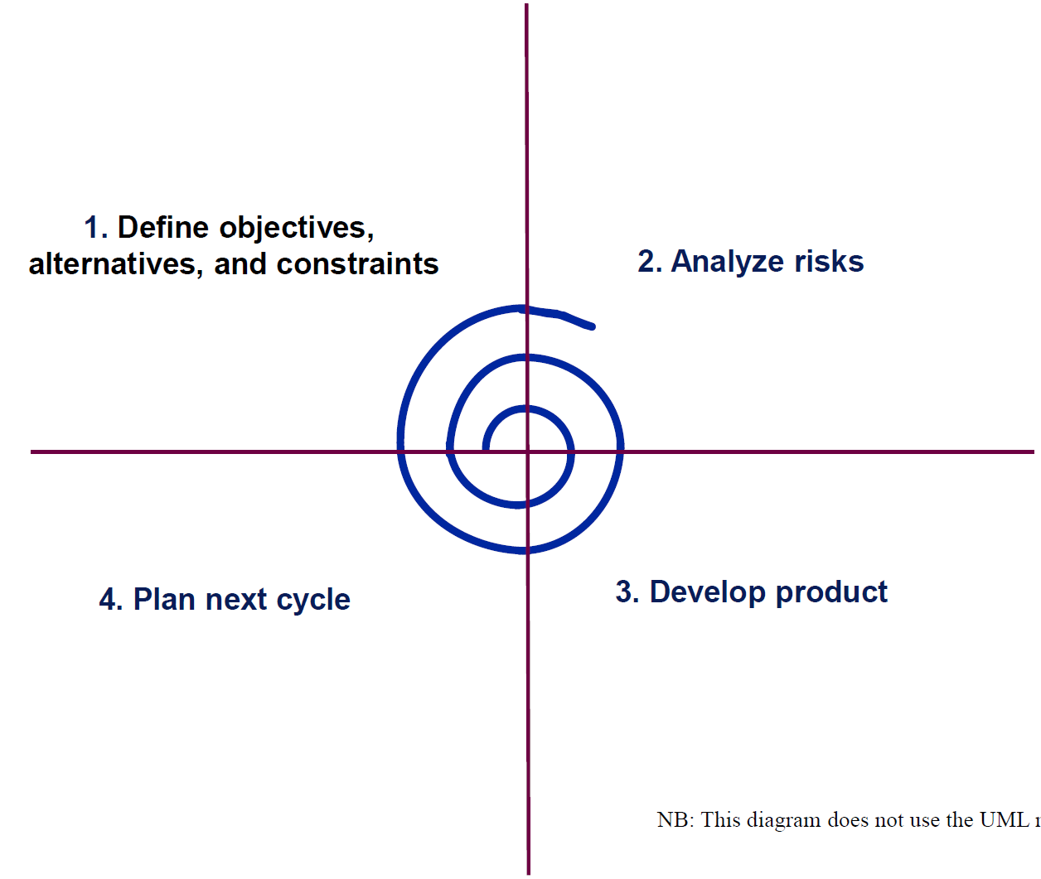
The Spiral Process

Slide 29
Rational Unified Process
Risk driven iterative process (a.k.a. Unified software Development Process)
Workflow activities produces a result of observable value
Workflows in Unified Process
Requirements (Product: Use case model)
Analysis (Product: Analysis model)
Design (Products: design model and deployment model)
Implementation (Product: software implementation)
Test (Products: Test cases and test results)

Slide 30
Rational Unified Process
Activity and effort defined by phases
Like Chess (opening, middle-game, end-game)
Time between two major milestones
Phases in Unified Process
Inception – Seed idea is developed
Elaboration – Software architecture is defined
Construction – Software is built to the point at which it is ready for release
Transition – Software is turned over to the user community

Slide 31
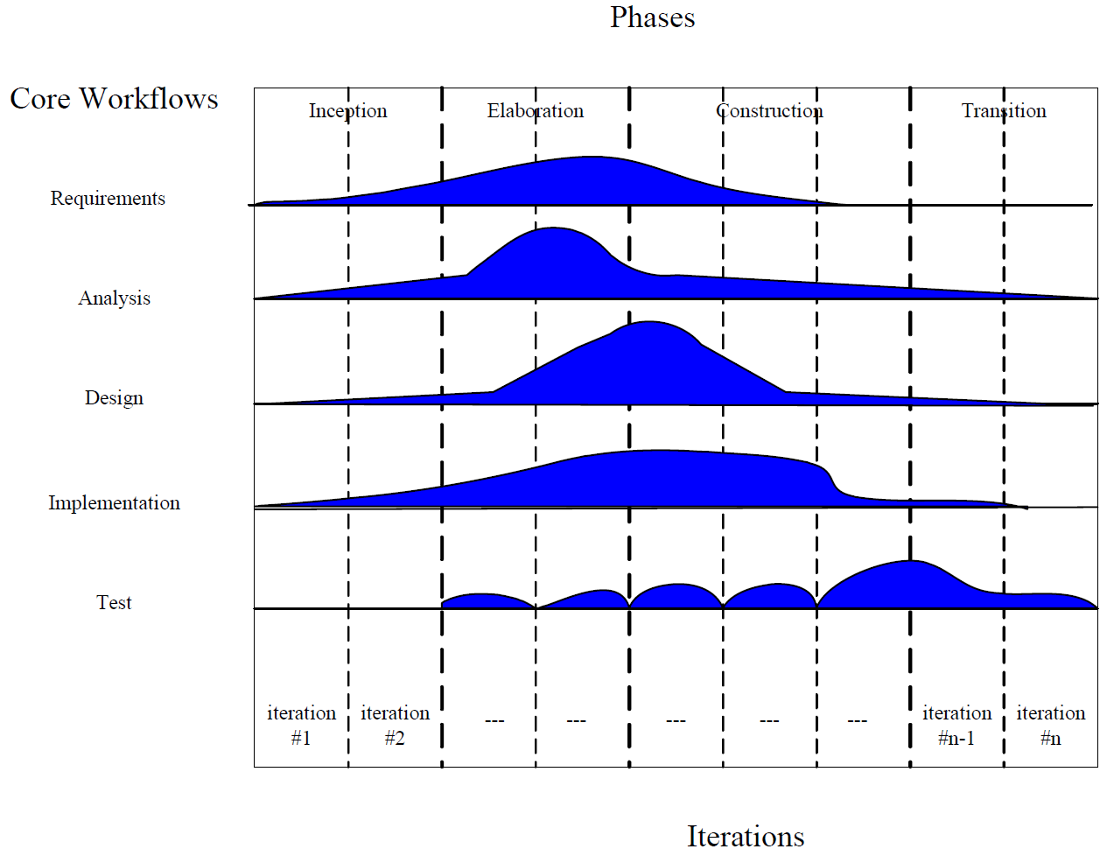
Rational Unified Process

Slide 32
Scrum Development
Development effort is iterative and incremental
Useful when it is difficult to plan ahead
Activity and effort organized into sprints (or iterations)
Artifacts
Product Backlog – an ordered list of requirements
Sprint Backlog – the list of work in this sprint
Increment – a usable version of the software
Sprint Burn Down Chart – daily progress for a sprint
One minute overview
https://www.youtube.com/watch?v=TRcReyRYIMg
https://www.youtube.com/watch?v=Z9QbYZh1YXY (Agile)

Slide 33
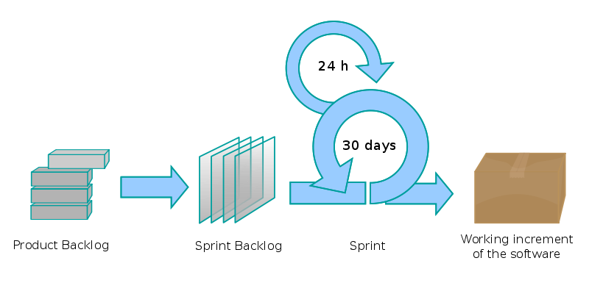
Scrum Process
Development periods (i.e. sprints) are “timeboxed”
The result of each sprint is a working product

Slide 34
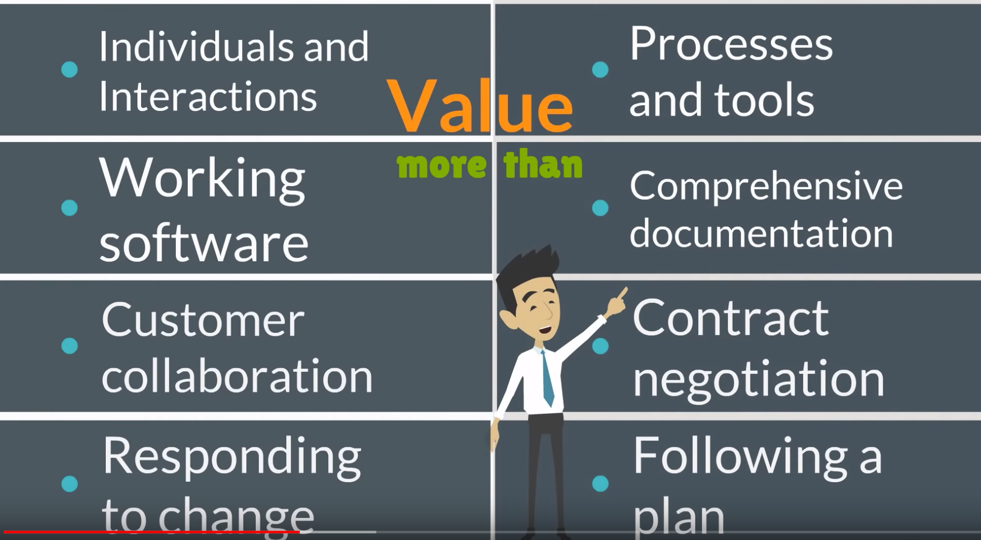
Value Left column over the right column
https://www.youtube.com/watch?v=Z9QbYZh1YXY

Slide 35
Scrum Terminology
Scrum Team
Product Owner – responsible to the stakeholders Maintains the product backlog
Scrum Master – responsible for the Scrum process
Development Team – group responsible for delivering shippable increments at the end of each sprint
Story – a feature added to the backlog “As a <usertype> I want to <do some action> so that <desired result>”
As a librarian I want to check-out a book so that the library knows who checked it out and when it is expected back.

Slide 36

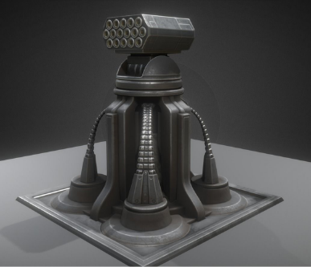
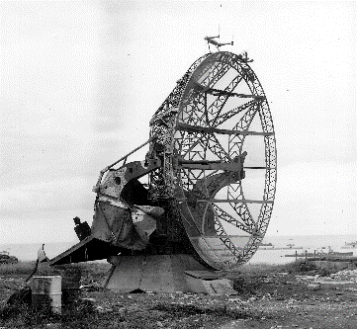
You’re the Product Owner
Articulate three new “stories” for our virtual DefenseDaemon…

Slide 37
Review
What is a software life cycle?
Phased approach to software development
A framework – tasks required to build quality software
Software Process Models
Waterfall – limitations of Waterfall Model
Exploratory - throwaway prototyping
Incremental - evolutionary prototyping
Spiral model – risk driven process model
RUP – full-spectrum approach with varying focus
SCRUM – rapid iterations over specific objectives

