Slide 1
Requirements Modeling
Lesson 7
CSCE 593 Intro to Software Engineering

Slide 2
Objectives
Communication vehicle among multiple audiences
Customers
Users
Analysts
Designers
Basis for Software Design
Provide precise statement of requirements to designers
Basis for Software Validation
Basis for system acceptance criteria
Basis for controlling evolution of system
Changes to existing requirements
Addition of new requirements

Slide 3
Requirement Components
Functional Reqs (“the system shall…”)
Non-Functional Reqs
Behavioral Reqs (quality goals)
“ities” (Maintainable, Reliable, Testable, Extensible, Portable, Scalability, Robust, Availability)
Information Reqs
External Interface Requirements
Design Constraints

Slide 4
Requirement Components
Functional Requirements (What system does, NOT how)
Inputs to software system
Outputs from software system
Processing to be performed
Non-Functional / Behavioral Requirements
Externally observable states
Transitions between states
Information Requirements
Entities (classes), Attributes, Relationships
Data Dictionary

Slide 5
Requirement Components
External Interface Requirements
User Interfaces
Specify characteristics of user interface
Can be detailed
Specify individual screens
Hardware Interfaces
Very important for embedded systems
Software Interfaces
Interfaces to other software systems
System context model
Depict boundary of system

Slide 6
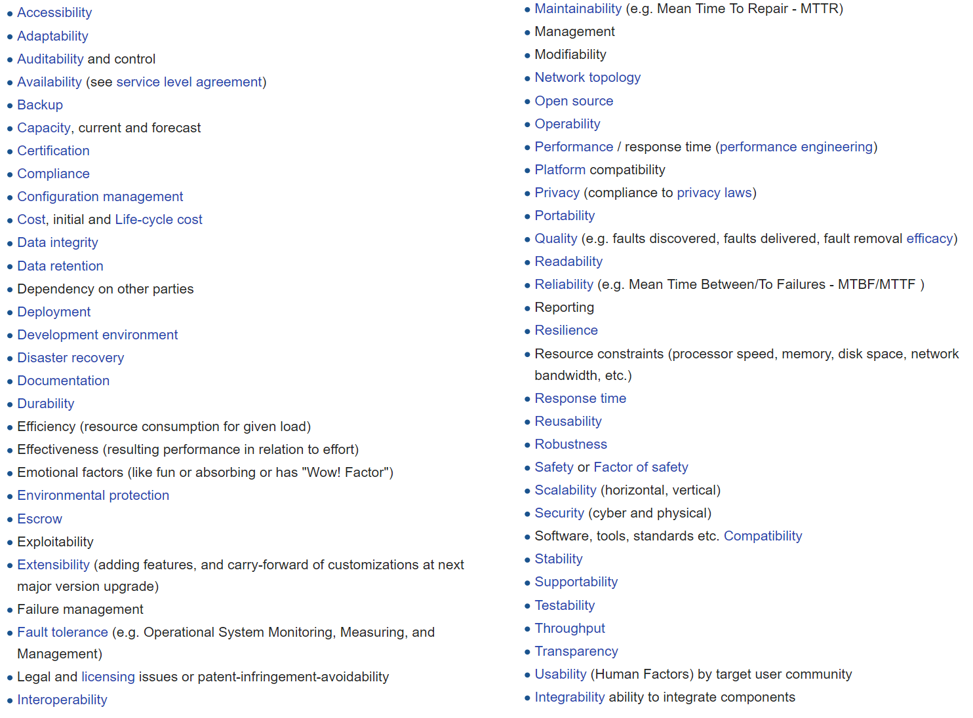
Non-Functional Reqs (“ities”)
User interface characteristics
Reliability
Security
Availability
Performance
Modifiability
Portability
Cost

Slide 7
Design Constraints
Hardware to be supported
System configuration
Centralized vs. Distributed
Windows vs. Unix
Existing software to be utilized
Portability requirements
Anticipated changes to be accommodated

Slide 8
Quality Attributes
A good requirement is:
Correct
Complete
Unambiguous
Consistent
Verifiable
Understandable
Traceable

Slide 9
Approaches to Reqs/Specs
Black Box Requirements Specification
Specify
External inputs and outputs
Externally visible states and transitions
Functions that produce outputs
Methods for Requirements Analysis and Specification
Structured Analysis (Data flow diagrams / Flow Chart)
Object-Oriented Analysis
Use Case Modeling

Slide 10
Use Case Modeling
Use Case
Describes sequence of interactions between user (actor) and system
Narrative description
Use Case model
Define system functional requirements in terms of Actors and Use cases
Use case relationships
include
extend

Slide 11
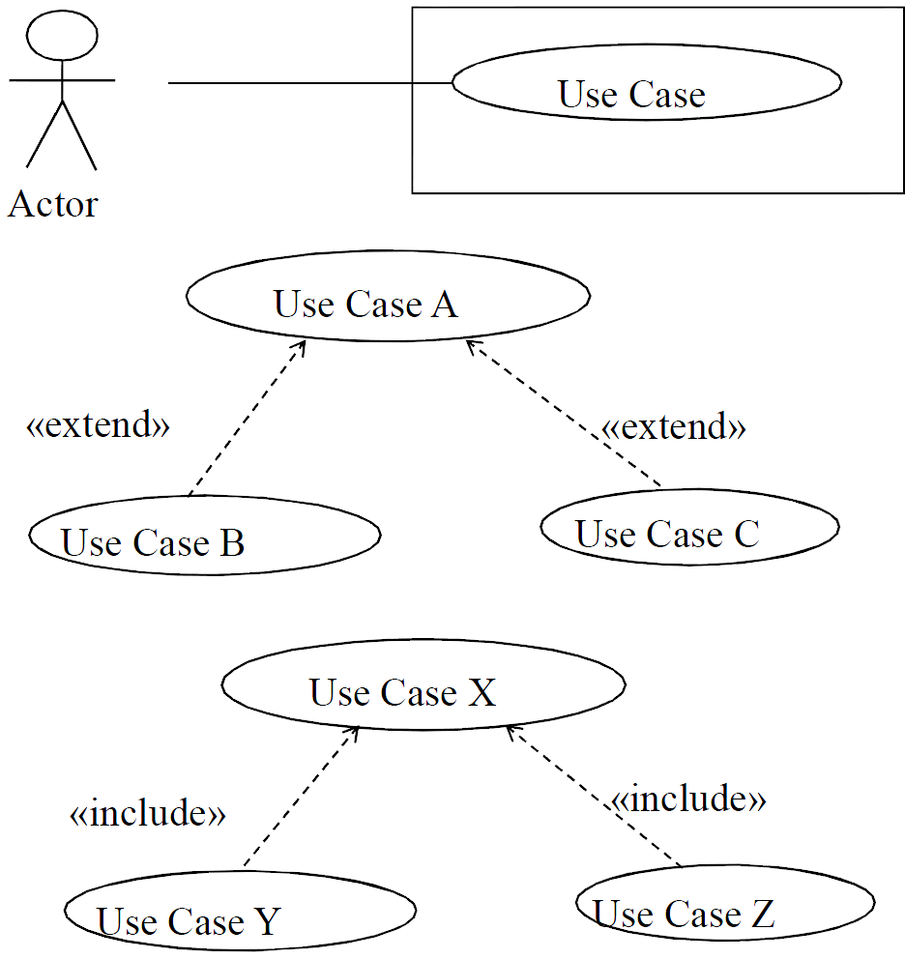
UML for a Use Case

Slide 12
Actors
Actor models external entities of system
Actors interact directly with system
Human user
External I/O device
External system
Timer
Actor initiates actions by system
May use devices or external system to physically interact with system
Actor initiates use cases

Slide 13
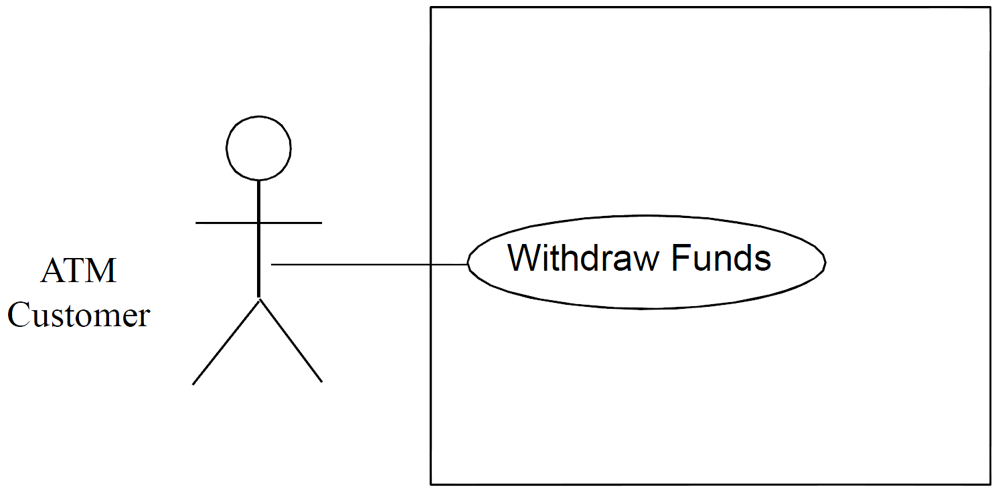
Human Actor
Human’s often interact with our system/software

Slide 14
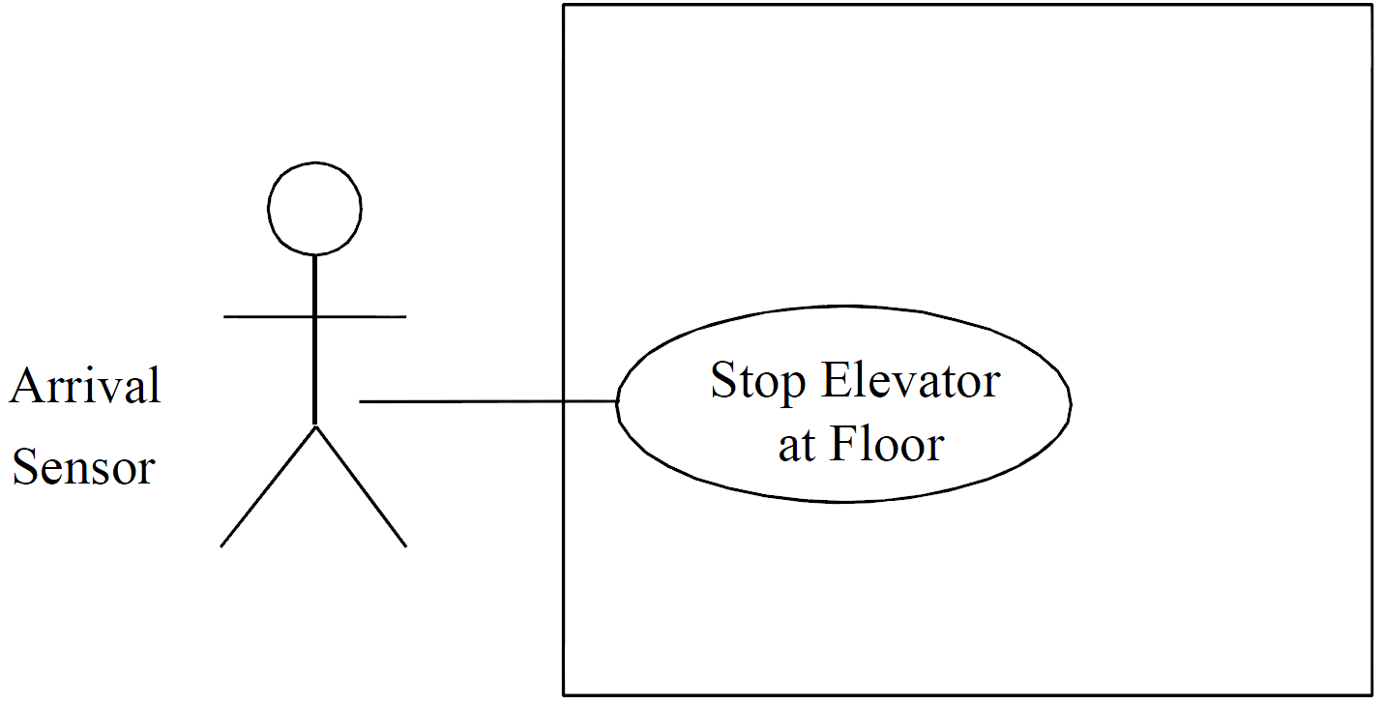
System Actors
Other systems may also act on our system/software

Slide 15
Actors
Primary Actor
Starts the use case by providing input to the system
Secondary Actor
Participates in use case
Can be Primary Actor of a different use case
Actor
Represents all users who use system in the same way
A user is an instance of an actor
Represents a role played by all users of the same type
Human user may play more than one role

Slide 16
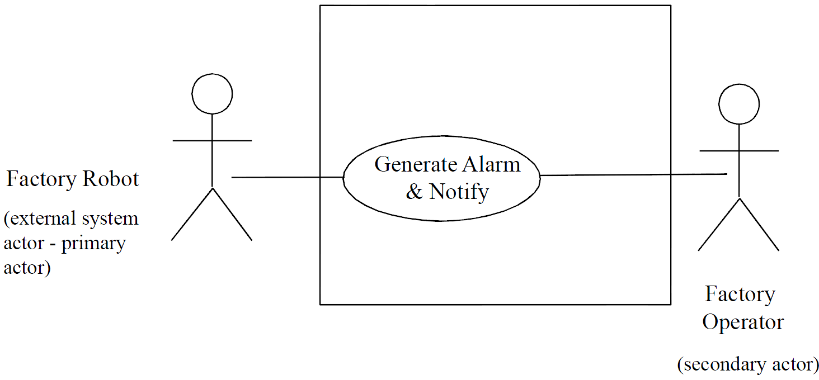
External Actors

Slide 17
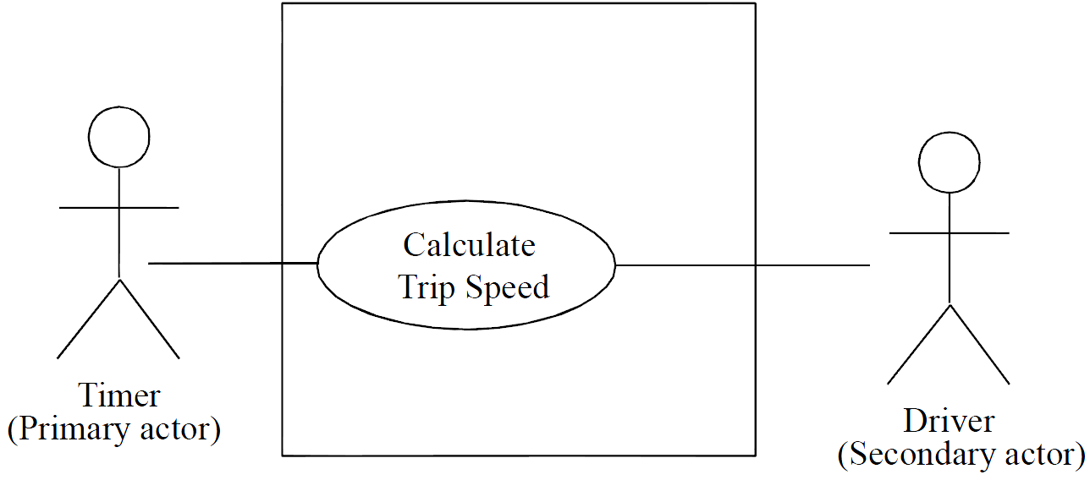
Timer Actor
Perhaps we want events to occur at certain times
Scheduled events

Slide 18
Use Cases
Identifying use cases
Consider each major function an actor needs to perform
Provides value to actor
Use case is a complete sequence of events initiated by an actor
Specifies interaction between actor and system
Use case starts with input from an actor
Basic path
Most common sequence
Alternative branches
Variants of basic path (e.g. for error handling)

Slide 19
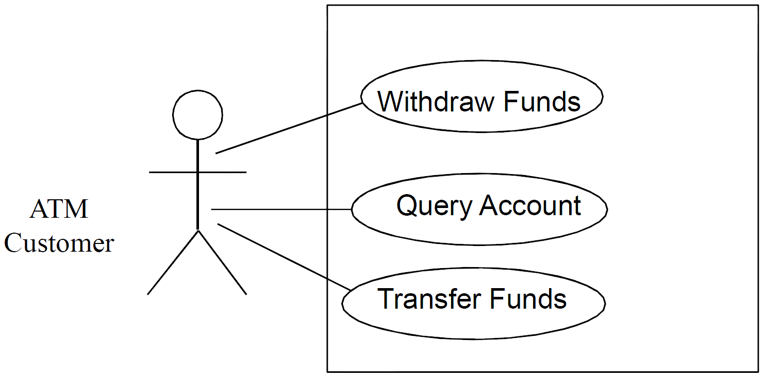
More than One Use Case
Systems can have more than one use case
Users decide what the system should do

Slide 20
Documenting Use Cases
Use case name
Summary
Dependency (on other use cases)
Actors
Preconditions
Main sequence
Alternative sequence(s)
Nonfunctional requirements
Postcondition
Outstanding questions

Slide 21
Use Case Relationships
Include relationship
Identify common sequences of interactions in several use cases
Extract common sequence into inclusion use case
Base use cases includes abstract use case
Example
Withdraw Funds use case includes Validate PIN use case

Slide 22
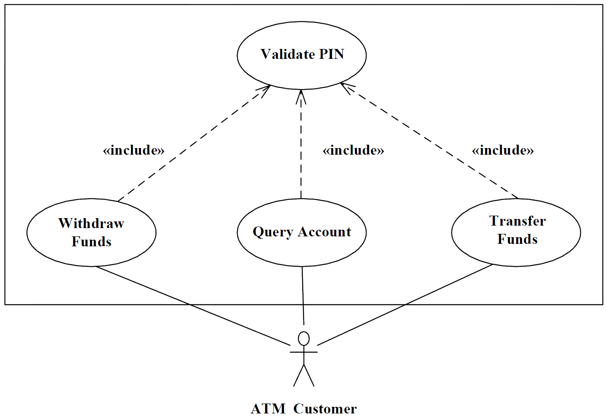
Inclusion Example

Slide 23
Use Case Relationships
Extend relationship
Use case A is an extension of use case B
Under certain conditions use case B will be extended by description given in use case A
Same use case can be extended in different ways
When to use extend
Show conditional parts of use case
Model complex or alternative paths
Example
Pay by Cash extends Checkout Customer

Slide 24
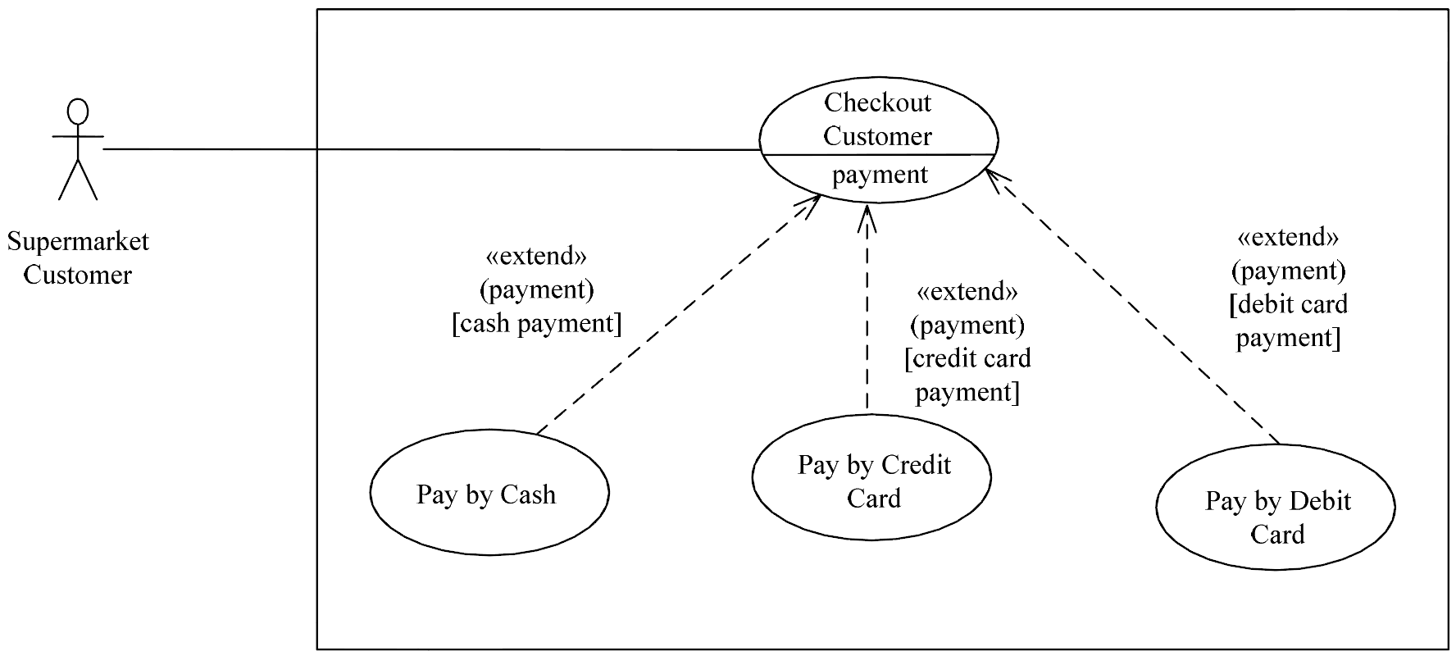
Extension Example
Abstracts details about how to pay from the Checkout Customer use case

Slide 25
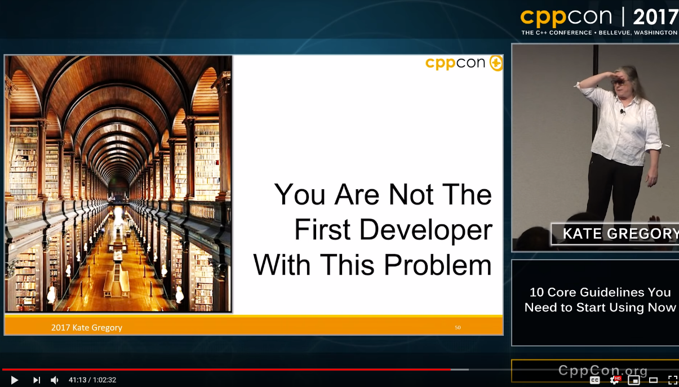
HW2 Review / Improve Your Coding
Kate Gregory – CppCon 2017
10 Core Guidelines You Need to Start Using Now
https://www.youtube.com/watch?v=XkDEzfpdcSg&vl=en

Slide 26
A Banking System
Multiple Automated Teller Machines (ATM)
Customer inserts ATM Card
Enters Personal Identification Number (PIN)
ATM Transactions
PIN Validation
Withdraw Funds from Checking or Savings Account
Query Account
Transfer funds between accounts
Banking System maintains information about
Customers
Debit cards
Checking and Savings Accounts

