Slide 1
Software Quality Attributes
Lesson 8
CSCE 593 Intro to Software Engineering

Slide 2
Overview
Maintainability
Modifiability
Testability
Traceability
Scalability
Reusability
Performance
Security
Availability

Slide 3
Maintainability
The extent to which software is capable of being changed after deployment
Reasons for modification
Fix remaining errors
Address performance issues
Change in software requirements

Slide 4
Modifiability
The extent to which software is capable of being modified during and after initial development
Localize modifications
Maintain semantic coherence
Anticipate expected changes
Generalize the module
Limit possible options (i.e. hide information)
Aim for Low Coupling and High Cohesion

Slide 5
Testability
Extent to which the software is capable of being tested
Establish a test plan early
Functional (black box) test cases
Based on use case descriptions
Integration (scenario) test cases
Tests interfaces between components
Based on use case interaction models
Unit (white box) test cases

Slide 6
Traceability
Extent to which products of each phase can be traced back to the products of previous phases
Tracing forward
Has this requirement been implemented?
Tracing backward
Which requirement does this feature support?

Slide 7
Scalability
Extent to which the system is capable of growing after initial deployment
Consider the hardware system
Centralized or distributed system?
Consider the software design
Are multiple instance of components/services allowed?

Slide 8
Reusability
Extent to which software is capable of being reused
Examples
Subroutine libraries
Game engines

Slide 9
Performance
Extent to which the system is expected to meet its performance goals (e.g. throughput and response time)

Slide 10
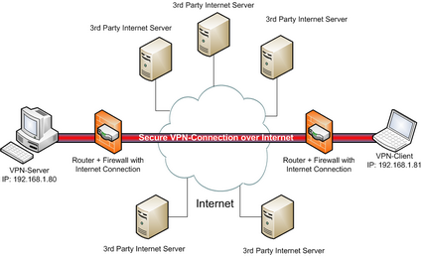
Security
Consideration must be given to the what threats may disrupt or exploit a system and its information
Threats
System penetration
Authorization (insider) violation
Confidentiality disclosure
Integrity compromise
Repudiation
Denial of service

Slide 11
Availability
How might failures impact/disrupt users or other systems
Hardware failures
Fault-tolerant hardware systems
High-availability through virtualization
http://www.youtube.com/watch?v=fKFFhK4zrZI&feature=plcp (this is an example and in no way an endorsement)
Distributed software systems
Multiple nodes with distributed control
Graceful degradation

Slide 12
Summary
Maintainability
Modifiability
Testability
Traceability
Scalability
Reusability
Performance
Security
Availability

