Slide 1
What is Statistical Learning?
Chapter 02 – Part I
Slides Inspired by content from IOM 530 “Applied Modern Statistical Learning Methods” – Gareth James (one of the authors of our book)

Slide 2
Outline
What Is Statistical Learning?
Why estimate f ?
Prediction (Estimation) vs. Inference

Slide 3
What is Statistical Learning?
Suppose we observe and for
We believe that there is a relationship between Y and at least one of the X’s.
We can model the relationship as
Where f is an unknown function and ε is a random error with mean zero.

Slide 4
A Simple Example

Slide 5
A Simple Example
ε_{i}
f

Slide 6
Different Standard Deviations
The difficulty of estimating f will depend on the standard deviation of the ε’s.

Slide 7
Different Estimates For f

Slide 8
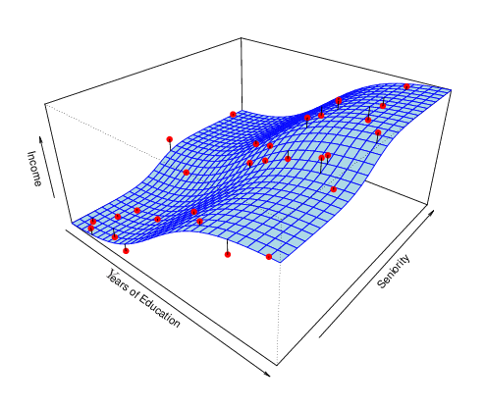
Income vs. Education & Seniority
Shown above is the “true” relationship between the variables Years of Education, Seniority, and Income.
CONCEPT CHECK: Describe the relationship between income, years of education and seniority that you see here

Slide 9
Why Do We Estimate f ?
Statistical Learning, and this course, are all about how to estimate f.
The term statistical learning refers to using the data to “learn” f.
Why do we care about estimating f ?
There are 2 reasons for estimating f,
Prediction (Estimation)
Inference (Explanation)

Slide 10
Prediction (Estimation)
If we can produce a good estimate for f (and the variance of ε is not too large) we can make accurate predictions for the response, Y, based on a new value of X.

Slide 11
Prediction / Estimation Example: Direct Mailing Decision
How much money an individual will donate to a charity?
Data:
X: 400 characteristics about each person
Y: How much they donated.
Business Question: For a given individual should I request a donation?
Is the expected value of taking the action greater than the cost of the action?
Assume that there is no desire to know what features are associated with people who contribute.

Slide 12
Inference (Explanation)
We may also be interested in the type of relationship between Y and the X's.
For example,
Which particular predictors (features) actually affect the response?
Is the relationship positive or negative?
Is the relationship a simple linear one or is it more complicated?

Slide 13
Inference Example: Understanding Home prices
How do characteristics affect home prices
Housing data:
X: 14 characteristics (e.g. number of beds; baths; square feet)
Y: cost of the home
Business Question:
How would altering the variables affect my home’s value?
For example
Would installing an in-ground pool increase my home’s value?
What is the financial impact of turning my 1-car garage into a woodworking shop?
What is the most cost-effective thing I could do to improve my home’s value before I sell it?

