Slide 1
Assessing model accuracy
Chapter 02 – Part 3
Slides Inspired by content from IOM 530 “Applied Modern Statistical Learning Methods” – Gareth James (one of the authors of our book)

Slide 2
Outline
Measuring the Quality of Fit for Regression
The Bias-Variance Trade-off for Regression
Measuring the Quality of Fit for Classification
Bayes Error
K-Nearest Neighbors
The Bias-Variance Trade-off for Classification

Slide 3
Measuring Quality of Fit - Regression
How do we evaluate a regression model’s performance?
One way: mean squared error (MSE):
Where is the prediction our method gives for the observation in our training data.
CONCEPT CHECK:
What is n in the equation?
Which is better – a higher, or a lower MSE?

Slide 4
Training vs. Test set performance
Model Fitting: Choose model parameters such that MSE is minimized on the Training Data
What we really care about is how well the method works on data that was not used for training (i.e. Test Data). Test data performance indicates the model’s ability to generalize.
There is no guarantee that the method with the smallest training MSE will have the smallest test MSE. If training performance is good and test performance is bad, the model has failed to generalize.

Slide 5
Training vs. Test errors
In general the more flexible a method is the lower its training MSE … it will “fit” or explain the training data very well.
In a more flexible model, the test MSE may be higher than in a less flexible model.
CONCEPT CHECK: Why would test MSE be larger than train MSE in a flexible model?

Slide 6
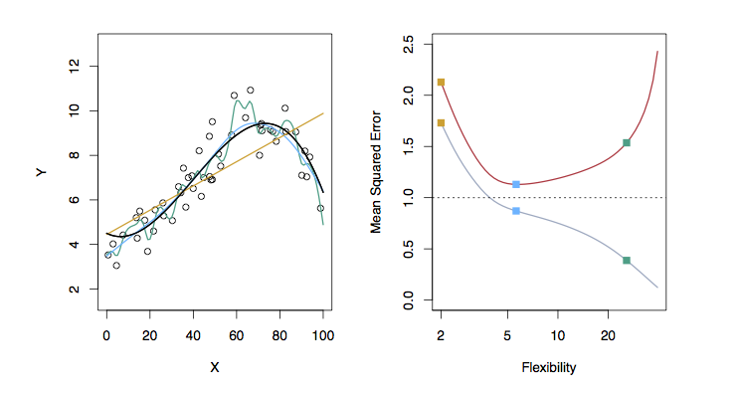
Examples with Different Levels of Flexibility: Example 1
TestMSE
Linear Model
More flexible smoothing spline
Smoothing Spline
TrainingMSE
Black: Truth
Orange: Linear Estimate
Blue: smoothing spline
Green: smoothing spline (more flexible)
RED: Test MSE
Grey: Training MSE
Dashed: Minimum possible test MSE (irreducible error)
CONCEPT CHECK:
Where does “irreducible error” come from?

Slide 7
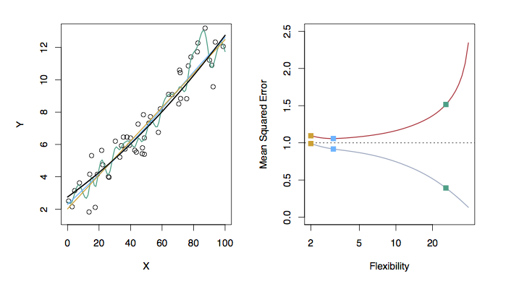
Examples with Different Levels of Flexibility: Example 2
TestMSE
More flexible smoothing spline
Smoothing Spline
Linear Model
TrainingMSE
Black: Truth
Orange: Linear Estimate
Blue: smoothing spline
Green: smoothing spline (more flexible)
RED: Test MSE
Grey: Training MSE
Dashed: Minimum possible test MSE (irreducible error)

Slide 8
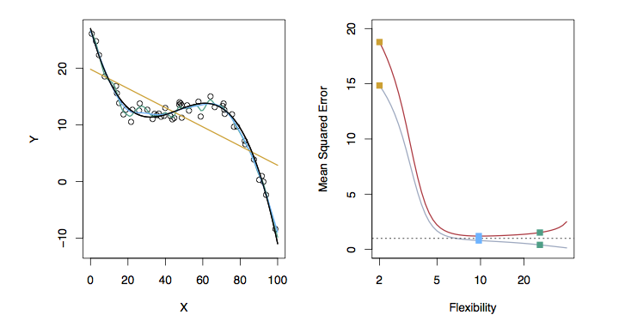
Examples with Different Levels of Flexibility: Example 3
TestMSE
Linear Model
More flexible smoothing spline
Smoothing Spline
TrainingMSE
Black: Truth
Orange: Linear Estimate
Blue: smoothing spline
Green: smoothing spline (more flexible)
RED: Test MSE
Grey: Training MSE
Dashed: Minimum possible test MSE (irreducible error)

Slide 9
Bias / Variance Tradeoff
The previous graphs of test versus training MSE’s illustrate a very important tradeoff that governs the choice of statistical learning methods.
There are always two competing forces that govern the choice of learning method: bias and variance.

Slide 10
Bias of Learning Methods
The Inductive Bias of a (machine) learning algorithm is the set of assumptions used to predict outputs given inputs it has not encountered (Tom Mitchell, 1980).
Intuition- Higher Bias: quicker to generalize well… but more likely to overgeneralize
In our text, Bias refers to the error that is introduced by modeling a real life phenomenon by a model that does not match the phenomenon.
Often we are talking about a real world phenomenon that is complicated being modeled by a much simpler model.
For example, linear regression assumes that there is a linear relationship between Y and X. It is unlikely that, in real life, the relationship is exactly linear so some bias will be induced when we select a linear model.
The more flexible/complex a method is the less bias it will generally have.

Slide 11
Variance of Learning Methods
Variance refers to the model’s sensitivity to error caused by small fluctuations in the training data.
Intuition – Variance tells us how sensitive the model is to having trained with a different set of training data from the same original phenomenon
Concept check: Why does choosing a higher variance model lead to a performance improvement on the training set but worse performance on the test set?

Slide 12
Bias-Variance Trade-off
It can be shown that for any given, X=x₀, the expected test MSE for a new Y at x₀ will be equal to
… As a modeling method gets more flexible the bias will decrease and the variance will increase but expected test MSE may go up or down
The mathematical details of the derivation are in the “Elements of Statistical Learning” book but are not covered in our course (https://web.stanford.edu/~hastie/ElemStatLearn/ )
Irreducible error

Slide 13
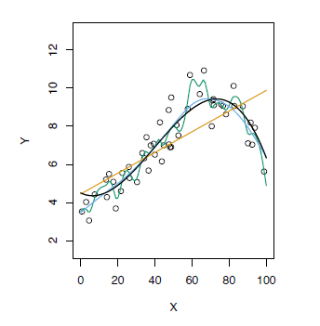
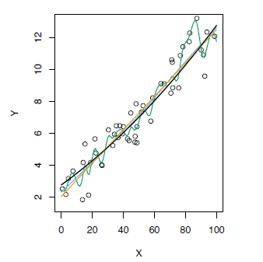
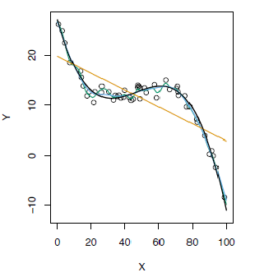
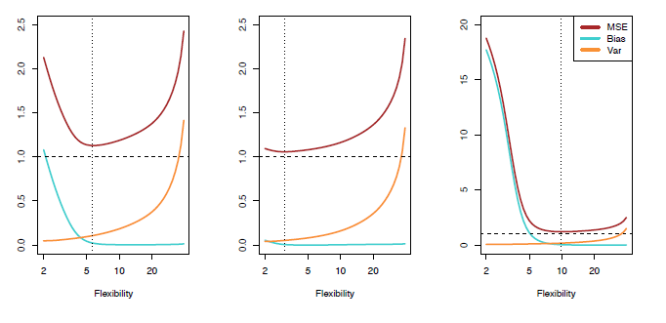
Test MSE, Bias and Variance

Slide 14
Assessing Classification Performance
For a regression problem, we used the MSE to assess the accuracy of the statistical learning method
For a classification problem we can use the error rate i.e.
is an indicator function, which will give 1 if the condition is true, otherwise it gives a 0.
Thus the error rate represents the fraction of incorrect classifications, or misclassifications

Slide 15
Bayes Error Rate (1 of 2)
One way to think about data is that there is some underlying process which “generates” the examples we observe
In classification, a probabilistic view of data generation implies that sampling is occurring from prior distributions of the class densities
The Bayes error rate refers to the lowest possible error rate that could be achieved if the “true” probability distribution of the phenomenon which generates observations was known.

Slide 16
Bayes Error Rate (2 of 2)
Bayes error rate is what would be obtain if each observation was labeled with the label of the highest-probability class (for that observation’s features)
On unseen data, sampled from the true distribution, a classifier (or statistical learning method) expected performance will not be better than the Bayes error rate.
However… we don’t know the true distribution of the phenomenon because we only get to see a (biased) sample
Bayes Error Rate is unknown in most real world problems

Slide 17
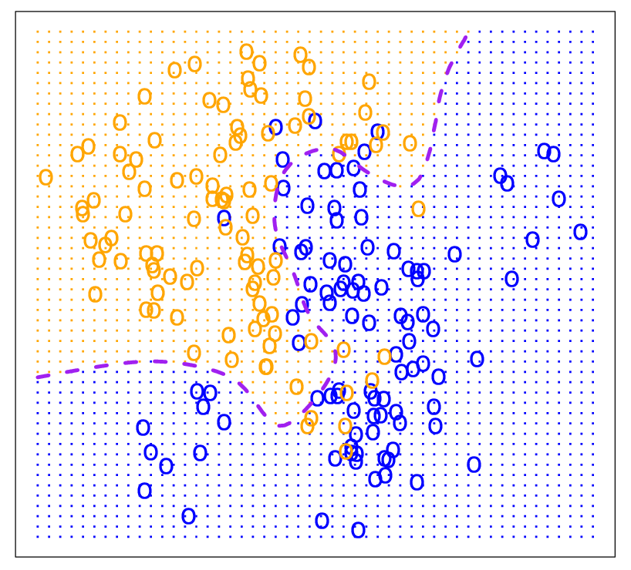
Bayes Optimal Decision Boundary
If the densities of the classes were known, the optimal boundary could be determined:
For any set of feature values, select the label of the class with the highest probability

Slide 18
K-Nearest Neighbors (KNN)
K-Nearest Neighbors is a flexible, non-parametric approach for classification
Requires a definition of “near” – e.g. a distance measure
Requires the setting of K – the number of neighbors to consider
For X_{i} determine the K nearest neighbors to X_{i} in training data
The class of X_{i} is estimated to be the class label (Y) of the majority (or plurality if more than 2 classes) of its neighbors
Smaller values of K lead to more flexible boundaries
Given a good choice for K, and enough training data, the label for an observation is based on a local density approximation of the classes
Thus, K-NN can be used to estimate the Bayes Classifier.

Slide 19
K-Nearest Neighbors (KNN)
Given a good choice for K, and enough training data, the label for an observation is based on a local density approximation of the classes
Thus, K-NN can be used to estimate the Bayes Classifier
… but how do we select a good choice for K?
Choose the one that works the best!
The process of choosing an algorithm parameter (such as K) is known as Hyperparameter Selection

Slide 20
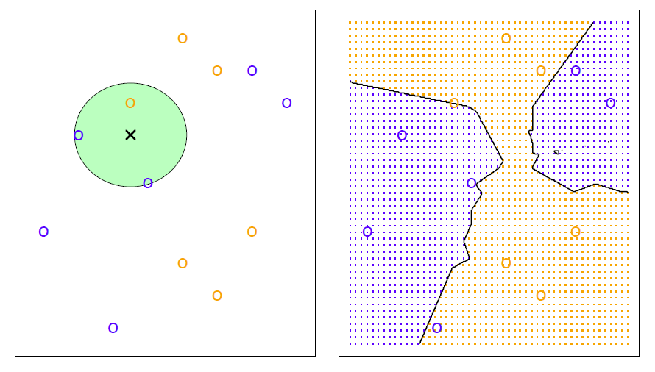
KNN Example with k = 3

Slide 21
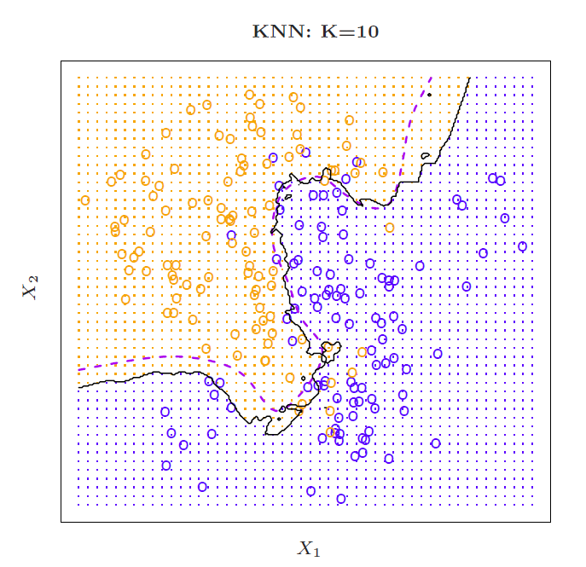
Simulated Data: K = 10

Slide 22
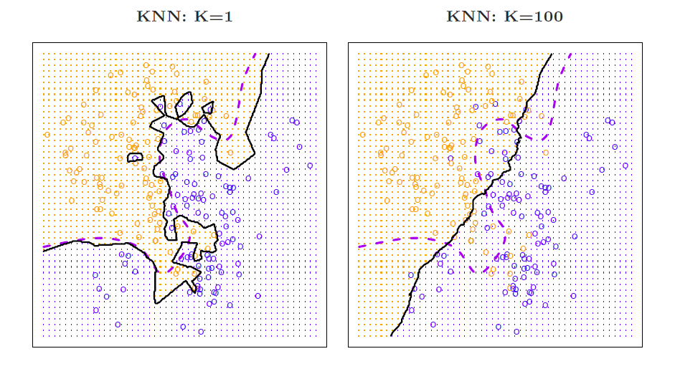
K = 1 and K = 100

Slide 23
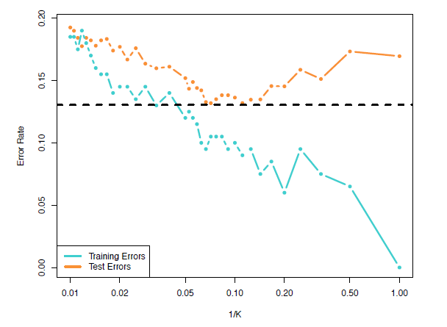
Training vs. Test Error Rates on the Simulated Data
Notice that training error reduces as k is decreased (as flexibility increases)
However, as K is reduced, the test error first decreases but then increases. WHY?
K=100
K=10
K=1

Slide 24
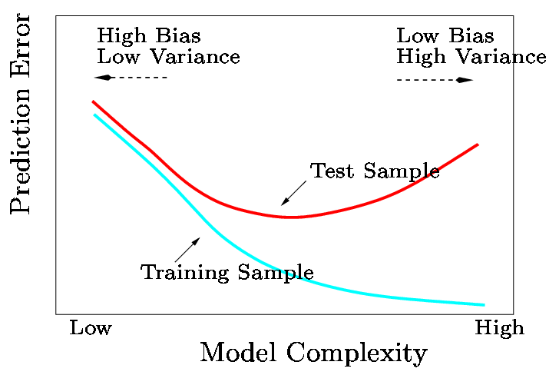
Model complexity & Performance The Bias-Variance Trade-off
As model complexity increases, training error generally declines*
As complexity increases, test errors will decline at first (as reductions in bias dominate) but will then start to increase again (as increases in variance dominate)
Where test error is minimized, the model has a good complexity
Find the model with the right complexity
More flexible/complicated is not always better

