Slide 1
Linear Regression
Chapter 03
Part 1: The Linear Regression Model

Slide 2
Outline for the Chapter
The Linear Regression Model
Least Squares Model Fitting
Measures of Fit
Inference in Regression
Other Considerations in Regression Model
Qualitative Predictors
Interaction Terms
Potential Fit Problems
Linear vs. KNN Regression

Slide 3
Outline for this segment
The Linear Regression Model
Least Squares Model Fitting
Measures of Fit
Inference in Regression
Other Considerations in Regression Model
Qualitative Predictors
Interaction Terms
Potential Fit Problems
Linear vs. KNN Regression

Slide 4
The (multiple) Linear Regression Model
$$y_{i}=β_{0}+β_{1}X_{1i}+β_{2}X_{2i}+…+β_{p}X_{pi}+ϵ$$
The parameters in the linear regression model are very easy to interpret.
β₀ is the intercept (i.e. the average value for Y if all the X’s are zero), β_{j} is the slope for the j^{th} variable X_{j}
β_{j} is the average increase in Y when X_{j} is increased by one and all other X’s are held constant.

Slide 5
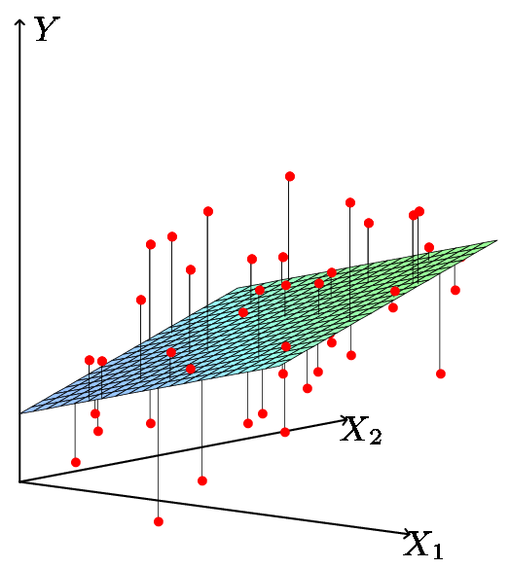
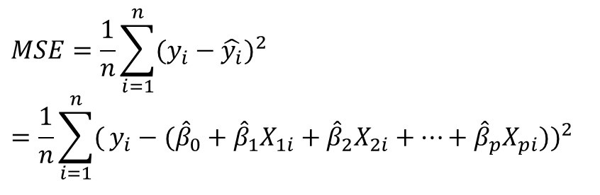
Least Squares Fit
Estimate the parameters using least squares
The best coeff’s are the ones which minimize the cost
$$MSE=\frac{1}{n}\sum_{i=1}^{n}{(y_{i}−\hat{y_{i}})^{2}} \\ =\frac{1}{n}\sum_{i=1}^{n}{(}y_{i}−({\hat{β}}_{0}+{\hat{β}}_{1}X_{1i}+{\hat{β}}_{2}X_{2i}+…+{\hat{β}}_{p}X_{pi}))^{2}$$
Concept Check: What is the difference between RSS and MSE?

Slide 6
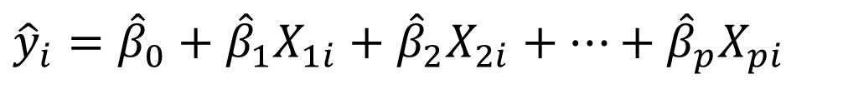
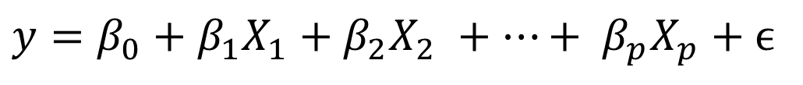
Relationship between population and least squares fit
Population
$$y=β_{0}+β_{1}X_{1}+β_{2}X_{2} +…+ β_{p}X_{p}+ϵ$$
Least Squares fit
$${\hat{y}}_{i}={\hat{β}}_{0}+{\hat{β}}_{1}X_{1i}+{\hat{β}}_{2}X_{2i}+…+{\hat{β}}_{p}X_{pi}$$
Would like to know β₀ through β_{p}: the population line. Instead we know through : the least squares line.
Use through as guesses for β₀ through β_{p} and as a guess for y.

Slide 7
Evaluation Criteria
There are a number of evaluation criteria for linear regression models.
We will discuss a subset of these next
RSS | p-value
MSE | R²
TSS | Correlation(X,Y)
Var & SE | F-statistic
RSE | Leverage statistic
t-statistic | VIF

Slide 8

Measure of Lack of Fit: Residual Sum of Squares (RSS)
RSS is an estimate of the error of a model with respect to the “correct” values. Range = [0, +∞)
For a given set of data, models which fit the data better will have a lower RSS
$$RSS=\sum_{i=1}^{n}{(y_{i}−{\hat{y}}_{i})^{2}}$$
Caution: RSS is sensitive to the Y scale of the data since it is measured in units of y.

Slide 9
Measure of Lack of Fit: Residual Standard Error (RSE)
RSE is an estimate of the standard deviation of the irreducible error ε.
Roughly the average amount that the response will deviate from the true regression line (because of ε)
Caution: RSE is sensitive to the Y scale of the data since it is measured in units of y.

Slide 10


Total Sum of Squares (TSS)
Our best guess for the value of y when we don’t have any other info is to guess the mean of the set of y values: $\bar{y}$
The sum of squared differences between this guess of $\bar{y}$ and the set of y values in the data is a lower bound for desired performance:
If our model obtains lower RSS than TSS it means our model is outperforming the guess of the mean of y
$$TSS=\sum_{i=1}^{n}{(y_{i}−\bar{y})^{2}}$$
TSS is non-negative. Zero means all labels are equal, and higher values express differences among the y values. Caution – TSS is affected by the scale of the y values.

Slide 11

Measures of Fit: R²
Some of the variation in Y can be explained by variation in the X’s and some cannot.
R² is a proportion of the variance explained by the model on X and is scale invariant:
R² is the fraction of variance that can be explained by using information gained by using the model on X instead of just guessing $\bar{y}$.
R² should have range [0, 1]
R²=0 means no variance of the response (Y) has been explained by the model.
R²=1 means all the variance in the response Y has been explained (the model perfectly fits to the data).

Slide 12
Prediction & Inference in Regression
The regression line from the sample is not the regression line from the population.
What we want to do:
Guess what value Y would take for a given X value
Assess how well the line describes the plot.
Use this Guess to estimate the population line.
Estimated (least squares) line.
14
12
10
8
6
4
2
0
-10
-5
0
5
10
X
True (population) line. Unobserved

Slide 13
Feature (Predictor) Relevance
Can we be sure that at least one of our X variables is a useful predictor? [i.e. not the case that β₁= β₂= ⋅⋅⋅ = β_{p}=0]
Do all the predictors help to explain Y, or are only a subset useful?
In other words, is β_{j}=0 or not? We can use a hypothesis test to answer this question.
Feature Selection: If we can’t be sure that β_{j}≠0 then there is no point in using X_{j} as one of our predictors.

Slide 14
Evaluating the regression model (1/2)
Test for:
H₀: all slopes = 0 (β₁=β₂=⋅⋅⋅=β_{p}=0),
H_{a}: at least one slope ≠ 0
p predictors (features) and n observations
Compute the F statistic
When F is close to 1 there is no relationship between the response and the predictors
When F > 1, we can consider rejecting H₀
The amount above 1 required depends on n. The larger n is, the less F has to be to reject H₀
Note: p<n for this to be useful

Slide 15
Evaluating the regression model (2/2)
Test for:
H₀: all slopes = 0 (β₁=β₂=⋅⋅⋅=β_{p}=0),
H_{a}: at least one slope ≠ 0
Answer comes from the F test in the ANalysis Of VAriance (ANOVA) table.
The ANOVA table has many pieces of information. What we care about is the F-Ratio and the corresponding p-value.

Slide 16
Given a passing F-test, Is β_{j} ≠ 0? is X_{j} an important variable?
We use a hypothesis test to answer this question
H₀: β_{j}=0 vs H_{a}: β_{j}≠0
Calculate
If t is large (equivalently p-value is small) we can be sure that β_{j}≠0 and that there is a relationship
Number of standard deviations away from zero.
P-value
is 17.67 SE’s from 0

Slide 17
Testing Individual Variables & Conditional Relationships
Example: Is there a (statistically detectable) linear relationship between Newspaper advertisements and Our Product’s Sales?
Small p-value: relevant
What if Newspaper is considered given all the other variables have been accounted for?
big p-value: not relevant
Interpretation: Newspaper might appear relevant, but is unrelated to sales when TV and Radio are part of the model Decision: Assuming TV & Radio are affordable and we use them, we don’t have a reason to also purchase Newspaper ads

Slide 18
Least Squares Pseudocode Exercise
Write pseudocode for a primitive method for determining the least-squares model fit in 1-variable linear regression (to find β₀ & β₁ )
Your observations are stored in matrix X. For each observation, assume you are given x₁ and the corresponding y.
Hint: If you want to do gradient descent, you could compute a “local gradient” near a value of β_{i} by computing the RSS change occurring from an epsilon increase of the coefficient:
RSS when using (β_{i} +ε) minus RSS when using (β_{i}-ε)
Think: how would you use these local gradients to search for a best set of beta values?
How would you extend your idea to a general multiple linear regression model fitting algorithm?

Slide 19
Least Squares Python Exercise
Write python code for a primitive method for determining the least-squares model fit in 1-variable linear regression (to find β₀ & β₁ )
Your observations are stored in matrix X. For each observation, assume you are given x₁ and the corresponding y.
Your portion of the code needs to compute a “local gradient” near a value of β_{i} by computing the RSS change occurring from an epsilon increase of the coefficient (for each coefficient):
RSS(f(X at β₀+ε, β₁))-RSS(f(X at β₀-ε ,β₁))
RSS(f(X at β_{0,} β₁ +ε))-RSS(f(X at β_{0 ,}β₁-ε))

Slide 20
Evaluation Criteria Worksheet
There are a number of evaluation criteria for linear regression models. Fill out the first side of the handout per the instructions
We will discuss a subset of these next
RSS | p-value
MSE | R²
TSS | Correlation(X,Y)
Var & SE | F-statistic
RSE | Leverage statistic
t-statistic | VIF

