Slide 1
Linear Regression
Chapter 03
Part 3: Potential Fit Problems and Alternatives

Slide 2
Outline
The Linear Regression Model
Least Squares Model Fitting
Measures of Fit
Inference in Regression
Other Considerations in Regression Model
Qualitative Predictors
Interaction Terms
Potential Fit Problems
Linear vs. KNN Regression

Slide 3
Potential Fit Problems Worksheet
There are a number of possible problems that one may encounter when fitting the linear regression model. Fill out the second side of the handout per the instructions
Non-linearity of the data
Dependence of the error terms
Non-constant variance of error terms
Outliers
High leverage points
Collinearity
These challenges will be explored in a Learning Activity
(Reference: ISLR Section 3.3.3)

Slide 4
Outline
The Linear Regression Model
Least Squares Model Fitting
Measures of Fit
Inference in Regression
Other Considerations in Regression Model
Qualitative Predictors
Interaction Terms
Potential Fit Problems
Linear vs. KNN Regression

Slide 5
KNN Regression
KNN Regression is similar to the KNN classifier.
To predict Y for a given value of X, consider k closest points to X in training data and take the average of the responses. i.e.
If k is small KNN is much more flexible than linear regression.
Is that better?

Slide 6
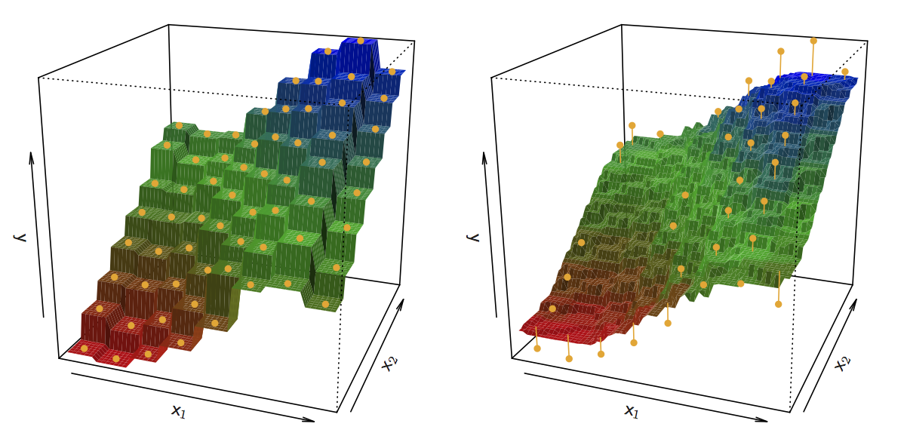
KNN Fits for k =1 and k = 9

Slide 7
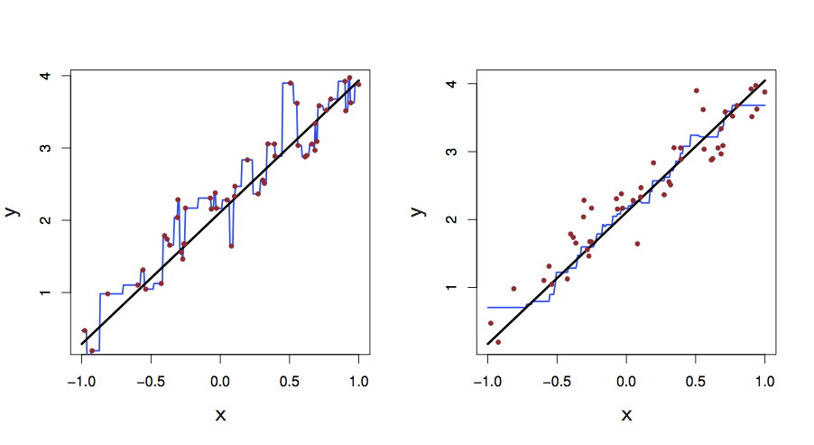
One-dimensional KNN Regression on noisy datapoints
True phenomenon is Linear
K=1
K=9

Slide 8
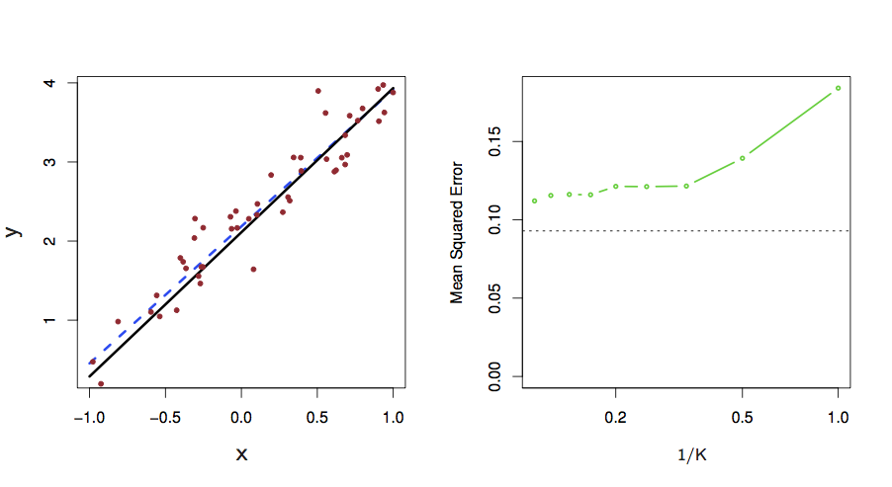
Linear Phenomenon: Linear Regression Fit vs. KNN
Test Set Error
KNN Error
Linear Regression Error
Concept Check: Why is KNN getting worse as k goes from big to small?

Slide 9
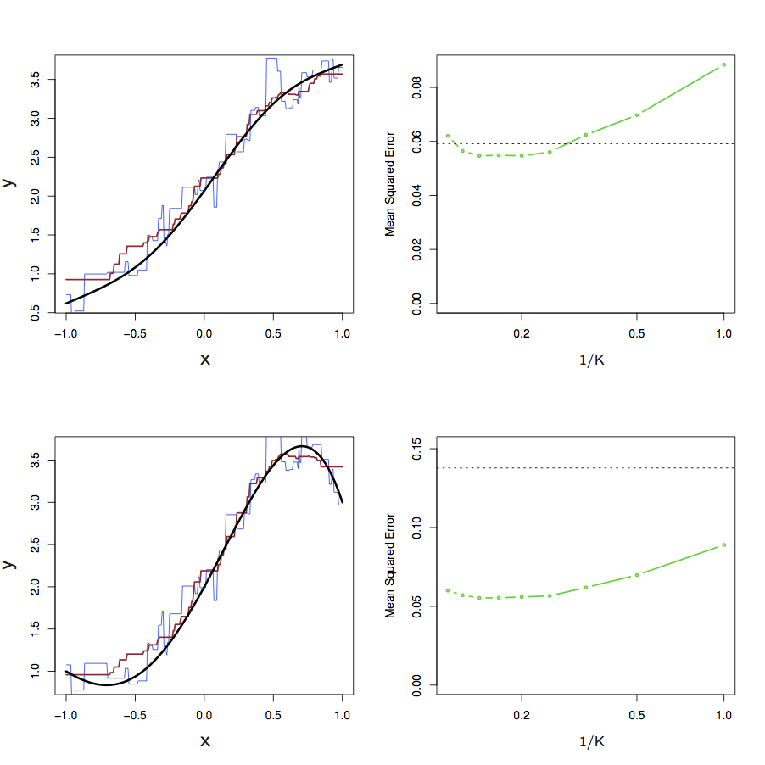
Nonlinear phenomenon: KNN vs. Linear Regression
Test Set Error
kNN Error
Linear Regression Error
Slightly nonlinear
Test Set Error
Linear Regression Error
Highly nonlinear
kNN Error

Slide 10
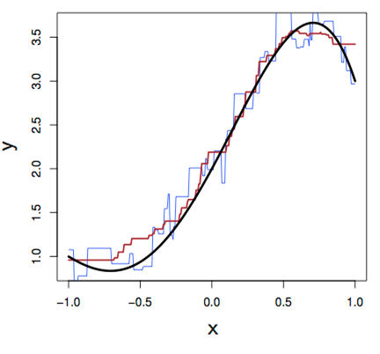
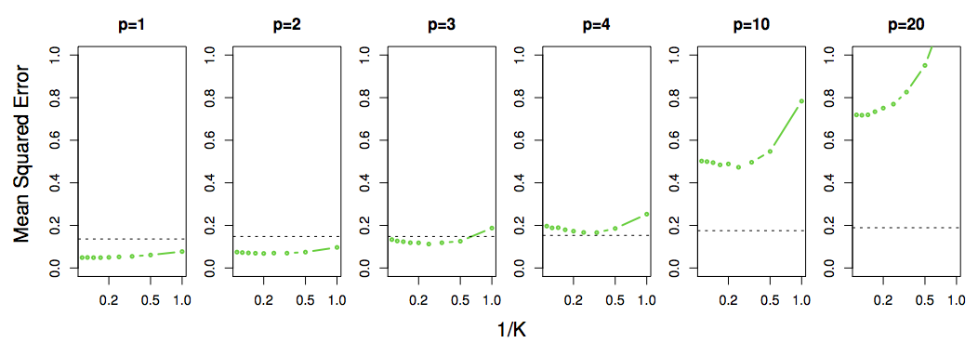
KNN is Not So Good in High Dimensional Situations
one feature is relevant & nonlinear, but adding irrelevant (noisy) features induce worse performance
Concept Check: Why does KNN perform ever worse than linear regression as we increase the number of (irrelevant) features?
This behavior is evidence of the phenomenon known as “The Curse of Dimensionality”

