Slide 1
Classification MEthods
Chapter 04 (part 01) – Logistic Regression

Slide 2
Outline
Classification problem examples
What’s wrong with using Linear Regression for classification?
Simple Logistic Regression
Logistic Function
Interpreting the coefficients
Making Predictions
Adding Qualitative Predictors
Multiple Logistic Regression

Slide 3
Classification
Recall that in the regression problem our goal is to estimate the (real) number based on observed features
Output Type = Cardinal
Classification: Estimating the category (class) to which something belongs
Classes often have no direct underlying numerical relationship but we might use numbers as output values
Output Type = Categorical
Example: Tank, Non-Tank

Slide 4
Classification Example: Credit Card Default
We would like to be able to predict customers that are likely to default (not pay off their credit card)
Possible X variables are:
Annual Income
Monthly credit card balance
The Y variable (Default) is categorical: Yes or No
How do we check the relationship between Y and X?

Slide 5
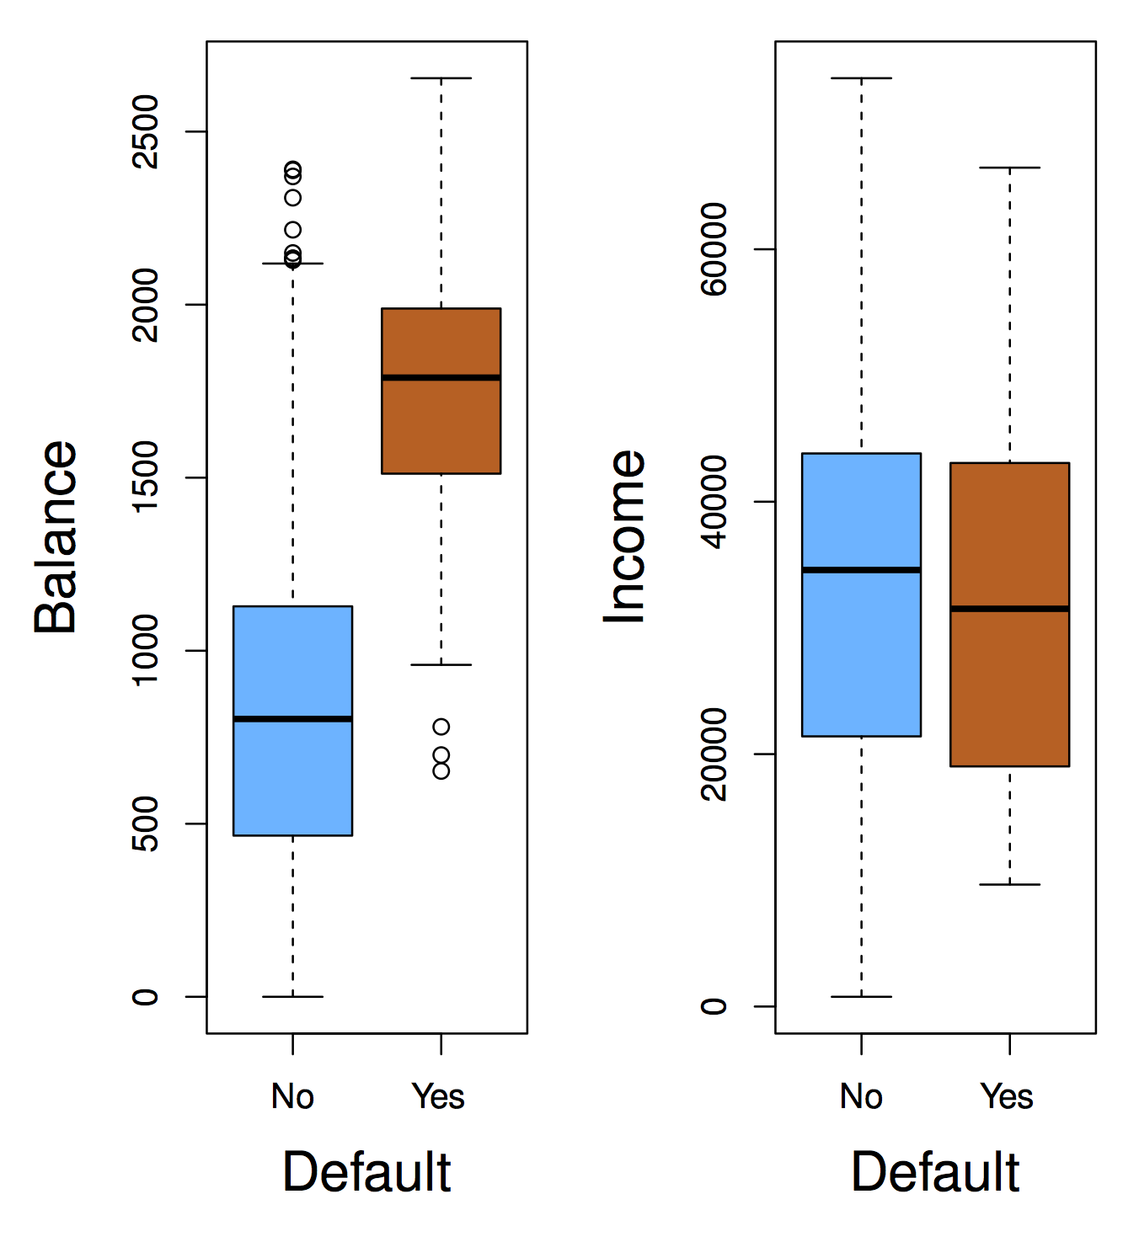
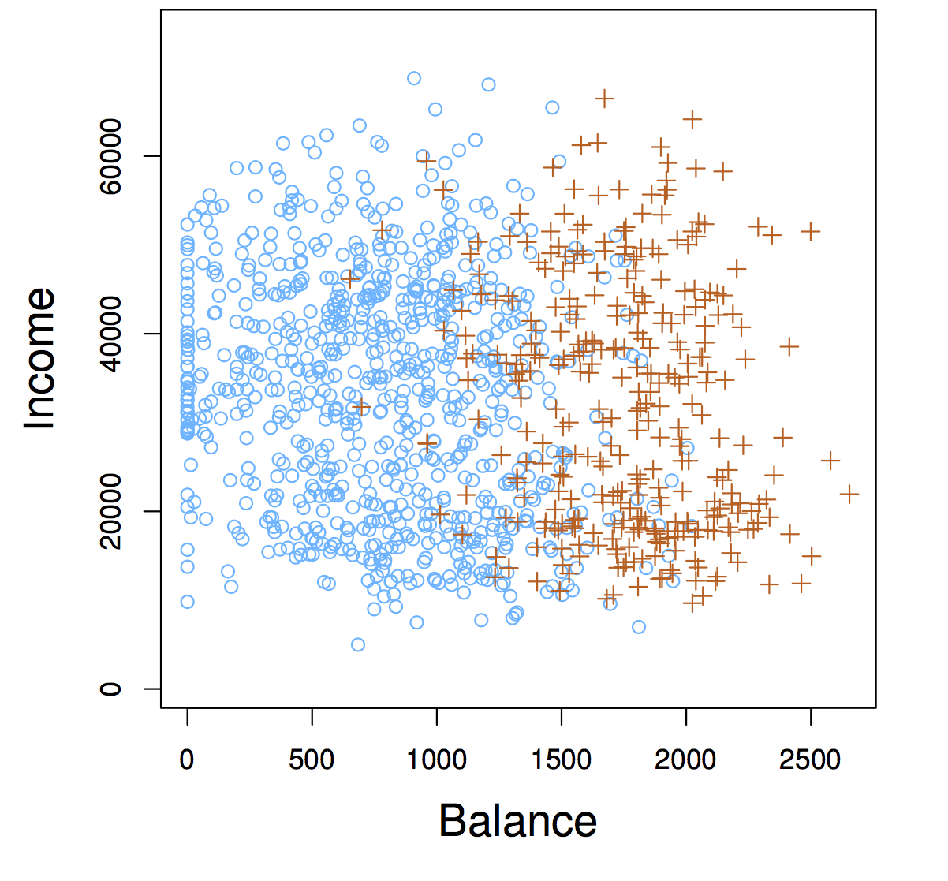
Data Exploration Finding good features for the (credit card) Default Dataset
Concept Check:
Is there a meaningful relationship between Balance and Defaulting?
Is there a meaningful relationship between Income and defaulting?

Slide 6
Credit card default prediction using card balance
Goal: predict whether credit card holders will default based on their current balance on the card
Y (Label: defaulted?) is categorical: 0 (no) or 1 (yes)
X (Balance) numerical (between 0 and $2500) which specifies how much balance is carried
An observation is a tuple (balance, defaulted?) gathered from actual customer behavior
Could we use Linear Regression when Y is categorical?
We might consider predicting the probability of default as a real number, using the observations to fit a linear regression model…

Slide 7
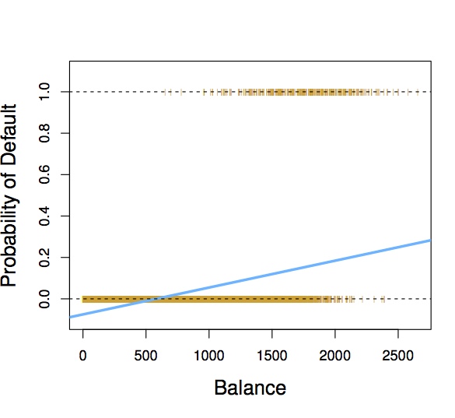
Linear Regression Solution
Linear Regression fits a line to the observations, but…
Given a large enough balance, this line exceeds 1… how do we interpret probability greater than 1?
How do we interpret probability values of Y between 0 and 1?
When Balance < 500, Pr(default) is negative… How do we interpret probability values less than zero?

Slide 8
Problems with using linear regression to fit data for classification problems
The regression line β₀+β₁X can take on any value between negative and positive infinity
In the credit card default classification problem, Y should only take on two possible values: 0 (customer doesn’t default or 1 (customer defaults).
Therefore the regression line almost always predicts the wrong value for Y in classification problems

Slide 9
Solution: Use Logistic Function
Let’s try to predict P(Y = 1), i.e., the probability of belonging to class 1 using a different function.
Model P(Y = 1) with a function that gives outputs between 0 and 1.
Determine the Boolean answer by thresholding p
Logistic function: Logistic Regression

Slide 10
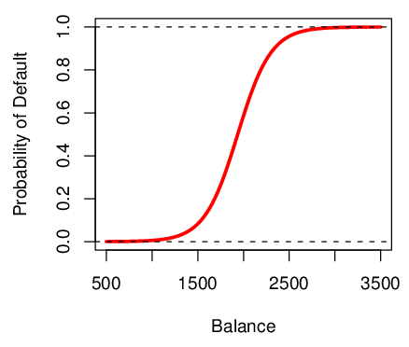
Logistic Function on Bank Default Data
The probability of default is close to, but not less than zero for low balances.
… and close to, but not above 1 for high balances

Slide 11

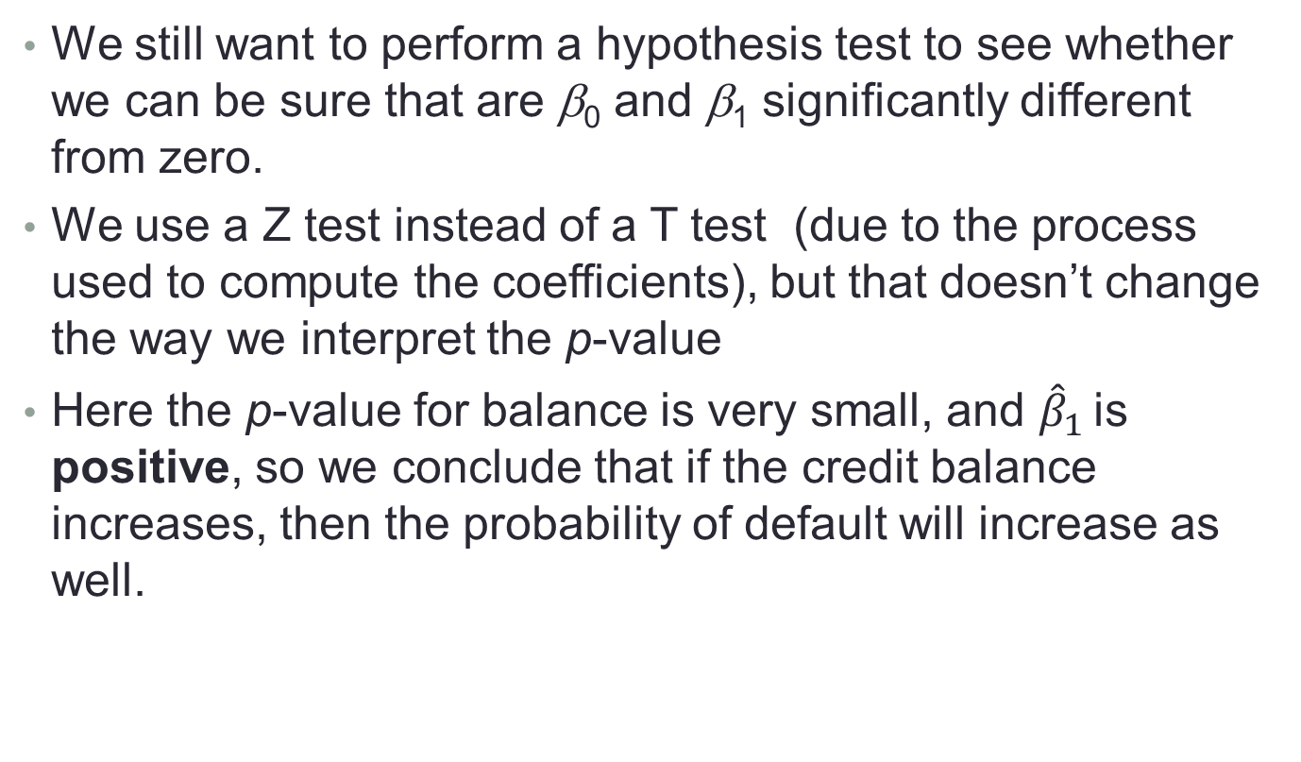
Logistic Regression Assessment: Are the coefficients significant?
We still want to perform a hypothesis test to see whether we can be sure that are β₀ and β₁ significantly different from zero.
We use a Z test instead of a T test (due to the process used to compute the coefficients), but that doesn’t change the way we interpret the p-value
Here the p-value for balance is very small, and ${\hat{β}}_{1}$ is positive, so we conclude that if the credit balance increases, then the probability of default will increase as well.

Slide 12

Using Logistic Regression to Make Predictions
Suppose an individual has an average balance of $1000. What is their probability of default?
The predicted probability of default for an individual with a balance of $1000 is less than 1%.
For a balance of $2000, the probability is much higher, and equals to 0.586 (58.6%).

Slide 13
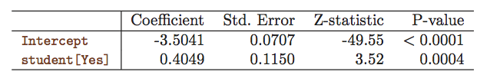
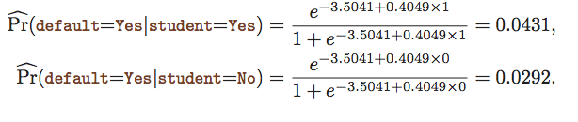

Logistic Regression Encoding Qualitative Predictors
We can predict if an individual will default by checking if she is a student or not. Thus we can use a qualitative variable “Student” coded as (Student = 1, Non-student =0).
${\hat{β}}_{1}$ is positive: This indicates students tend to have higher default probabilities than non-students

Slide 14

Multiple-Feature Logistic Regression
Similar to the method for multiple linear regression, we can fit multiple logistic regression coefficients

Slide 15
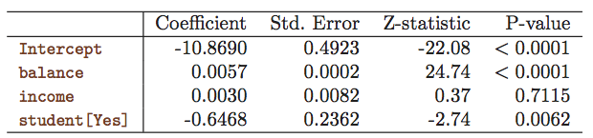
Multiple Feature Logistic Regression Credit Card Default Data
Predict Default using:
Balance (quantitative)
Income (quantitative)
Student (qualitative)

Slide 16

Making Predictions with multiple-feature Logistic Regression
A student with a credit card balance of $1,500 and an income of $40,000 has an estimated probability of default

Slide 17
Interpreting multiple-feature Logistic Regression Explain what happened here…
The sign of the student coefficient changes when fitting a model with more features – Why?
Positive
Negative

Slide 18
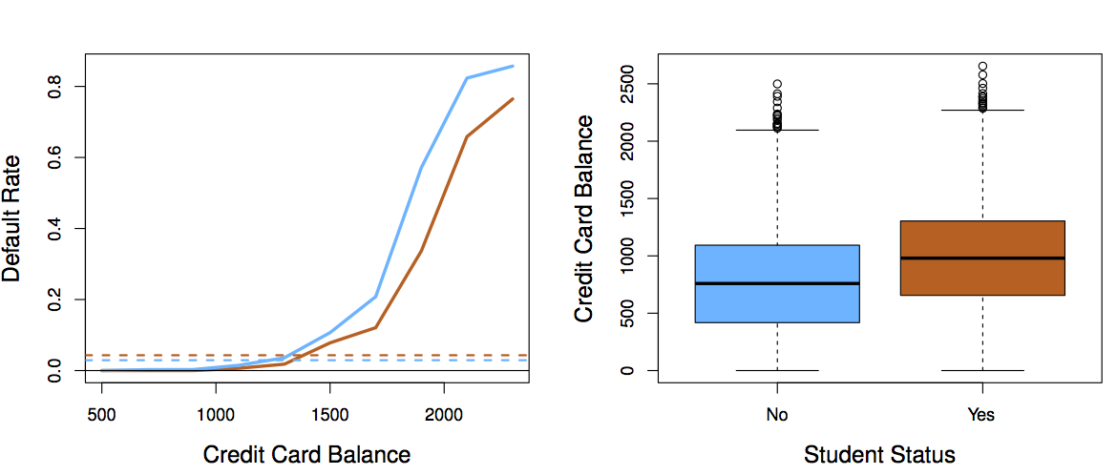
Interpreting multiple-feature Logistic Regression To whom should credit be offered?
A student (orange) is risker than non students (blue) when no information about the credit card balance is available
However, for two individuals with the same credit card balance, the student is less risky than a non student

Slide 19
Logistic Function: Thinking & Coding Practice
What do you think happens to the shape of the curve as you alter the size and sign of β₀? β₁?
Write a function which accepts β₀, β₁, and X and returns P(Y=1)
β₀ and β₁ are scalars
X is a (n x 1) matrix.
P(Y=1) is a (n x 1) matrix
Plot the results and see what happens when you alter the betas. Does it match your intuition?

Slide 20
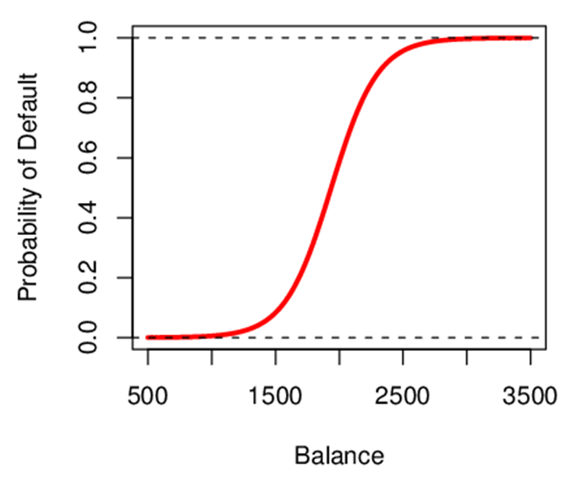
Interpreting β₁
Interpreting what β₁ means is not very easy with logistic regression, simply because we are predicting P(Y) and not Y
If β₁ =0, no relationship between Y and X
If β₁ >0, when X gets larger Y approaches 1
If β₁ <0, when X gets larger Y approaches 0
But how much bigger or smaller depends on where we are on the slope
Concept Check:
How is the logistic line altered by changing β₀ ?

