Slide 1
Classification MEthods
Chapter 04 (part 02)
Linear Discriminant Analysis (LDA) & Quadratic Discriminant Analysis (QDA)

Slide 2
Outline
Logistic Regression Limitations
Overview of LDA
Estimating Bayes’ Classifier
LDA formulation
Alternative LDA formulation
Classification performance measures (2-class)
Overview of QDA
Comparison between LDA and QDA

Slide 3
Logistic Regression Limitations
Logistic regression parameter values are unstable when the classes are well separated
In the case where n is small, and the distribution of predictors X is approximately normal, then LDA is more stable than Logistic Regression
LDA is also more popular than logistic regression when there are more than two response classes

Slide 4
Linear Discriminant Analysis
Goal: Classify observations
Will a consumer buy a product or not?
Will a customer be satisfied or not?
Which candidate will a voter vote for?
LDA Key intuition:
Represent each class by a model of a simple distribution with parameters fitted according to the training data samples
Predict the class of a new observation by which class distribution has the highest probability at that observation’s feature values

Slide 5
Assumptions of LDA
The observations are an unbiased random sample (i.i.d.) of the population
Each predictor variable is normally distributed
All classes share common (co)variance parameters

Slide 6
Bayes’ Classifier
Bayes’ classifier is the golden standard. Unfortunately, it is usually not determinable unless we are using synthetic data from a known distribution
Concept check: What is the property associated with data points along the Bayes Classification Boundary?
So far, we have estimated Bayes classifier with two methods:
KNN classifier
Logistic Regression

Slide 7
Estimating Bayes’ Classifier
With Logistic Regression we modeled the probability of Y being from the k^{th} class as
However, Bayes’ Theorem states for a K-class problem,
: Prior Probability of coming from class k
: Unknown density function for x given that x is an observation from class k (we can choose this function depending on our model)
Idea: Model classes using distributions, then use Bayes Theorem to make classification decisions

Slide 8
Bayes requires estimating and
We need to estimate and f_{k}(x) to compute p(x)
The most common model for f_{k}(x) is the Normal Density
Using the normal density, we only need to estimate three parameters to compute p(x):

Slide 9
Use Training Data set for Estimation
The mean could be estimated by the feature-wise average of all training observations from the k^{th} class.
The variance could be estimated as the weighted average of variances of all K classes. In LDA we make the assumption that the variances for each class are equal.
Estimate, as the proportion of the training observations that belong to the k^{th} class.

Slide 10
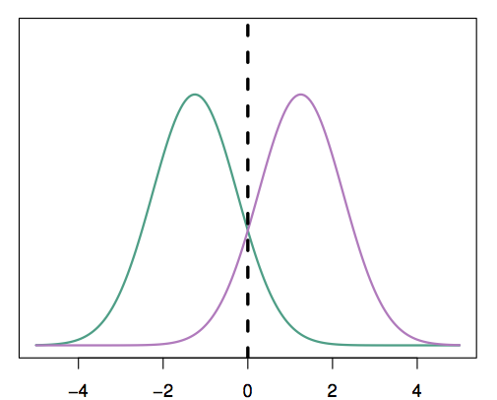
Bayes Example with One Predictor (p =1)
Suppose we have only one predictor (p = 1)
Two normal density function f₁(x) and f₂(x), represent two distinct classes
The two density functions overlap, so there is some uncertainty about the class to which an observation with an unknown class belongs
The dashed vertical line represents Bayes’ decision boundary

Slide 11
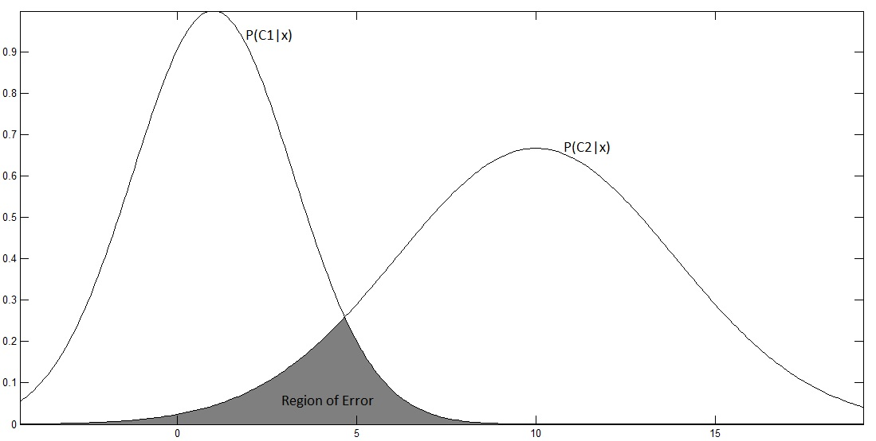
More complex example with one predictor (2-class, single feature)
A discriminator is established at the point of equal probability…
With a true Bayes classifier, this discriminator is not necessarily exactly between the class means
https://ranabasheer.wordpress.com/tag/bayes/

Slide 12
LDA intuition (2-class, single feature)
LDA assumes that the observations in each class are Gaussian with the same variance but different means
Model each class using
sample mean
(average) sample variance of each class
Bayes classifier & LDA not necessarily equal

Slide 13
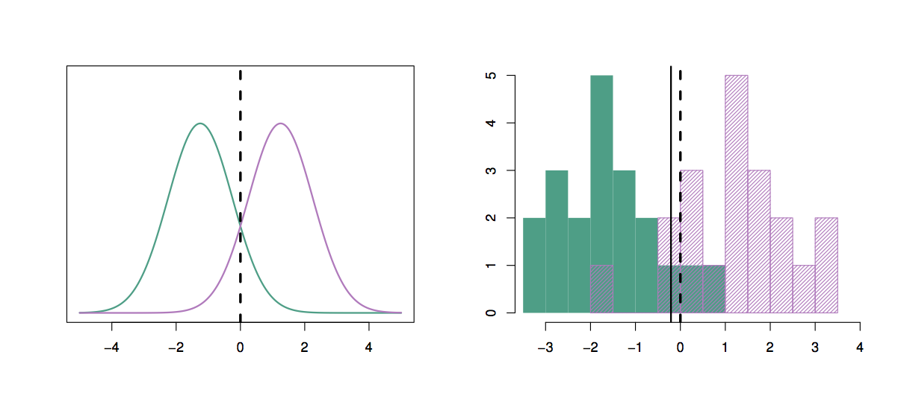
Differences between Bayes and LDA performance are also due to sampling issues which are used to estimate class means and variances
20 synthetic observations were drawn from each of the two classes
The dashed vertical line is the Bayes’ decision boundary
The solid vertical line is the LDA decision boundary
Bayes’ error rate: 10.6%
LDA error rate: 11.1%

Slide 14
Applying LDA
LDA assumes that each class has a normal distribution with one mean per class but the same variance for every class
The key variables are estimated from the training data
Bayes’ theorem is used to compute p_{k} and the observation is assigned to the class with the maximum probability among all K probabilities

Slide 15
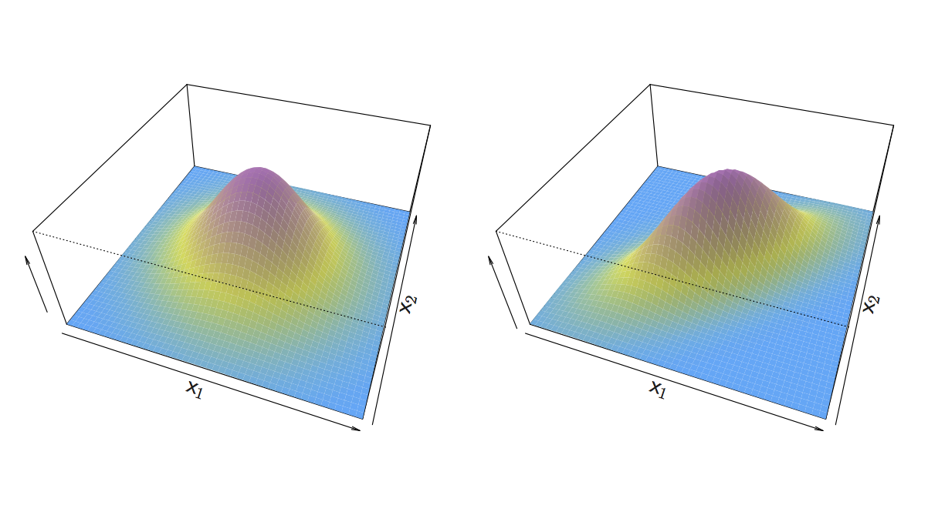
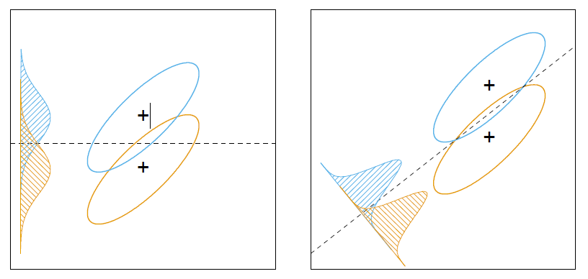
LDA intuition (more than 1 feature)
If X is multidimensional (p > 1), we use exactly the same approach except the density function f(x) is modeled using the multivariate normal density
Need to find the direction for which a projection into fewer dimensions yields the most information for discrimination of the LDA (Bayes-like) classifier using Covariance
Elements of Statistical Learning – Figure 4.9

Slide 16
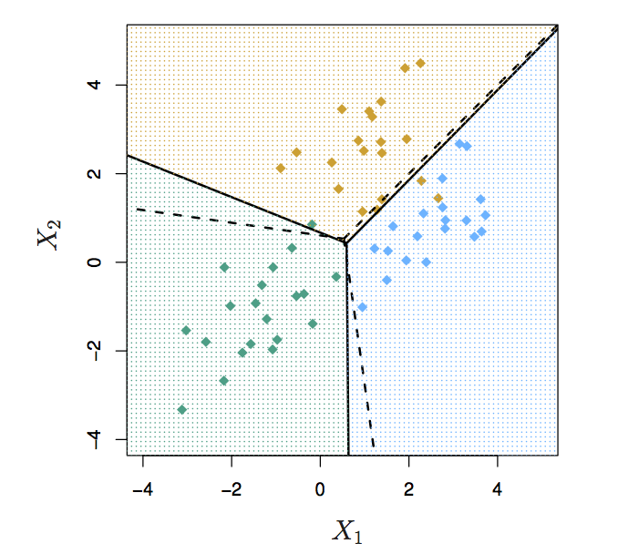
Multiclass LDA
Three classes & Two predictors (p =2)
20 observations were generated from each class
The dashed lines are Bayes’ boundaries
The solid lines are LDA boundaries

Slide 17
Alternative LDA formulation
LDA involves the determination of linear equation (just like linear regression) that will predict which class the case belongs to.
D: discriminant hyperplane
w: discriminant coefficients
X: variable
w₀: constant (default = 0)

Slide 18
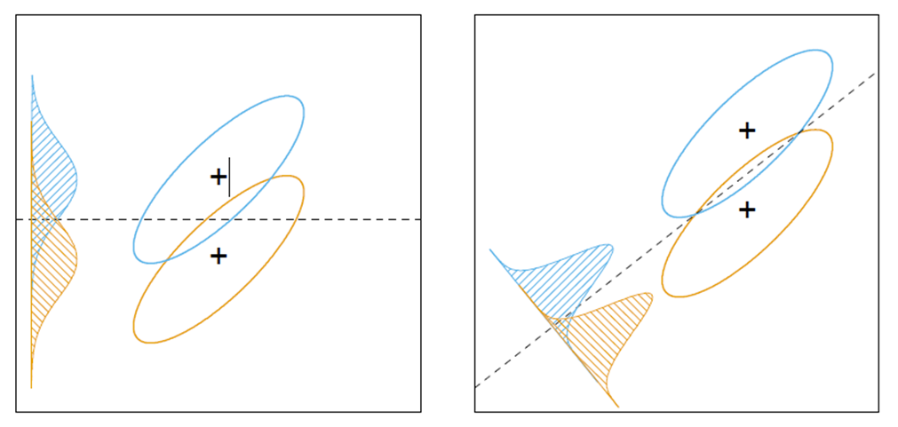
Alternative LDA formulation
Goal: discriminate between the different categories
Choose the w’s in a way to maximize the distance between the means of different categories
Features which help classify observations tend to have large w’s (weight)

Slide 19
Alternative LDA computation (2 class, 1 feature)
Select the discriminator line D such that

Slide 20
Alternative LDA computation (2 class, multi-feature)
Select the discriminator line D such that

Slide 21
Alternative LDA in practice
In practice LDA is often combined with a feature reduction technique to reduce the effective dimensionality of the space
When using LDA packages, select a smaller “components” parameter to enact dimensionality reduction
sklearn.discriminant_analysis.LinearDiscriminantAnalysis(solver=’svd’, shrinkage=None, priors=None, n_components=None, store_covariance=False, tol=0.0001)[source]
n_components : int, optional
Number of components (< n_classes - 1) for dimensionality reduction.
Further details in Elements of Statistical Learning

Slide 22
2-class Performance Measures
Altering the decision boundary
Confusion Matrix
ROC

Slide 23
Altering the decision boundary
Sometimes the (approximate) Bayes decision boundary may not be adequate for the business case
?
?
?

Slide 24
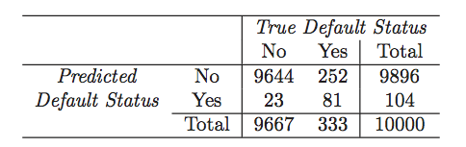
Classifier performance on Default Data (at p(y|x) > 0.5 as Threshold for Default)
LDA makes 252+ 23 = 275 mistakes on 10000 predictions (2.75% misclassification error rate – not bad…)
But LDA miss-predicts 252/333 = 75.5% of defaulters
A lot of people the model predicts would not default end up defaulting! This will cost the bank $$
We shouldn’t use 0.5 as threshold for predicting default if this will cost the bank a lot of money

Slide 25
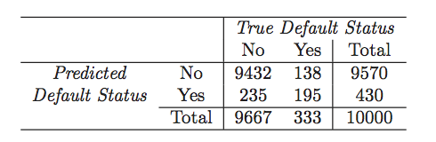
Use p(y|x) > 0.2 as Threshold for Default?
Now the total number of mistakes is 235+138 = 373 (3.73% misclassification error rate – looks worse)
But we only miss-predicted 138/333 = 41.4% of defaulters
Business case would need to evaluate the opportunity loss of not allowing higher maximum balances

Slide 26
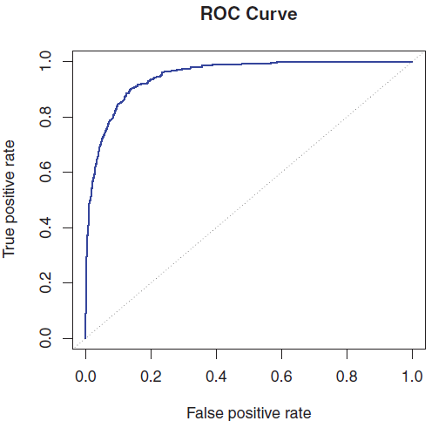
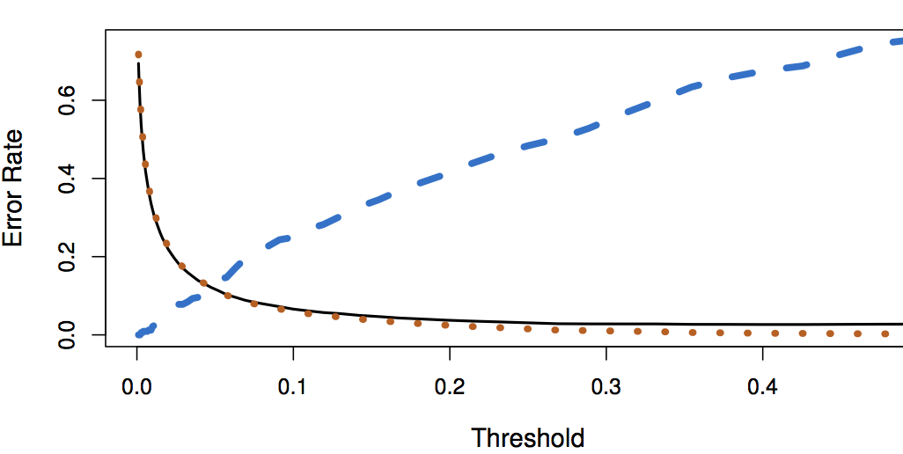
Threshold Values, Error Rates, ROC
Black solid: overall error rate
Blue dashed: Fraction of defaulters missed
Orange dotted: non defaulters incorrectly classified

Slide 27
Quadratic Discriminant Analysis (QDA)
LDA assumed that every class has the same variance/ covariance
However, LDA may perform poorly if this assumption is far from true
QDA works identically as LDA except that it assumes separate variances/covariances for each class
Allows for nonlinear boundaries between classes

Slide 28
Which is better? LDA or QDA?
Since QDA allows for different variances among classes, the resulting boundaries become quadratic
Which approach is better: LDA or QDA?
QDA may work better when the variances are very different between classes and we have enough observations to accurately estimate the variances
LDA may work better when the variances are similar among classes or we don’t have enough data to accurately estimate the true differences in the variances

Slide 29
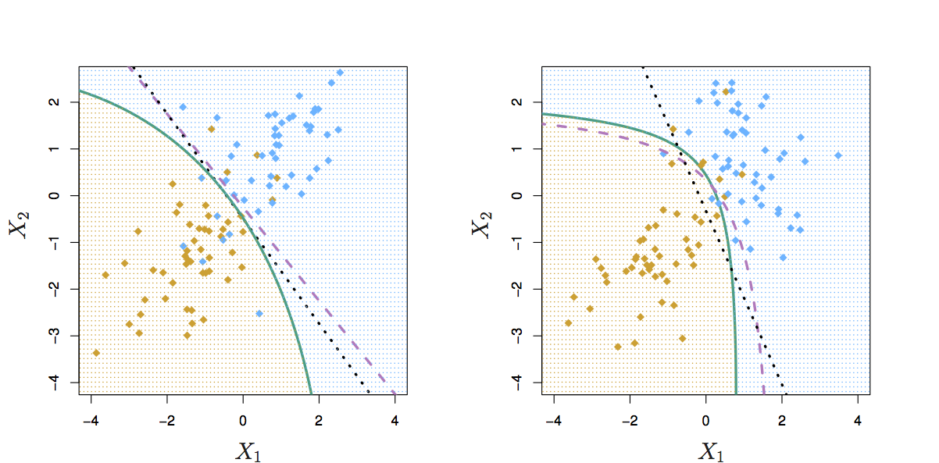
Comparing LDA to QDA
Left: covariances of the classes are equal (LDA is better fit)
Right: covariances of the classes are not equal (QDA is better fit)
Purple dashed: Bayes’ ideal boundary
Black dotted: LDA boundary
Green solid: QDA boundary

Slide 30
Comparison of Classification Methods
KNN (Chapter 2)
Logistic Regression (Chapter 4)
LDA (Chapter 4)
QDA (Chapter 4)

Slide 31
Logistic Regression vs. LDA
Similarity: Both Logistic Regression and LDA produce linear boundaries
Difference: LDA assumes that the observations are drawn from the normal distribution with common variance in each class, while logistic regression does not have this assumption.
LDA would do better than Logistic Regression if the assumption of normality holds,
otherwise logistic regression can outperform LDA

Slide 32
KNN vs. (LDA and Logistic Regression)
KNN is a nonparametric approach – it doesn’t fit a model
KNN makes no assumptions about the shape of the decision boundary
Advantage of KNN: We can expect KNN to outperform both LDA and Logistic Regression when the decision boundary is highly non-linear
Disadvantage of KNN: KNN does not tell us which predictors/features are important (no table of coefficients)

Slide 33
QDA vs. (LDA, Logistic Regression, and KNN)
QDA is a higher-variance parametric model which offers a compromise in performance between non-parametric KNN method and linear methods such as LDA and logistic regression
QDA can provide information on feature importance
QDA requires more data to fit the higher-parameter model (and the parameter count grows linearly with to the number of classes)
If the true decision boundary is:
Linear: LDA and Logistic outperforms
Moderately Non-linear: QDA outperforms
More complicated: KNN is superior

Slide 34
Why not Logistic Regression?
Logistic regression parameter values are unstable when the classes are well separated
Work on in-class Problem #1
In the case where n is small, and the distribution of predictors X is approximately normal, then LDA is more stable than Logistic Regression
LDA is also more popular than logistic regression when there are more than two response classes

Slide 35
In Class Work – Classifier Performance and ROC
Work on problem 2 now

