Slide 1
Resampling MEthods
Chapter 05

Slide 2
Overview
Rationale for resampling
The golden rule
Methods
Validation Set
Leave-One-Out Cross Validation
K-Fold CV
Bias-Variance Tradeoff

Slide 3
What are resampling methods?
Tools that involve repeatedly drawing samples from a training set and refitting a model of interest on each sample in order to obtain more information about the fitted model
Model Assessment: estimate error rates on unseen data
Model Selection: select appropriate model hyperparameters (e.g. level of model flexibility)
They are computationally expensive! But these days we have powerful computers
Two resampling methods:
Cross Validation
Bootstrapping

Slide 4
Borghetti’s “Golden Rule” Model Decision-making vs. Performance Reporting
You already know that:
Training sets are used to fit models, and training set accuracy may vary greatly from test set performance, so it is inappropriate to report model quality based on the training set performance
Golden Rule: If you use an observation as part of your decision-making process, then you should NOT use it as part of a set of data you are using to report performance
Decision-making includes things like fitting a model, choosing hyperparameters, and selecting which model to use

Slide 5
Training v. Validation v. Test Data
TEST Data: Used for performance prediction only. It estimates performance of a model on unseen data. Sequester the test set before exploring the data
NON-TEST-SET DATA:
Training Data: Used to “fit” parameterized models (e.g. find coefficients/weights or as the data for non-parametric methods like KNN
Validation Data – 2 uses; Pick One:
Obtain an (average) estimate of a model’s performance quality from non-training data
Make selection decisions (e.g. pick the best k in KNN; select whether LDA or QDA model works best; feature selection)

Slide 6
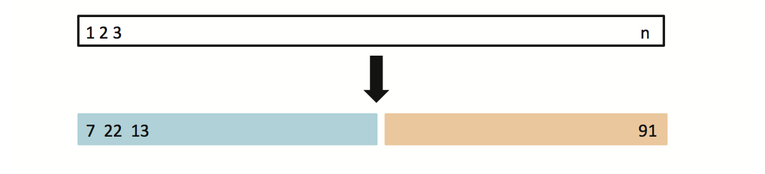
5.1.1 Model Selection using The Validation Set Approach
Goal: select the best model (e.g. LDA vs. QDA)
If we have a large data set, randomly* split the non-test data into training and validation sets
Use the training set to build each possible model (i.e. the different combinations of variables)
Select the model that gave the lowest error rate when applied to the validation set
Training Set
Validation Set
*be careful when randomizing selection from time-series or sequence-based data

Slide 7
Model Selection using Validation Set Example: Auto Data
Suppose that we want to predict mpg from horsepower
Goal: select the best of 10 possible models:
Model 1: features = horsepower (Linear only)
Model 2: features = horsepower + horspower² (Linear + Quadratic)
…
Model 10: features = horsepower + horspower² +…+ horsepower¹⁰
Which model gives a better fit?
Randomly split Auto data set into training (196 obs.) and validation set (196 obs.)
Fit all models using the training data set
Evaluate MSE on each model using the validation data set
Select model with the lowest validation MSE
Question: If we use the validation set to determine which model is the better fit, is the MSE of the winning validation set a good estimate for MSE on novel/unseen data?

Slide 8
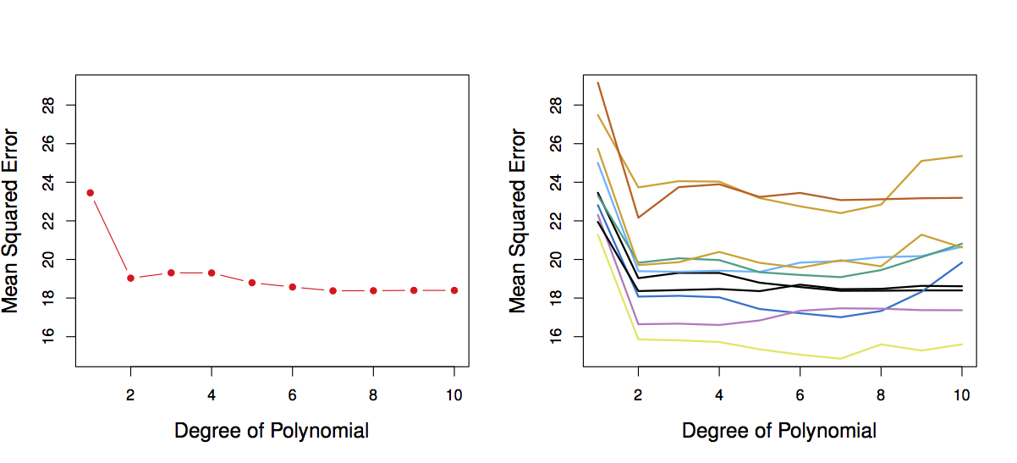
Validation Set Variability Example
Model selection task: which order of polynomial model fits best (from polynomials with orders 1:10)
There is a lot of variability among the MSE’s…
Validation error rate for a single (random) 50/50 split
Validation method repeated 10 times, each time the split is chosen randomly
“Spaghetti plot”

Slide 9
Validation Set Approach in summary
Advantages:
Simple to understand
Easy to implement
Computationally cheap
Disadvantages:
The validation MSE of a single split can be highly variable
Only a subset of observations are used to fit the model (training data). Statistical methods tend to provide worse estimates when trained on fewer observations

Slide 10
Cross Validation
Goal: reduce variability of the results of the validation set method
Intuition: repeated resampling (bootstrapping) can yield:
Better statistical properties on the estimate of a value
Better estimation of the distribution of the possible results
Procedure:
Repeatedly conduct a train-then-evaluate process using different subsets of the data.
Estimate the performance as the mean of the (lower variance) performance estimates

Slide 11
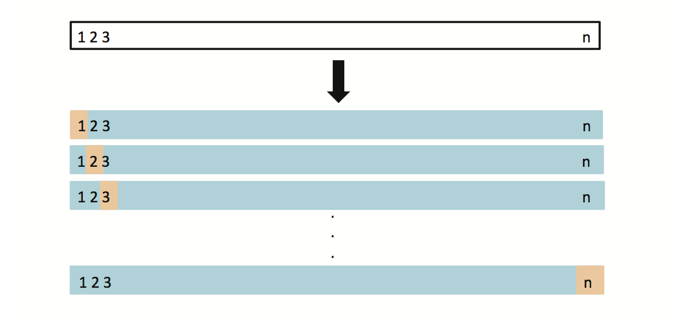
5.1.2 Leave-One-Out Cross Validation (LOOCV)
This method is similar to the Validation Set Approach, but it tries to address the ValSet’s disadvantages
For each suggested model, do:
Split the data set of size n into
Training data set (blue) size: n -1
Validation data set (beige) size: 1
Fit the model using the training data
Validate model using the validation data, and compute the corresponding MSE
Repeat this process n times
The MSE for a model is computed as follows:

Slide 12
LOOCV vs. the Validation Set Approach
LOOCV has less chance of statistical sample bias
We repeatedly fit the statistical learning method using training data that contains n-1 observations - almost all the data set is used for training in each iteration
LOOCV uses more of the data for training: When data is limited, it may be a good choice
LOOCV produces a single MSE
The validation set approach produces different MSE when applied repeatedly due to randomness in the splitting process, while performing LOOCV multiple times will always yield the same results
LOOCV is computationally intensive (disadvantage)
We fit each model n times

Slide 13
5.1.3 k-fold Cross Validation
LOOCV is computationally intensive, and the validation set approach has high variability… is there a hybrid approach?
k-fold Cross Validation:
Randomly divide the data set into k different partitions (e.g. k = 5, or k = 10) known as “folds”
Repeat a train-validate process k times using those folds:
In the i^{th} iteration, we train using combined data from all of the folds except the i^{th} and use the data from the i^{th} fold for validation.
By averaging the k different MSE’s we get an estimated error rate for unseen observations

Slide 14
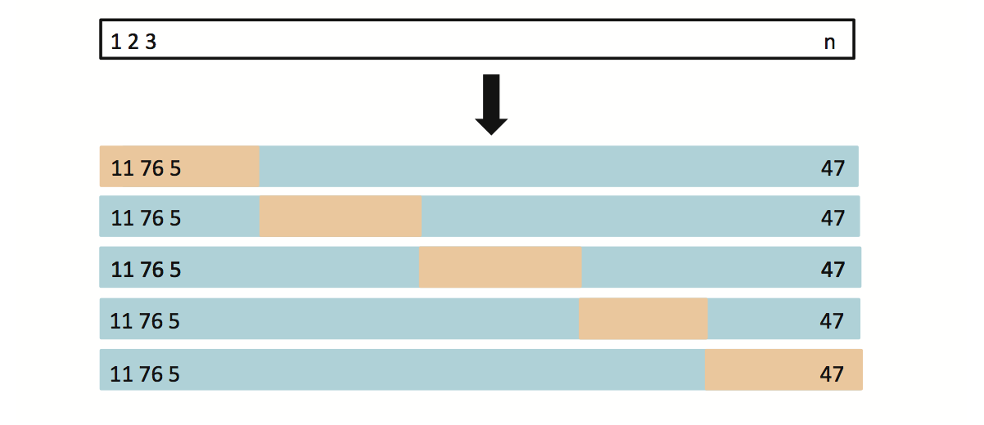
k-fold Cross Validation
Example: k = 5
Original dataset observation indices
Shuffle & Partition into k folds
Repeat 5 times: Train on Blue, validate on Beige

Slide 15
Auto Data: LOOCV vs. k-fold CV
LOOCV is a special case of k-fold, where k = n
They are both stable, but LOOCV is more computationally intensive
10-fold CV was repeated 9 times, and the figure shows the slightly different CV error rates

Slide 16
Auto Data: Validation Set Approach vs. k-fold CV Approach
10-fold CV is more stable
Validation method repeated 10 times, each time the split is chosen randomly
10-fold CV repeated 9 times

Slide 17
5.1.4 Bias-Variance Trade-off for k-fold CV
Putting aside that LOOCV is more computationally intensive than k-fold CV… Which is better LOOCV or k-fold CV?
LOOCV is less bias than k-fold CV (when k < n)
But, LOOCV has higher variance than k-fold CV (when k < n)
Thus, there is a trade-off between what to use
Conclusion:
We tend to use k-fold CV with (k = 5 and k = 10)
It has been empirically shown that they yield test error rate estimates that suffer neither from excessively high bias, nor from very high variance

Slide 18
5.1.5 Cross Validation on Classification Problems
So far, we have been dealing with CV on regression problems
We can use cross validation in a classification situation in a similar manner
Divide data into k parts
Repeat k times:
Hold out one part, fit the model using the remaining data and compute the error rate on the held-out data
CV error rate is the mean of the k error rates we have computed

Slide 19
Model Selection Example: Use CV to Select Classification Model
Model Choice includes Logistic Regression ( with terms of deg = 1, 2, …10) and KNN with many choices for K
The data set used is simulated (refer to Fig 2.13)
The purple dashed line is the Bayes’ boundary
Bayes’ Error Rate: 0.133

Slide 20
Use CV to Select Classification Model
Logistic regression with only linear terms (degree 1) is not able to fit the Bayes’ decision boundary
Logistic regression with quadratic terms does better than linear
Error Rate: 0.201
Error Rate: 0.197

Slide 21
Use CV to Select Classification Model
Using cubic and quartic predictors, the accuracy of the model improves
Error Rate: 0.160
Error Rate: 0.162

Slide 22
Use CV to Select Classification Model
Logistic Regression
KNN
Concept Check: How do we interpret the results of these graphs? What value polynomial should we choose?
Blue: Training Error
Black: 10-fold CV Error
Beige: Test Error

Slide 23
Bootstrap (5.2)
In class exercise

Slide 24
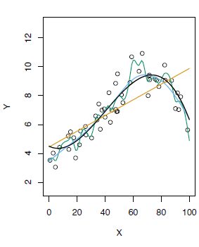
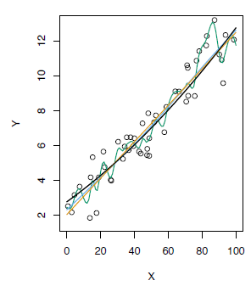
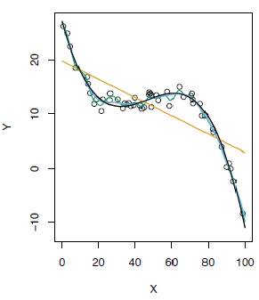
k-fold Cross Validation on Three Simulated Data Sets
Black: True Model
Orange: Linear Regression
Blue: Low Flexibility Spline
Green: High Flexibility Spline
From Chapter 2 Fig 2.9, 2.10, and 2.11
Blue: True Test MSE
Black-dashed: LOOCV MSE
Orange: 10-fold MSE
Refer to chapter 5 for the bottom graphs, Fig 5.6 page 182

Slide 25
Cross Validation in Practice
CV can help estimate MSE or Classification Accuracy
If we can estimate MSE before running the actual MSE how could we use it in our model selection process?
What types of things could we decide about our Machine Learning modeling process?
MINUTE PAPER: Brainstorm and write down your specific uses for CV.

