Slide 1
Decision Trees
Chapter 08 (part 01)

Slide 2
Outline
The Basics of Decision Trees
Regression Trees
Classification Trees
Regularization via Pruning
Trees vs. Linear Models
Advantages and Disadvantages of Trees

Slide 3
Decision Trees for Regression

Slide 4
Prediction as Partitioning the feature space
One way to make predictions in a regression problem is to divide the feature space (i.e. all the possible values for for X₁,X₂,…,X_{p}) into distinct regions, say R₁, R₂,…,R_{k}
Then for each observation that falls in a particular region (say R_{j}) we make the same prediction for y
The value of the prediction should be influenced by the response variables of the observations which are members of the region
Decisions Required:
Where to split?
How do we decide on what regions to use i.e. R₁, R₂,…,R_{k} or equivalently what tree structure should we use?
What values should we use for predictions?

Slide 5
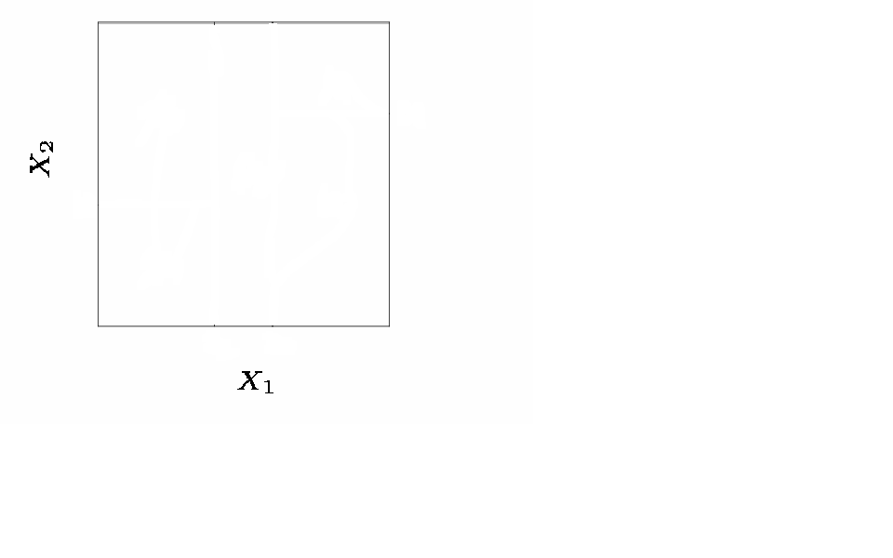
Building the tree (2 feature example)
Create the partitions by iteratively splitting one of the existing regions into two regions
After the initial split, must decide which subregion to split next

Slide 6
Where to Split?
Consider splitting a region into two regions, X_{j}>s and X_{j}≤s for all possible real values of s and feature indices j.
One option: Choose the s and j that results in the lowest remaining error on the training data after the split is implemented.

Slide 7
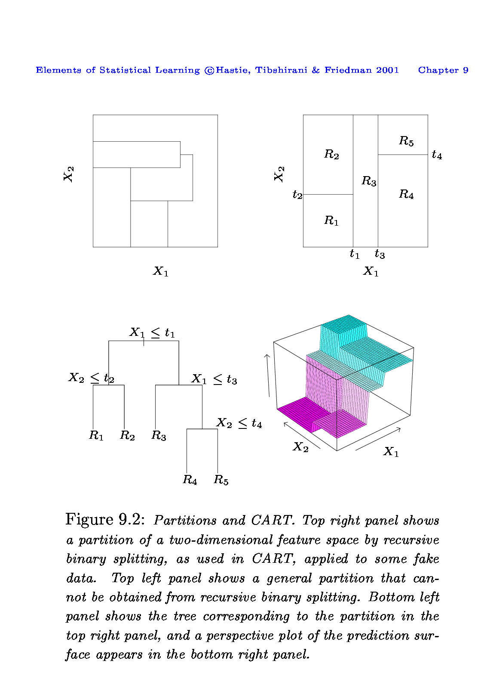
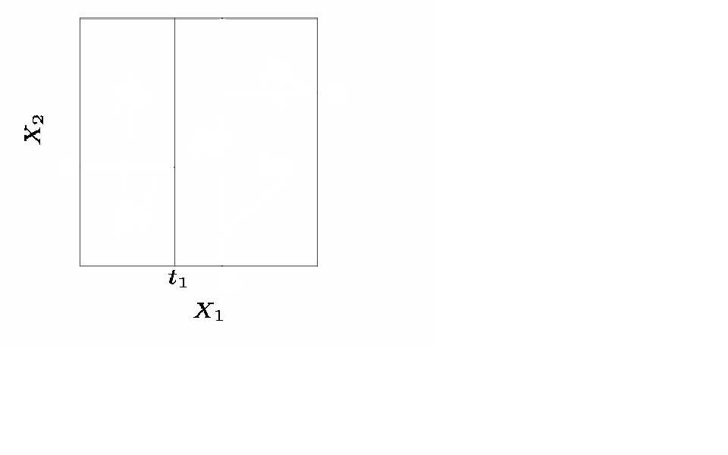
First Split: Which partitioning has lowest error for tree?
First split on X₁=t₁

Slide 8
Where to Split Next?
Suppose the optimal split was on X₁ at point t₁.
Repeat the process looking for the next best split except that we must also consider whether to split the first region or the second region.
Best decision is the one leaving the Smallest residual error for the whole tree.

Slide 9
Second Split
First split on X₁=t₁
If X₁<t₁, split on X₂=t₂

Slide 10
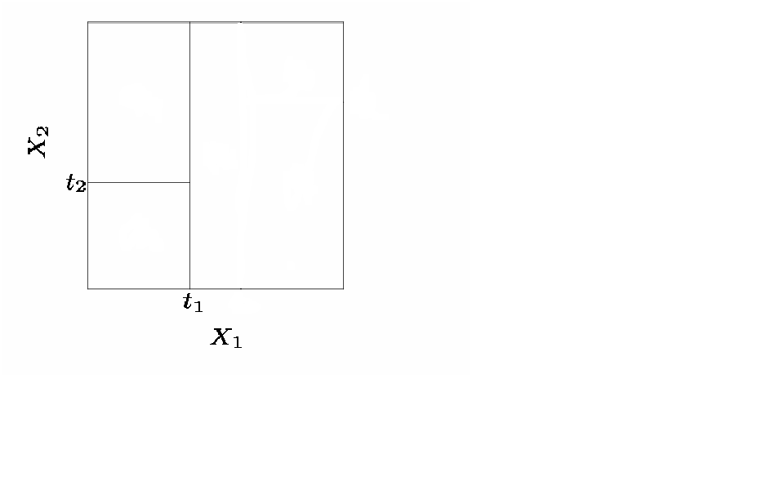
Where to make the third split?
Here the optimal split was the left region on X₂ at point t₂.
This process continues until our regions have too few observations to continue e.g. all regions have 5 or fewer points.

Slide 11
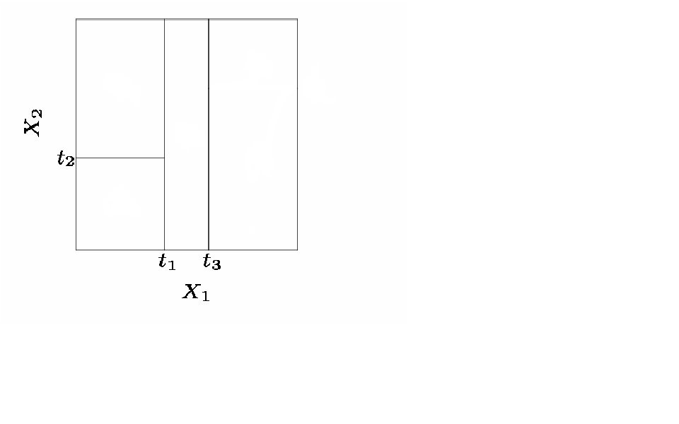
Third split
First split on X₁=t₁
If X₁<t₁, split on X₂=t₂
If X₁>t₁, split on X₁=t₃
If X₁>t₃, split on X₂=t₄

Slide 12
Fourth Split
First split on X₁=t₁
If X₁<t₁, split on X₂=t₂
If X₁>t₁, split on X₁=t₃
If X₁>t₃, split on X₂=t₄

Slide 13

What values should we use for ?
$$\hat{Y_{1}},\hat{Y_{2}},…,\hat{Y_{k}}$$
For region R_{j}, the best prediction is simply the average of all the responses from our training data that exist in region R_{j}.

Slide 14
Multi-feature example
two predictors and five distinct regions
Depending on which region our new X comes from we would make one of five possible predictions for Y.
y = 27
y = 0
y = 23
X₂
y = 20
y = 8
X₁

Slide 15
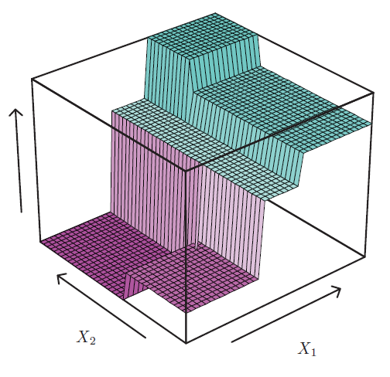
Alternative Tree Visualizations
R₅
R₄
R₃
y
R₂
R₁
Partitions can be represented with a tree structure.
This provides a very simple way to interpret the model

Slide 16
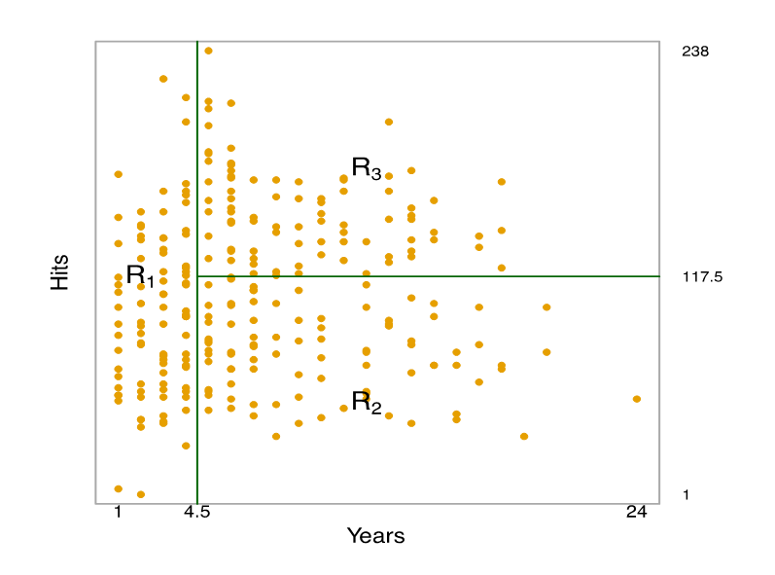
Example: Baseball Players’ Salaries
R₁
R₂
R₃
The predicted Salary is the number in each leaf node. It is the mean of the response for the observations that fall there
Note that Salary is measured in 1000s, and log-transformed
The predicted salary for a player who played in the league for more than 4.5 years and had less than 117.5 hits last year is

Slide 17
decision Trees for Classification

Slide 18
Growing a Classification Tree
A classification makes a prediction for a categorical Y
For each region (or node) we predict the most common category among the training data within that region
The tree is grown (i.e. the splits are chosen) in exactly the same way as with a regression tree except we need a different criteria to optimize
There are several possible different criteria to use such as the gini index and cross-entropy but the easiest one to think about is to minimize the error rate.

Slide 19
Regularization via Pruning

Slide 20
Improving Tree Accuracy
A large tree (i.e. one with many terminal nodes) may tend to overfit the training data since you could continue to split until each observation had its own leaf node.
Generally, we can improve estimated test set accuracy by “pruning” the tree i.e. cutting off some of the terminal nodes.
How do we know how far back to prune the tree? We use cross validation to see which subtree has the lowest validation error rate.

Slide 21
Pruning Example: Baseball Players’ Salaries

Slide 22
Pruning Example: Baseball Players’ Salaries
The minimum cross validation error occurs at a tree size of 3 (number of leaf node regions = 3)

Slide 23
Pruning Example: Baseball Players’ Salaries
Even though training error continues to decrease with additional leaf nodes…
Cross Validation indicates that the minimum CV error is when the tree size is three (i.e. the number of leaf nodes is 3)
Concept Check:
Why does training error continue to decrease as trees gain additional leaf nodes?
Why does cross-val prefer shallower trees?

Slide 24
Advantages and disadvantages of trees

Slide 25
Trees vs. Linear Models
Which model is better?
If the relationship between the predictors and response is linear, then classical linear models such as linear regression would outperform regression trees
On the other hand, if the relationship between the predictors is non-linear, then decision trees can outperform linear approaches

Slide 26
Trees vs. Linear Model: Classification Example
Top row: the true decision boundary is linear
Left: linear model (better)
Right: decision tree (worse)
Bottom row: the true decision boundary is non-linear
Left: linear model (worse)
Right: decision tree (better)

Slide 27
Pros and Cons of Decision Trees
Pros:
Trees are very easy to interpret (probably even easier than linear regression)
Trees can be displayed graphically, and are easily interpreted even by non-expert
Trees handle both classification and regression problems
Cons:
Trees don’t have the same prediction accuracy as some of the more complicated approaches in ML

Slide 28
In Class Exercise Part 1
Given a set of datapoints in a region, write code for making a single splitting decision based on minimizing MSE. You should write this as a function call where you are provided
A matrix X of predictor values (n rows containing X₁ through X_{P}) which fall into the current region
vector of real valued labels (Y), one value per row
Use i to index through the observations
Use j to index through the predictors
Use s to represent the splitting threshold for the chosen predictor
Return the values for j and s which minimizes training set MSE
Challenge: Can you vectorize it?
Call your function splitRegion(df)
Return(j,s,yLow,yHigh,dfLow,dfHigh)

Slide 29
In Class Exercise Part 2
Add code (to wrap your code from part 1) to allow consideration for determining which of the regions in the tree affords the best next split. You should write this as a function where you get:
The current tree which partitions the space into regions 1..r
The training set MSE for this tree
A function “region(T, k)” which returns the matrix X of observations belonging in region k of the tree T, along with a vector of true Y values for those observations.
Return the region (k), split feature (j) and threshold (s) which minimizes the training set MSE over the choice of region, feature and threshold

