Slide 1
Bagging, Random Forests, Boosting
Chapter 08 (part 02)

Slide 2
Outline
Bagging
Bootstrapping
Bagging for Regression Trees
Bagging for Classification Trees
Out-of-Bag Error Estimation
Variable Importance: Relative Influence Plots
Random Forests
Boosting

Slide 3
Bagging (Bootstrap AGGregatING)

Slide 4
Problem with Decision Trees
(basic) Decision trees suffer from high variance
At each branch, the decision of which feature to split on and where to make the split depends on the data
The results could be quite different if one of the training observations had been swapped for a different one
We would like to have models with low variance
To solve this problem, we can use bagging (bootstrap aggregating).
Bagging is a general process for machine learning
It could be a preprocessing step for any model

Slide 5
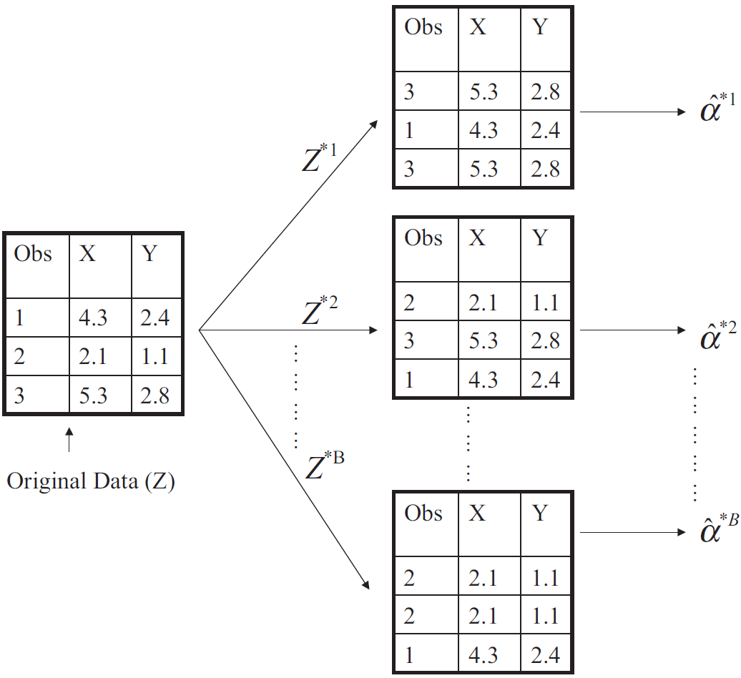
Bootstrapping Revisited
Resample the observed dataset to obtain a new set of data equal to the size to the observed dataset
Each new observation is obtained by random sampling with replacement from the original dataset.

Slide 6
What is bagging?
Bagging is an extremely powerful idea based on two things:
Averaging: reduce variance
Bootstrapping: generate many alternative training datasets
Why does averaging reduce variance?
Averaging a set of observations reduces variance. Recall that given a set of n independent observations Z₁, …, Z_{n}, each with variance σ² ,the variance of the mean of the observations is given by

Slide 7
How does bagging training work?
Generate B different bootstrapped training datasets
Train the model separately on each of the B training datasets, to obtain B different models.

Slide 8
Bagging for Regression Trees
Construct B regression trees using B bootstrapped training datasets. Do not prune the trees
Average (or vote) to determine the resulting predictions

Slide 9
Bagging for Classification Trees
Construct B regression trees using B bootstrapped training datasets
For prediction, there are two approaches:
Record the class that each bootstrapped data set predicts and provide an overall prediction to the most commonly occurring one (majority vote)
If the classifier produces probability estimates average the probabilities and predict the class with the highest probability

Slide 10
Example 2: Car Seat Data (Classification)
The red line represents the test error rate using a single tree.
The black line corresponds to the bagging error rate using majority vote
The blue line averages the class probabilities before deciding class.

Slide 11
Out-of-Bag Error Estimation
Bootstrapping randomly selects a subset of observations to train each tree
The remaining non-selected subset could be used to estimate performance on unseen data
On average, each bagged tree uses around 2/3 of the observations, leaving 1/3 of the observations used for estimating performance

Slide 12
Variable Importance
Bagging typically improves the accuracy over prediction using a single tree, but it is harder to interpret the model
With hundreds of trees contributing to the prediction it is no longer clear which variables are most important
Thus bagging improves prediction accuracy at the expense of interpretability
But, we can still get an overall summary of the importance of each predictor using Relative Influence Plots

Slide 13
Inference with multiple trees
Which variables are most useful in predicting the response?
Relative influence plots give a score for each variable.
These scores represent the decrease in MSE (or Gini Index for classification) when splitting on a particular variable
The most influential variable is given a value of 100 and other variables are shown as a relative fraction of the influence of the most influential variable
The larger the score the more influence the variable has
A number close to zero indicates the variable is not important and could be dropped

Slide 14
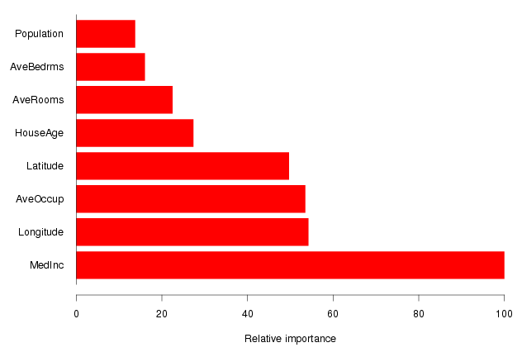
Example: Housing Data
Median Income is clearly the most important variable.
Longitude, Latitude and Average occupancy are the next most important.

Slide 15
Problems with Bagging?
If there is a very strong predictor in the data set along with a number of other moderately strong predictors, then in the collection of bagged trees, most or all of them will use the very strong predictor for the first split
All bagged trees will look similar. Hence all the predictions from the bagged trees will be highly correlated
Averaging many highly correlated quantities does not lead to a large variance reduction
If we want to reduce the variance, we need something to do something to break the correlation of outputs

Slide 16
Random Forests

Slide 17
Random Forests
A very efficient statistical learning method
Builds on the idea of bagging, but it provides an improvement because it de-correlates the trees
How does it work?
Build a number of decision trees on bootstrapped training sample, but when building these trees, each time a split in a tree is considered, a random sample of m predictors is chosen as split candidates from the full set of p predictors (Usually )

Slide 18
Why are we considering a random sample of m predictors instead of all p predictors for splitting?
If each tree has a different subset of p predictors, then the trees wont get stuck always picking the same best predictor if one of the p predictors was stronger than most others
This means each tree will give grow differently and a set of trees grown this way will have less correlation in their outputs
Random forests “de-correlate” the outputs that bagged trees would have generated… leading to more reduction in variance

Slide 19
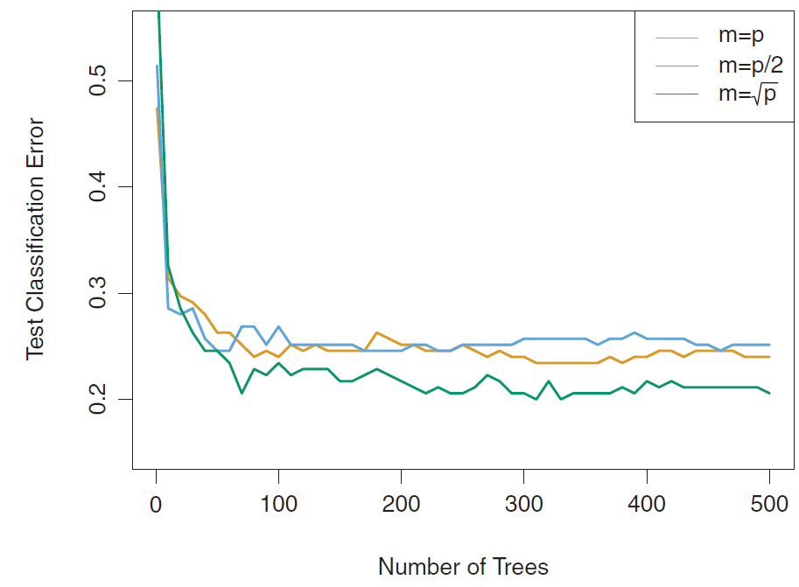
Random Forest Hyperparameter “m”
m is the number of features randomly selected for use in each tree
If random forests are set m = p, this is equivalent to bagging
Empirically, sqrt(p) often works well

Slide 20
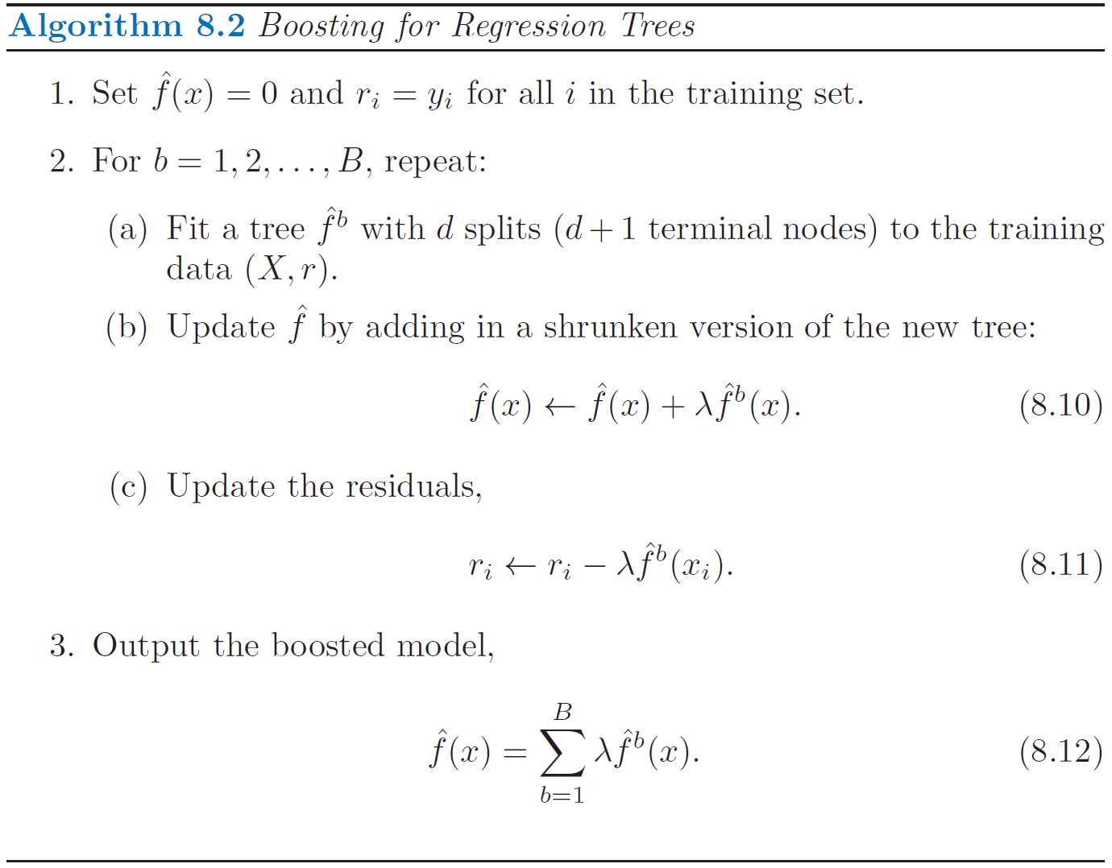
Boosting – Random Forest alternative
Idea: build a forest of B trees incrementally, but when building the next tree, instead of fitting a model to best predict Y, attempt to best predict the residual error remaining in the forest
Use crossval to determine a good size for the forest (B)
This algorithm learns slowly
Smaller lambda leads to slower learning… which means lower variance

Slide 21
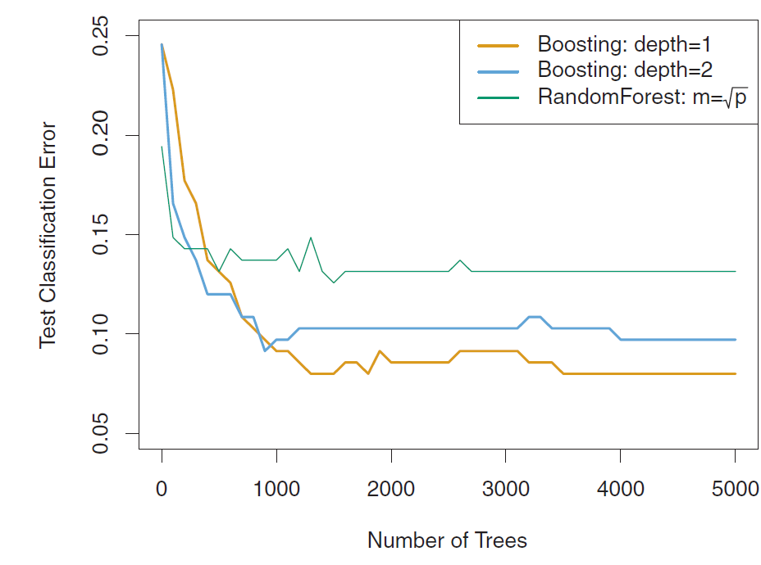
Boosting
d is the interaction depth
d = 1 gives us a stump with two leaf nodes
Boosted stumps tend to perform well

Slide 22
Trees & Forest Summary
Trees and Forests offer non-linear machine learning models which can answer both prediction and inference questions
There are many alternative tree & forest model architectures
Each architecture has a set of hyperparameters to determine
Cross-validation should be used to make model and hyperparameter decisions… but this increases the computational cost of finding a good model

Slide 23
Example 1: Housing Data (Regression)
Red line: test mean sum of squares using a single tree.
Black line: bagging test error rate as a function of number of bootstrapped trees

