Slide 1
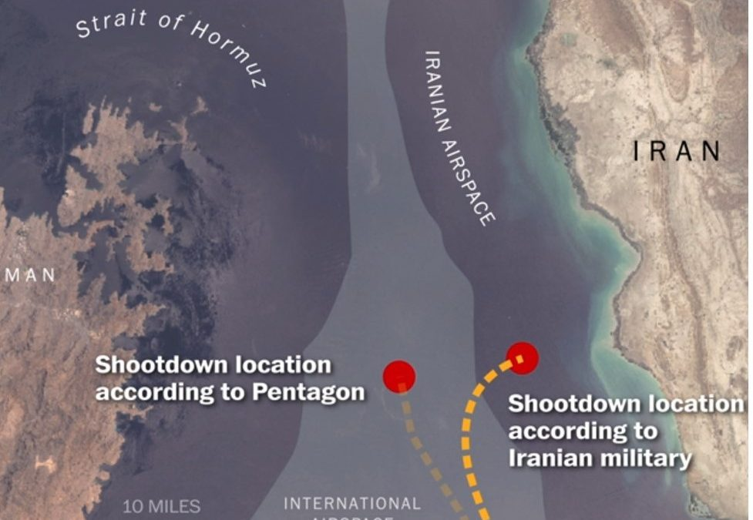


Detecting GPS Spoofing with Classical Machine Learning
2d Lt Mark A. Demore II

Slide 2
Overview
Background
Problem Statement and Research Hypothesis
Data Source
Methodology
Results
Conclusions
Future Work

Slide 3
Background
Software Defined Radio has made GPS spoofing commonplace
USAF assets heavily rely on GPS for navigation and timing
Iranian use of GPS Spoofing
MIL-STD-1553 is a serial, avionics communications bus with assumed trust between components
Many approaches to mitigating GPS spoofing are costly, inflexible, and physical

Slide 4
Problem Statement and Research Hypothesis
Problem: The USAF lacks a flexible and lightweight solution to detect GPS spoofing across their many assets.
Research Hypothesis: A bus monitor, with a trained machine learning model, could effectively detect a GPS spoofing attack using data obtained from the messages passed on the bus.
Research Questions: What is the best model to classify MIL-STD-1553 messages as spoofed or unspoofed?
Primary Measure of Effectiveness: Recall
Notes:
False positive better than false negative

Slide 5
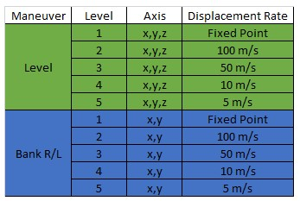
Data Source
Marvin - AFRL’s Avionics Vulnerability Assessment System (AVAS) in tandem with Vampire FPGA
Message parsing:
Convert to usable form, break up words and extract data
Remove unrelated messages
Downsample
Scale
Features:
Spoofed – GPS: Latitude, Longitude, Altitude
Unspoofed – ADC: Altitude, Airspeed; EFI: Angle of Attack; INS: x/y/z Velocity, Acceleration; GPS: Time
Notes:
Downsample so each obs is avg of 3 sec
Scale between 0,1

Slide 6
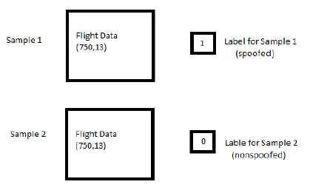
Methodology
3 classical, supervised ML classification approaches:
Logistic Regression with CV (5 fold)
Naïve Bayes (Gaussian)
Random Forest (100 trees)
Trained and Tested on:
Each drift rate individually (80/20)
All of the data combined (80/20)
All but one drift rate, test on unseen rate
Metrics:
Precision
Recall
F1 Score

Slide 7
Results
Logistic Regression w/ CV
Performed well for high drift rates and hold position
Gaussian Naïve Bayes
Very similar results to Logistic Regression
Random Forests
Perfect in all cases but unseen attacks
Best all around results

Slide 8
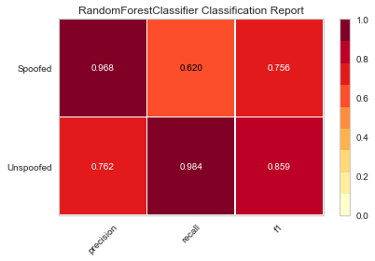
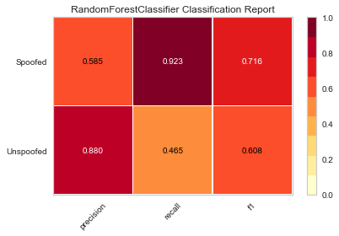
Conclusions
Unseen drift rates greatly impact the models
More precise attacks will be more difficult to detect
Random Forests perform marginally better than
Multivariate Long Short Term Fully Convolutional
Networks
Results for Unseen Fixed Point
Results for Unseen 5m/s Drift

Slide 9
Future Work
Get better data
More accurate simulation
More precise spoofing attacks
Real flight data
Try unsupervised learning approaches

