Slide 1
Detecting GPS Spoofing with Classical Machine Learning
2d Lt Mark A. Demore II

Slide 2
Overview
Background
Problem Statement and Research Hypothesis
Data Source
Methodology
Results
Conclusions
Future Work

Slide 3
Background
GPS spoofing is becoming increasingly prevalent with an increase in commercial systems, like Software Defined Radio, that are capable of mimicking GPS signals
USAF assets heavily rely on GPS for navigation and timing
Adversaries, namely Iran, have shown their capabilities with GPS spoofing and compromised military and civilian air and sea vehicles
MIL-STD-1553 is a serial, avionics communications bus with assumed trust between components
Many approaches to mitigating GPS spoofing are costly, inflexible, and physical

Slide 4
Problem Statement and Research Hypothesis
Problem: The USAF lacks a flexible and lightweight solution to detect GPS spoofing across their many assets.
Research Hypothesis: A bus monitor, with a trained machine learning model, could effectively detect a GPS spoofing attack using data obtained from the messages passed on the bus.
Research Questions: What is the best model to classify the messages as spoofed or unspoofed?

Slide 5
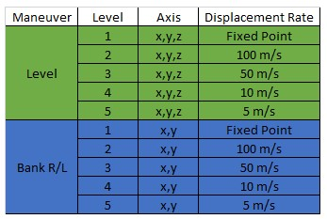
Data Source
AFRL’s Avionics Vulnerability Assessment System (AVAS) uses a flight simulator to generate MIL-STD-1553 messages and send them over the bus, where their Vampire FPGA converts the messages to UDP packets

