Slide 1
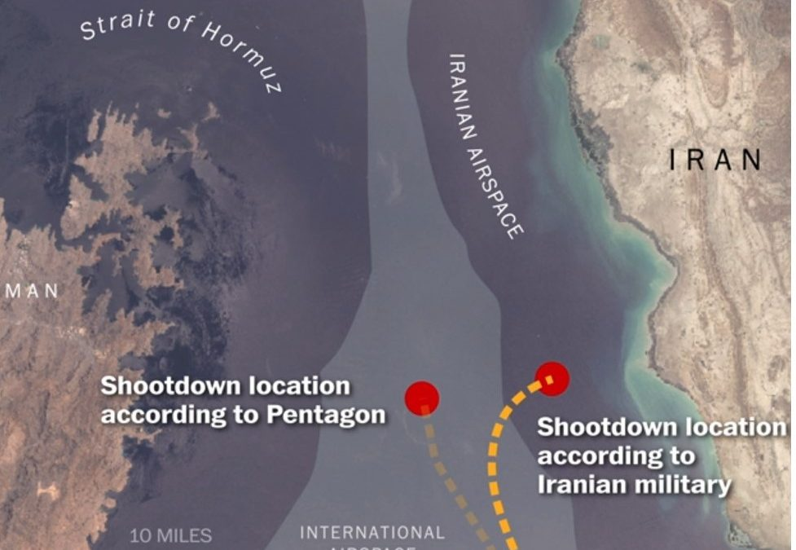


Detecting GPS Spoofing with Advanced Machine Learning
2d Lt Mark A. Demore II

Slide 2
Background
Software Defined Radio has made GPS spoofing commonplace
USAF assets heavily rely on GPS for navigation and timing
Iranian use of GPS Spoofing
MIL-STD-1553 is a serial, avionics communications bus with assumed trust between components
Many approaches to mitigating GPS spoofing are costly, inflexible, and physical
Integrated GPS/INS – Tightly vs Loosely Coupled

Slide 3
Problem Statement and Research Hypothesis
Problem: The USAF lacks a flexible and lightweight solution to detect GPS spoofing across their many assets.
Research Hypothesis: A bus monitor, with a trained machine learning model, could effectively detect a GPS spoofing attack using data obtained from the messages passed on the bus.
Research Questions: What is the best model to classify MIL-STD-1553 messages as spoofed or unspoofed?
Primary Measure of Effectiveness: Recall
Notes:
False positive better than false negative

Slide 4
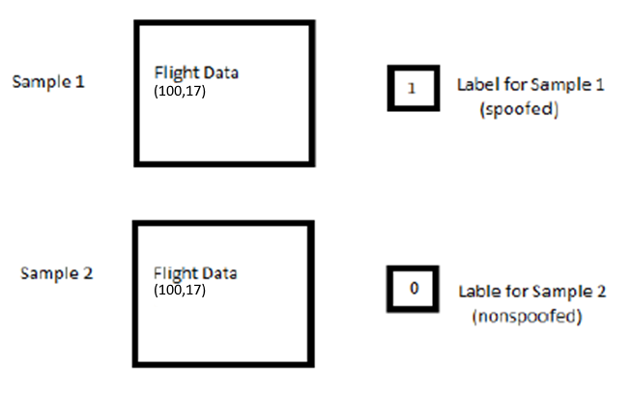
Data Source
ANT Center FLY
Position, Velocity, Attitude recorded from flight test
Barometer and IMU readings simulated
Attacks:
Single axis <5ms drift
Time shift
Message parsing:
Downsample – 1 sample per second
Normalize
Features:
Spoofed – GPS: Latitude, Longitude, Altitude
Unspoofed – Baro: Alt; IMU: Δθ, Δvelocity; Velocity: North, East, Down; Attitude: Roll, Pitch, Yaw
Notes:
Downsample so each obs is avg of 3 sec
Scale between 0,1

Slide 5
Methodology
3 classical, supervised ML classification approaches:
Random Forest (100 trees)
K-Nearest Neighbors (5 neighbors)
Support Vector Classification
Metrics:
Precision
Recall
F1 Score
6 Advanced, supervised ML classification approaches:
Multi-Layer Perceptron (sklearn and keras implementation)
CNN
MLSTM
MLSTM w/ dropout
MLSTM-CNN
MLSTM-FCN (Marvin Implementation)
Metrics:
Loss
Accuracy

Slide 6
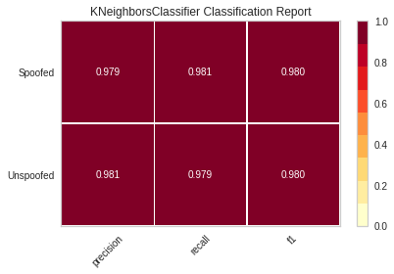
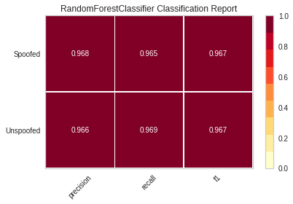
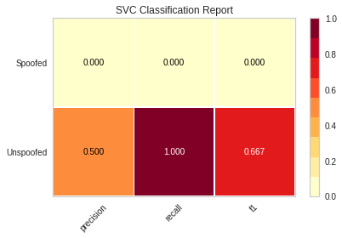
Results – Classical Methods
K Neighbors and Random Forests
Very high recall rate, even when looking at all 4 flights
Support Vector
Basically just outputs ‘Unspoofed’

Slide 7
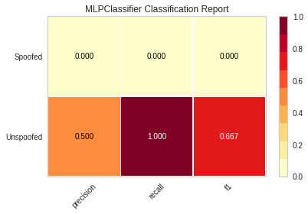
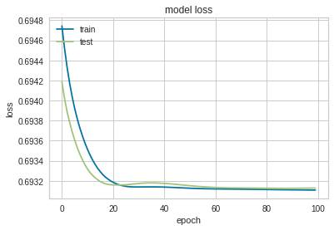
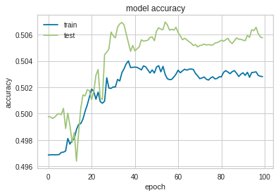
Results – Advanced Methods
Basic Multi-layer Perceptron
SKLearn model – single class output
Keras model – loss and accuracy change in the right direction
Accuracy peaks at 0.5

Slide 8
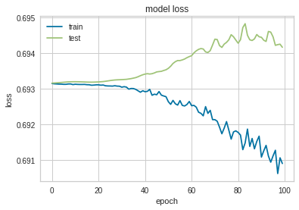
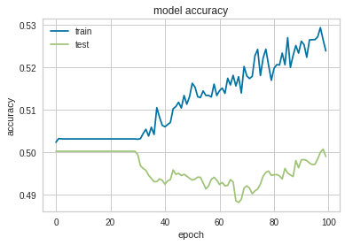
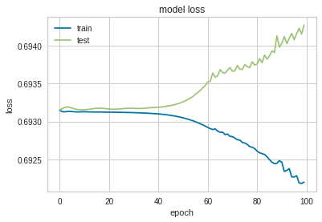
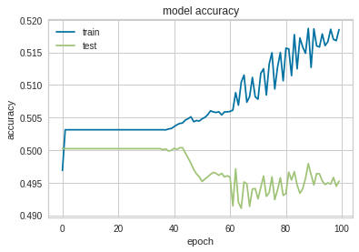
Results – Advanced Methods
CNN
Convolutional Neural Network
Divergence between train and test results
Accuracy only slightly above 0.5
Multivariate Long-Short Term Memory
Very similar results
MLSTM

Slide 9
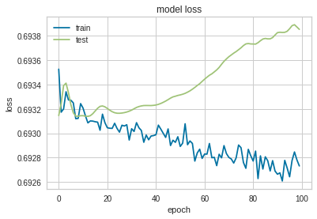
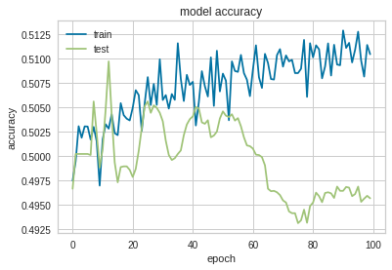
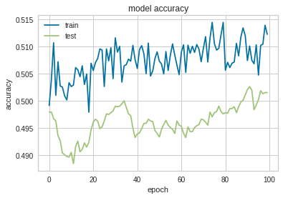
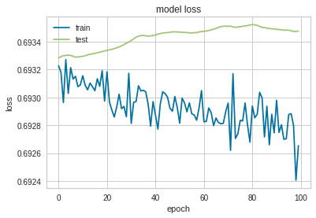
Results – Advanced Methods
MLSTM Dropout
MLSTM with Dropout
Improvement from training set
Decreasing accuracy among test set
MLSTM-CNN
No meaningful improvement
MLSTM-CNN

Slide 10
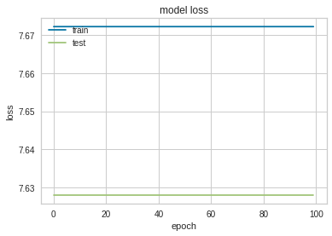
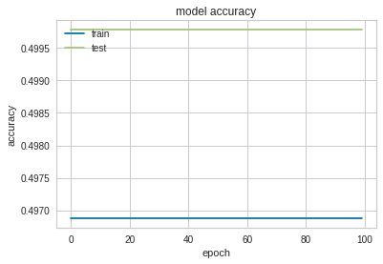
Results – Advanced Methods
MLSTM-FCN (Marvin Implementation)
High loss
Loss and accuracy constant
Needs further adapted for new dataset

Slide 11
Conclusions
New dataset is compatible with classical classification methods
Based on previous research, may ultimately work better than advanced methods
More timesteps
Finer tuning of hyperparameters
May need to pivot from classification to anomaly detection methods

Slide 12
Future Work
Test with time shift attack
Tune hyperparameters further
Resolve timestep issue
Try anomaly detection approach
Autoencoders
Look into including other features

Slide 13
References
1. DoD, “MIL-STD-1553B: Interface Standard for Digital Time Division Com-mand/Response Multiplex Data Bus,” 1978.
2. O. Stan, Y. Elovici, A. Shabtai, G. Shugol, R. Tikochinski, and S. Kur, “Protect-ing Military Avionics Platforms from Attacks on MIL-STD-1553 CommunicationBus,” pp. 1–15.
3. U. Department Of Defense, “Global Positioning System Standard PositioningService,”Www.Gps.Gov, no. September, pp. 1 – 160, 2008. [Online]. Available:http://www.gps.gov/technical/ps/2008-SPS-performance-standard.pdf
4. J. A. Volpe, “VULNERABILITY ASSESSMENT OF THE TRANSPORTA-TION INFRASTRUCTURE RELYING ON THE GLOBAL POSITIONINGSYSTEM,” 2001.
5. Y. Guo, M. Wu, K. Tang, J. Tie, and X. Li, “Covert spoofing algorithm ofUAV based on GPS/INS-integrated navigation,”IEEE Transactions on VehicularTechnology, vol. 68, no. 7, pp. 6557–6564, 2019.
6. N. O. Tippenhauer, C. P ̈opper, K. B. Rasmussen, and S.ˇCapkun, “On the re-quirements for successful GPS spoofing attacks,”Proceedings of the ACM Con-ference on Computer and Communications Security, pp. 75–85, 2011.
7. Y. Fan, Z. Zhang, M. Trinkle, A. D. Dimitrovski, J. B. Song, and H. Li, “A Cross-Layer Defense Mechanism Against GPS Spoofing Attacks on PMUs in SmartGrids,”IEEE Transactions on Smart Grid, vol. 6, no. 6, pp. 2659–2668, 2015.
8. E. Schmidt, Z. Ruble, D. Akopian, and D. J. Pack, “Software-Defined RadioGNSS Instrumentation for Spoofing Mitigation: A Review and a Case Study,”29. IEEE Transactions on Instrumentation and Measurement, vol. 68, no. 8, pp.2768–2784, 2019.
9. K. A. Kramer and S. C. Stubberud, “Fuzzy evidence accrual for GPS navigationprotection of UAVs,”Proceedings - 2012 IEEE 1st AESS European Conferenceon Satellite Telecommunications, ESTEL 2012, 2012.
10. A. Rawnsley, “Iran’s Alleged Drone Hack: Tough, but Possible — WIRED,” 2011.[Online]. Available: https://www.wired.com/2011/12/iran-drone-hack-gps/ [Ac-cessed: 2020-06-23]
11. R. Pickrell, “Iran is reportedly jamming ship GPS navigation systems to seizethem - Business Insider,” 2019. [Online]. Available: https://www.businessinsider.com/iran-is-jamming-ship-gps-navigation-systems-to-seize-them-2019-8[Ac-cessed: 2020-06-23]
12. “US military builds case against Iran with new tanker attack photos -Business Insider,” 2019. [Online]. Available: https://www.businessinsider.com/us-military-builds-case-against-iran-new-tanker-attack-photos-2019-6 [Accessed:2020-06-23]
13. A.Juhasz,“BritishOilTankerSeizedByIranWillBeReleasedSoon,IranianOfficialSays,”2019.[Online].Available:https://www.npr.org/2019/09/22/763230263/british-oil-tanker-seized-by-iran-will-be-released-soon-iranian-official-says [Ac-cessed: 2020-06-23]
14. W. L. Edwards, B. J. Clark, and D. M. Bevly, “Implementation details of adeeply integrated GPS/INS software receiver,”Record - IEEE PLANS, PositionLocation and Navigation Symposium, pp. 1137–1146, 2010.30
15. R. James, G., Witten, D., Hastie, T., Tibshirani,An Introduction to StatisticalLearning - with Applications in R — Gareth James — Springer, 2013. [Online].Available:https://www.springer.com/gp/book/9781461471370{\%}0Ahttp://www.springer.com/us/book/9781461471370
16. S. Athmaja, M. Hanumanthappa, and V. Kavitha, “A survey of machine learningalgorithms for big data analytics,”Proceedings of 2017 International Conferenceon Innovations in Information, Embedded and Communication Systems, ICIIECS2017, vol. 2018-Janua, pp. 1–4, 2018.
17. S. Das and M. J. Nene, “A survey on types of machine learning techniques in in-trusion prevention systems,”Proceedings of the 2017 International Conference onWireless Communications, Signal Processing and Networking, WiSPNET 2017,vol. 2018-Janua, pp. 2296–2299, 2018.
18. A. Wu, H. Dong, Q. Wu, and L. Ling, “A survey of application-level protocolidentification based on machine learning,”Proceedings - 2011 4th InternationalConference on Information Management, Innovation Management and IndustrialEngineering, ICIII 2011, vol. 3, pp. 201–204, 2011.
19. M. Mamdouh, M. A. Elrukhsi, and A. Khattab, “Securing the Internet of Thingsand Wireless Sensor Networks via Machine Learning: A Survey,”2018 Interna-tional Conference on Computer and Applications, ICCA 2018, no. Section II, pp.215–218, 2018.
20. T. Lane and C. Brodley, “Applications of Machine Learning to Anomaly Detec-tion.”Applications of Artificial Intelligence in Engineering, Southampton, UK:Comput. Mech. Publications., p. 11314, 1997.31
21. Y. Du, H. Wang, and Y. Pang, “A Hidden Markov Models-based anomaly intru-sion detection method,”Proceedings of the World Congress on Intelligent Controland Automation (WCICA), vol. 5, pp. 4348–4351, 2004.
22. N. T. Van, T. N. Thinh, and L. T. Sach, “An anomaly-based network intrusiondetection system using Deep learning,”Proceedings - 2017 International Confer-ence on System Science and Engineering, ICSSE 2017, pp. 210–214, 2017.
23. J. Wang, W. Tu, L. C. Hui, S. M. Yiu, and E. K. Wang, “Detecting Time Synchro-nization Attacks in Cyber-Physical Systems with Machine Learning Techniques,”Proceedings - International Conference on Distributed Computing Systems, pp.2246–2251, 2017.
24. M. R. Manesh, J. Kenney, W. C. Hu, V. K. Devabhaktuni, and N. Kaabouch,“Detection of GPS Spoofing Attacks on Unmanned Aerial Systems,”2019 16thIEEE Annual Consumer Communications and Networking Conference, CCNC2019, pp. 1–6, 2019.
25. S. Semanjski, A. Muls, I. Semanjski, and W. De Wilde, “Use and validation of su-pervised machine learning approach for detection of GNSS signal spoofing,”2019International Conference on Localization and GNSS, ICL-GNSS 2019 - Proceed-ings, pp. 1–6, 2019.
26. A. Savitha, Y. R. Bhanumathy, R. R. Chetwani, and M. Ravindra, “Automatedverification of spacecraft auxiliary data,”2015 IEEE International Conferenceon Computational Intelligence and Computing Research, ICCIC 2015, pp. 1–4,2016.
27. A. Fansler, “PROTECTION OF THE MIL-STD-1553 WITH DISCRETEWAVELET ALGORITHMS,” 2020.32
28. X. Ying, J. Mazer, G. Bernieri, M. Conti, L. Bushnell, and R. Poovendran, “De-tecting ADS-B Spoofing Attacks Using Deep Neural Networks,”2019 IEEE Con-ference on Communications and Network Security, CNS 2019, pp. 187–195, 2019.
29. B. Losier, “DESIGN OF A TIME-BASED INTRUSION DETECTION ALGO-RITHM FOR THE MIL-STD-1553 ON MIL-STD-1553,” 2019.
30. S. J. Genereux, A. K. Lai, C. O. Fowles, V. R. Roberge, G. P. Vigeant, and J. R.Paquet, “MAIDENS: MIL-STD-1553 Anomaly-Based Intrusion Detection SystemUsing Time-Based Histogram Comparison,”IEEE Transactions on Aerospace andElectronic Systems, vol. 56, no. 1, pp. 276–284, 2020.
31. J. M. Marvin, “Detecting GPS Spoofing with Deep Learning,” 2019.

