Slide 1
CSCE 823
The Perceptron

Slide 2
Recall the Key Network Concepts:
The architecture/structure of the network (nodes, connections, layers)
The weighted summation and activation function
The update/learning rule (example: backprop)
The Loss/Cost Function (example: RMSE)

Slide 3
Perceptrons Require:
The architecture/structure of the network (nodes, connections, layers)
The weighted summation and activation function (e.g. step / Heaviside function)
The update/learning rule (perceptron learning)
The Loss/Cost Function (classification error)

Slide 4
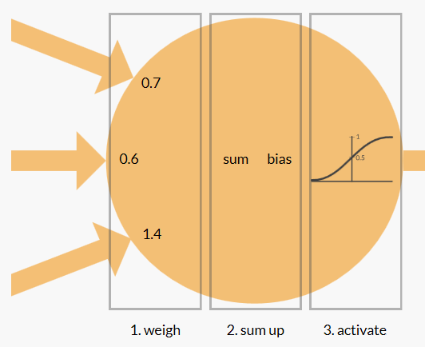
Perceptrons
Multiple Input / Single Node / One output
Key components:
Inputs & Weights
Bias
Summation
Activation Function
Use for: Classification or Regression
Animation At
https://appliedgo.net/perceptron/

Slide 5
The Simple Perceptron (1/5)
In order to mimic the structure of the neurons, we need a mathematical model to work with
x₀₌₁
w₁
x₁
w₀
w₂
x₂
Σ
y
.
.
.
w_{n}
x_{n}
1 if NET >0
y(x)=
0 otherwise

Slide 6
The Simple Perceptron (2/5)
x_{n} are the postsynaptic stimulus from the previous layer
w_{n} represents the concentration of stimulus within the synapse (which is “measured” within the synapse)
w_{n}x_{n} represents the action potential of each dendrite
x₀₌₁
w₁
x₁
w₀
w₂
x₂
.
.
.
w_{n}
x_{n}

Slide 7
The Simple Perceptron (3/5)
The summation represents the collective action potential of ALL dendrites coming into the cell body
x₀₌₁
w₁
x₁
w₀
w₂
x₂
Σ
.
.
.
w_{n}
x_{n}

Slide 8
The Simple Perceptron (4/5)
Activation Function (AF)
Determines if enough potential exists to fire
If it fires, the output is 1, otherwise it is 0
x₀₌₁
w₁
x₁
w₀
w₂
x₂
Σ
y
.
.
.
w_{n}
x_{n}
1 if NET >0
y(x_{i})=
0 otherwise

Slide 9
The Simple Perceptron (5/5) Biological Analogy
Stimulus within the synapse
Postsynaptic Action Potential
Cell Body
x₀₌₁
w₁
Presynaptic Action Potential
x₁
w₀
w₂
x₂
Σ
y
.
.
.
w_{n}
x_{n}
1 if NET >0
y(x_{i})=
0 otherwise
Postsynaptic Action Potential (Potential Of Each Dendrite)

Slide 10
The Simple Perceptron – Inverter
input x1 | output
0 | 1
1 | 0
w₀= 0.5
1
w₁= −1
x₁

Slide 11
The Simple Perceptron–Bool OR
input x1 | input x2 | output
0 | 0 | 0
0 | 1 | 1
1 | 0 | 1
1 | 1 | 1
w₀= −0.5
1
w₁=1
w₂=1
x₁
x₂

Slide 12
The Simple Perceptron – Bool AND
input x1 | input x2 | output
0 | 0 | 0
0 | 1 | 0
1 | 0 | 0
1 | 1 | 1
w₀= −1.5
1
w₁=1
w₂=1
x₁
x₂

Slide 13
The Simple Perceptron – Bool XOR?
input x1 | input x2 | output
0 | 0 | 0
0 | 1 | 1
1 | 0 | 1
1 | 1 | 0
x₁
x₂

Slide 14
The Simple Perceptron – Decision Surface
x₂
x₂
+
+
+
-
+
-
-
x₁
x₁
+
-
-
+
-
This is the XOR problem…
Perceptron is able to represent some useful functions (x₁,x₂) and choose weights w₀=-1.5, w₁=1, w₂=1
But functions that are not linearly separable (e.g. XOR) are not representable.
Notes:
Et of all hyperplanes in n-dimensional space

Slide 15
Boolean XOR using Simple Perceptron(s)
XOR
y
What did we do here?
Added a layer
Allows us to do something more complicated
Built a non-linear discriminator
−0.5
input x₁ | input x₂ | output
0 | 0 | 0
0 | 1 | 1
1 | 0 | 1
1 | 1 | 0
1
−1
OR
AND
−0.5
h₁
h₂
−1.5
1
1
1
1
x₁
x₂
Notes:
Network of multiple perceptrons can learn any boolean function

Slide 16
Perceptron Classification Decision
Recall
x is the input vector
With the bias: x = [1, x₁, x₂, x₃, …, x_{n}]
w is the weight vector
With the bias: w = [w₀, w₁, w₂, w₃, …, w_{n}]
Output decision for classification
If w^{T}x > 0, assign as class C₁
Else, assign as class C₂
C₁
C₂

Slide 17
Backup slides

Slide 18
Perceptron Learning Update using error descent
General Form of update: w(t+1) = w(t) – α(t)x_{k}(error²)
This update adjusts the weights such that the discrimination boundary is a little bit closer to classifying observation k correctly
If correctly identified then error = 0 i.e. don’t update weights:
if w^{T}x_{k} > 0 and x_{k} ∈ C₁ then w(t+1) = w(t) – α(t)x_{k}(0)
if w^{T}x_{k} ≤ 0 and x_{k} ∈ C₂ then w(t+1) = w(t) – α(t)x_{k}(0)
If incorrectly identified then error = 1 i.e. update weights:
if w^{T}x_{k} > 0 and x_{k} ∉ C₁ then w(t+1) = w(t) – α(t)x_{k}(1)
if w^{T}x_{k} ≤ 0 and x_{k} ∉ C₂ then w(t+1) = w(t) + α(t)x_{k}(1)
α(t) is the learning rate… more shortly…

