Slide 1
CSCE 823
Single Perceptron Learning

Slide 2
Single Perceptron Revisited
Single layer perceptron with Heaviside (step) activation function
Learning rule for class 1 & 2 observations:
If correctly identified: don’t update weights
if w^{T}x_{k} > 0 and x_{k} ∈ c₁ then w(t+1) = w(t)
if w^{T}x_{k} ≤ 0 and x_{k} ∈ c₂ then w(t+1) = w(t)
If incorrectly identified: update weights
if w^{T}x_{k} > 0 and x_{k} ∉ c₁ then w(t+1) = w(t) – α(t)x_{k}
if w^{T}x_{k} ≤ 0 and x_{k} ∉ c₂ then w(t+1) = w(t) + α(t)x_{k}
Define learning rule w/gradient descent
w(t+1)=w(t) - α(t)∇C(w(t))
Where C is the cost function

Slide 3
Generalizing the Learning Rule
For the single perceptron with step activation function… Two cases when class incorrectly predicted:
w^{T}x > 0
Define C(w(t)) = w^{T}x (which is positive)
w(t+1) = w(t) - α(t)∇C(w(t))
= w(t) - α(t)∇w^{T}x
= w(t) - α(t) ∂(w^{T}x) / ∂w
= w(t) - α(t) x
w^{T}x ≤ 0
Define C(w(t)) = -|w^{T}x| (which is negative)
w(t+1) = w(t) - α(t)∇C(w(t))
= w(t) - α(t)∇(-w^{T}x)
= w(t) - α(t) ∂ (-w^{T}x ) / ∂w
= w(t) + α(t) x

Slide 4
How To Train Perceptrons?
Foreshadowing: Gradient descent
Gradient Operator
Cost
Function
Learn Rate
Updated Prototype
Training Step (Discrete)
Current Prototype
Gradient Operator – Compute the partial derivative of the cost function C with respect to the prototype vector w

Slide 5
Revisit: Simple Perceptron without activation (ADALINE)
Consider the simple linear perceptron
1:1 linear activation (activation is the value of NET)
Output is a continuous valued output
x₀=1
w₁
x₁
w₀
w₂
x₂
Σ
y
.
.
.
w_{n}
x_{n}
y = w^{T}x = w₀ + w₁x₁ + … + w_{n}x_{n} = NET

Slide 6
Revisit: Simple Perceptron without activation
Goal is to minimize the error
One of the most common error measures?
Squared Error (SE) or Mean Squared Error (MSE)
Define the error for one sample as
D is desired target
y is the prediction

Slide 7
Computing the Error Gradient
Gradient Descent: w(t+1)=w(t) - α(t)∇C(w(t))
∇C(w(t)) = ∇½ (D - yhat)²
= ∂ (½ (D - w^{T}x)²) / ∂w
= 2⋅½ (D - w^{T}x)(∂(D-w^{T}x)/∂w)
= 2⋅½ (D - w^{T}x)(0 - x)
= -(D - w^{T}x)x
= -(D - y)x
Therefore:
w(t+1)=w(t) – (-1)α(t)(D - yhat)x
w(t+1)=w(t) + α(t)Δw(t) where Δw(t)=(D-yhat)x

Slide 8
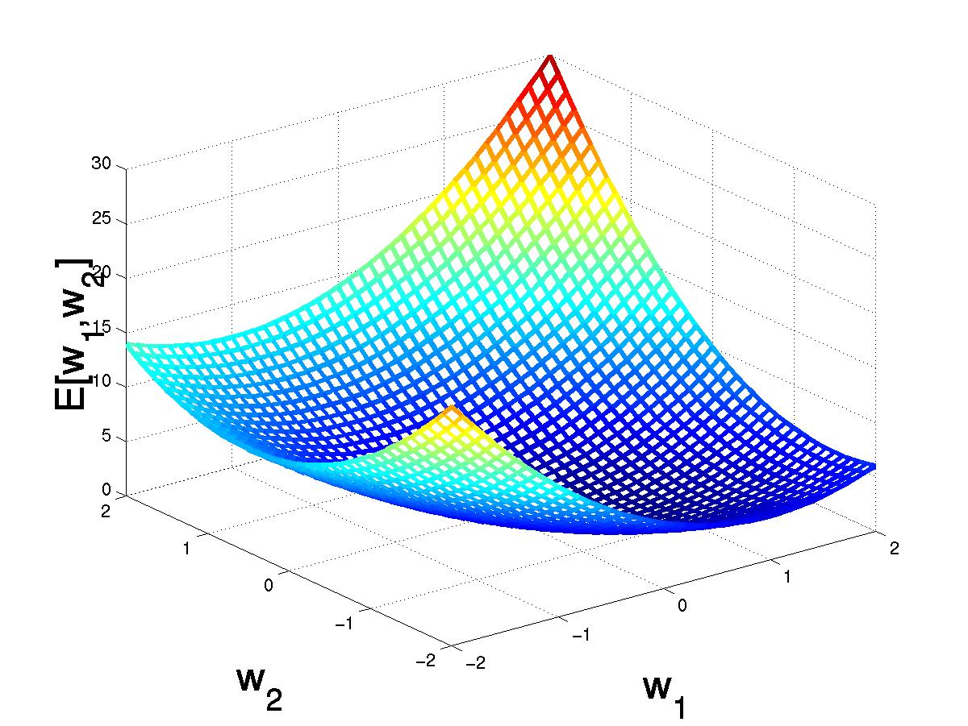
Gradient Descent in Weight Space
(w₁,w₂)
(w₁+Δw₁,w₂ +Δw₂)
Notes:
Error surface for E(LMS) is always a parabolic with one global minimum FOR SINGLE LINEAR UNIT!

Slide 9
Comparing Perceptron & GD Rules
Perceptron learning rule guaranteed to succeed if
Classes are linearly separable
Sufficiently small learning rate α(t) (IMPORTANT)
Linear unit training rules using gradient descent
Guaranteed to converge to the hypothesis w/min squared error
Requires sufficiently small learning rate α(t)
Converges even when training data contains noise
Converges even when training data are not linearly separable

Slide 10
Perceptron Hyperparameters
Learning Rate
Learning Rate with decay
Activation Function

Slide 11
Options for learning rate?
When our learning rate is too large, we don’t converge
When it is too small, gradient descent is too slow
One option is to start with a larger learning rate and make it smaller via decay

Slide 12
Decayed Learning Rate (1/3)
Functional Decay
Fixed Learning Schedule
Empirical results suggest that decaying learning rate is critically important
Stepsize may be large at first to make big steps forward, but should decrease near the optimal solution
From the perceptron update equations, recall that the α(t) is the learn rate at training step t
How do we decay parameters?
Functional decay
Fixed learning rate decay schedules

Slide 13
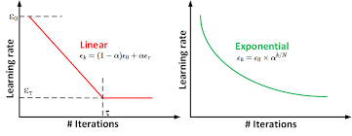
Decayed Learning Rate (2/3) Functional Decay
Functional decay (“cooling”)
Define a function decaying in time, multiply the base rate by that decayed function
e.g., α(t) = α₀⋅e^{-at/τ} where t is the current time step and a and τ controls the decay rate
Pros / Cons
Automated once set
Can be sensitive to hand-picked value of parameters (e.g. a and τ)
As # of training steps gets large relative to a/τ, α(t) approaches zero: continuing to train yields no improvements

Slide 14
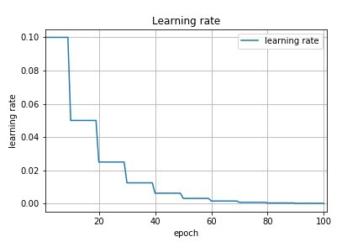
Decayed Learning Rate (3/3) Fixed LR Schedule
Fixed Learning Rate schedule
Leave parameters fixed for a certain number of training steps
Decrease parameter values manually AFTER some predefined number of training steps
Pros / Cons
No need to worry about parameters going to 0
Sensitivity to the schedule set by the user
Schedule may be problem-dependent

Slide 15
Perceptron Activation
The activation function is a hyperparameter with many choices
Linear
Step / Heaviside
Logistic function (aka sigmoid): (0,1)
Tanh: (-1,1)

Slide 16
Other Perceptron Options: Changing the Activation Function
Consider the (nonlinear) Logistic Function
f(NET) = 1/(1+exp(-NET))
x₀=1
x₁
w₁
w₀
w₂
x₂
Σ
y
.
.
.
w_{n}
x_{n}
Notes:
Other good units are:
Delta Rule
LMS rule
Adaline rule
Widrow-Huff rule

Slide 17
Gradient Descent with the Logistic function
Where the logistic function and its derivative is defined as:
Scalar
Scalar
Scalar
Vector

Slide 18
Gradient Descent with tanh()
Where tanh() and its derivative is defined as:
Scalar
Scalar
Vector

Slide 19
General Form – Delta Rule
As seen, Δw = -∂E/∂w (Note: E means Error)
In general write: Δw_{j}^{k} = -∂E^{k}/∂w_{j}
That is, the change in w_{j} due to the input sample x^{k}
Define the total derivative at time t as:

Slide 20
General Form – Delta Rule
Recall:
Define:
Where:
Then:
Delta Rule

Slide 21
Online Learning (Compatible with a data stream)
Initialization
Choose a sufficiently small initial learn rate
Choose a starting point for the weights
Typically use normally distributed random values
Online learning → update after each x^{k}
For each training sample x^{k}
For each weight vector w_{j}
Feed forward → that is, compute y=f(w_{j}^{T}x^{k})
Compute: Δw_{j}(t) using delta rule for activation function
Update: w_{j}(t+1) = w_{j}(t) + α(t) Δw_{j}(t)

Slide 22
Perceptrons Summary
Components for the network architecture
Activation Functions
Network Structure
Learning Rule
Activation Functions
Linear, threshold, Logistic, tanh()
Network Structures
So far, only single layer!
Learning Rule
Gradient Descent minimization of an Error Function
Error Function typically Squared Error between desired response and actual response
y
P₁
x₁
x₂
x₃

Slide 23
Backup slides

Slide 24

Convergence of the Delta Rule…
It will converge because E^{k} is a Lyapunav function (https://en.wikipedia.org/wiki/Lyapunov_function )
E^{k} is scalar, positive semi-definite since E^{k}(w(t)) ≥ 0 and E^{k} = 0 iff w(t) = 0
E^{k} has continuous derivatives w.r.t w
is negative semidefinite. As such, any change of w in time according to the learning rule (previous slide), will cause a decrease in the error E^{k}
$$\frac{∂E^{k}}{∂t}$$
Notes:
Positive Definite:
Positive Semi-Definite:
Negative Semi-Definite:

